Slide 1


Managing a Workload Through Load Balancing Technique in Cloud Environment
Presentation for
Dissertation Phase – II (2740002) by
Srushti Patel (140400702017)
Carried Out at
Department of Computer Engineering
Sankalchand Patel College of Engineering, Visnagar (040)
Under the Supervision of
Dr. Hiren B. Patel
For Partial Fulfillment of the Degree to be awarded by
GUJARAT TECHNOLOGICAL UNIVERSITY
July 2016

Slide 2
Presentation Outlines
Previous work
Overall View of Work
Literature Review
Proposed work
  Architecture
  Agent walk-1 Flow chart
  Agent walk-2 Flow chart
Tools & Technologies to be used
Simulation Result
Conclusion
Paper Publication
References

Slide 3
1. Previous Work
Introduction about cloud computing
  Three types of service model: SAAS, PAAS, IAAS
  Four types of deployment model: Public, Private, Hybrid And community Cloud.
Motivation
  During the load balancing process, few issues are yet to be fully addressed. Couple of them are:
    Some of the nodes are overutilized or some of the nodes are underutilized
    Improper workload in Cloud environment results into overhead in resource utilization and in turn inefficient usage of energy
    response time of jobs
    communication cost of servers
    maintain cost of VMs,
    throughput and overload of any single node.
  By addressing the concern of load balancing, we aim to address multiple facets of Cloud viz. (a) resource utilization (b) CPU time (c) Migration time.

Slide 4
(cont…)
Problem statement
Problem raised while dealing with load balancing
    How to minimize the CPU time
    How to increase the resource utilization &
    How to decrease the energy consumption and Migration time etc.
Background Theory for Load balancing
  Goal of Load Balancing in to the Cloud Computing is to,
    Reassigning the total load in to the multiple nodes of system.
    Effective resource utilization
    Improve the response time of the job
    Removing a condition in which some of the nodes are over loaded while some others are under loaded.

Slide 5
2. Overall View of Work
Objective
We intend to present a technique to clear up the problem (like Resource utilization, overall performance, CPU Time and overload of any single node) associated with Load Balancing in Cloud Environment.
Experimentation Result Experimentation is perform and generate results which may lead toward achievement of our claims.
Proposed Mechanism
An Agent Based Load Balancing technique has been modified by adding Standard Deviation method to decide the status (under load/over load) of a host and also perform job allocation and VM migration techniques.

Slide 6
3. Literature Review
Problem Identified
Task Scheduling, Load balancing, Resource management
Overutilized or Underutilized resources
Improper workload & Co2 Emission
Review
Papers
[3] | [6] | [7] | [5] | [4]
Optimal resource allocation
Reduce response time of jobs, performance, energy saving, resource utilization
Reduce CPU time
Increase resource utilization, decrease power consumption
Proposed solution
Fig 1. Summarized Literature Review

Slide 7
4. Proposed Work

Slide 8
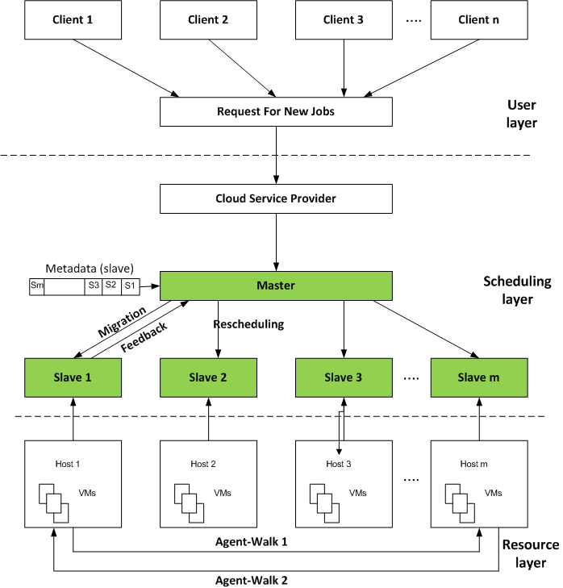
System Architecture
Fig.2 System Architecture^{[5]}

Slide 9
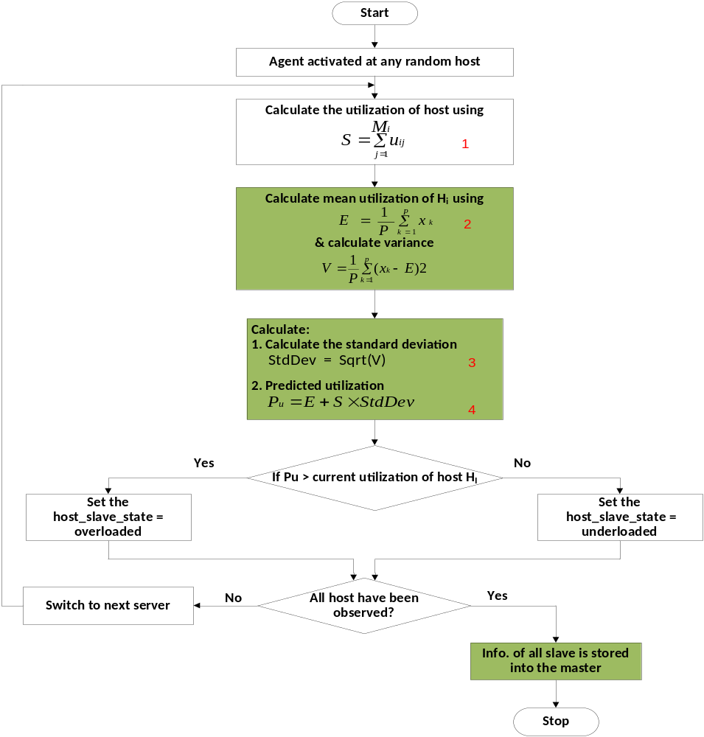
Agent Walk-1
Fig.3 Agent walk1

Slide 10
Agent Walk-1(cont…)
First of all Agent Activated at any random host and calculate the utilization of host using equation 1.
After that calculate the mean utilization of Host using equation 2 where, E = Mean utilization of Host, xk = Utilization of VM on host Hi in time frame k , P = Total time frames.
Now Calculate the variance for Standard Deviation using equation 3 where, V= Variance and E = mean utilization of Host
After calculating variance we find out the Predicted Utilization Pu using equation 4. Where, StdDev is the Standard Deviation calculating using Square root of variance V^{[10]}.

Slide 11
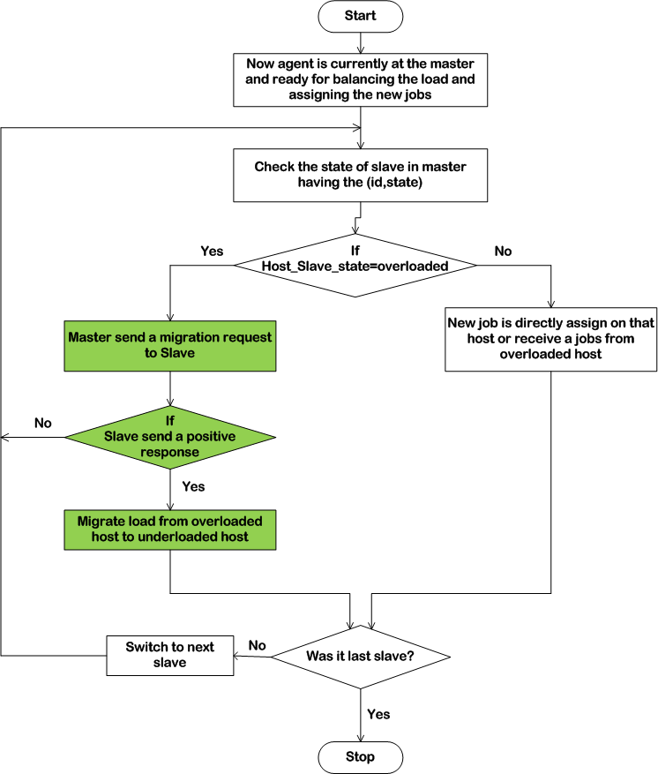
Agent Walk-2
Fig 4. Agent Walk-2.

Slide 12
5. Tools & Technologies to be used
Implementation Configuration:
  Core i3 processor
  Operating System : Windows 8 (64-bit)
  Simulator : CloudSim 3.0 toolkit
  RAM : 2 GB
CloudSim^{[8]}
  CloudSim is an extensible simulation toolkit that enables modeling and simulation of Cloud computing systems and application provisioning environments.
  We are going to use CloudSim tool for the implementation. Because of our proposed approach has been implemented in CloudSim tool.

Slide 13
6. Simulation Result

Slide 14
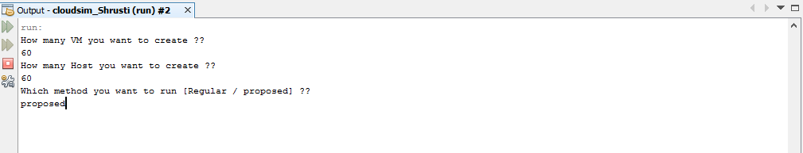
(cont…)
Fig. 5 shows the how many VMs and Host you want to create.
Fig. 5 GUI For selecting Host, VMs, and Cloudlets

Slide 15
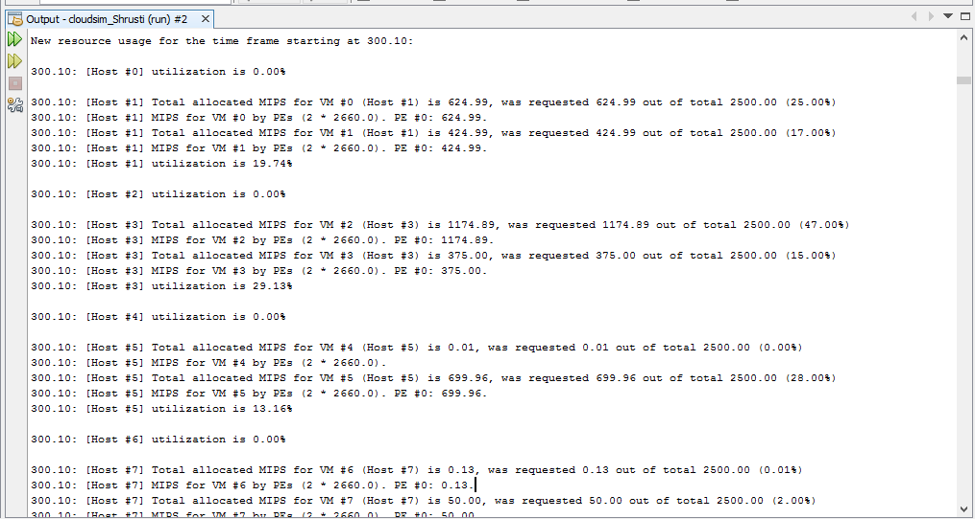
(cont…)
Fig. 6 shows the Utilization of all VMs and Host and also shows the requested MIPS by VM form the total capacity of that Host.(Equation 1 in fig.3)
Fig. 6 utilization of host

Slide 16
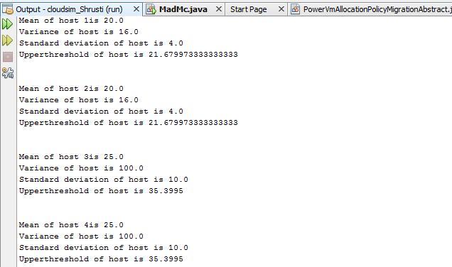
(Cont…)
Fig. 7 shows the Mean utilization of all Host, Also calculating the variance and standard deviation, finally calculate the upper threshold or also we can say that predicted utilization for the host for finding the over utilized node.(Equation 2 , 3 & 4 in Fig.3 )
Fig. 7 : Mean utilization, Standard Deviation and upper threshold of all Host

Slide 17
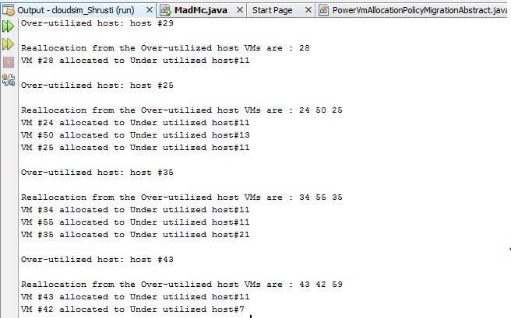
(cont…)
Fig. 8 shows the Over Utilized node and also generate a migration map for migration of VMs from Over Loaded Host to Under loaded.
Fig 8: Over utilized Host and Migration map for VM into Host

Slide 18
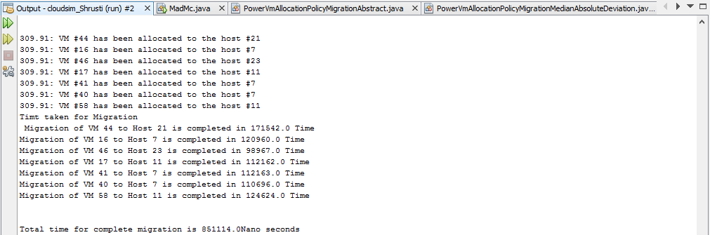
(cont…)
Fig. 9 shows the Migration time for migrating a VMs from Overloaded Host to under loaded Host.
Fig.9 Migration time for VMs.

Slide 19
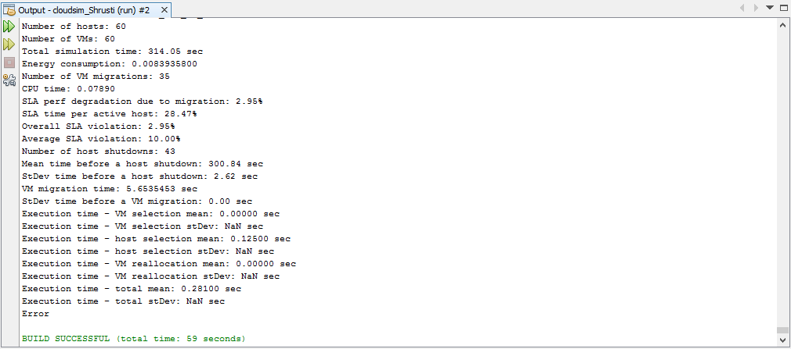
(cont…)
Fig.10 shows the Overall result of proposed system that shows the Energy consumption, No of migrated VMs, Migration time for VMs, No. of Host shutdown and CPU time.
Fig.10 Overall results of proposed system

Slide 20
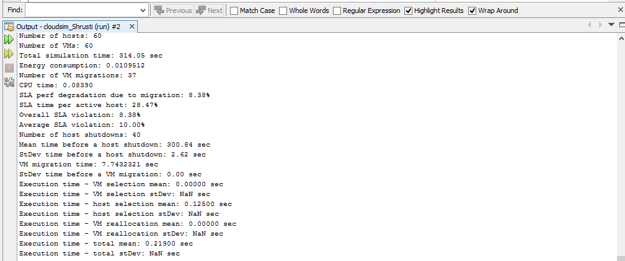
(cont…)
Fig. 11 shows the Overall result of Existing system that shows the Energy consumption, No of migrated VMs, Migration time for VMs, No. of Host shutdown and CPU time.
Fig.11 Overall results of existing system

Slide 21
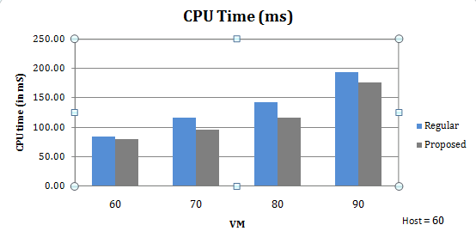
(cont…)
Fig. 12 shows the result of CPU time shown in Table 5.4 for Same Host and Different VMs on it. The results shows the proposed system’s, CPU time is less as compared to Existing method
Fig.12 CPU Time chart

Slide 22
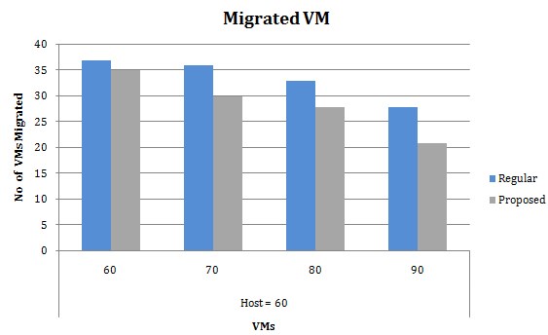
(cont…)
Fig. 13 shows the number of VMs Migrated from Overloaded Host to Underloaded Host
Fig.13 Migrated VMs.

Slide 23
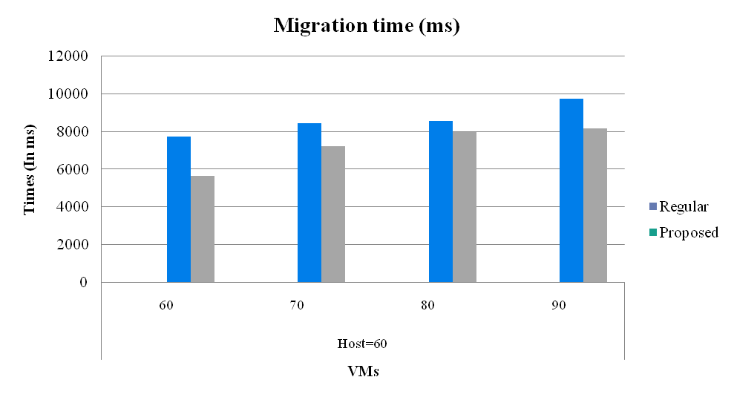
(cont…)
Fig. 14 shows the total migration time for all VMs which is migrated from Overloaded host to underloaded host.
.
Fig. 14 Migration time

Slide 24
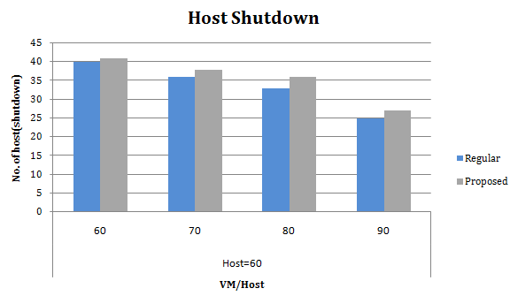
(cont…)
Fig. 15 shows the total Host shut down. When the number of host shutdown increases then resource utilization will increases.
Fig. 15 Host shutdown

Slide 25
7. Conclusion
In this post-graduate dissertation, we study the various load balancing schemes and the issues of load balancing in Cloud computing. Improper workload in Cloud environment results into over or under utilization of computing resources and that affects the performance of overall system. It help to achieve the user satisfaction by improving the metrics like, response time, migration time, throughput, resource utilization and performance.
In our proposed work, we modify the agent based dynamic load balancing algorithm by adding the standard deviation method to decide whether the host is overloaded or not. To provide a better load balancing in terms of improved performance, reduced CPU time, increased resource utilization.
We implement this method in Cloudsim toolkit 3.0 and generated results of proposed method are compared with existing load balancing algorithm. Result shows the overall performance of proposed method has been improved as compared to the existing load balancing method.

Slide 26
8. Publication
The Paper titled “DYNAMIC LOAD BALANCING TECHNIQUES FOR IMPROVING PERFORMANCE IN CLOUD COMPUTING” in International Journal of Computer Applications (IJCA), March 18, 2016.
Available online at: (http://www.ijcaonline.org/archives/volume138/number3/24356-2016908717)

Slide 27
9. References
www.csrc.nist.gov/publications/nistpubs/800145/SP8145
www.rackspace.co.uk
Li, K., Xu, G., Zhao, G., Dong, Y., & Wang, D. (2011, August). Cloud task scheduling based on load balancing ant colony optimization. In Chinagrid Conference (ChinaGrid), 2011 Sixth Annual (pp. 3-9). IEEE.
Grover, J., & Katiyar, S. (2013, August). Agent based dynamic load balancing in Cloud Computing. In Human Computer Interactions (ICHCI), 2013 International Conference on (pp. 1-6). IEEE
Wu, C. M., Chang, R. S., & Chan, H. Y. (2014). A green energy-efficient scheduling algorithm using the DVFS technique for cloud datacenters. Future Generation Computer Systems, 37, 141-147.
Liu, Y., Zhang, C., Li, B., & Niu, J. (2015). DeMS: A hybrid scheme of task scheduling and load balancing in computing clusters. Journal of Network and Computer Applications.
Chen, H., Zhu, X., Guo, H., Zhu, J., Qin, X., & Wu, J. (2015). Towards energy-efficient scheduling for real-time tasks under uncertain cloud computing environment. Journal of Systems and Software, 99, 20-35.
Saleh Atiewi, Salman Yussof “Comparison between CloudSim and GreenCloud in Measuring Energy Consumption in a Cloud Environment” IEEE-2015
Cao, Z., & Dong, S. (2012, December). Dynamic VM consolidation for energy-aware and SLA violation reduction in cloud Computing. In Parallel and Distributed Computing, Applications and Technologies (PDCAT), 2012 13th International Conference on (pp. 363-369). IEEE.
Cao, Z., & Dong, S. (2012, December). Dynamic VM consolidation for energy-aware and SLA violation reduction in cloud Computing. In Parallel and Distributed Computing, Applications and Technologies (PDCAT), 2012 13th International Conference on (pp. 363-369). IEEE.

Slide 28
Questions / Suggestions ?
Thank you!

