Slide 1


P.E.S COLLEGE OF ENGINEERING MANDYA
Mini Project On
WEATHER QUALITY MONITORING SYSTEM
Under the Guidance Of
Dr . B.S NANDA
Professor
Presented By:
ANUSHA S A 4PS21EC011
CHANDANA K B 4PS21EC022
DEEKSHA S 4PS21EC029
GAGANA S 4PS21EC036

Slide 2
Introduction to Smart Weather Quality Monitoring System
A weather quality monitoring system involves using connected devices and sensors to measure and analyze the weather quality in real-time.
These sensors collect data on pollutants like CO, smoke, benzene and NH3.
The data can then be accessed and monitored through applications on smartphones or computers, enabling individuals and authorities to respond quickly to hazardous conditions, improve public health, and make informed decisions about environmental management.

Slide 3
Literature Survey
S.No | Author | Title | Publisher and Year | Description
1 | Gunawan, Teddy Surya, | "Design and Implementation of Portable Outdoor Air Quality Measurement System using Arduino." | International Journal of Electrical & Computer Engineering. (2018). | The paper presents a cost-effective, portable outdoor air quality measurement system using Arduino Uno and four pollutant sensors (CO, O3, PM10, and PM2.5). The system showed a 14% error margin and is capable of measuring PM2.5 and evaluating sub-API values. Future improvements include sensor calibration and adding more functionalities to enhance the system's performance.
2 | Deekshath, R., et al. | "IoT based environmental monitoring system using arduino UNO and thingspeak.“ | International Journal of Science Technology & Engineerig. (2018) | The EMS (Environmental Monitoring System) application continuously updates and displays sensor data for users. This data is accessed directly and remains independent of third parties.

Slide 4
S.No | Author | Title and Year | Publisher and Year | Description
3 | Patil, Kailas, et al. | "A consumer-based smart home and health monitoring system.." | International Journal of Computer Applications in Technology . (2022) | This Paper makes use of 3 sensors to measure the weather/environment factors such as temperature, humidity, light intensity, dew point and heat index. The values read from the sensors are processed by the Arduino micro-controller and stored in a text file which can be processed upon to derive analysis. The readings are also displayed on an on board LCD for quick viewing. All these readings can be analyzed to get the weather characteristics of a particular area and record the weather pattern. These recorded parameters are essential and vary from places to places.
4 | Banara, Samriddhi, Teena Singh, and Anamika Chauhan. (ICONAT). | “Iot based weather monitoring system for smart cities.” | International Conference for Advancement in Technology . (2022) | The level of pollution has increased with times by lot of factors like the increase in population, increased vehicle use, industrialization and urbanization which results in harmful effects on human wellbeing by directly affecting health of population exposed to it. In order to monitor In this project we are going to make an IOT Based Air Pollution Monitoring System in which we will monitor the Air Quality over a web server using internet and will trigger a alarm when the air quality goes down beyond a certain level, means when there are sufficient amount of harmful gases are present in the air like CO2, smoke, alcohol, benzene and NH3

Slide 5
PROBLEM STATEMENT
DESIGN AND IMPLEMENT WEATHER QUALITY MONITORING SYSTEM
PROBLEM DESCRIPTION
To design and develop an intelligent Weather quality monitoring system to measure, analyze, and report on environmental parameters such as air quality, temperature, and humidity.

Slide 6
OBJECTIVES
To monitor and present environmental data, such as humidity and temperature, in order to give a thorough picture of the interior climate.
To detect different gases like CO(carbonmonooxide), NH3(Ammonia), Nox (nigrogen oxides), and other pollutants, using gas sensors. To monitor and display the current levels of air quality.
To create an LCD screen user interface that makes it simple for consumers to access and understand environmental and air quality data.
.
.
.

Slide 7
COMPONENTS REQUIRED
Gas sensor:
Used to measure levels of benzene, smoke,NH3, CO and NOx.
MQ 135:
Detects gases like Ammonia,carbon monoxide,Nitrogen Oxides,benzene.
DHT 11/22:
Measuring humidity and temperature values in heating, ventilation and air conditioning systems.
LCD display:
To display real-time data on air quality, temperature, and humidity.
Arduino uno:
The central microcontroller to manage sensors and process data.
Bread board and connecting wires:
For connecting sensors and modules to the Arduino Uno.
.
Buzzer:
& Fan
It turns on when temperature, humidity is high and air quality goes below threshold.

Slide 8
METHODOLOGY
1. Define Requirements: Clearly outline the purpose of the weather monitoring system. Identify what parameters you need to measure like temperature, humidity, , precipitation
2. Select Sensors: Choose appropriate sensors for each parameter based on accuracy, reliability, and environmental suitability.
4. Data Transmission: Ensure transmission of data from sensors to the central monitoring system.
5. Central Monitoring System: Develop or select a system to receive, store, and process data from sensors. This could be a computer, microcontroller
6. Data Processing and Analysis: Implement algorithms to process raw sensor data into meaningful weather parameters like calculating average temperature
7. Visualization and Display: Create interfaces like dashboards to display weather data.
8. Alerting Mechanisms: Set up alerts for extreme weather conditions based on predefined thresholds.
.

Slide 9
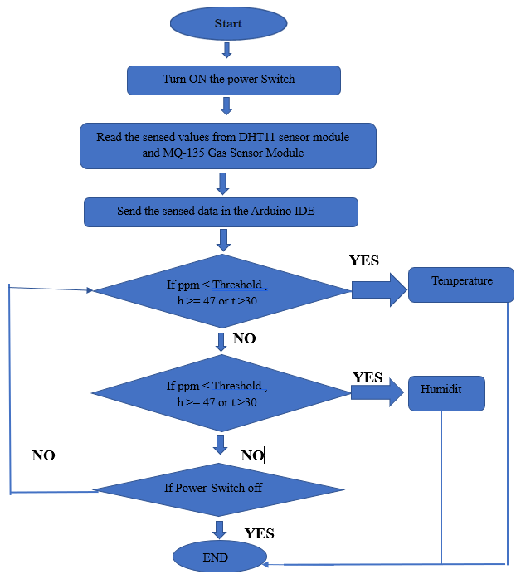
FLOW CHART

Slide 10
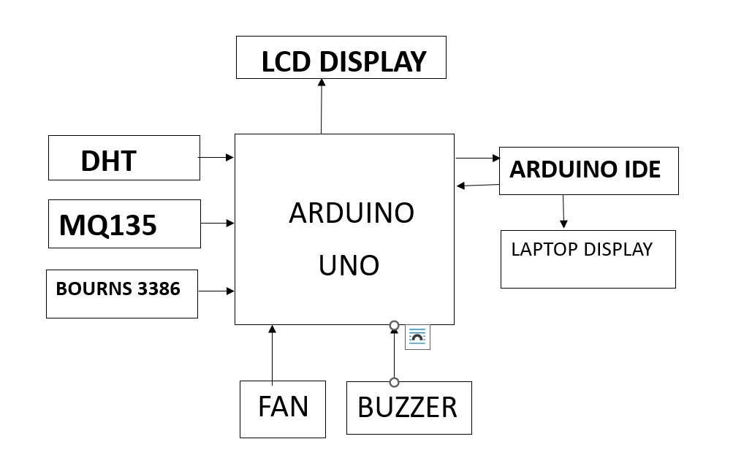
BLOCK DIAGRAM
Fig.1 Block diagram of weather monitoring system

Slide 11
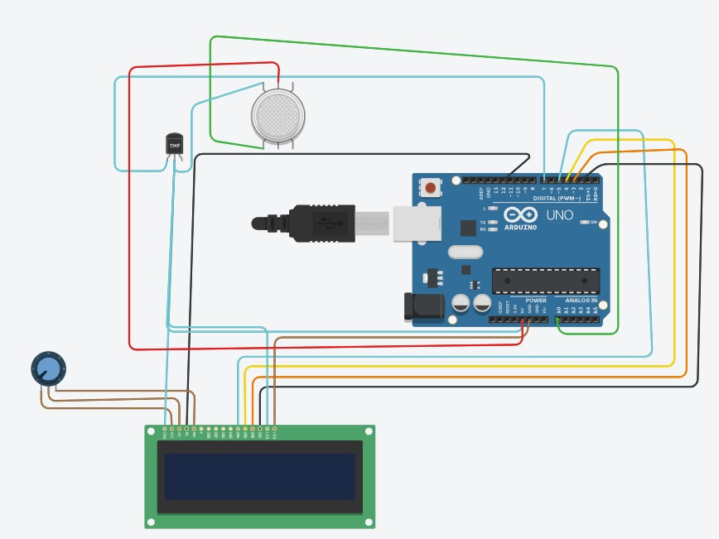
CIRCUIT DIAGRAM
Fig.2 Circuit Diagram of weather Quality Monitoring System

Slide 12
ADVANTAGES AND DISADVANTAGES
Advantages
Real-Time Data Collection
Cost Effective
Scalability and Flexibility
Enhanced Decision-Making
Comprehensive Data Collection
Disadvantages
Reliability and Accuracy
Connectivity Issues
Data Privacy and Security

Slide 13
CONCLUSION:
A smart Weather quality monitoring system provides an innovative solution to address the critical issue of environment and air pollution. By integrating advanced sensors, such a system can continuously and accurately monitor various air quality parameters in real-time.
The data collected enables prompt identification of pollution sources, facilitating timely intervention and mitigation measures. Additionally, the system can enhance public awareness by providing accessible and transparent air quality information and environmental factors like temperature and humidity through connected devices and applications.

