Slide 1
Financial Analytics Dashboard
Dashboard Design using Power BI

Slide 2
Objective
To design an interactive and insightful business dashboard using Power BI.
Key goals:
- Visualize key performance indicators (KPIs)
- Identify sales and profit trends
- Provide stakeholder-driven insights
- Enable data-driven decision making

Slide 3
Key Performance Indicators (KPIs)
- Total Sales
- Total Profit
- Average Profit Margin
- Total Units Sold
- Total Discounts Given
- Sales by Product and Segment

Slide 4
Dashboard Overview
The dashboard includes visuals such as:
- Cards
- Line Charts
- Bar Charts
- Matrix
- Pie Charts
Refer to the next slides for actual visuals.

Slide 5
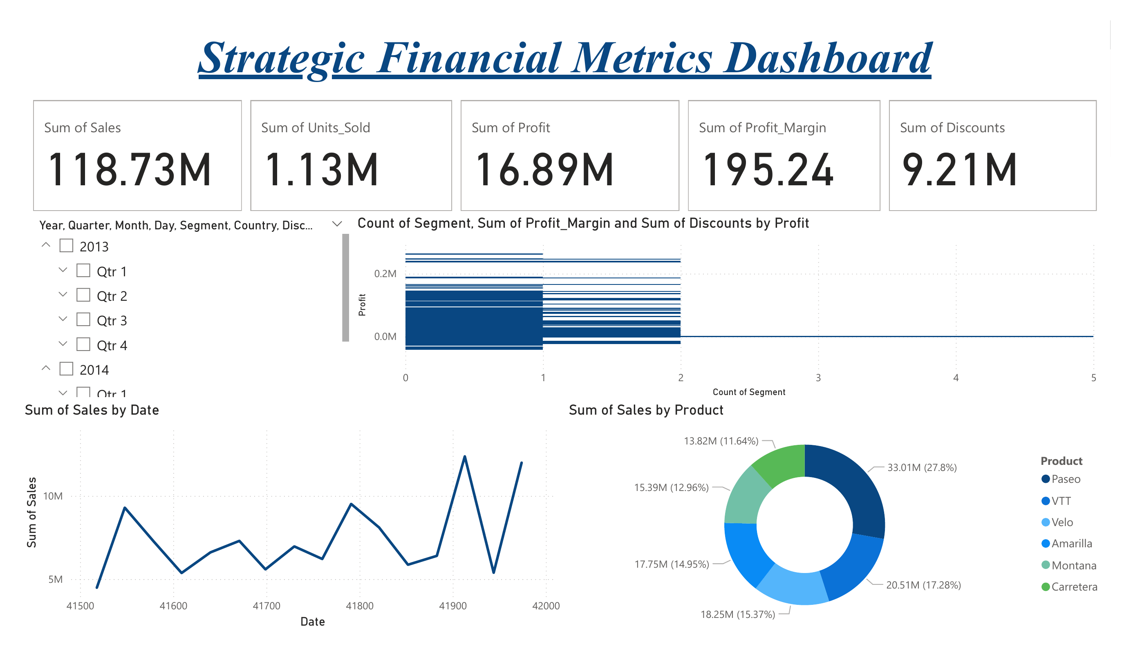

Slide 6
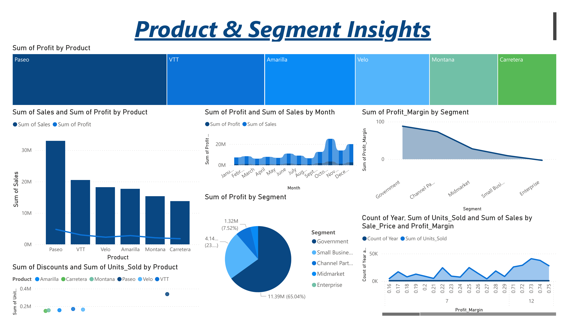

Slide 7
Insights & Recommendations
- High-performing products: Paseo, VTT
- Government segment contributes highest profit
- Sales peak during Q2 and Q3
- Profit margin varies greatly by product and segment
- Strategic discounting can boost sales with minimal margin loss

Slide 8
Tools & Learnings
- Tool Used: Power BI Desktop
- Concepts Applied: Data Cleaning, KPI Creation, DAX, Visual Design
- Learned dashboard interactivity using slicers & filters
- Practiced storytelling through data visualization

