Slide 1


Bangalore Institute of Technology
K.R. Road, V.V. Pura, Bengaluru.-560004.
Department of Computer Science & Engineering
State level Project Competition-2025
“Crop Price Prediction Using SARIMA Models”
Presented by
Project ID-25PC38
USN-1BG23CS131 Name-Sanchita H
USN-1BG23CS159 Name-Srusti M
USN-1BG23CS170 Name-Thrisha R
USN-1BG23CS190 Name-Vismaya M
Under the Guidance of
Priyanka S
Assistant Professor
Computer Science
B N M Institute of Technology

Slide 2
Bangalore Institute of Technology
K.R. Road, V.V. Pura, Bengaluru.-560004.
Department of Computer Science & Engineering
Agenda
Introduction
Highlights of Existing System
Problem Statement
Proposed System
Architecture
Module Decomposition/Description
Results and Performance Analysis
Snapshots
Applications
Conclusion And Future Scope
References
DEMO(is Must)

Slide 3
Bangalore Institute of Technology
K.R. Road, V.V. Pura, Bengaluru.-560004.
Department of Computer Science & Engineering
INTRODUCTION
This project aims to forecast monthly prices of 15 major crops across 4 zones and 10 regions using SARIMA models. It leverages historical market data, weather, and soil conditions to improve prediction accuracy.
Objectives:
Predict crop prices using SARIMA.
Handle seasonal trends and missing data.
Generate user-friendly reports and visualizations.
Purpose: To support farmers, traders, and policymakers in making informed decisions through accurate price forecasting.
Scope: Covers 15 crops, 10 regions, and 4 zones with integrated soil and weather data. Reports are generated and sent via email.
Applicability: Useful for agricultural planning, market analysis, and government policy-making.

Slide 4
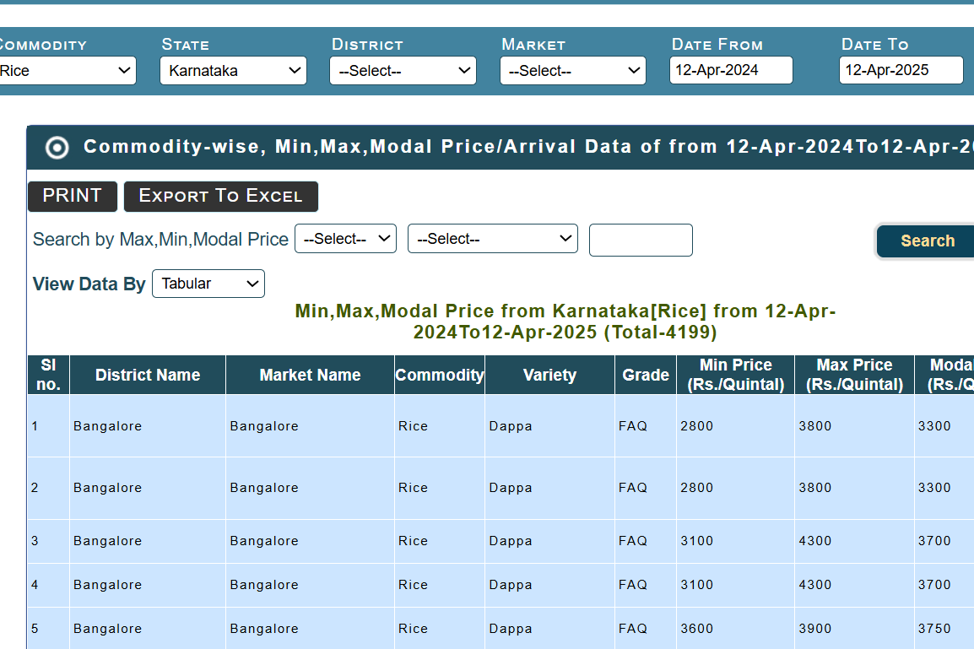
Bangalore Institute of Technology
K.R. Road, V.V. Pura, Bengaluru.-560004.
Department of Computer Science & Engineering
EXISTING SYSTEM
The current agricultural platforms such as Agmarknet and Krishi Portal primarily offer historical price data for various crops across multiple markets. While these systems serve as valuable repositories of market information, they possess certain limitations:
Absence of automated price forecasting models
Lack of integration with weather and soil data
No support for personalized user interfaces
Inability to generate predictive reports or disseminate them via email
Data updates are largely manual and not optimized for real-time decision-making
These constraints indicate the need for an intelligent, automated, and user-centric system to enhance agricultural market planning.

Slide 5
Bangalore Institute of Technology
K.R. Road, V.V. Pura, Bengaluru.-560004.
Department of Computer Science & Engineering
PROBLEM STATEMENT
“Farmers and stakeholders face significant challenges due to the unpredictability of crop prices, which affects planning and market decisions. Existing systems primarily offer historical data without reliable forecasting capabilities. Moreover, they often ignore key seasonal and environmental factors that influence prices. Hence, there is a need for an intelligent system that can accurately predict crop prices using historical trends and seasonal patterns.”
Input: The input dataset comprises historical market data for agricultural commodities, including attributes such as district name, commodity type, minimum price, maximum price, modal price, and corresponding dates
Output: The model generates a one-year price forecast for the selected crop, presenting results in both tabular and graphical formats. The table displays predicted modal prices for each month, while the line graph visualizes the trend of price fluctuations over time.

Slide 6
Bangalore Institute of Technology
K.R. Road, V.V. Pura, Bengaluru.-560004.
Department of Computer Science & Engineering
PROPOSED SYSTEM
Implements the SARIMA model to perform accurate time-series forecasting of crop prices.
Analyzes historical data to capture trends, seasonality, and market fluctuations.
Allows users to select crops, zones, and reporting centers via an interactive web interface.
Processes and cleans datasets, handling missing values before forecasting.
Displays predicted monthly prices for one year in both table and graph formats.
Sends forecast reports to users via email for convenient access.
Integrates soil and weather data to provide more context-aware predictions.
Built using Python, Pandas, Statsmodels for modeling, and Flask for the frontend interface.

Slide 7
Bangalore Institute of Technology
K.R. Road, V.V. Pura, Bengaluru.-560004.
Department of Computer Science & Engineering
ARCHITECTURAL DESIGN
User Interface (Frontend): Developed using Flask, offering dropdowns for crop, zone, and region selection..
Processing Module: Handles data cleaning, monthly aggregation, and interpolation of missing values.
Prediction Engine: Uses the SARIMA model to forecast crop prices for a selected period (1 year).
Results Module: Displays predicted prices in tabular and graphical formats for better analysis.
Email Report System: Generates and sends prediction reports to the user’s registered email.

Slide 8
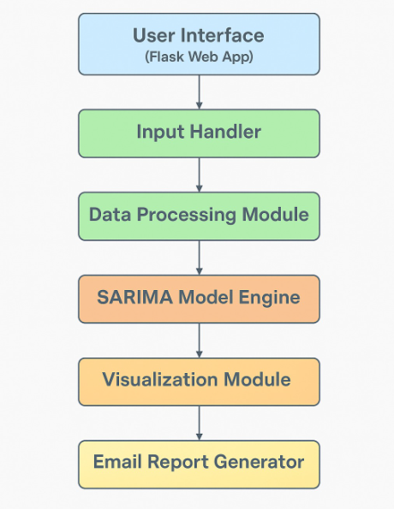
Bangalore Institute of Technology
K.R. Road, V.V. Pura, Bengaluru.-560004.
Department of Computer Science & Engineering
ARCHITECTURAL DESIGN

Slide 9
Bangalore Institute of Technology
K.R. Road, V.V. Pura, Bengaluru.-560004.
Department of Computer Science & Engineering
MODULE DECOMPOSITION/DESCRIPTION
Module Name | Description
🔒 User Authentication | Handles user sign-up and login, validates credentials, and maintains session.
📝 Input Module | Accepts user inputs like crop type, zone, region, and center.
🧹 Data Preprocessing | Cleans and prepares historical price, weather, and soil data for modeling.
📈 Prediction Module | Uses SARIMA model to forecast future crop prices based on preprocessed data.
📊 Visualization Module | Displays predictions using interactive graphs and tables for better insight.
❌ Error Handling Module | Displays appropriate error messages for invalid input or login failures.
📧 Email Reporting Module | Sends the predicted crop prices to the user’s registered email.

Slide 10
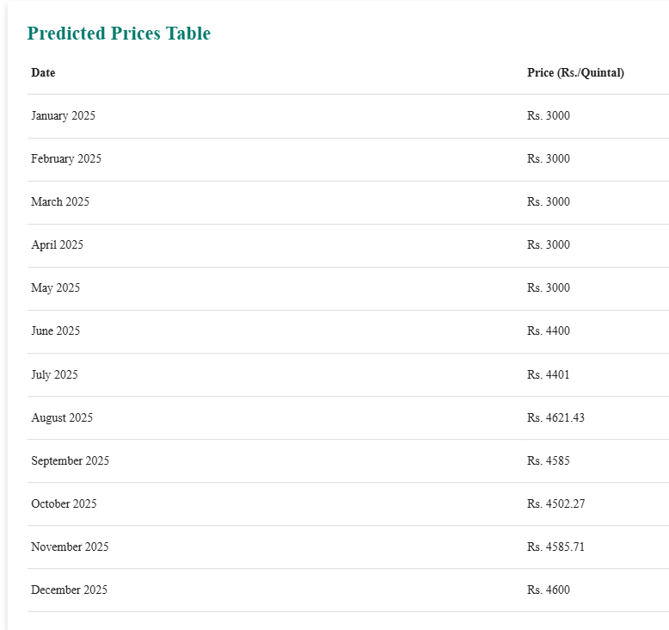
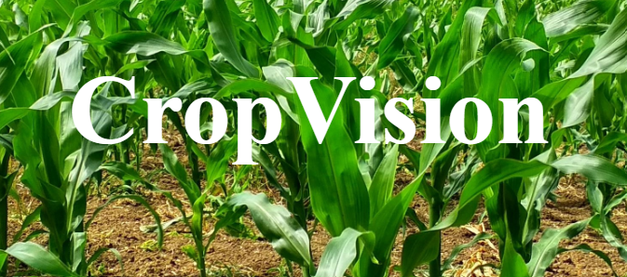
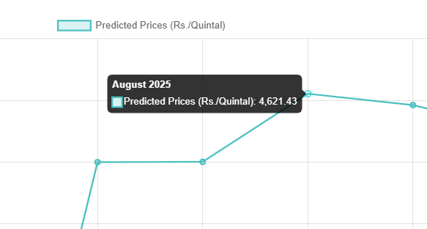
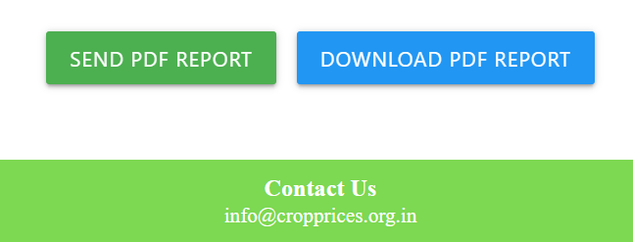
Bangalore Institute of Technology
K.R. Road, V.V. Pura, Bengaluru.-560004.
Department of Computer Science & Engineering
RESULTS AND PERFORMANCE ANALYSIS
The system accurately forecasts crop prices for 12 future months using the SARIMA model.
Predicted prices are displayed in both tabular format and a clear, interactive line graph.
The user interface allows seamless selection of crop, zone, and region for personalized forecasting.
Email reports are generated and sent, enhancing accessibility and usability.
SARIMA’s ability to model seasonality and trends ensures consistent and reliable predictions.

Slide 11
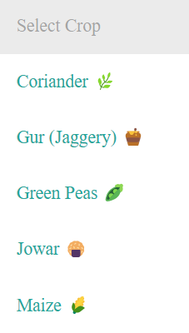
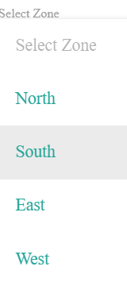
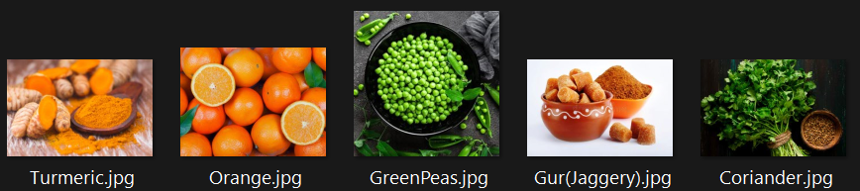
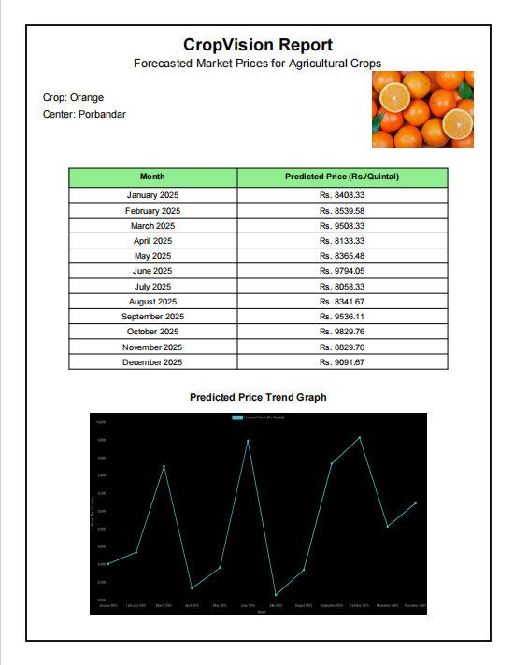
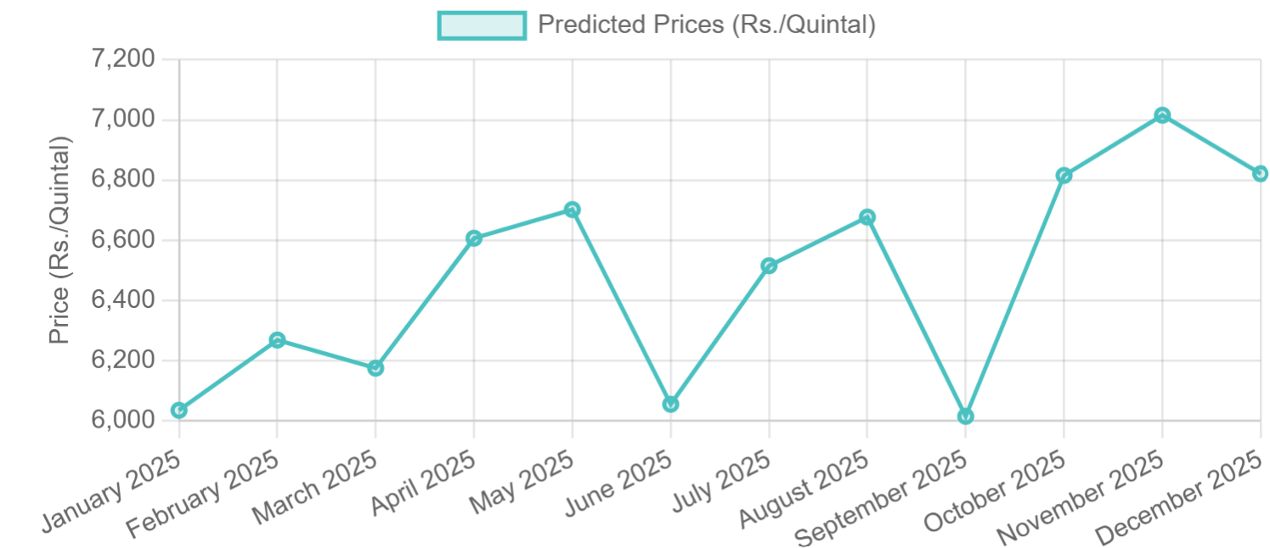
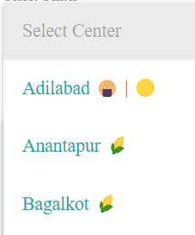
Bangalore Institute of Technology
K.R. Road, V.V. Pura, Bengaluru.-560004.
Department of Computer Science & Engineering
SNAPSHOTS

Slide 12
Bangalore Institute of Technology
K.R. Road, V.V. Pura, Bengaluru.-560004.
Department of Computer Science & Engineering
APPLICATIONS
Farmers can plan crop cycles and market engagement based on expected prices.
Policy makers gain insights for designing effective agricultural and economic policies.
Traders and wholesalers can manage inventory and pricing strategies efficiently.
Agro-tech companies can integrate forecasting into smart farming solutions.
Researchers can use the system for analyzing long-term market behavior and trends.

Slide 13
Bangalore Institute of Technology
K.R. Road, V.V. Pura, Bengaluru.-560004.
Department of Computer Science & Engineering
CONCLUSION AND FUTURE SCOPE
The project effectively forecasts crop prices using SARIMA, providing reliable predictions with minimal preprocessing. The web interface enhances usability and helps stakeholders make informed decisions. In the future, the system can be expanded by integrating real-time data, supporting more crops and regions, and improving accuracy through advanced machine learning models.
Future Scope:
Implement crop filters for easier data navigation
Enable users to upload their own crop price data
Integrate an AI chatbot to assist users with queries
Include real-time weather data using Weather APIs
Explore and integrate additional ML models
Dynamically select the best-performing model based on evaluation metrics

Slide 14
Bangalore Institute of Technology
K.R. Road, V.V. Pura, Bengaluru.-560004.
Department of Computer Science & Engineering
REFERENCES
[1] Mohita Chaudhary, “AI Aided Tools for Fresh Produce Yield and Price Forecasting: Deep Learning Approaches”, Journal of Agricultural Science,Vol.2 , Page No.10,2021.
[2] Harsh Tiwari, “IoT System for Crop Recommendation Based on Soil and Weather Patterns”,Environemtal
Research Letters,Vol.13,Page No.15,2023.
[3] Ersin Elbasi,” Crop Prediction Model Using Machine Learning Algorithms”,Journal of Agricultural Science,Vol.2,Page No.7,2023.
[4] Nischitha K , “Crop Prediction using Machine Learning Approaches”,Asian journal of Environmental Science,Vol.3,Page No.24,2020 .
[5] Archana Gupta , “Crop Prediction System using Machine Learning Algorithms”,Organic Agriculture Journal, Vol.5,Page No.75,2020.

Slide 15
Bangalore Institute of Technology
K.R. Road, V.V. Pura, Bengaluru.-560004.
Department of Computer Science & Engineering
THANK YOU

