Slide 1


Internship Phase-II
Project Assessment Report
Course: Deep Learning and Reinforcement Learning
“Transfer Learning For Flower Classification”
Team Members :
Internship Offered By:
E2E Management Services
NAME | USN
Sanchita H | 1BG23CS131
Srusti M | 1BG23CS159

Slide 2
Project Objectives
The primary objective of this project is to design and implement an intelligent image classification system that accurately identifies the species of flowers using deep learning techniques. By leveraging the tf_flowers dataset and harnessing the power of transfer learning with MobileNetV2, the project aims to deliver a model that is not only accurate but also optimized for computational efficiency.
This project goes beyond traditional classification tasks by:
Applying fine-tuned transfer learning to reuse pre-trained knowledge while adapting to the unique patterns in the flower dataset.
Integrating a custom loss function (Focal Loss) to effectively handle class imbalances and improve sensitivity toward minority classes.
Utilizing a custom SGD optimizer to gain better control over convergence and performance.
Visualizing and interpreting the model’s predictions to ensure explainability and class-wise performance insights.

Slide 3
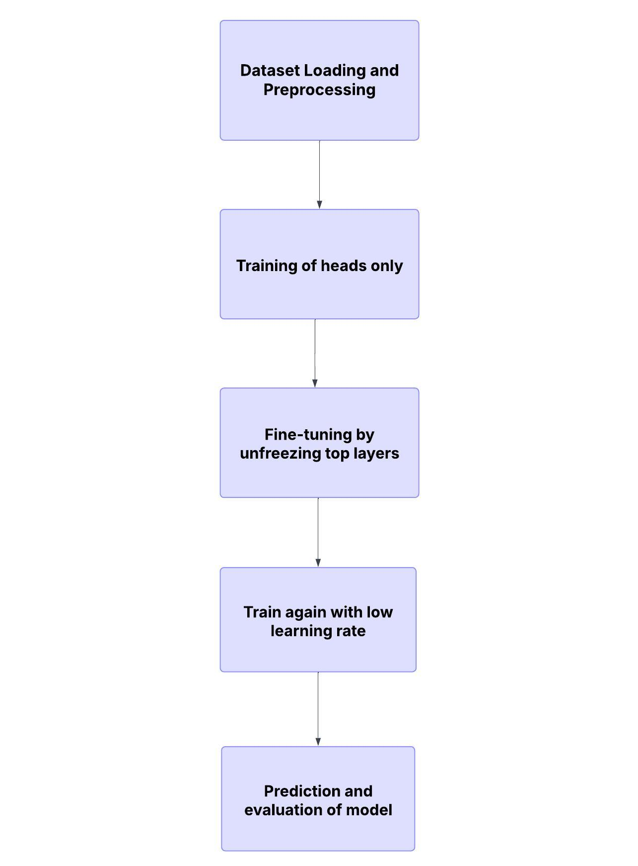
Methodology and Workflow
Flowchart:
Dataset: Tf_flowers from Tensorflow datasets.
Split: Data is split into two parts:
80% training
20% validation
Preprocessing:
Resized images to 224 x 224
Normalized pixel values to [0,1]
Model:
MobileNetV2 pretrained on ImageNet
Custom Optimizer:
Implemented MySGDOptimizer
Fine-Tuning:
Unfroze top layers of base model

Slide 4
Key Assumptions
MobileNetV2 pretrained on ImageNet is transferable to flower dataset.
Tf_flower dataset is sufficiently balanced for validation
Frozen early layers retain useful general features.
Custom optimizer mimics behaviour of SGD effectively
Fine-tuning with a smaller learning rate enhances performance.

Slide 5
Model Evaluation and Analysis
Model Architecture:
Base Model: MobileNetV2 (pre-trained on ImageNet, 16M parameters)
Custom Layers:
GlobalAveragePooling → Dense(256, swish) → BatchNorm → Dropout
Dense(128, swish) → BatchNorm → Dropout
Dense(64, relu) → Dropout → Dense(5, softmax)
Loss Function: Custom Focal Loss (handles class imbalance)
Optimizer: Custom SGD Optimizer (MySGDOptimizer)
Training Phases:
Phase 1: Freeze base model, train only head layers (5 epochs)
Phase 2: Unfreeze last 30 layers, fine-tune entire model (5 epochs)
Evaluation Results:
Phase 1 Accuracy (Frozen Base): ~80.25
Phase 2 Accuracy (Fine-tuned): ~96.47
Loss: Decreased significantly after fine-tuning.
Per-Class Accuracy: (From bar graph, you can add)
Rose: 96.45%
Sunflower: 83.58%
Dandelion: 96%
Tulip: 92.72%
Daisy: 90.34%
Dataset Summary:
Name: tf_flowers (from TensorFlow Datasets)
Size: 3,670 images
Classes: 5 (e.g., dandelion, daisy, tulips, sunflowers, roses)
Split:
Training set: 80% (≈ 2,900 images)
Validation set: 20% (≈ 700 images)
Performance Metrics Used
Accuracy: Measures the overall correct predictions out of total predictions.
Validation Accuracy & Loss: Helps monitor generalization to unseen data and detect overfitting.
Per-Class Accuracy: Reveals which specific flower classes the model predicts well vs. poorly.
Batch-wise Accuracy: Tracks consistency of performance across different data batches.

Slide 6
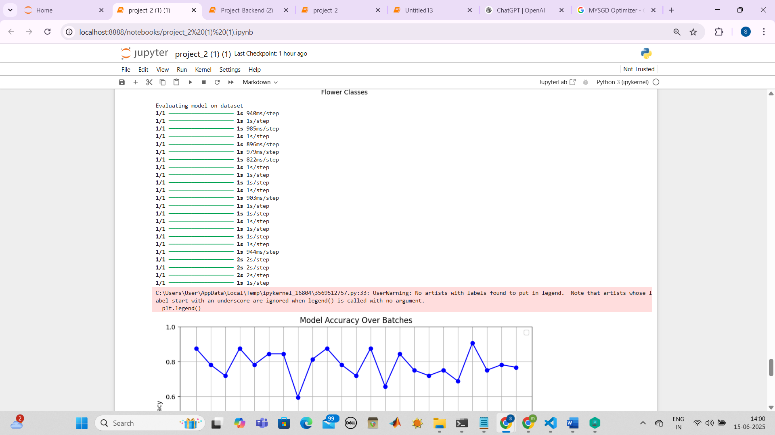
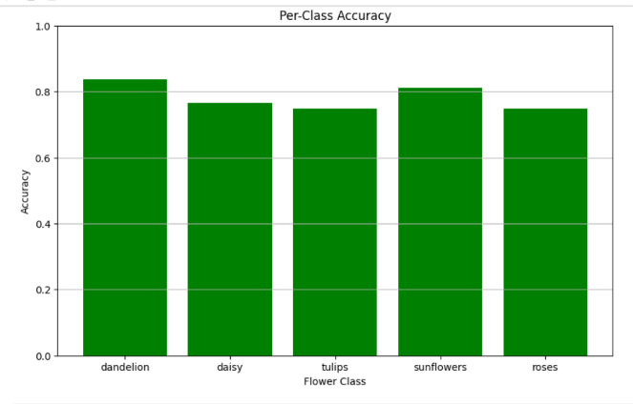
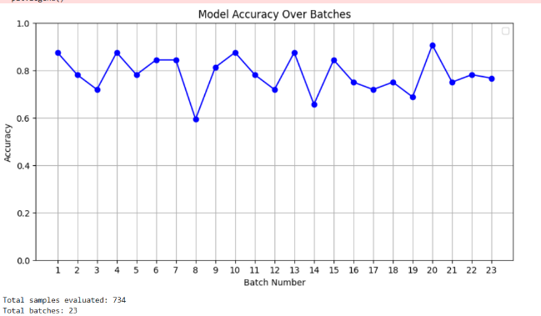
Model Evaluation and Analysis

Slide 7
Project Summary and Outcomes
Project Summary:
Built using a working flower classifier using transfer learning.
Used MobileNetV2 + custom classification head
Achieved promising validation accuracy with fine-tuning
Demonstrated implementation of custom optimizer
Validated transfer learning’s effectiveness for image classification tasks

Slide 8

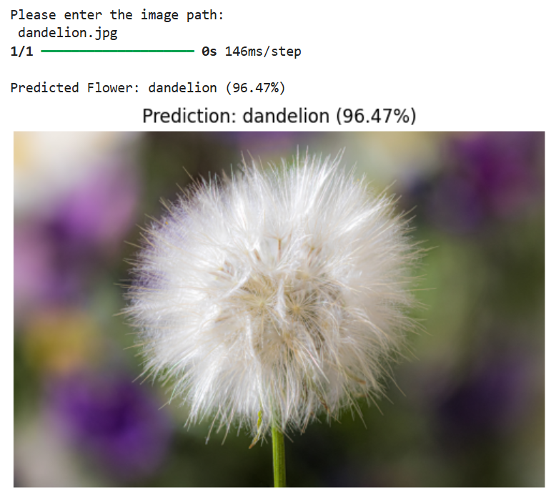
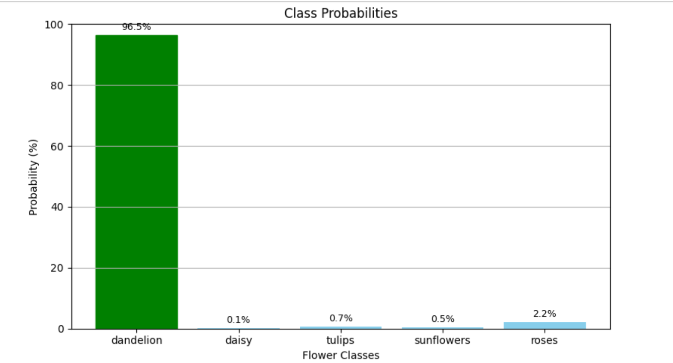
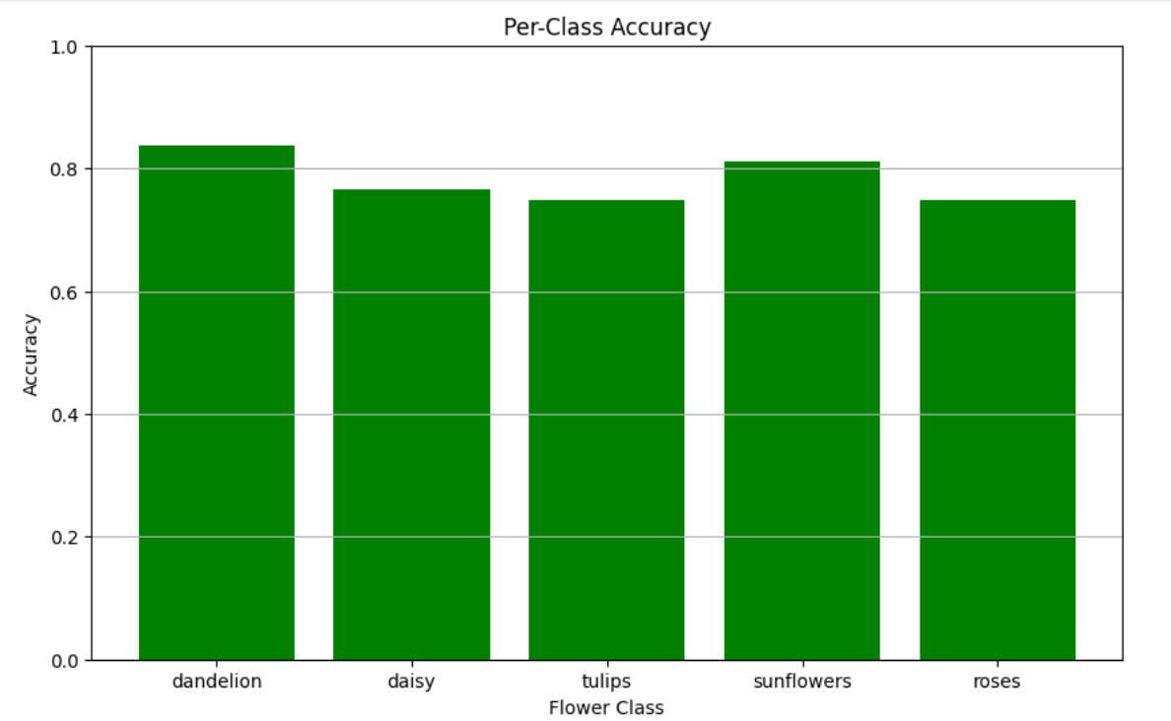
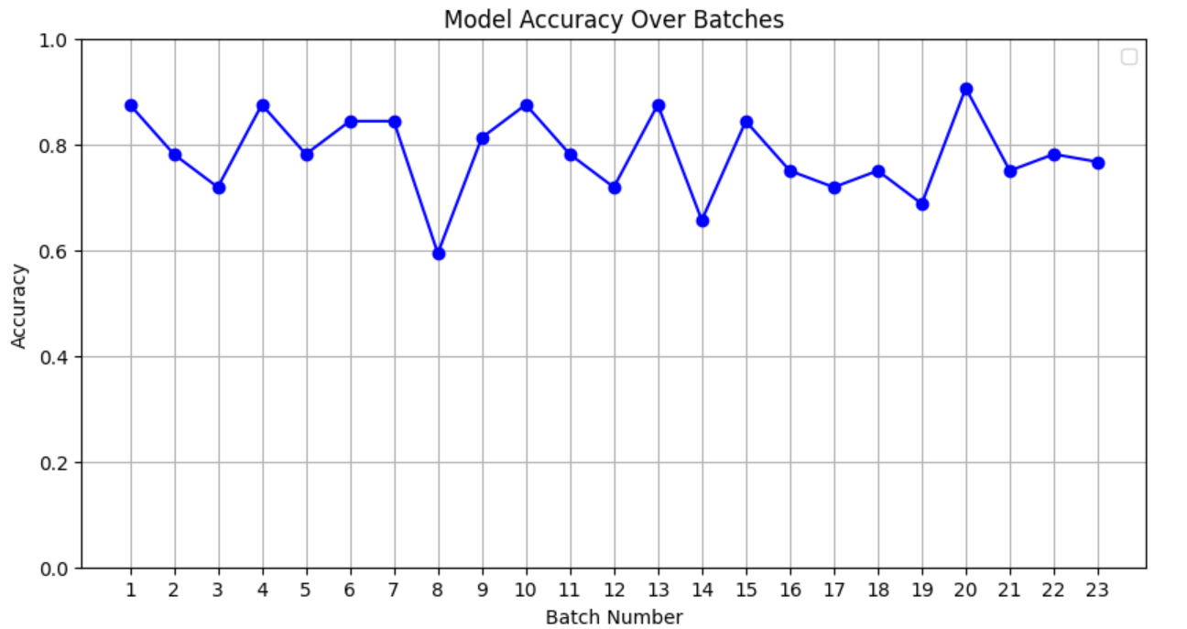
Outcome:

Slide 9
Future Improvements and Extension
Usage of advanced Optimizers : AdamW,Ranger, etc.
Addition of Image Augmentation for flipping,rotating and zooming.
Test with different models : EfficientNet,ViT
Deployment: Deploy as web or mobile app using Tensorflow.js
Model Explainability:Using Grad-CAM

Slide 10
Reflections and Learning Outcomes
Understood Deep Learning basics and model training workflow.
Explored Transfer Learning using pre-trained MobileNetV2.
Learned to fine-tune layers for better accuracy.
Gained hands-on with custom loss functions (Focal Loss).
Practiced data augmentation and normalization techniques.
Built skills in using TensorFlow Datasets (TFDS).
Implemented image preprocessing and resizing.
Visualized model performance through graphs and charts.
Improved decision-making through metric-based evaluation.

Slide 11
GitHub Link :
A detailed project report, including objectives, methodology, evaluation, and learning outcomes, has also been prepared and can be accessed in the repository.
https://github.com/Srusti20/Deep-Learning-and-Reinforcement-Learning-/blob/main/Project-Internship-2/TransferLearning_project.ipynb
Additional Resources: The complete source code, along with implementation details, data preprocessing pipeline, model architecture, training strategy, and evaluation scripts, is available on the GitHub repository:
https://github.com/Srusti20/Deep-Learning-and-Reinforcement-Learning-/blob/main/Project-Internship-2/ReadMe%20(2).pdf
Supporting Materials:

