Slide 1

Presented by : Sruthi
AZURE - 2024
Presented By :
SRUTHI

Slide 2
AGENDA
What is Virtual Network (Vnet) With example.
What is Service Endpoint With example.
What is Private Link With example.
What is Azure DNS With example.
What is Azure Bastion With example.
What is Route Server With example.
What is NAT Gateway With example.
What is Traffic Manager With example.
Azure networks are virtual networks that allow users to connect their organizational resources and services.

Slide 3

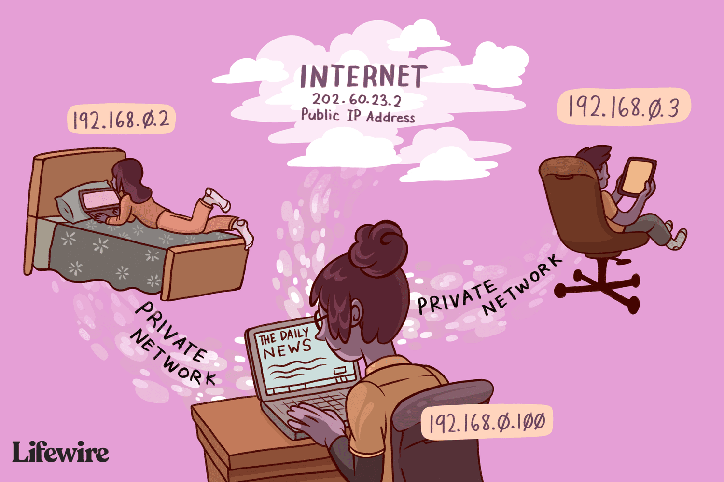

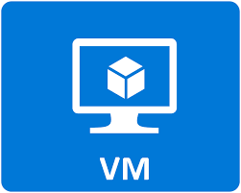
VIRTUAL NETWORK
Azure virtual networks or also known as Azure VNETs are the basic building block of your private network on the Azure Cloud.
It is a cloud-based network that allows users to securely communicate between Azure resources, the internet, and on-premises networks.
There are Public IP and Private IP.
IANA – Internet Assigned Number Authority

Slide 4



Public
Customer
Sales
IP : 10.0.0.0/16
Virtual Network
Private
Production
IP : 10.0.1.0/24
Customer
IP : 10.0.0.0/16
Customer access the sales team directly but cannot access production team.

Slide 5
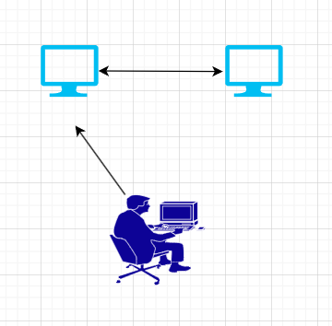
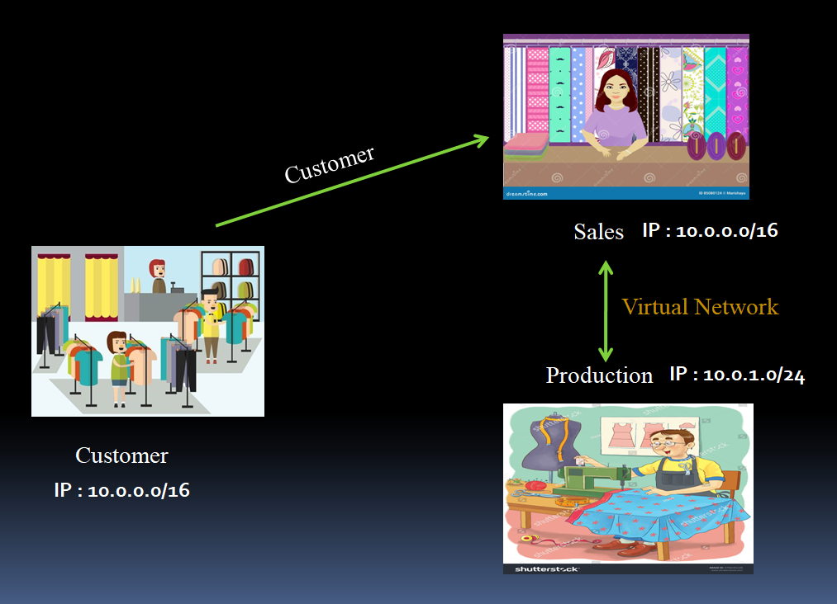
Everyone can access google.com but the data inside the google.com is private.
Search the request (Private)
VNET
Frontend
Backend
Request sends (public)
www.google.com

Slide 6
NSG
NSG is a tool for activating rules that manage traffic to the Virtual networks.
Within NSG, an inbound rule refers to incoming traffic requests, while an outbound rule relates to outgoing traffic requests.
These rules align with our organizational policy, dictating the permissions for both incoming and outgoing access.
After the creation of NSG, there are default security rules that we can't change, but we can override those rules with custom rules.
AZURE NETWORK SECURITY RULES
Traffic Control: Network Security Groups provides the facility of defining the rules to allow or deny the traffic based on specific criteria letting control over the network communication.
Port-Level Security: The rules defined in the network security groups will restrict the traffic based on TCP/UDP ports preventing the unauthorized access to sensitive services or applications.
IP Filtering: Network security groups support the application level filtering by enabling or blocking the traffic based on the application protocols, and enhancing the security for cloud based applications.

Slide 7


THEATRE
SECURITY CHECK
While we enter into the theatre, there is a ticket checker to allow in or allow out.

Slide 8
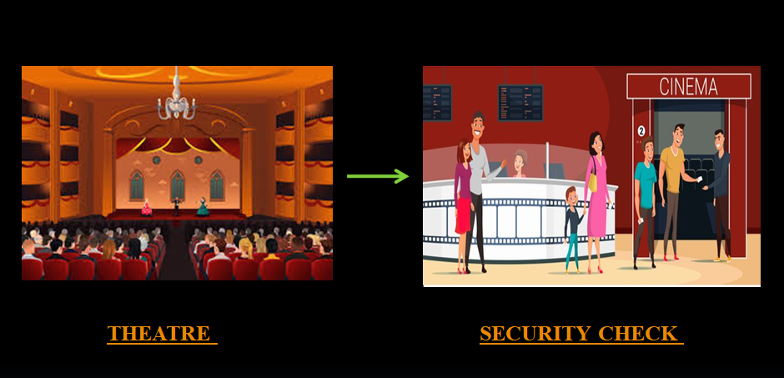
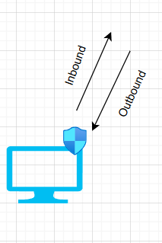
Inbound rules control the incoming traffic to the services allowing administrators to specify which incoming connections should be permitted or blocked.
VM
NSG
Outbound represents the data that leaving from the network to outside or a specific resources within a network. we have to restrict the data flow that going to outside to avoid it is not get collected to authorized users and unsecured networks.

Slide 9
SERVICE ENDPOINT
Endpoints allow you to secure your critical Azure service resources to only your virtual networks.
Service endpoint is a network configuration feature that allows you to extend your virtual network (VNet) to securely connect to Azure services over a direct and optimized route.
Service Endpoints enables private IP addresses in the VNet to reach the endpoint of an Azure service without needing a public IP address on the VNet.
The virtual machine will use its private IP address to communicate with the public end point of the storage account.

Slide 10
Class
A
B
c
Even hostel is a private zone, If she leaves from hostel, she looks in public zone, so she have go any of the 3 classes.
Public
Hostel
Private
1
2

Slide 11
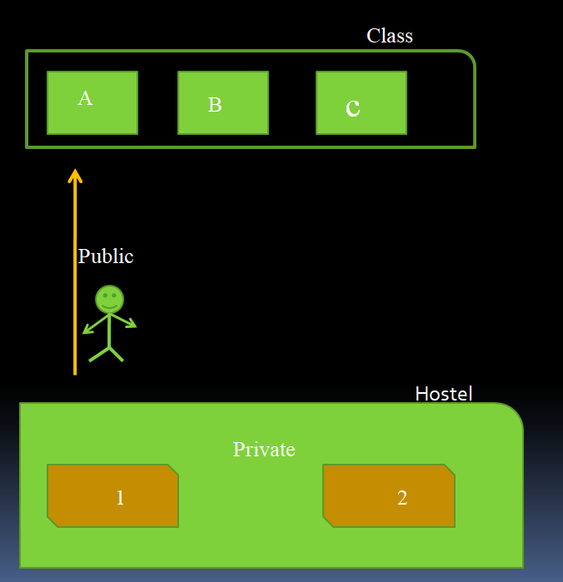
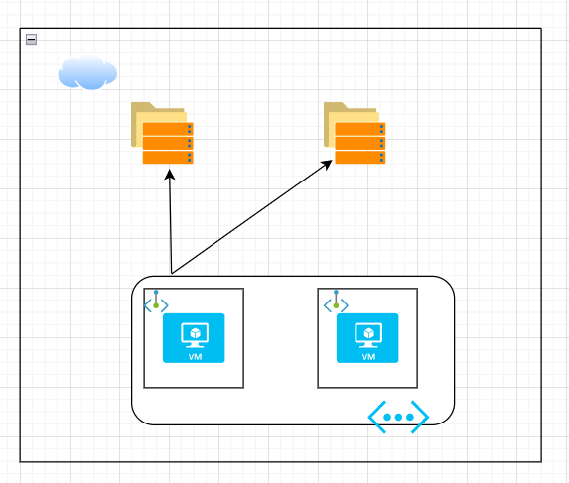
Azure storage
Subnet 1
Subnet 2
Virtual network
Subnet are in private network , when it leaves to storage from Vnet it looks for a Public IP

Slide 12
Private end point
Unlike a service endpoint, a private endpoint is a network interface that uses a private IP address from your virtual network.
By enabling a private endpoint, you're bringing the service into your virtual network.
If you noticed service endpoint only enables the communication by using private IP within VNET whereas the Private Endpoint will attach a network interface to the resource and the resource will be part of this VNET.
• This will ensure no traffic leaves the virtual network and all the communication is private.

Slide 13
Class
A
B
c
Even hostel is a private zone, If she leaves from hostel, she looks in public zone, so she have go any of the 3 classes.
For that , if we provide a ID Card
Public
Identity card Class A
Hostel
Private
1
2

Slide 14
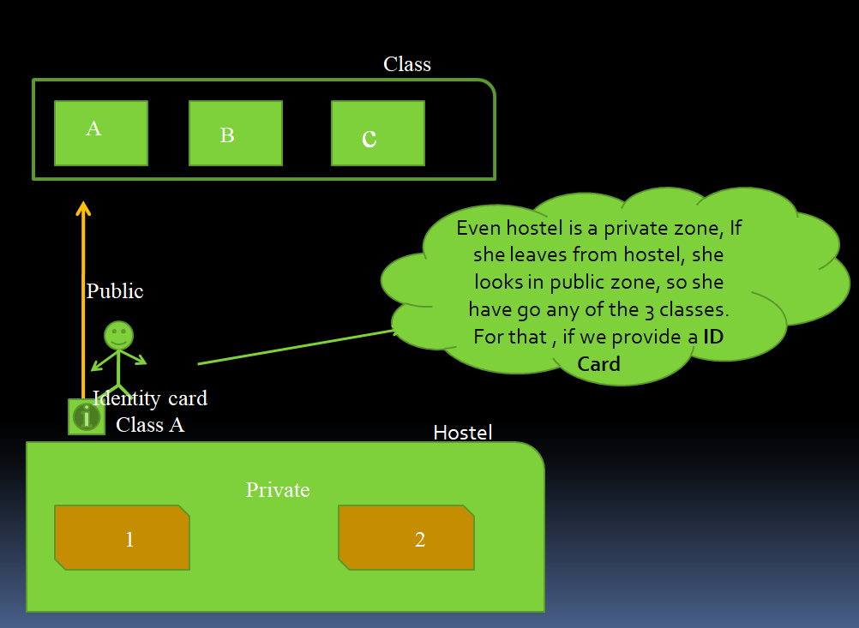
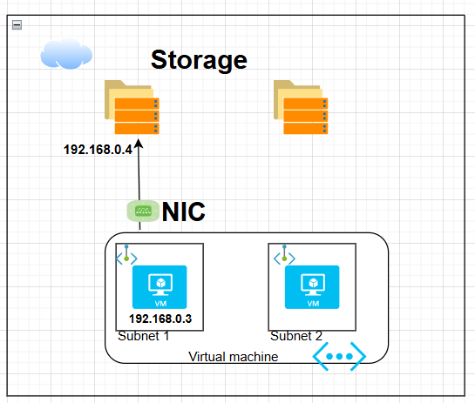
Assign a IP address to the storage to access with private address

Slide 15
TRAFFIC MANAGER
Azure Traffic Manager is a cloud-based DNS load balancer that directs incoming DNS requests to the most appropriate service endpoint.
It operates at the DNS layer to quickly and efficiently direct incoming DNS requests.
An example would be sending requests to the closest endpoints, improving the responsiveness of your applications.
It can direct the traffic based on the different routing methods.
Traffic manager methods
Priority routing method
Weighted Routing method

Slide 16
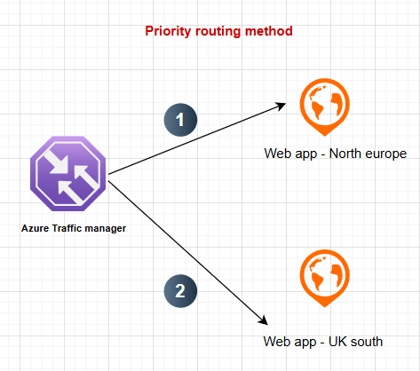
PRIORITY ROUTING METHOD
The Traffic Manager profile contains a prioritized list of service endpoints. By default, Traffic Manager sends all traffic to the primary (highest-priority) endpoint. If the primary endpoint isn't available, Traffic Manager routes the traffic to the second endpoint.
If traffic heavy in 1, it sends the requested to 2

Slide 17
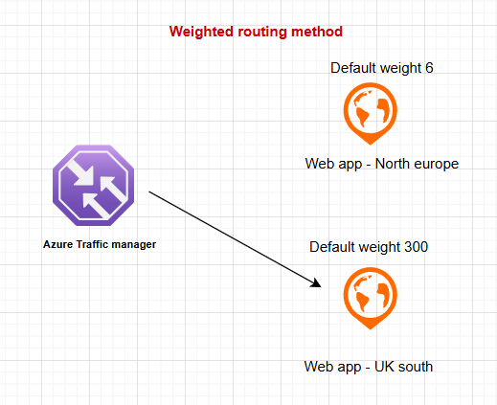
WEIGHTED TRAFFIC-ROUTING METHOD
In the Weighted traffic-routing method, you assign a weight to each endpoint in the Traffic Manager profile configuration. The weight is an integer from 1 to 1000. This parameter is optional. If omitted, Traffic Managers uses a default weight of '1'. The higher weight, the higher the priority.
If the north-europe , endpoint weight is 6.and uk-south, endpoint weight is 300.
Traffic manager prefers region , UK south

Slide 18
AZURE DNS
The Domain Name System (DNS) turns domain names into IP addresses, which browsers use to load internet pages.
Every device connected to the internet has its own IP address, which is used by other devices to locate the device.
DNS servers make it possible for people to input normal words into their browsers, such as google.com, without having to keep track of the IP address for every website.

Slide 19

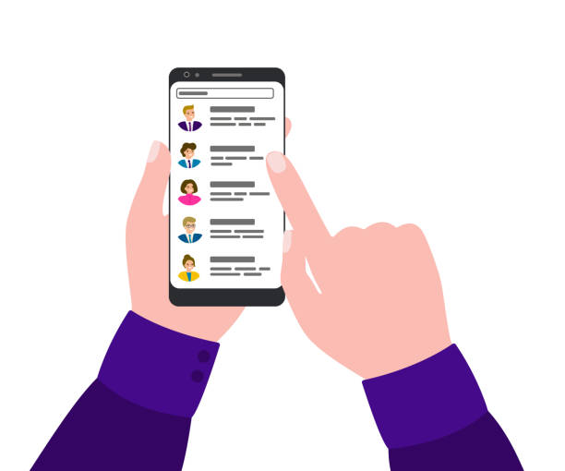
For first time, we have save the number.
Then we can search through name of the contact

Slide 20
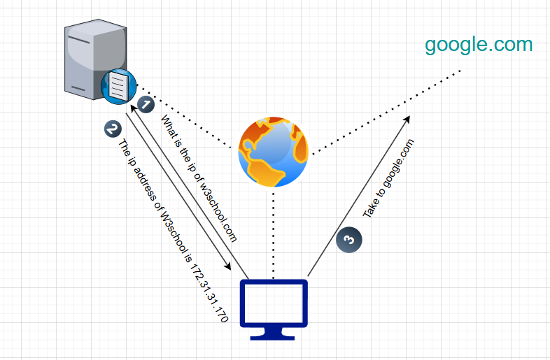
Request to DNS Server
Respond from DNS Server, i.e, find the IP of the W3School.com
It moves to W3School.com

Slide 21
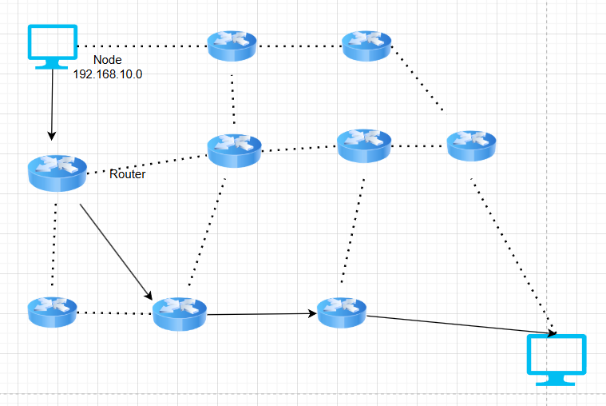
ROUTE SERVER
Azure Route Server simplifies dynamic routing between your network virtual appliance (NVA) and your Azure virtual network.
It enables network appliances to exchange route information with Azure virtual networks dynamically.
This NVA( network virtual appliance) could be a firewall, a router, a Load Balancer etc. from any third-party vendor like Cisco, Palo Alto, F5 etc.

Slide 22

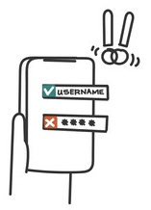

AZURE BASTION
Azure Bastion is a service you deploy that lets you connect to a virtual machine using your browser and the Azure portal. The Azure Bastion service is a fully platform-managed PaaS service that you provision inside your virtual network.
Privacy change
User
Login security
Access multiple options

Slide 23
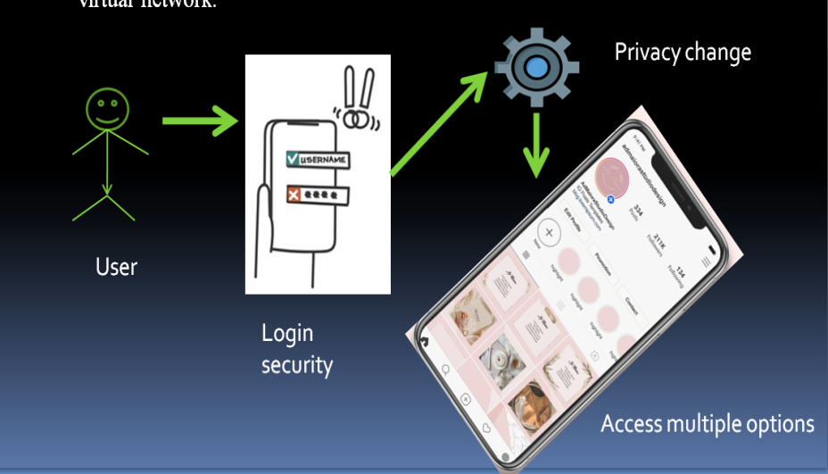
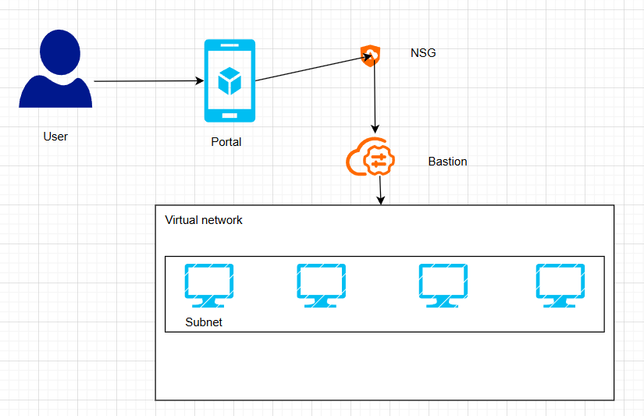
Here, user uses instagram(Portal).
Login with user password (NSG)
User enter as public
Moves setting to change public to private (Bastion)
We use any option as a private

Slide 24
NAT GATEWAY
Network Address Translation (NAT) is designed for IP address conservation.
NAT translates private IP addresses in an internal network to a public IP address before packets are sent to an external network.
Enhancing security for private networks by keeping internal addressing private from the external network.
TYPES OF NAT
Static NAT
Dynamic NAT

Slide 25
In this, a single unregistered (Private) IP address is mapped with a legally registered (Public) IP address i.e one-to-one mapping between local and global addresses. This is generally used for Web hosting.
Suppose, if there are 3000 devices that need access to the Internet, the organization has to buy 3000 public addresses that will be very costly.
STATIC NAT
In this type of NAT, an unregistered IP address is translated into a registered (Public) IP address from a pool of public IP addresses.
Suppose, if there is a pool of 2 public IP addresses then only 2 private IP addresses can be translated at a given time. If 3rd private IP address wants to access the Internet then the packet will be dropped therefore many private IP addresses are mapped to a pool of public IP addresses.
DYNAMIC NAT

Slide 26
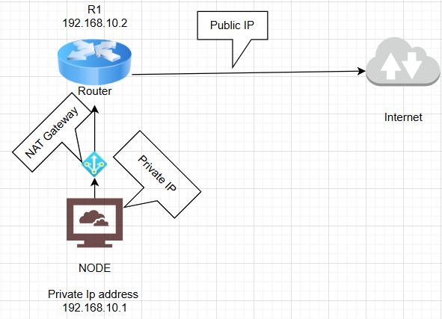
Imagine the scenario….
John started a company XYZ. Almost there are 20 developers. Each one has its own private address. If they have to surf in browser .They need a public IP.
Private
10.0.0.1
In that case. NAT will used. NAT convert a private address to public address that router have. Router access the internet and surf.
Router + NAT
10.0.0.2
Internet
125.10.1.2/3
10.0.0.3

