Slide 1

PREDICTION OF CALORIES USING NUTRITION DATA
PRESENTED BY
SRUTHI ANNAMRAJU(11372707)
SAI TRISHA PUSULURI(11373822)

Slide 2

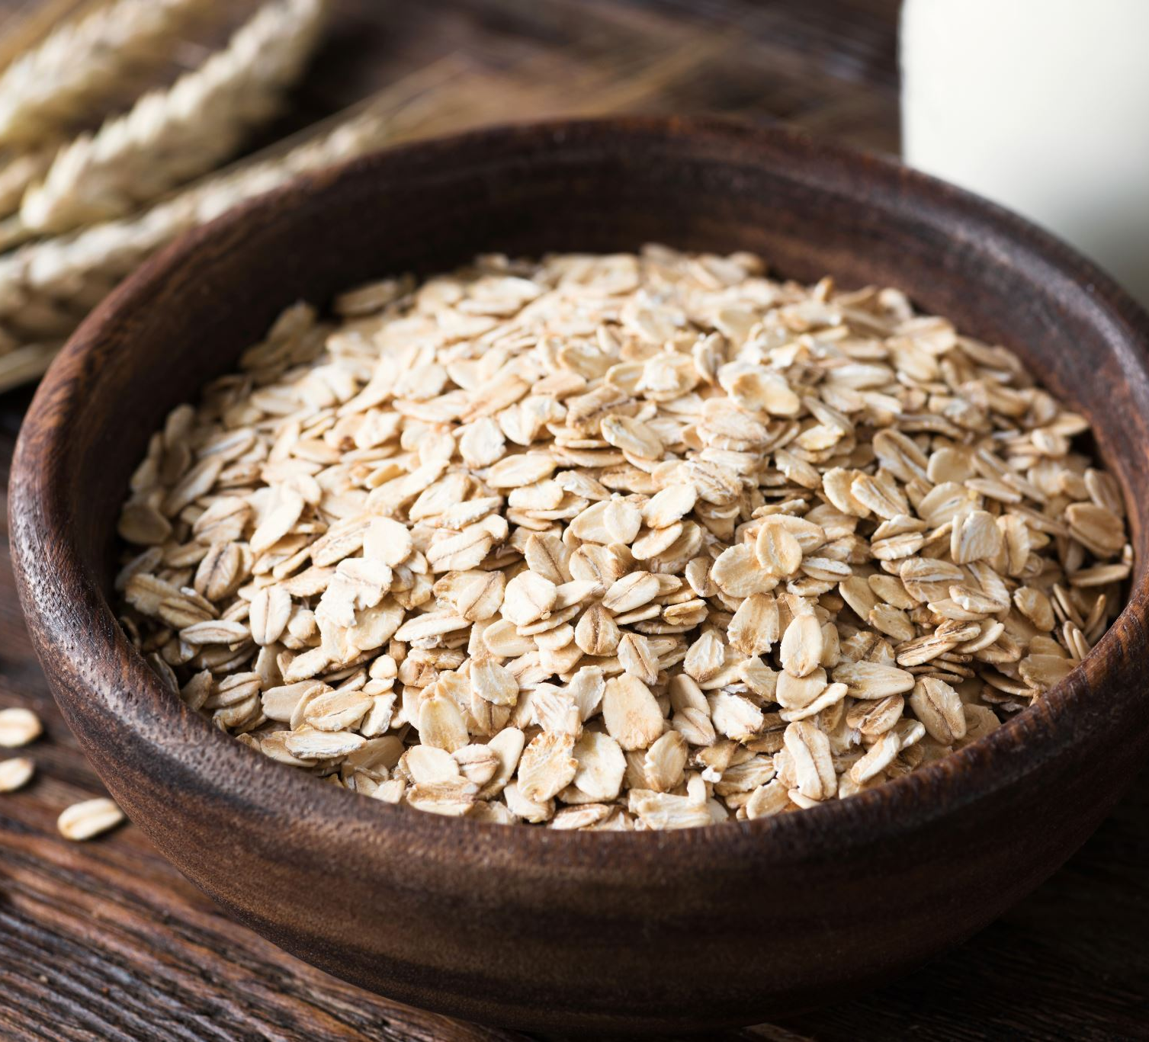
INTRODUCTION
In our day to day lives, people always worry about the calorie intake they take, and it is very important for them to know the calories from the type of food they eat.

Slide 3
MOTIVATION AND OBJECTIVE
Daily diet is one of the prominent parts of our life. Intake of Nutrition and prediction of calories is something which everybody is very eager to know. This made us to consider the Nutrition dataset.
The objective is to predict calories based on nutrition intake and various factors like carbohydrates, total fat, saturated acid, cholesterol, iron, protein, sodium etc. in this nutrition data set.

Slide 4
DATA SET AND CLEANING
The dataset at the beginning was largely left unaltered. It has many missing values, null values which needed to be replaced in order to make the dataset clean and prepared for the analysis.
All the attributes have units that are removed. Missing values have been replaced by the mean value using “proc stdize”.

Slide 5
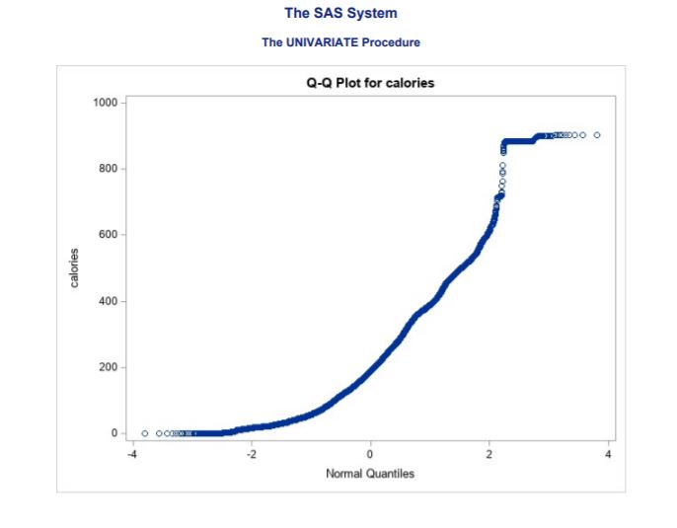
REGRESSION ASSUMPTION CHECK
Normality assumption is checked by plotting Q-Q plot.

Slide 6

MULTI COLLINEARITY CHECK
All variables need to be checked for the association between the independent variables.
H0: There is no association
H1: There is association between the variables
Here we see that if Variance inflation factor greater than 10 then shows the cause of multi-collinearity. Now, we must remove those variables which are having VIF>10 in order to best fit the model.

Slide 7

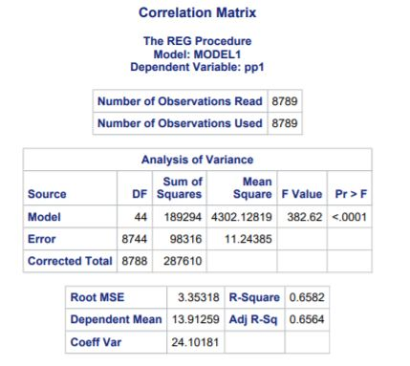
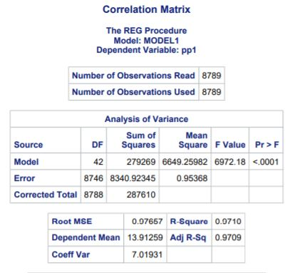



RESULTS AND ANALYSIS

Slide 8

FORWARD SELECTION
Forward selection method gives the most accurate result with 97 % accuracy. It also uses the smaller number of variables.
Step1 to Step2

Slide 9
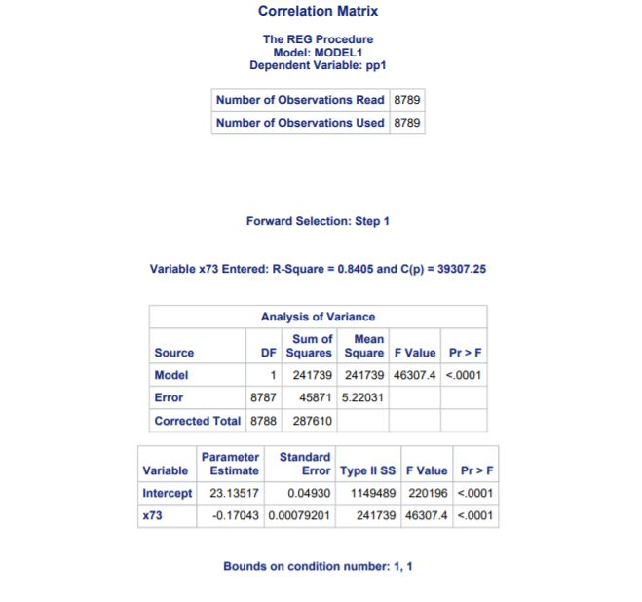
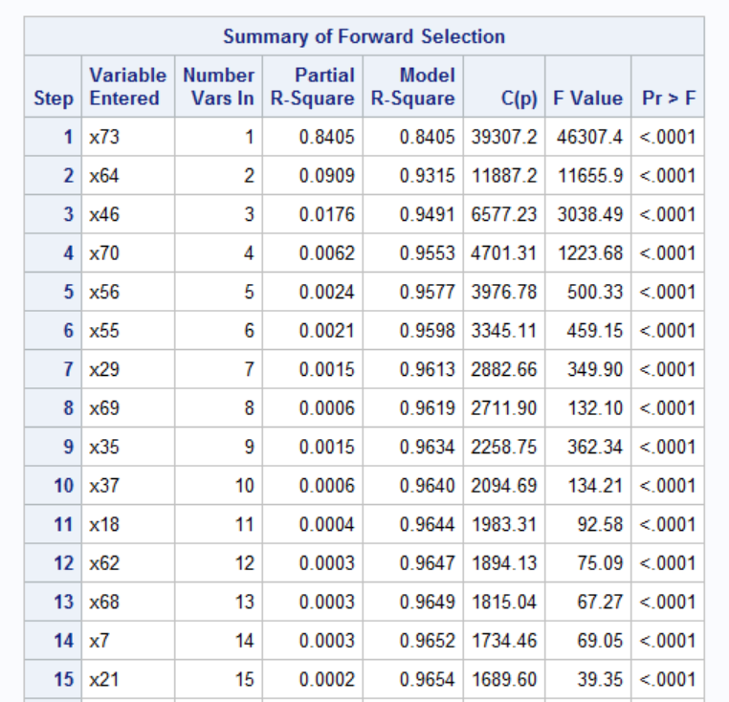
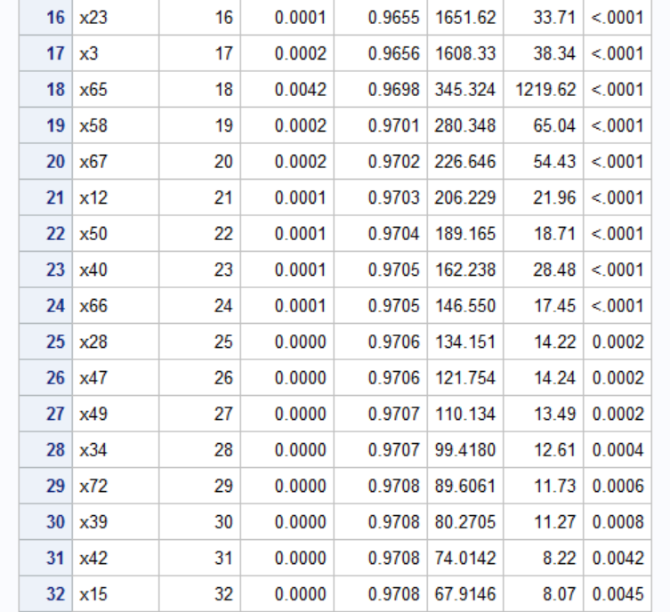
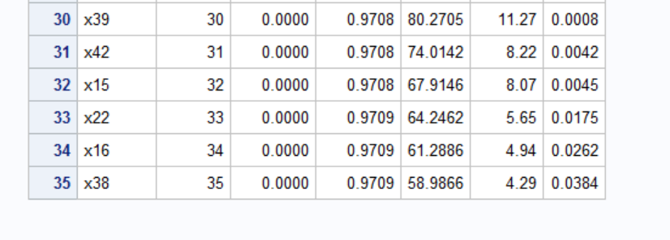
RESULTS AND ANALYSIS

Slide 10
BACKWARD ELIMINATION
We apply Backward elimination and observe the model to remove the variables which are not significantly contributing to the model.
Step 0 to Step 29 are followed here in this step.

Slide 11
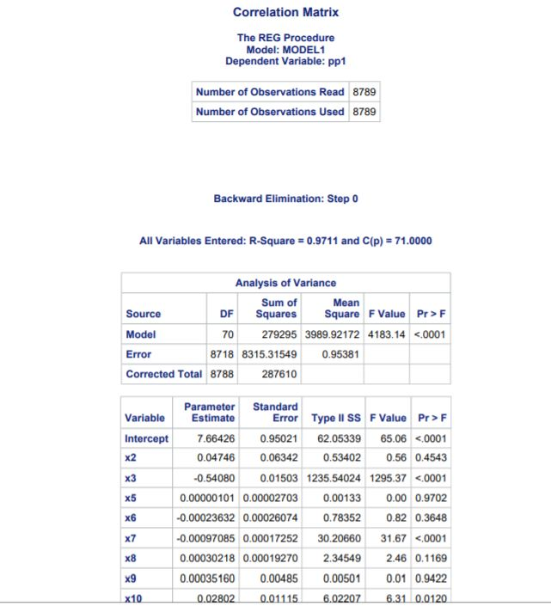
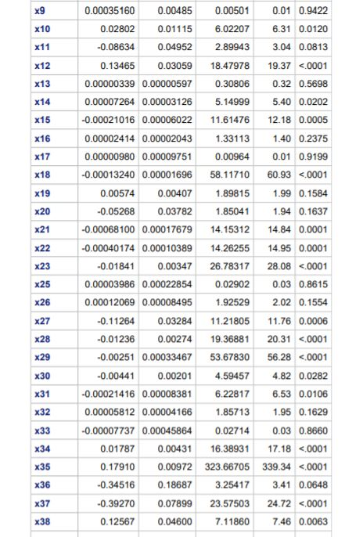
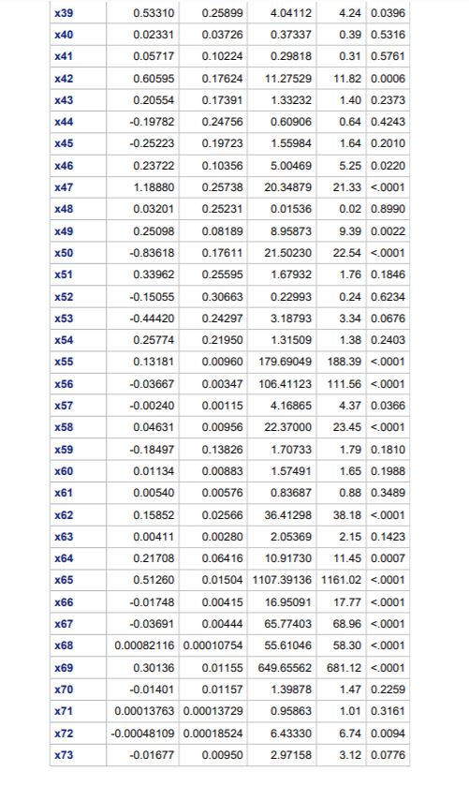
RESULT AND ANALYSIS

Slide 12
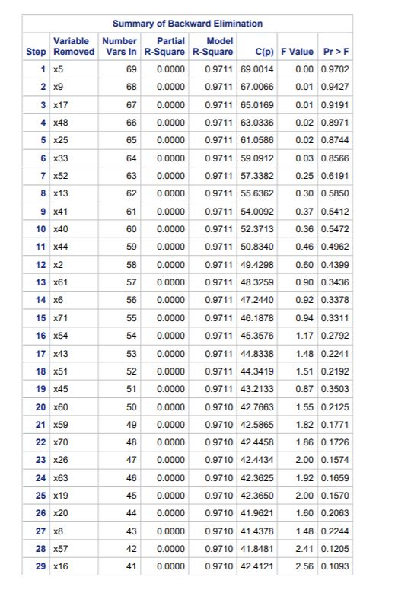
SUMMARY OF BACKWARD ELIMINATION

Slide 13
PREDICT THE CALORIES USING THE MULTI REGRESSION EQUATION OF FINAL MODEL
sqrt(Calories)=5.99481 + 0.28154*fat + 0.17154*lysine + 0.00383*ash
-0.03564*fiber+ 0.14748*carbohydrate -0.00272*magnesium
+ 0.31759*alcohol+ 0.19382*protein - 0.43567*arginine
-0.00013339*lucopene + 0.16832*maltose +0.00083062*fatty_acids_total_trans -0.00083616*folic_acid + -0.00067491*vitamin_c + 0.01786*vitamin_e
-0.54111*cholesterol + 0.51249*saturated_fatty_acids + 0.05334*fructose
-0.03754*polyunsaturated_fatty_acids + 0.1148*vitamin_a -1.07405*serine +
0.02369*glutamic_acid - 0.01763*monounsaturated_fatty_acids -0.01221*iron
+ 0.92567*methionine + 0.23787*proline + 0.01493*zink
-0.00061001*theobromine + 0.61509*cystine + 0.40608*histidine
-0.00020576*carotene_beta- 0.00021432*vitamin_d +
0.00003574*cryptoxanthin_beta + 0.09053*aspartic_acid

Slide 14
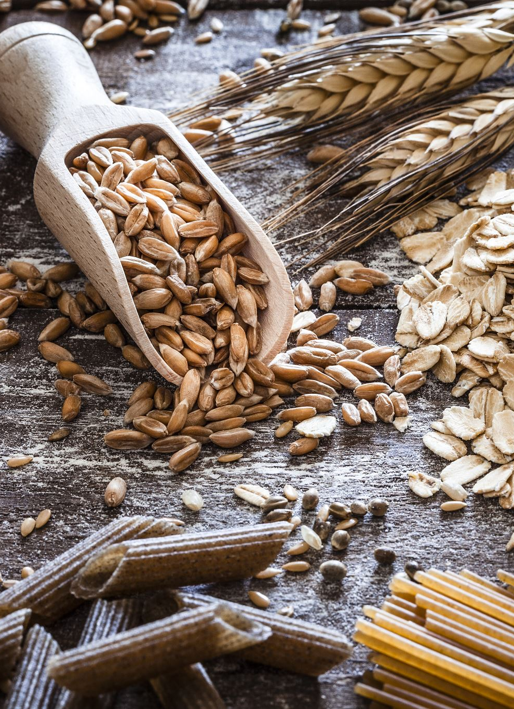
FORECASTS
we can conclude that calories can be predicted and compared to the different nutrients in the food which are factors that will be affecting the calories in any food item. But this also requires ongoing exploration as to find out for a greater number of food items and for different serving sizes, proportion.

Slide 15

THANK YOU

