Slide 1

INFO 5709 DATA VISUALIZATION FINAL PROJECT-3 WORLDWIDE ANALYSIS OF COVID-19 DATA
SRUTHI ANNAMRAJU
11372707

Slide 2
OUTLINE
Introduction
Problem Statement
Motivation
Tool used
Questions?
Dash Board
Approaches
Future Work
Demo

Slide 3
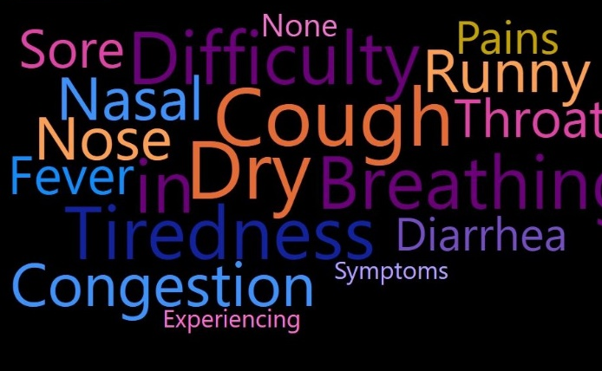
INTRODUCTION
New virus of SARS family
Discovered in late 2019
Declared as a pandemic by WHO
Prime Symptoms
Dry Cough
Difficulty in Breathing

Slide 4

PROBLEM STATEMENT
It is very important for us to understand about this spread of pandemic.
It can give us an idea if the situation will improve or 1.3 billion population should still be home for few more weeks

Slide 5
MOTIVATION
As we are currently dealing with this deadly virus, analyzing the data can help individuals and authorities to understand the past and get ready for the future.
There is lots of work going on these days on Covid-19 as the world is grappling with this pandemic which motivated me to take up this project.
This is an attempt to analyze the worldwide COVID-19 data.

Slide 6

TOOL USED
MICROSOFT POWER BI is used for data cleaning and also visualizations.

Slide 7

QUESTIONS?
How are the cumulative confirmed, death and recovered cases has spread globally?
How are the confirmed cases of top 10 countries distributed on daily basis?
What is the growth comparison of the USA and China with respect to confirmed cases?
Considering 1 million population, how are the countries affected?
What are the countries with the highest mortality rates?

Slide 8
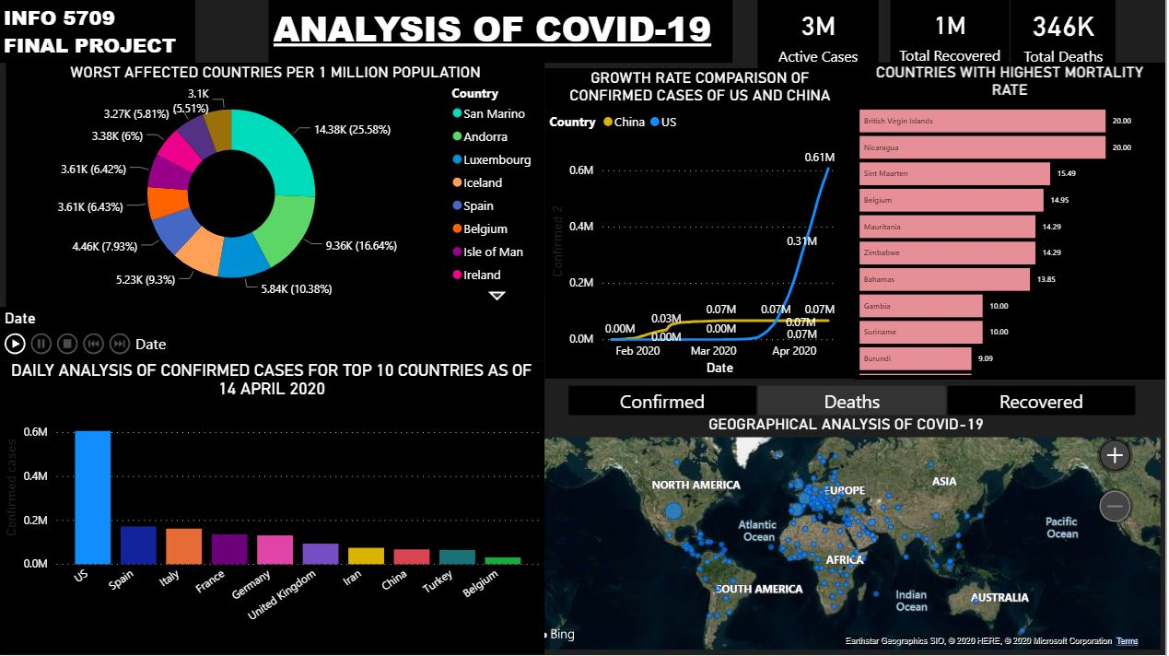
DASHBOARD

Slide 9

APPROACHES
First visualization created is a map based on the geographical locations.
Second visualization created is a column chart which shows the confirmed cases of top 10 countries from January 22, 2020 to April 14, 2020.
The third visualization is a line chart which is used to represent the trend change in the USA and China over time.
Fourth visualization is the donut chart which categorizes the worst affected countries data according to total cases per million.
Fifth visualization is horizontal bar chart which is used to represent the countries which are in the danger zone with the highest mortality rates.

Slide 10

FUTURE WORK
This project can be extended further by updating the data every possible now and then
This can be dug deeper analyzing on
How the lock down dates affecting the growth of the cases per country.
How is the severity of the cases in each country.
How many got confirmed positive in all tested people and much more.

Slide 11

DEMO
Sruthi_Annamraju_FinalProject_5709.pbix

Slide 12
Thank You

