Slide 1
SRUTHI ANNAMRAJU
INFO 5810 -Fall 2020
TEXT MINING PROJECT

Slide 2

PERFUMES: CORRELATION ANALYSIS ON RATINGS
HALLOWEEN COSTUMES: TEXT AND CLUSTERING ANALYSIS ON AMAZON REVIEWS AND RATINGS

Slide 3
Agenda
Introduction
About Data Set
Data Cleaning
Data Analysis-Goals
Final design diagrams
Conclusion

Slide 4
Introduction
The primary focus of this text mining project is to analyze the correlation of the attributes of our daily used item Perfumes and to get an overview of the Amazon reviews of Halloween costumes in the year 2020.
The main motive behind selecting two datasets on Perfume and Halloween costumes is because of
My addiction to perfumes and habit of reviewing them online and
I always wanted to dress up for Halloween and was looking for Halloween costumes too on Amazon where I found out there are many reviews and ratings.
Textual analysis on these kinds of reviews data would be great and ideal.

Slide 5
About Dataset
Perfume dataset contains around 50K rows and major attributes like ratings, longevity rating of perfumes, sillage of perfumes.
Halloween costume reviews dataset has 7814 rows and major attributes like text reviews, ratings, product name and title of the reviews.
Links :
Perfume reviews dataset: https://www.kaggle.com/sagikeren88/fragrances-and-perfumes
Halloween costume reviews dataset: https://www.kaggle.com/thomaskonstantin/popular-halloween-costumes-amazon-reviews

Slide 6
Data Cleaning
Attribute types are modified according to the requirement.
All the missing values has been replaced.
Duplicates and redundant have been removed.

Slide 7
Data Analysis-Goals
To analyze how ratings of Halloween costumes are distributed?
To get an overview of how the perfume attributes rating, longevity, sillage and votes are correlated with each other?
To understand the frequently repeated Halloween costume reviews of 2020.
Grouping the Halloween costume text reviews using the K-means clustering analysis.

Slide 8
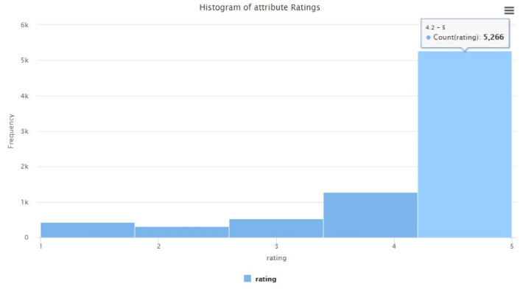
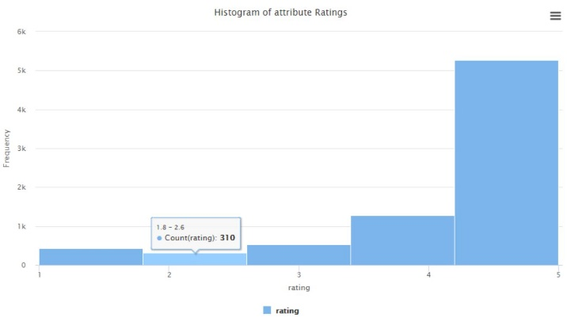
1. Distribution of Halloween costume ratings
highly distributed within bin range of 4.2-5
least distributed within range of 1.8-2.6.

Slide 9
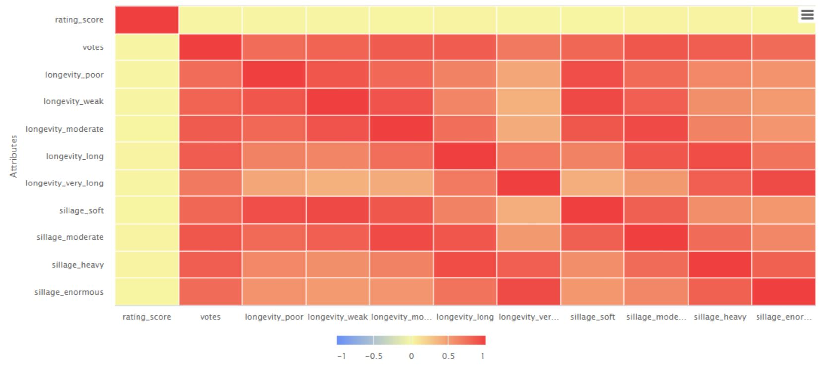
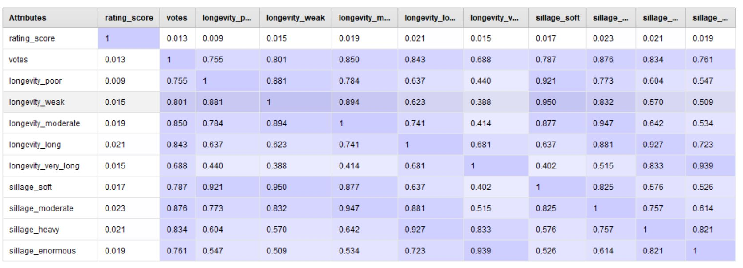
2. Correlation analysis on attributes of Perfume
Correlation is not a causation !
All the attributes are positively correlated.
All the major attributes ratings, longevity and sillage are highly correlated with each other.
Rating and votes have very less correlation effect.

Slide 10
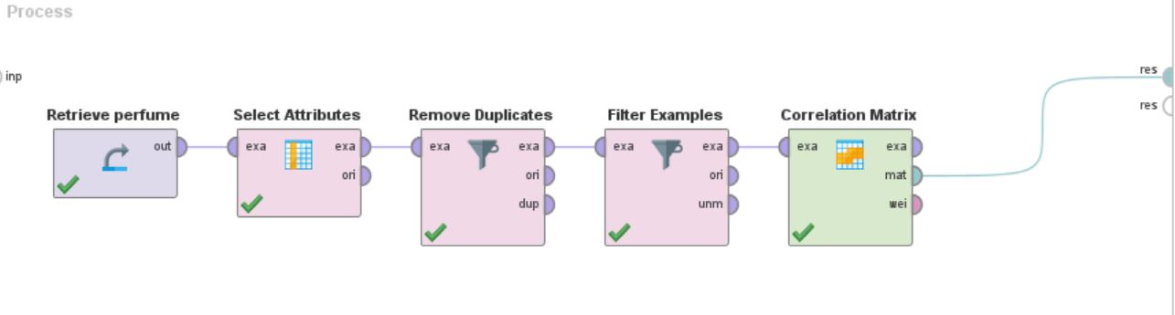
Final design diagram of Correlation analysis

Slide 11
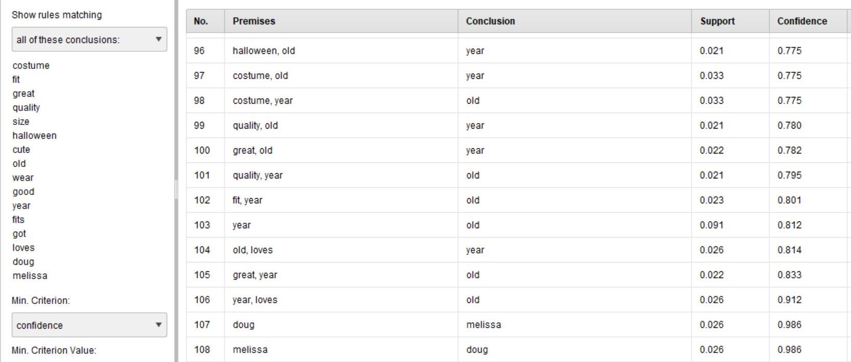
3. Association Rule Analysis of attribute “text reviews”
The most occurred words in the text reviews are Halloween, costumes, loves, quality, dough, Melissa, fit, great etc.
Dough and Melissa has the highest confidence met with 98%.
Halloween costumes of brand Dough and Melissa is most reviews by the customers on Amazon.

Slide 12
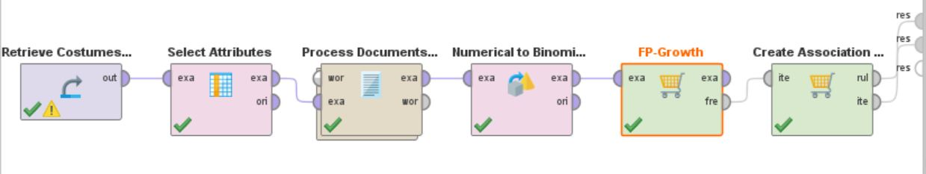
Final design diagram of Association Rule analysis

Slide 13
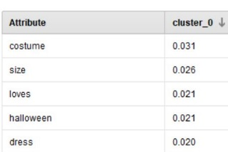
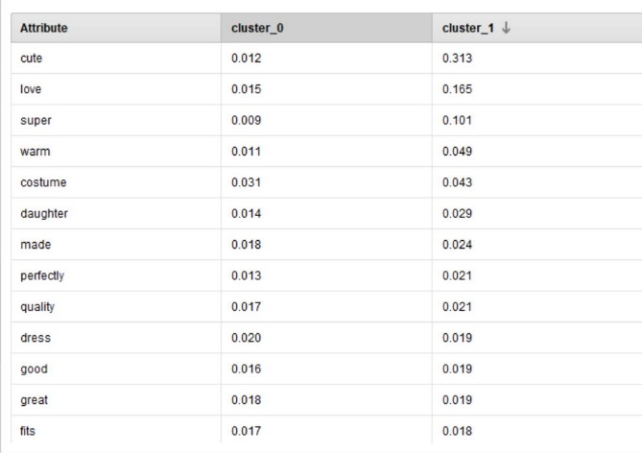
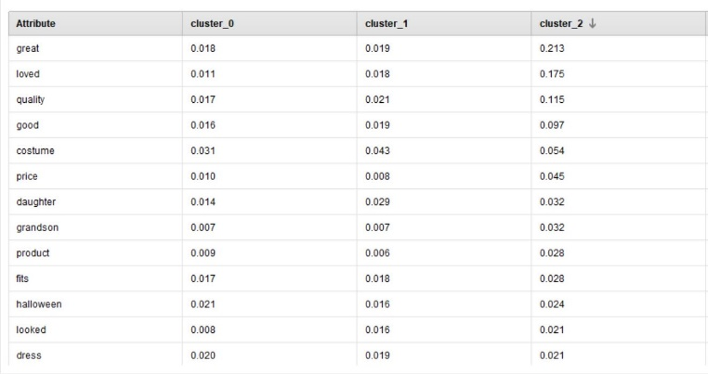
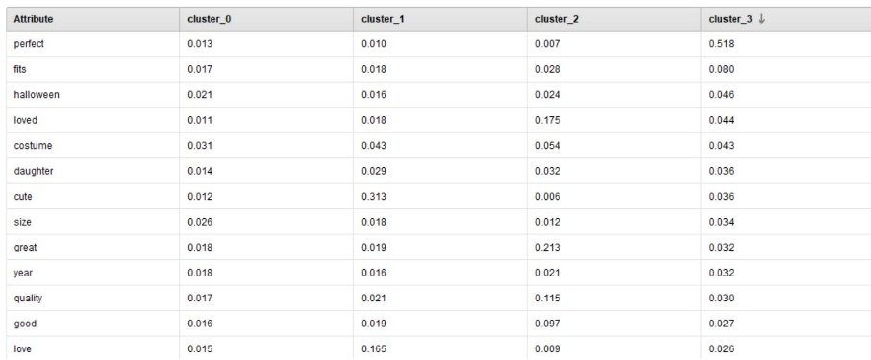
4. K-means clustering analysis to group the text reviews of Halloween costumes.
K=4 clusters and n=10 iterations
Cluster 0: costume, loves, Halloween, dress
Cluster 1: cute, love, super, warm, costume
Cluster 2: great, loved, quality, good, costume
Cluster 3: perfect, fits, Halloween, loved, costume

Slide 14
Continuation.
Customers loves Halloween costumes
Halloween costumes are cute and super warm
Halloween costumes are great and have good quality
Halloween costumes perfectly fits most of them and they love it.
Overall, it can be said that “Lovely Fit and Great Quality Halloween Costumes”.

Slide 15
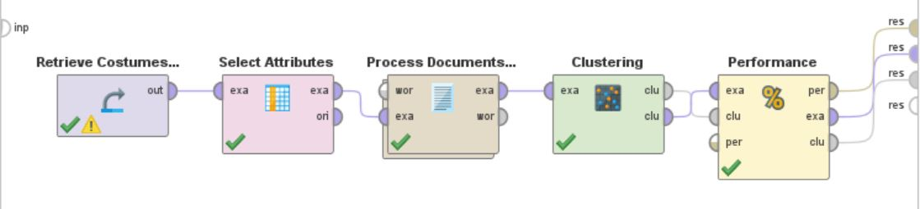
Final design diagram of K-means cluster analysis

Slide 16
Conclusion
Overall, we can say that the two main things which makes a perfume best i.e., high in ratings are Longevity and Sillage of a perfume and Secondly, many of the customers who bought Halloween costumes from Amazon are very happy with the products as they reviewed with the factors like good quality, great fit and lovely Halloween costumes.
These are the few goals that I have performed and not definitely limited to.
There is always scope of performing even more deeper analysis on these kinds of potential data sets and data keeps adding day by day giving us larger view to analyze our goals.

Slide 17
Thank You

