Slide 1
Amazon music clustering
Unsupervised Machine Learning

Slide 2
Problem statement
Manual genre tagging is impossible at scale, with millions of songs available on platforms like Amazon Music.
For every song we will be having different audio features like tempo, energy, danceability, loudness, valence etc.
So, the goal of this project is to automatically group similar songs using unsupervised clustering techniques by analyzing these audio features.
By this songs will be organized into meaningful clusters that represent genres, moods, or listening styles.
Therefore, this helps in music recommendation systems, playlist generation, and understanding listener behavior.

Slide 3
Approach
Firstly, the data is made ready for clustering by going through the following steps:
1. Data Exploration and Preprocessing
2. Feature selection: Only the required audio features for clustering are selected by removing all other text-based columns like track_name, artist_name, track_id etc.
3. Normalizing the data: As clustering is distance-based, feature scaling is important. So, to bring all features into same scale StandardScaler is used.
Applying K-Means clustering algorithm:
For K-Means determining the best number of clusters 'k' is crucial. So, for knowing the best 'k' the following methods are used:
1. Elbow method
2. Silhouette score
3. Davies-Bouldin index

Slide 4
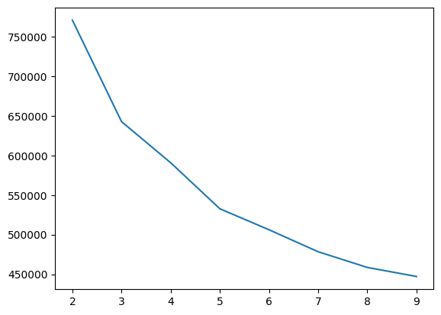
Elbow method
It’s a plot between SSE (inertia) and k. Elbow point indicates best k.
Here we have elbow point at 3
So according to elbow method k=3
is the best choice.

Slide 5
SILHOUETTE SCORE DAVIES-BOULDIN INDEX
Measures how close points are to their own cluster vs. Others.
A score closer to 1 indicates that the data point is very similar to other data points in the cluster.
The results for our model are:
Evaluates clustering quality by measuring how compact and well separated the clusters are.
Lower values indicate better defined clusters.
The results for our mode are:
for clusters:2 silhouette_score is:0.203154
for clusters:3 silhouette_score is:0.238852
for clusters:4 silhouette_score is:0.227101
for clusters:5 silhouette_score is:0.184695
for clusters:2 davies_bouldin_score is:1.943495
for clusters:3 davies_bouldin_score is:1.575285
for clusters:4 davies_bouldin_score is:1.840162
for clusters:5 davies_bouldin_score is:1.700854
Highest score is at k=3
So k=3 is best
Lowest score is at k=3
So k=3 is best
According to the 3 methods k=3 is the best one. So, K-Means clustering is implemented using k=3.Now the data is divided into 3 clusters.

Slide 6
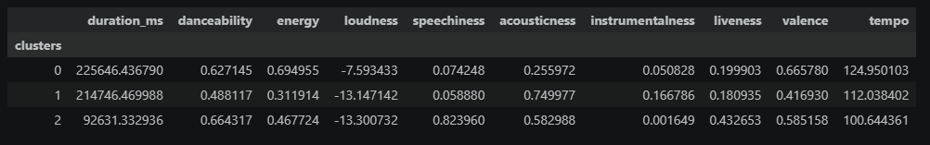
Naming the clusters
For naming the 3 clusters we must see the average feature values for each cluster.
According to these values each cluster can be named as:
Cluster 0 | High energy, tempo, loudness, and valence. Low acousticness. | "Party Powerhouses" — These are long, fast, loud, and happy electronic, pop, or rock tracks.
Cluster 1 | High acousticness/instrumentalness. Low danceability, energy, and valence. | "Acoustic Solitude" —They are classical, ambient, slow-paced, and instrument-heavy.
Cluster 2 | High danceability, speechiness, and liveness. Low duration and loudness. | "Lyrical Grooves" — Short tracks with heavy focus on lyrics (high speechiness).

Slide 7
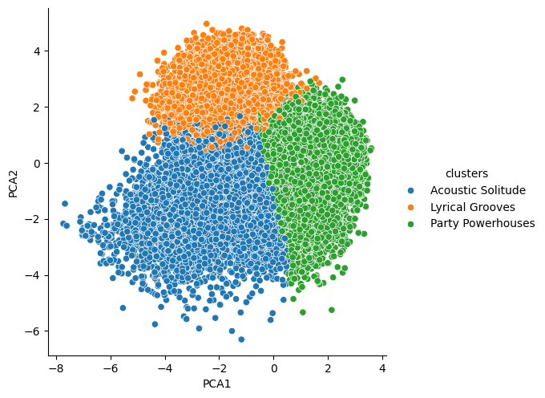
Visualizing clusters
The dataset is reduced to 2 components using PCA(Principal Component Analysis) to visualize clusters.

Slide 8
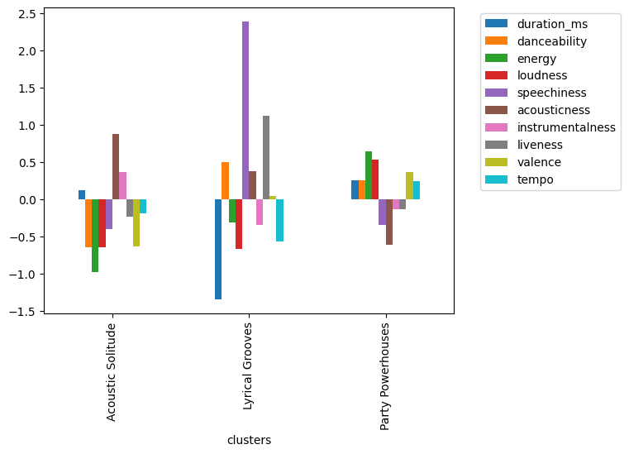
Average feature values per cluster

Slide 9
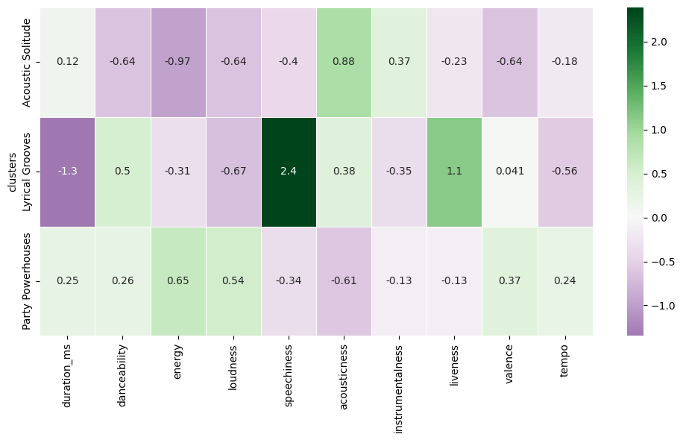
Comparing features across clusters

Slide 10
Wrapping up
Finally, the cluster labels are added to the original DataFrame and dataset is exported to csv file.
Now it can be used for
Personalized Playlist Curation: Songs that sound similar can enhance playlist generation.
Improved Song Discovery: Can suggest similar tracks to users based on their preferred audio profile.
Artist Analysis: Helps artists and producers identify competitive songs in the same audio cluster.
Market Segmentation: Streaming platforms can use clusters to analyze user listening patterns and optimize recommendations or promotions.

Slide 11
THANK YOU

