Slide 1
Library Management System
Project – COEN275
Sruthi Thiyagarajan, Fuqiong Zhao, Sowmya Chirravuri, Suman Basavaraj Shiri

Slide 2
Library - Design
Problem Definition
Design a library management system using object-oriented principles. This generic library design must address scalability. The designed system should have two interfaces: Member interface and Admin interface. The members can rent books for a specific time, like them, and review them. Admin has all the authority to add, delete, browse books and send notifications to library members.
Requirement Analysis
Any library member should be able to search books by title, price, category(type), and ISBN.
Each book will have a unique identification number; there could be more than one copy of a book, and library members should be able to check out any copy.
The system should be able to retrieve information like who took a particular book or what are books checked out by a specific library member.
The library member has to provide their card credentials upon signing up for the security of the rental books.
There should be a maximum limit (90) on how many days a member can keep a book.
The system should be able to collect fines for books returned after the due date.
The system should be able to send notifications when the book is not returned within the due date.
Each of the library members should have a wallet from which the amount will be deducted for the rentals.
On damage or not return of the books after the maximum time limit, the system can charge the library members with their credit cards.
The system should provide library members with like and review options for a book.
The library member should be able to read the messages received in their account.

Slide 3
Assumptions
Any member can rent any book that is available from the library.
The book must be available before the member can rent it.
Members must have a valid credit card to sign up an account.
Members can rent multiple books.
Members can rent the book for a maximum of three month.
Members need to provide an expected return date.
Any book return after the expected return date will evoke a fine.
Members pay through the virtual wallet provided by the system.
Members can load money to the wallet.
Member’s wallet must have enough balance to pay the bill in order to return the book.
Members can like the book. Every user member can only have one like.
Members have access to all the book reviews.
Members have access to the title and expected return date of their borrowed book.
Members can search book by book title, by category, by price and by ISBN.
Members can read notifications from admin.
There is only one account for admin.
Admin can manage the books by adding and deleting them.
Admin can browse all the books, tracking the rented books and send notification to members.
The system uses SQLite to store the database.

Slide 4
Use cases
Here are the main Actors in our system:
Admin: Mainly responsible for adding and removing books, tracking rented books and their availability, sending notifications to members.
Member: All member can rent the book from the library.
Here are the top use cases of Admin interface:
Add/Remove books: To add and remove books from the book database.
Track rented books and their availability: To read a table record of all the books info.
Send notification to members: To send notification to users when the expected return date is approaching.
Here are the top use cases of Member interface:
Browse books: To browse all the books in library, including the book title, author, category, price, likes and review.
Search books by certain criteria: To search book by their title, price, category and ISBN.
View search history: To view the history of book search.
Borrow books: To enter the expected return date and to rent the book for such period.
Return books: To return books to library before or after the expected return date.
Pay the bill: To pay the rent and possible fine through wallet.
Load wallet: To add money to the wallet to make sure the balance is enough to pay the bill.
Like the book: To like the book through the like button.
Write review of the book: To write the review of the book.
Record borrowed books: To record the borrowed book, borrow date, expected return date and expected bill.
Receive notification from admin: To receive notification from the admin.

Slide 5
Classes
Main classes of our library management system
GUI Classes
mainwindow: The central part of the organization for which this software has been designed. It has attributes of “startWidget” to start the program. It also contains all the widgets needed, for example, ”signupWidget”, “loginWidget”, “memberWidget” and “adminWidget”. In addition, it contains the “controller” which connects the frontend and the backend.
startWidget: Used to kick off the program by choosing signup or login.
signupWidget: Used for signig up new member account. Signal to controller to save account info to database.
loginWidget: Used for login for existing members. Signal to controller to get to the member interface.
imageWidget: Layout the books with their titles in memberWidget for members to browse.
bookWidget: The widget to show individual book information.
adminWidget: The widget to show admin interface.
memberWidget: The widget to show member interface.
OO Classes
User: Base class for Admin and Member classes.
admin: Derived class from User. Used in adminWidget.
member: Derived class from User. It contains personal information (i.e., username, email, password etc.) and the borrowing history of the member (i.e., borrowed book, borrow date, expected return date, ect.).
transaction: Contains information of the member’s credit card.
bookstudent: The class to store like/review information.
book: Contains book information (i.e., title, author, price, availability, borrowedBy, like, etc.)
Controller: The class that is responsible for all the communications between frontend and backend.
Database: The class that is responsible for all the operations on SQLite database.

Slide 6
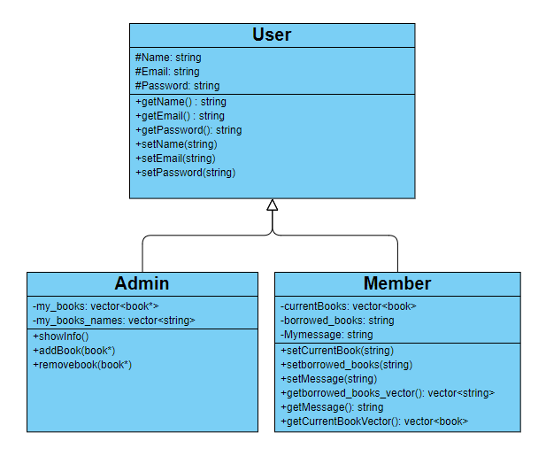
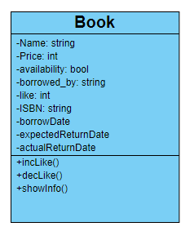
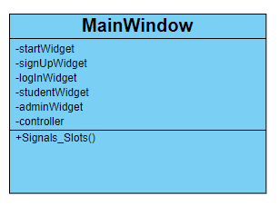
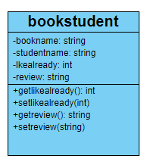
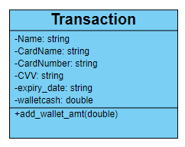
Classes

Slide 7
OO Concepts
All main pillars
Encapsulation
Inheritance
Overloading – operator and function
Others
Iterator
Map
Vector
UML design - Has-a and Is-a relationships
User Class = Base class, Inheritance
Admin/Member Class = Derived class, Inheritance

Slide 8
UML Use case and diagrams

Slide 9
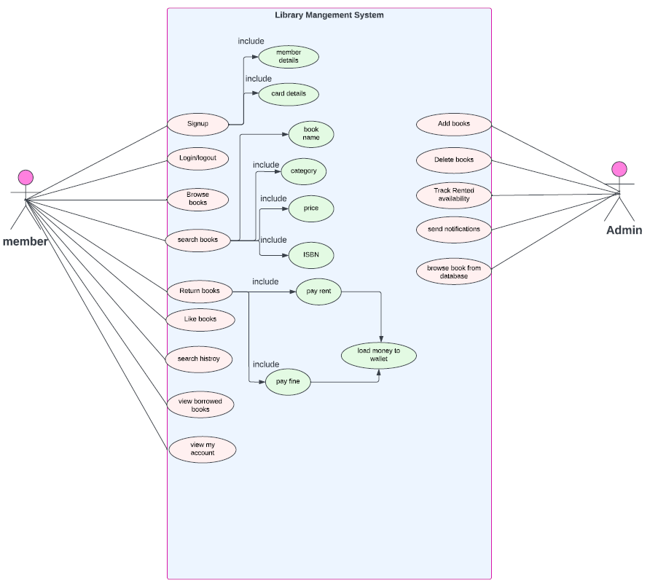
Use case diagram

Slide 10
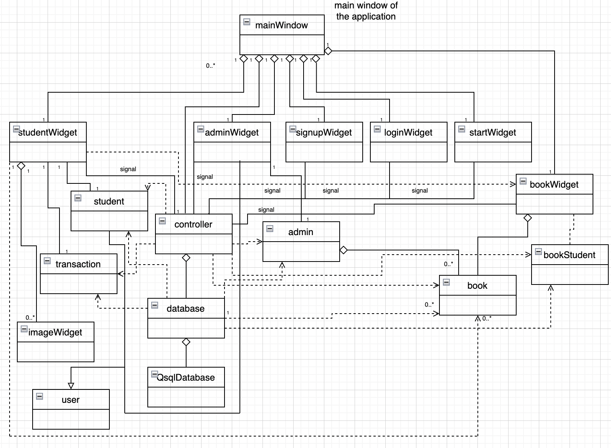
Class diagram

Slide 11
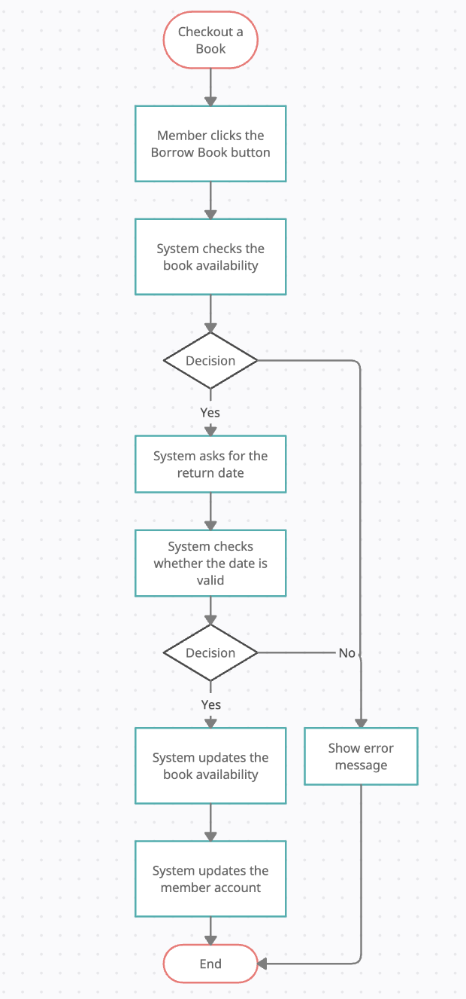
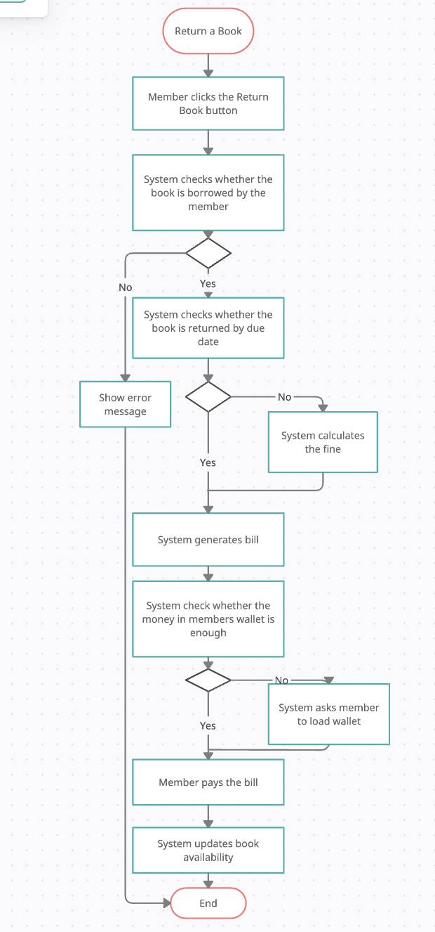
Activity Diagram
Checkout a book
Return a book

Slide 12
Class Implementation

Slide 13
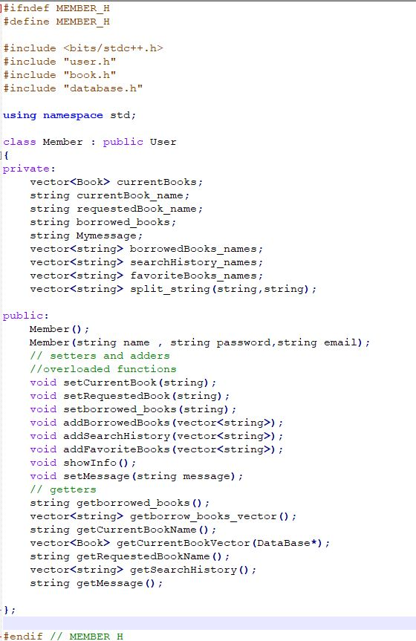
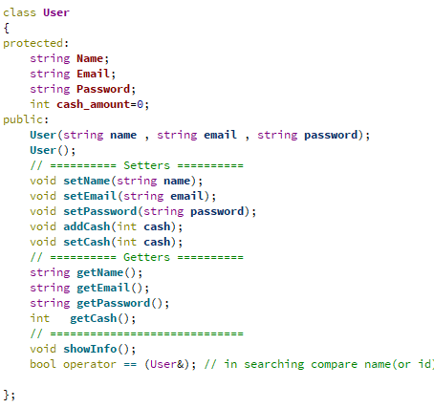
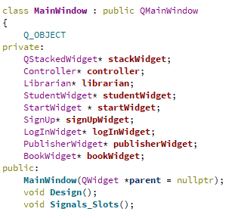
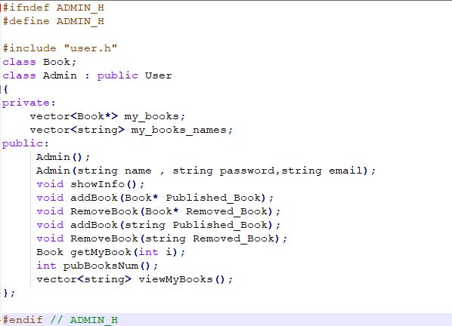

Slide 14
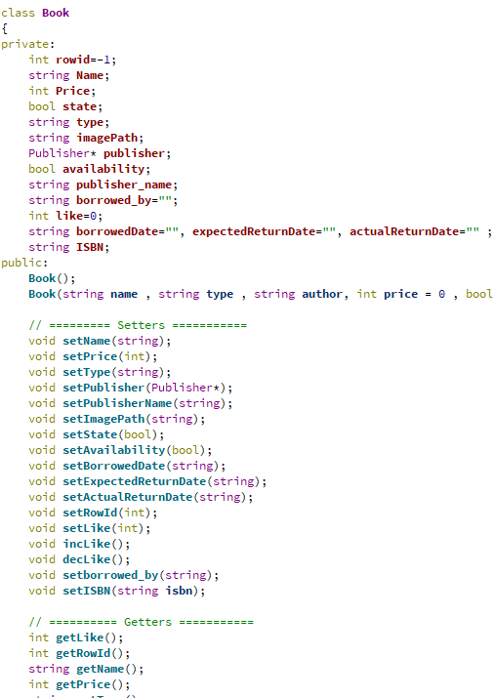
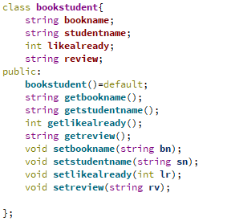
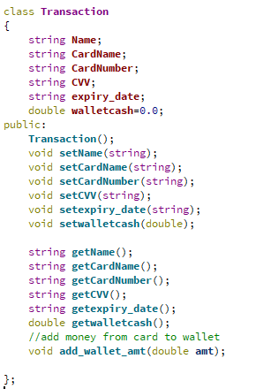

Slide 15
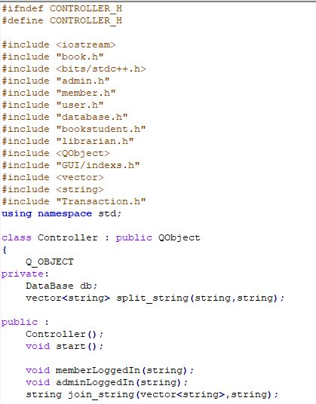
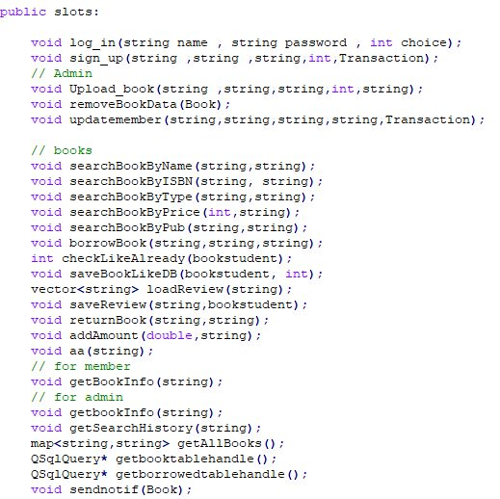
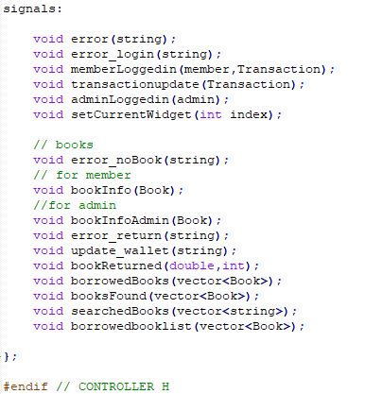

Slide 16
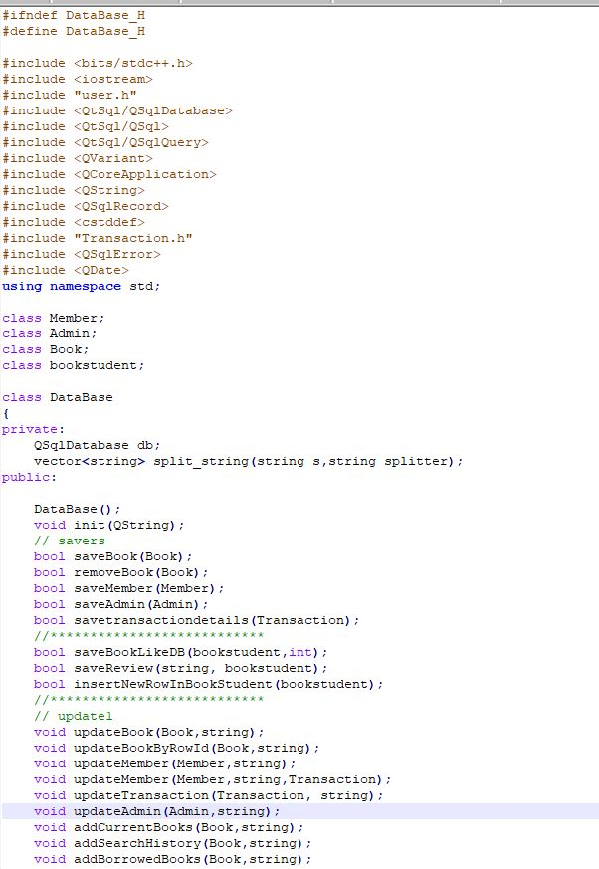
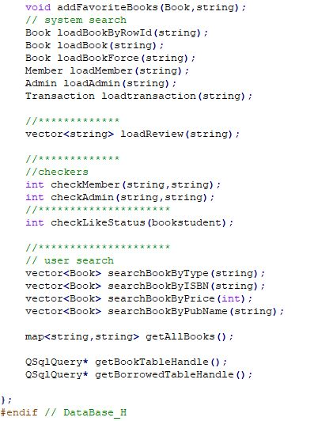

Slide 17
Screen shots of the user interfaces

Slide 18
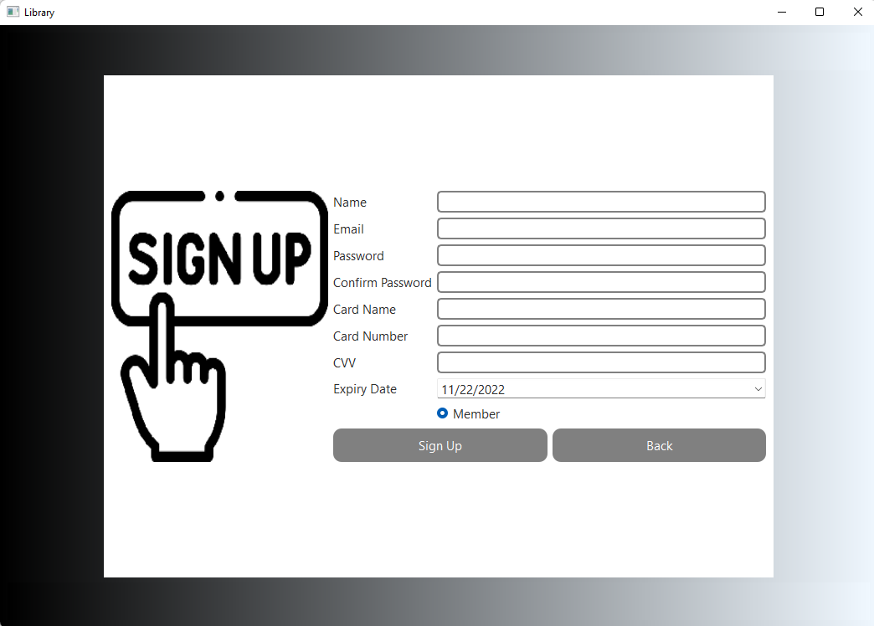
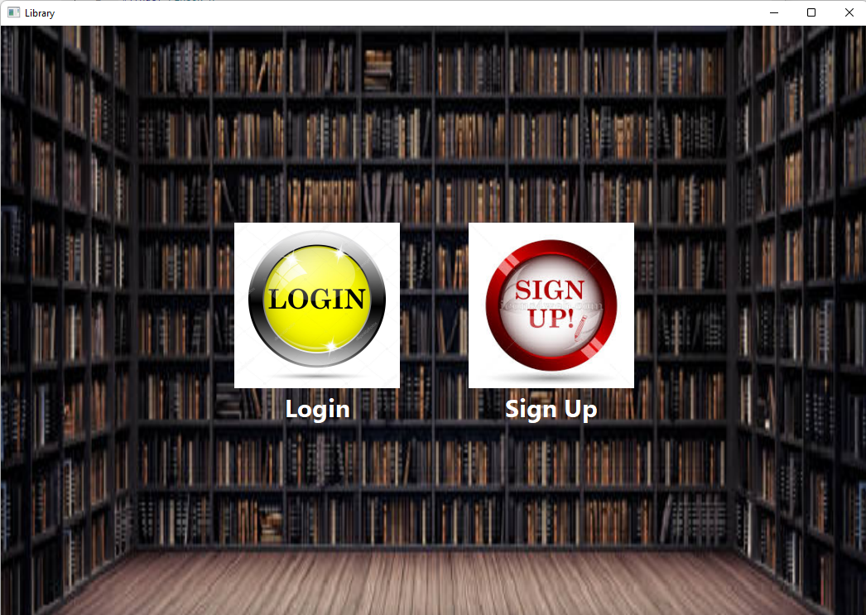
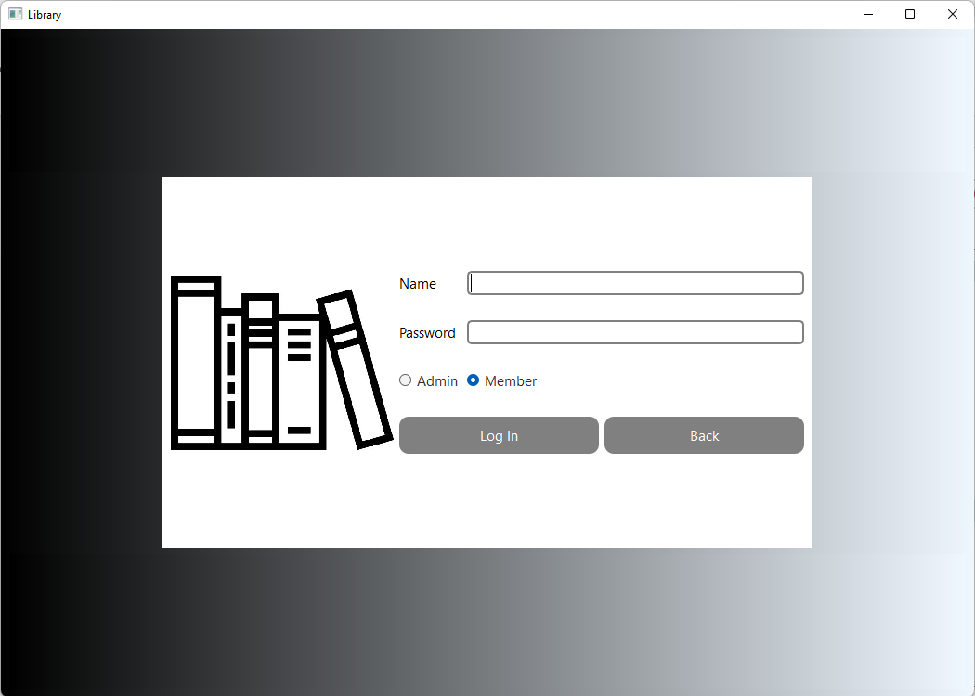
Signup interface
Start of program
Login interface

Slide 19
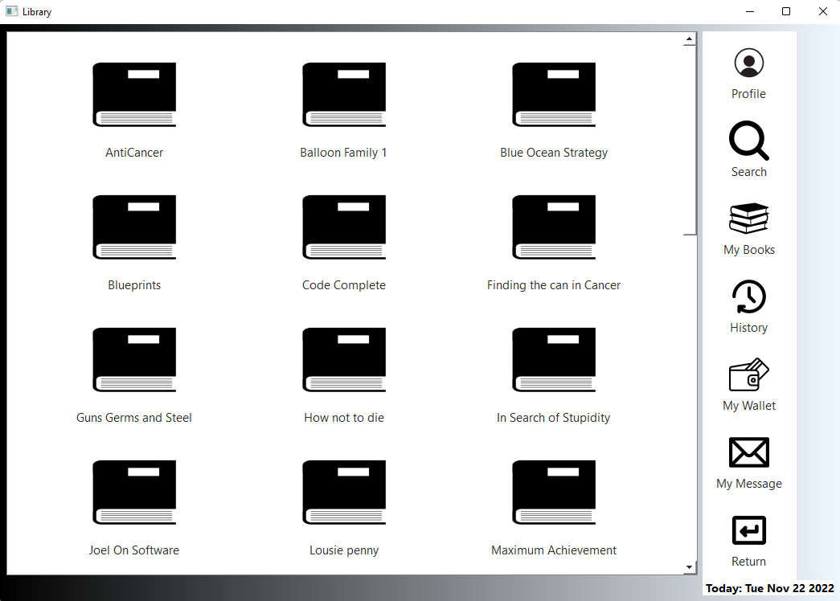
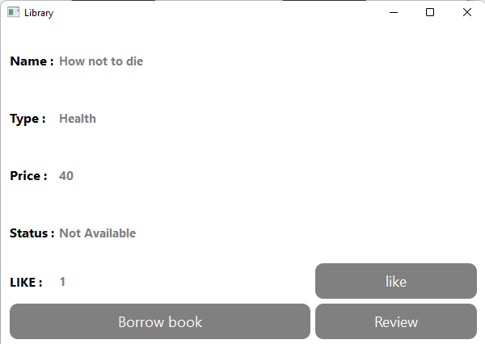
Book info interface
Member interface

Slide 20
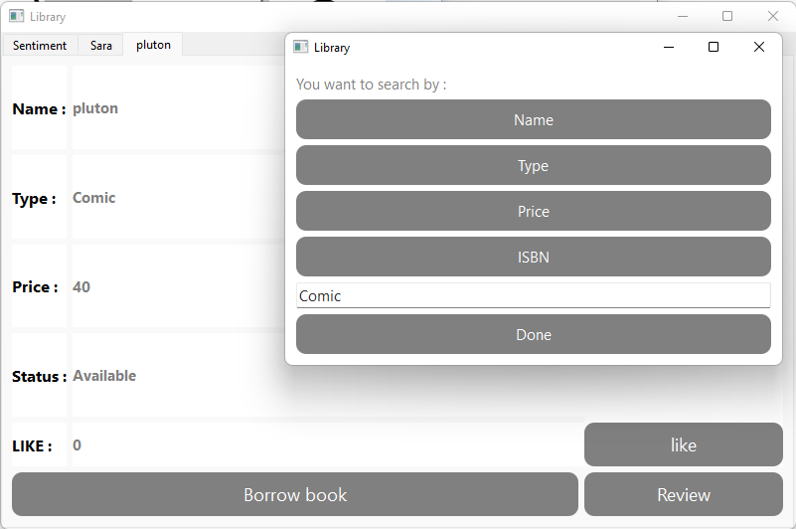
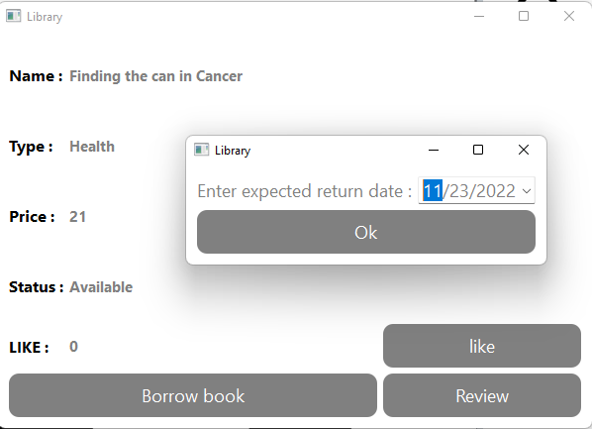
Search a book
Borrow a book

Slide 21
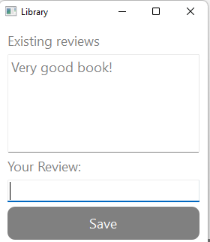
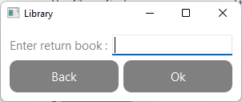
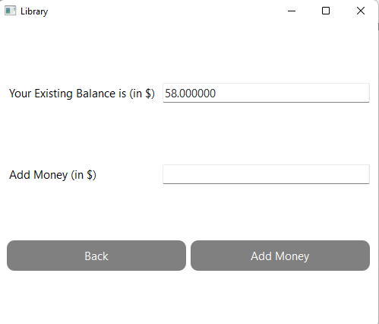
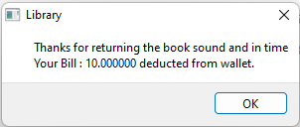
Write a book review
Return a book
Load the wallet

Slide 22
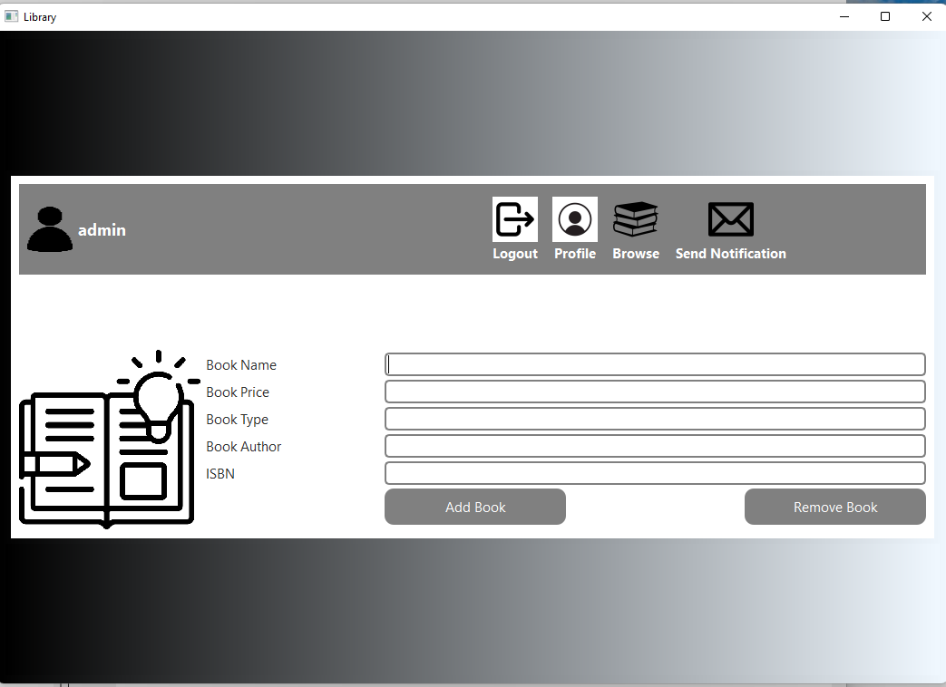
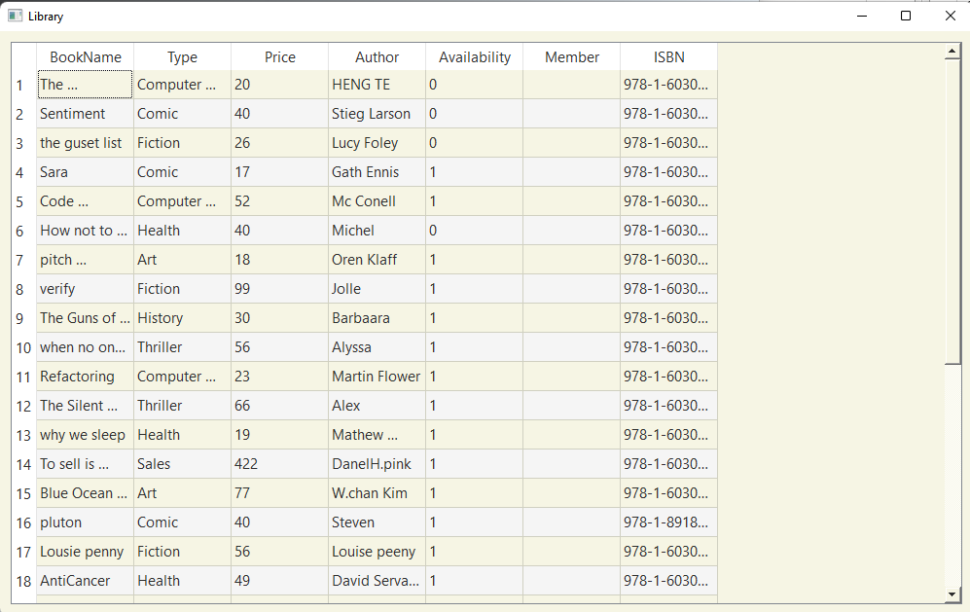
Admin interface
Browse books from admin interface

Slide 23
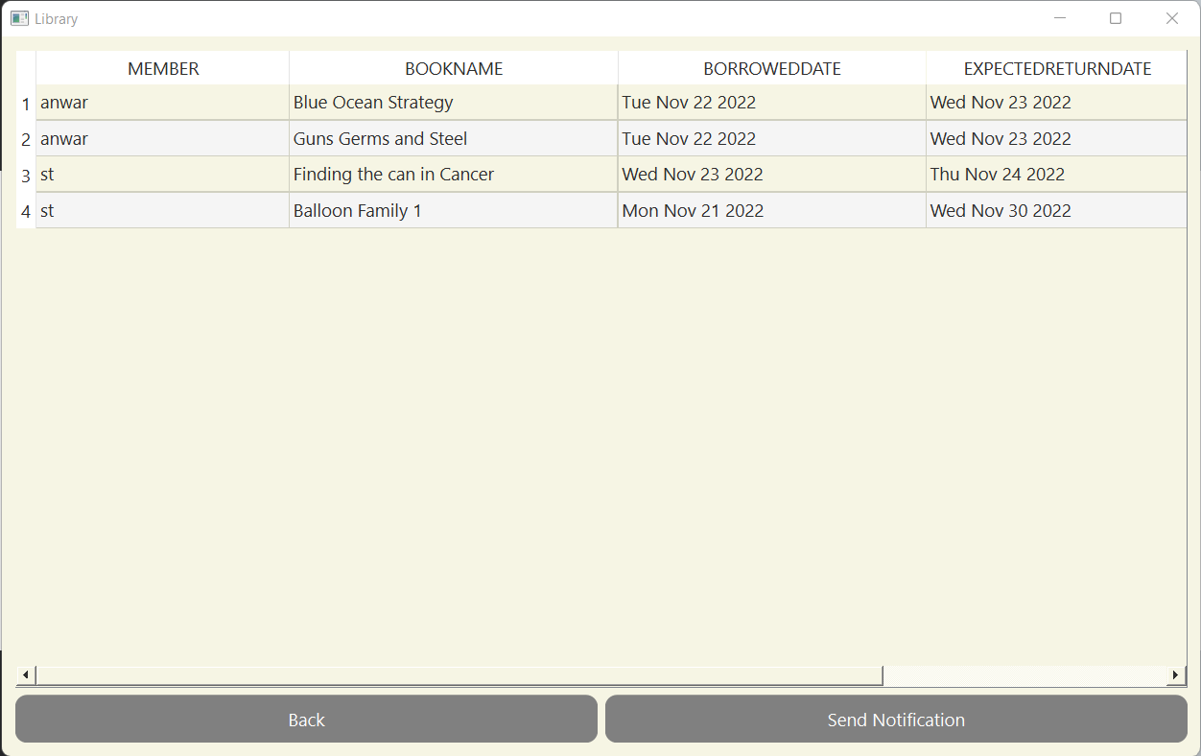
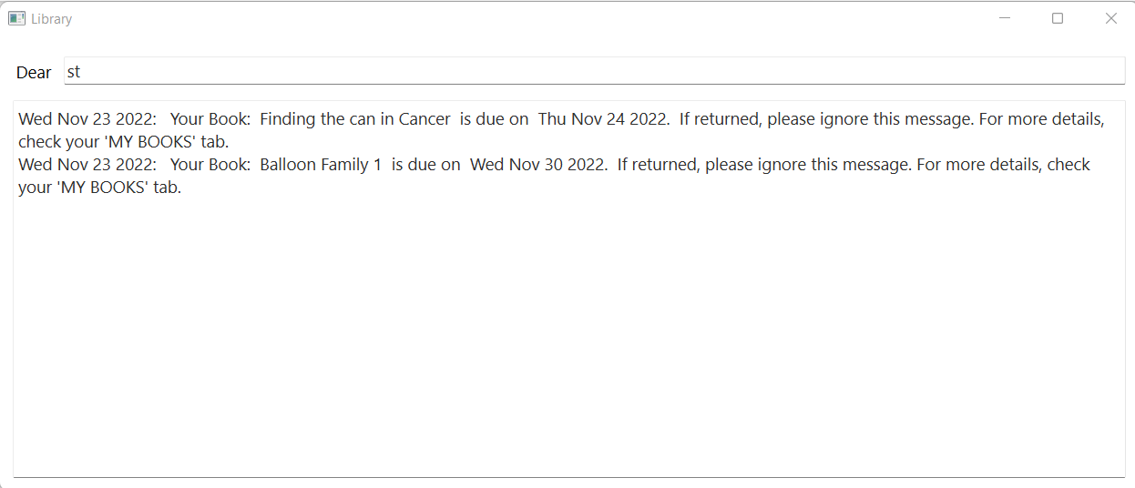
Send Notification Interface
My Message Interface in the member login

Slide 24
Thank you

