Slide 1

ALFIDO TECH
Frontend Developer Internship
FIRST REVIEW
Supervisor Details
Guide name : Mr.Jacob Navin kumar J
Department of CSE
School of Technology
The Apollo University
Students Details
Name :B.Sruthi
reg.no:122411510118
Program: CSE-A

Slide 2
ABSTRACT
This internship was conducted at Alfido Tech as a Frontend Developer Intern for a duration of two months. The primary objective was to gain practical knowledge in frontend web development and understand real-world web project workflows.
During the internship, I learned and applied technologies such as HTML, CSS, and JavaScript to design and develop responsive web pages. I successfully completed two major projects:
1. A professional personal portfolio website with sections for About, Skills, Projects, Education, and Contact, incorporating interactive features like smooth scrolling, navigation highlighting, and scroll-based animations.
2. An advanced to-do list application demonstrating DOM manipulation, event handling, and local storage implementation.
The internship strengthened my understanding of web development concepts, improved problem-solving abilities, and provided hands-on experience in building user-friendly interfaces. I developed strong technical skills, project planning abilities, and confidence in developing frontend applications independently.

Slide 3
INTRODUCTION
Frontend development focuses on designing and developing the user interface of websites.
It improves user experience through responsive and interactive web pages.
Modern websites require attractive design and smooth functionality.
HTML, CSS, and JavaScript are core technologies used in frontend development.
This internship provided practical experience in developing real-world web applications.
6. This internship enhanced technical knowledge, problem-solving abilities, and confidence in developing real-world web applications.

Slide 4
Problem statement
Clear and concise definition of the problem:
Students often have theoretical knowledge of web development but lack practical experience in building real-world web applications.
Existing system limitations:
Limited hands-on exposure to frontend technologies.
Lack of experience in responsive design, API integration, and project deployment.
Insufficient knowledge of version control tools like Git and GitHub.
Need for the proposed solution:
To gain practical frontend development skills through real-time projects.
To learn how to design responsive and interactive websites.
To understand industry-standard tools and workflows, including Git, GitHub, and project deployment.

Slide 5
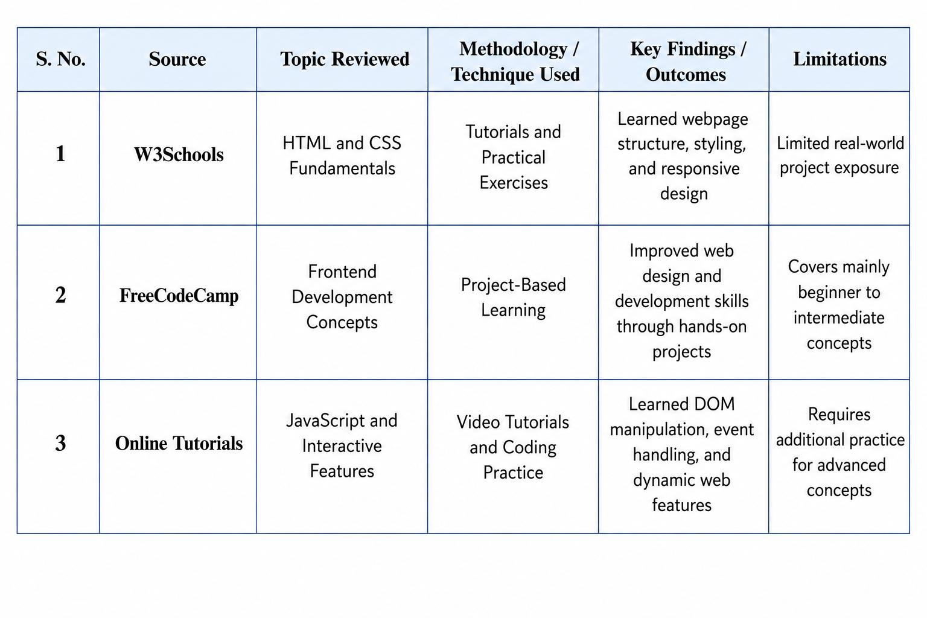
LITERATURE REVIEW

Slide 6
EXISTING SYSTEM
Existing Learning Method | Limitations
Theory-based learning | Less practical exposure
Static web pages | Limited interactivity
No deployment practice | No real-world experience
Basic coding exercises | Limited project knowledge

Slide 7
OBJECTIVES
To design and develop responsive and user-friendly web applications using HTML, CSS, and JavaScript.
To improve frontend development skills through hands-on project implementation and real-world problem solving.
To gain practical experience in DOM manipulation, API integration, and responsive web design.
To learn version control and project management using Git and GitHub.
To deploy web applications using GitHub Pages and understand the complete development workflow.
To evaluate the developed projects based on functionality, responsiveness, usability, and performance.

Slide 8
PROPOSED SYSTEM
Learning Resources
↓
HTML & CSS
↓
Responsive Portfolio Website
↓
To-Do List Application
↓
Git & GitHub
↓
GitHub Pages Deployment
↓
Frontend Developer Skills
Advantages:
Practical learning
Responsive design experience
GitHub knowledge
Deployment experience
Better UI development skills

Slide 9
SYSTEM ARCHITECTURE
📚 Learning Resources
(W3Schools, FreeCodeCamp, Online Tutorials)
↓
💻 HTML & CSS
↓
🎨 Responsive Portfolio Website
↓
📝 To-Do List Application
↓
🐙 Git & GitHub Version Control
↓
🚀 GitHub Pages Deployment
↓
👨‍💻 Frontend Developer Skills

Slide 10
WORK COMPLETED SO FAR
6/8
2/4
50%
Weeks Covered
Projects Completed
Task Completion
🌐 Live Website Link
Portfolio Project:
https://sruthi0622.github.io/Alfido-TechInternship/Portfolio/
Main Internship Homepage:
https://sruthi0622.github.io/Alfido-Tech-Internship/
To-Do List Project:
https://sruthi0622.github.io/Alfido-Tech-Internship/todo-list/

Slide 11
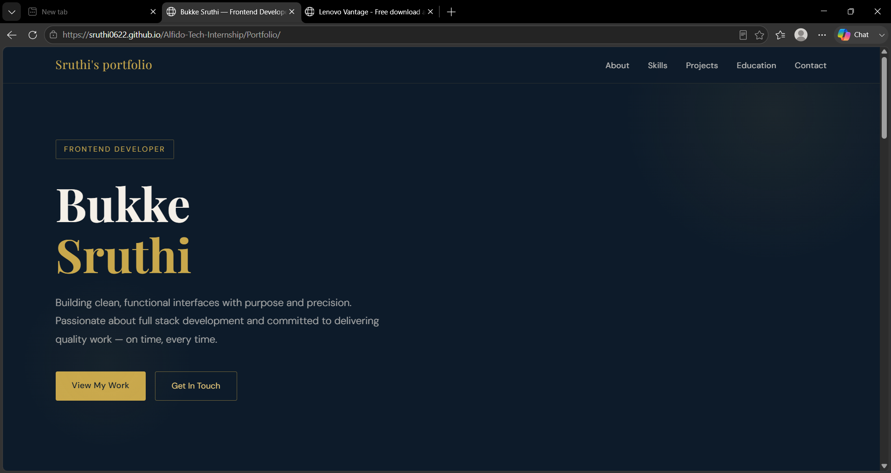
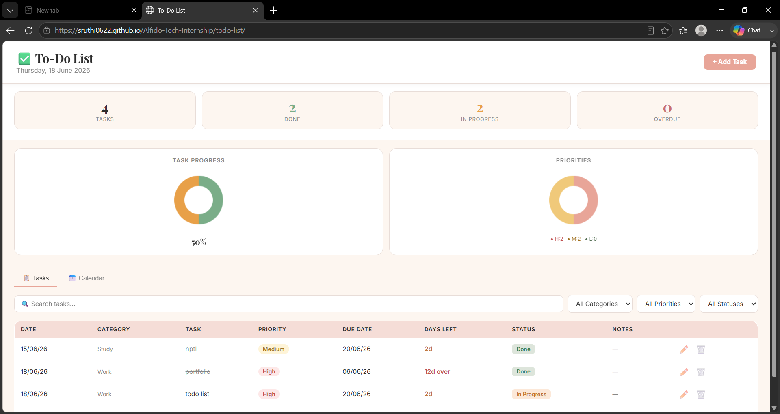
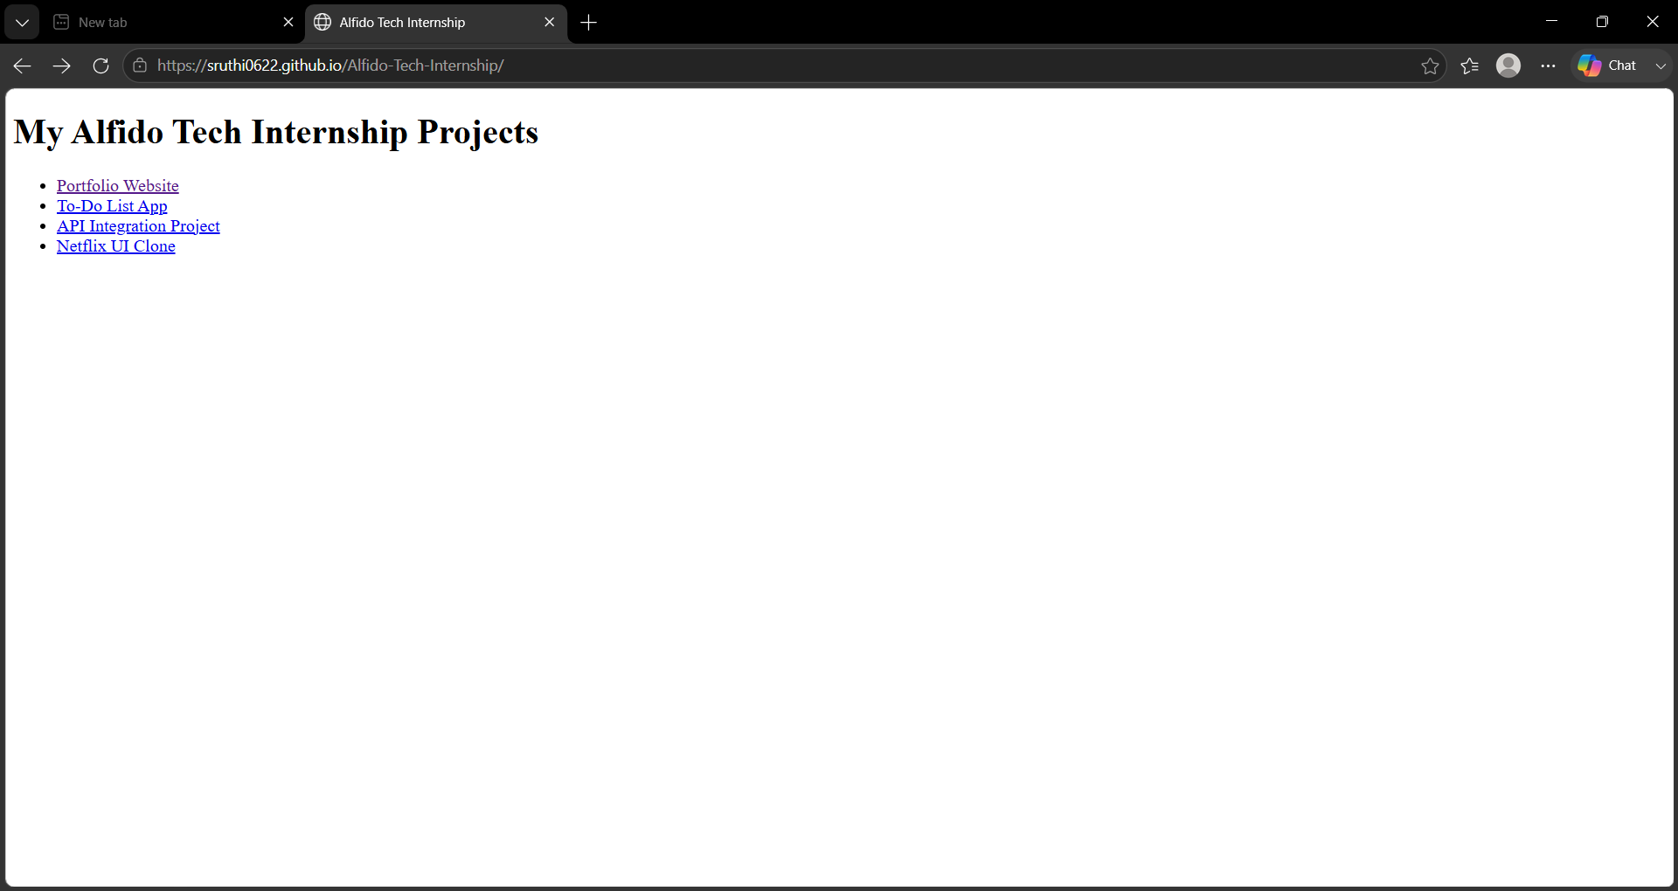
Output Section
Portfolio Website Output
To-Do List Application Output
Internship Homepage Output

Slide 12
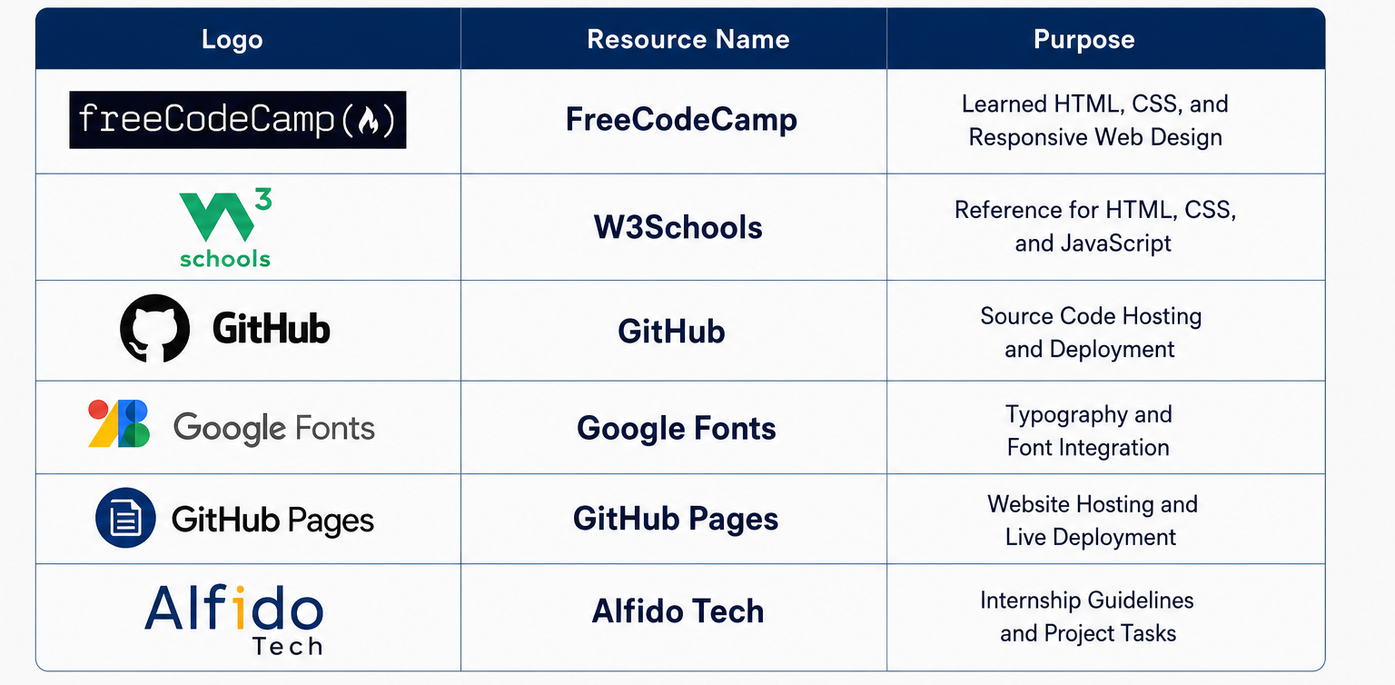
REFERENCES

Slide 13
THANK YOU

