Slide 1
Business Dashboard Summary
Global Superstore | Generated by ChatGPT

Slide 2
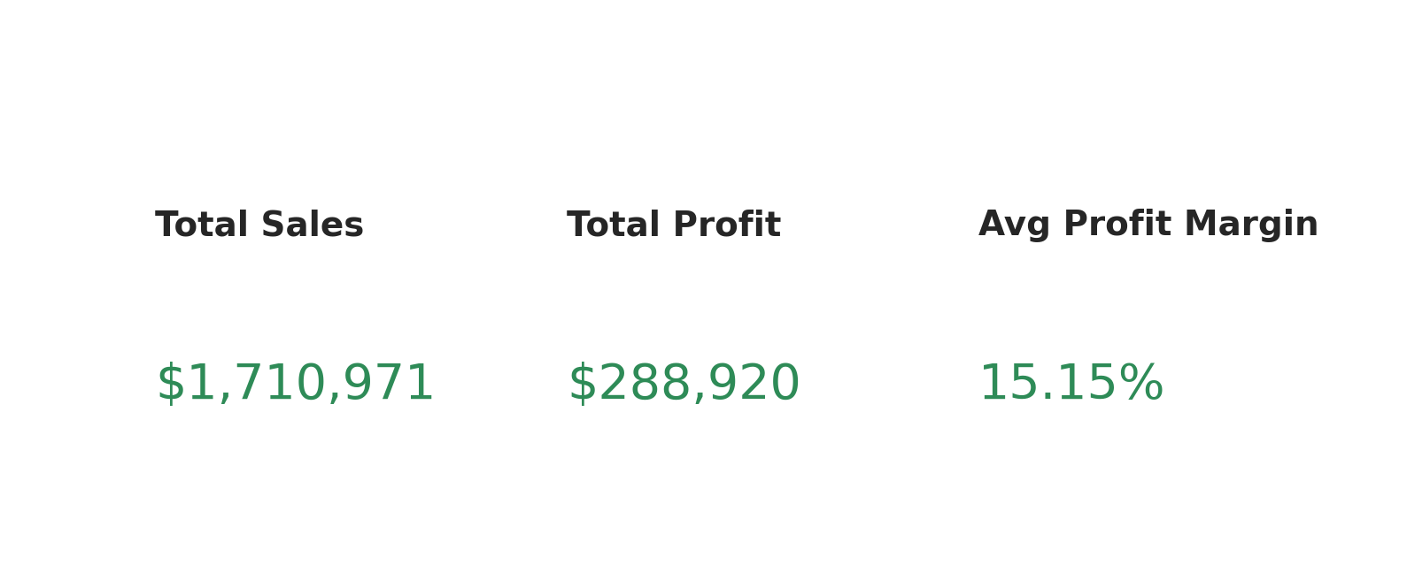
KPI Summary

Slide 3
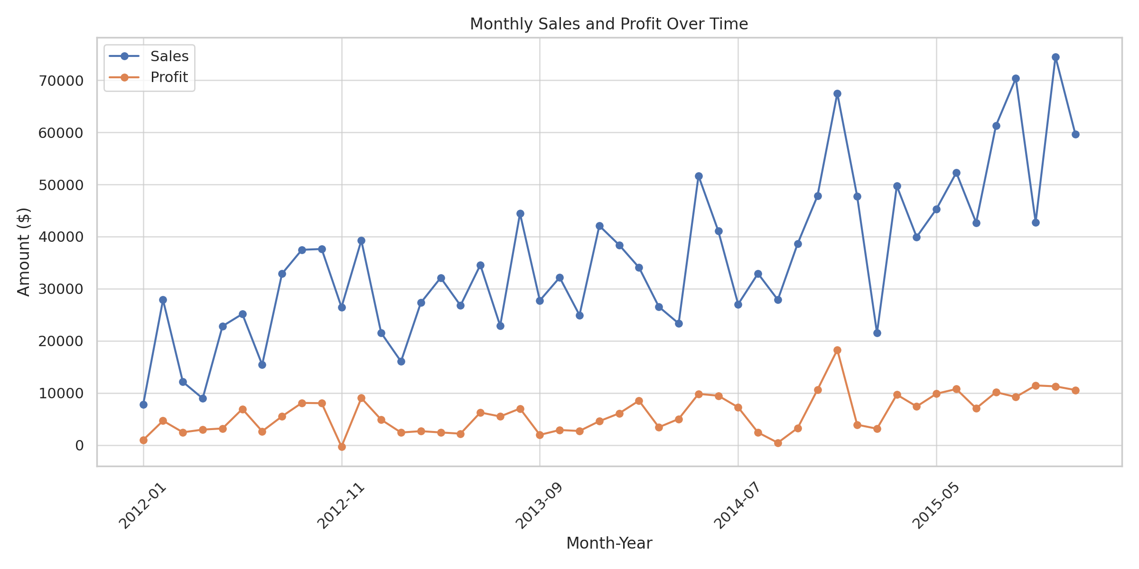
Monthly Sales and Profit

Slide 4
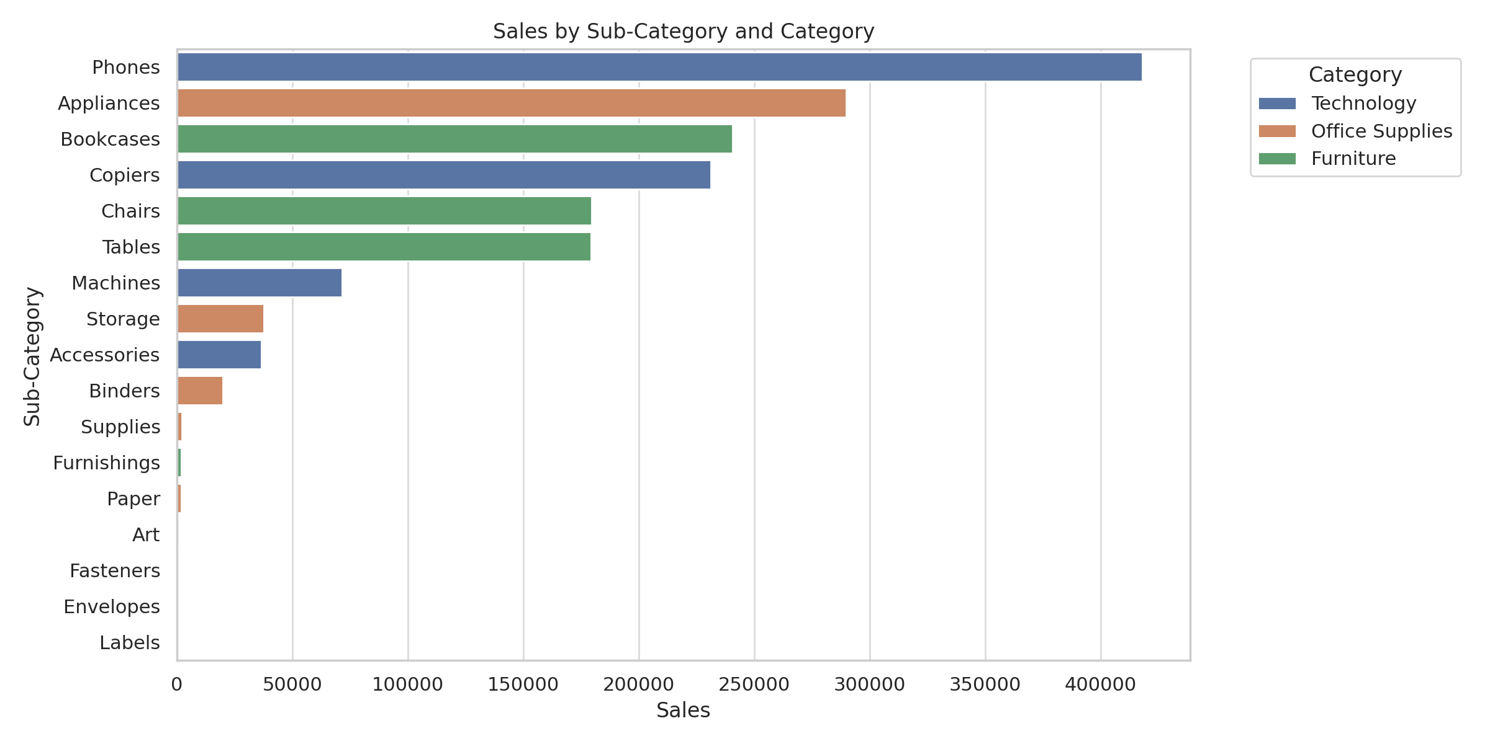
Sales by Sub-Category

Slide 5
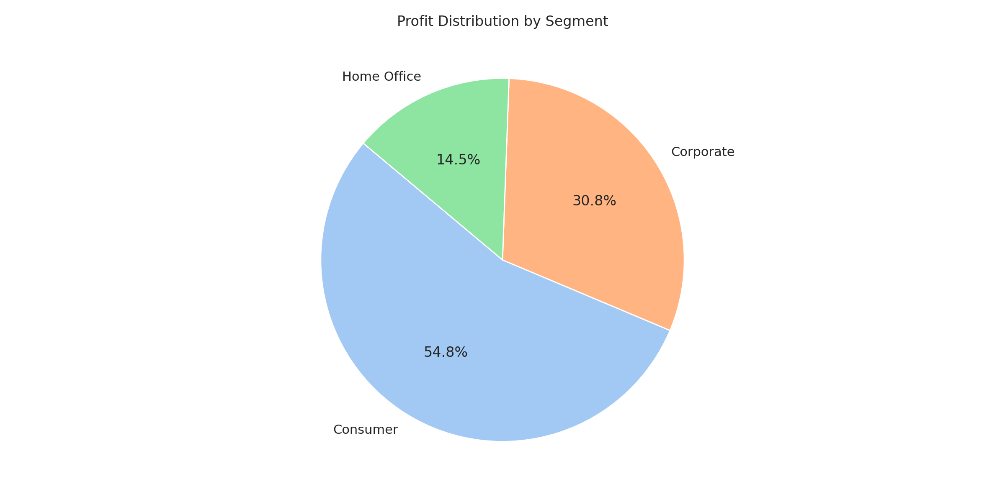
Profit by Segment

