Slide 1

Portfolio Optimization with Machine Learning Techniques
DATA 690 Special Topics in Data Science (06.2278) SP2025
Professor Abdullah Karasan
Team Members:
Sruthi Kapudasi
Harshitha Josyula

Slide 2
Introduction
Traditional portfolio optimization relies on Modern Portfolio Theory (MPT).
This project enhances portfolio performance by integrating machine learning:
Time series forecasting (ARIMA models)
Unsupervised learning (clustering)
Monte Carlo simulation
Multi-strategy integration
Goal: Improve risk-adjusted returns beyond traditional methods.

Slide 3
Motivation
Why Portfolio Optimization?
1. Real-world investment decisions are complex and influenced by market volatility.
2. Helps maximize returns while minimizing risk.
3. Increasing importance in personal finance and institutional investments.

Slide 4
Data and Methodology
Dataset:
30 stocks across 6 sectors (2018-2023)
Daily prices from Yahoo Finance
5 stocks each from
Technology, Financials, Healthcare, Energy, Consumer Staples, Consumer Discretionary
Optimization Strategies:
Traditional MPT
Cluster-Based
Monte Carlo
Integrated Approach

Slide 5
Time Series Forecasting
Top Forecasted Annual Returns (ARIMA):
AAPL: 31.49%
MSFT: 30.07%
COP: 24.74%
AMZN: 22.06%
Forecasting Insights:
Identified high-potential assets
Forecasts aligned with actual performance
Combined forecasts with historical data for improved predictions.
COST: 25.51%

Slide 6
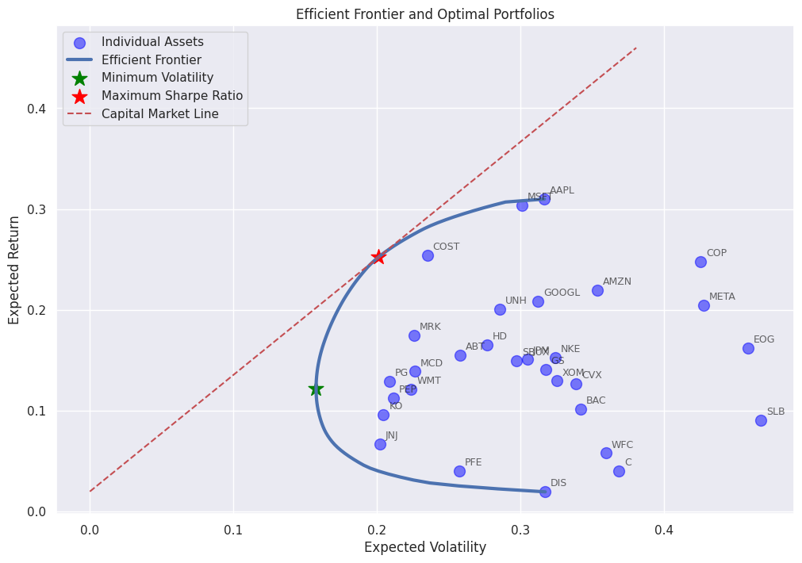
TRADITIONAL MPT(Mean-Variance Portfolio Theory)
Efficient Frontier Visualized: The curve illustrates optimal portfolios offering the highest expected return for each level of risk, helping investors make data-driven allocation decisions.
Maximum Sharpe Ratio Portfolio: Identified by the red star, this portfolio delivers the best risk-adjusted returns and lies on the Capital Market Line (CML), representing the ideal portfolio for most investors.
Minimum Volatility Portfolio: Highlighted by the green star, this portfolio minimizes risk but offers lower returns, which is ideal for conservative, risk-averse investors.
Capital Market Line (CML): Shows the best possible combinations of risk-free assets and the market portfolio, outperforming inefficient portfolios below the line.

Slide 7
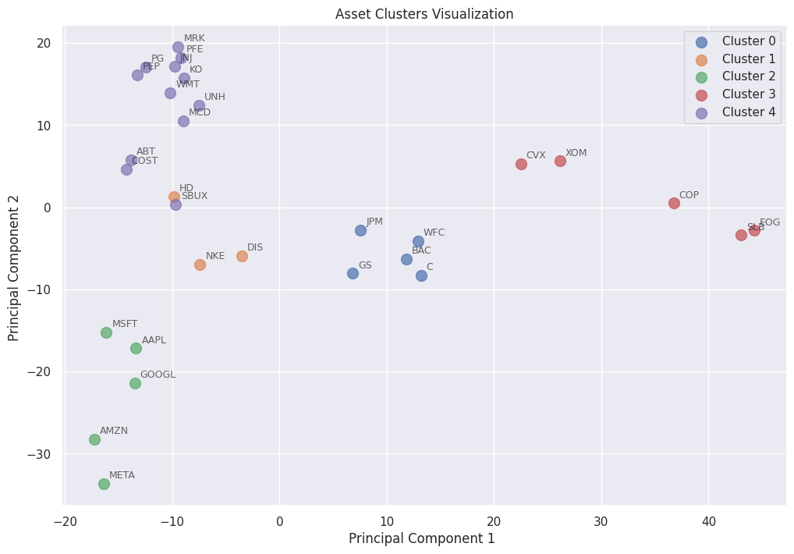
Key Insights for Asset Clustering Results
Cluster 2 (High-Growth Tech Stocks): Highest average return (~25%) and best risk-adjusted performance (Sharpe Ratio 0.75); ideal for aggressive growth portfolios.
Cluster 4 (Stable Blue-Chip Stocks): Largest cluster with low volatility and solid returns (~13.66% return, Sharpe 0.58); suitable for conservative investors.
Cluster 1 (Balanced Performers): Moderate returns (~11.25%) with decent risk control; fits balanced investment strategies.
Cluster 3 (High Risk, Moderate Return): Higher returns (~15.15%) but with the highest volatility (~40%); caution advised.
Cluster 0 (Underperformers): Lowest returns (~9.85%) and poor risk-return profile (Sharpe 0.30); best avoided or kept at minimal exposure.
Clustering revealed market segments transcending traditional sector classifications.

Slide 8
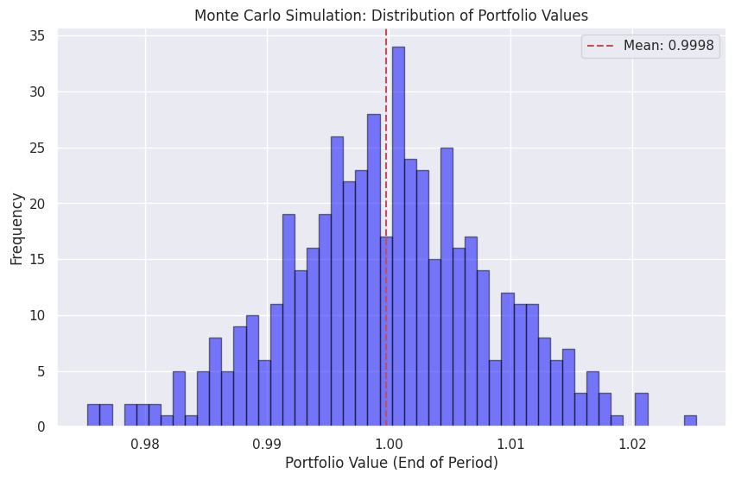
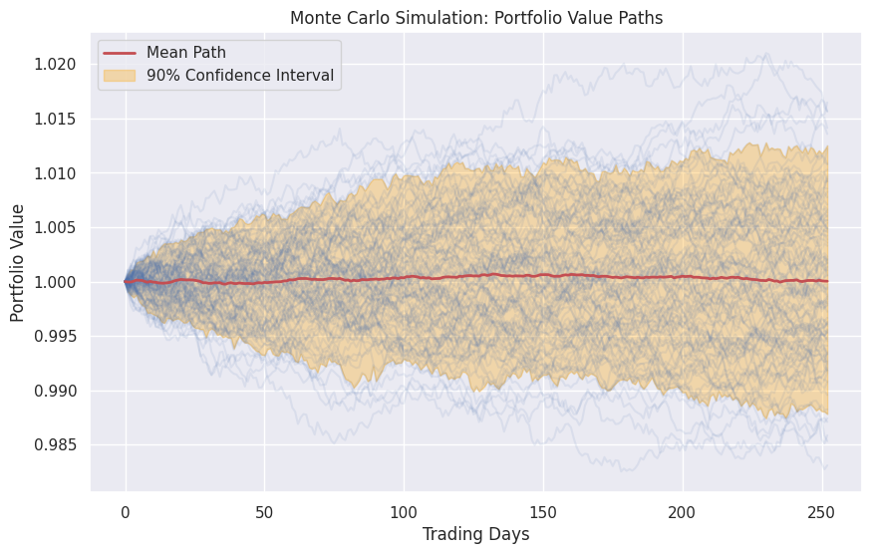
Monte Carlo and Traditional MPT Equivalence
Unexpected Finding:
Possible Explanations:
Return distributions were normal
Both methods found the same optimal solution
Simulation approach needs refinement.
Identical results for Monte Carlo and Traditional MPT.

Slide 9

Key Insights
ML Enhancement Value:
Cluster: +10.02 percentage points vs Traditional MPT
Integrated: +3.98 percentage points with the same Sharpe ratio
Strategic Diversification:
Quality of assets > quantity
Cluster approach delivered the highest performance
Integration Advantage:
Combined multiple techniques for balanced outcomes

Slide 10
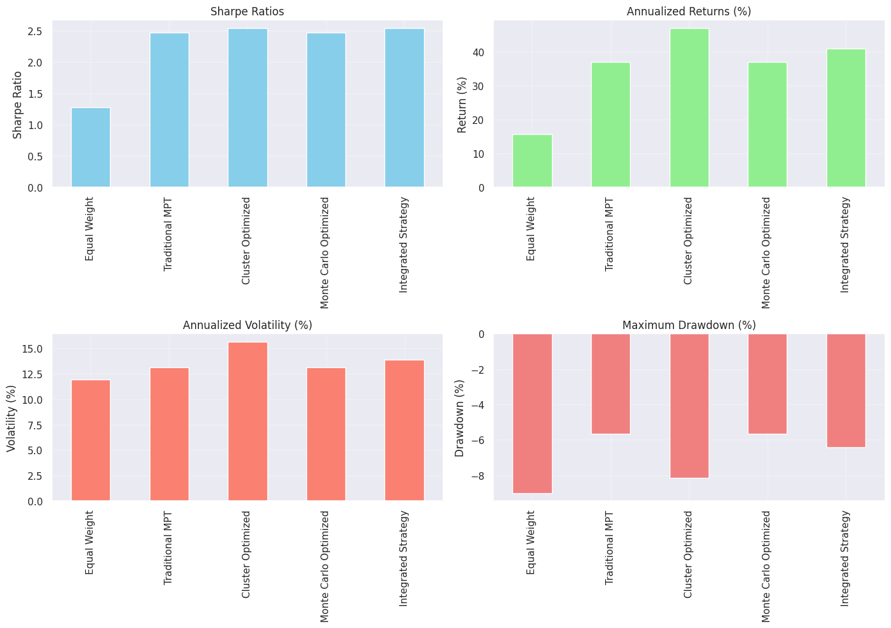
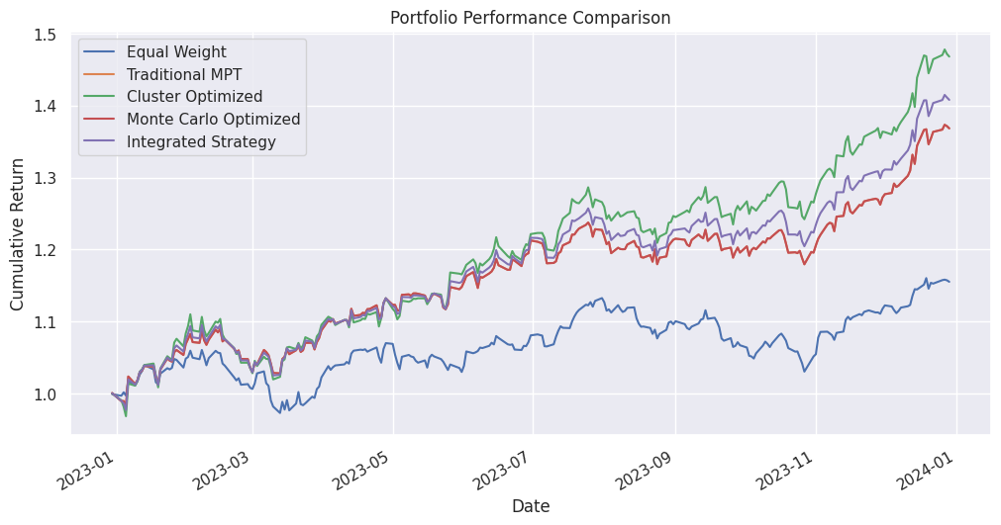
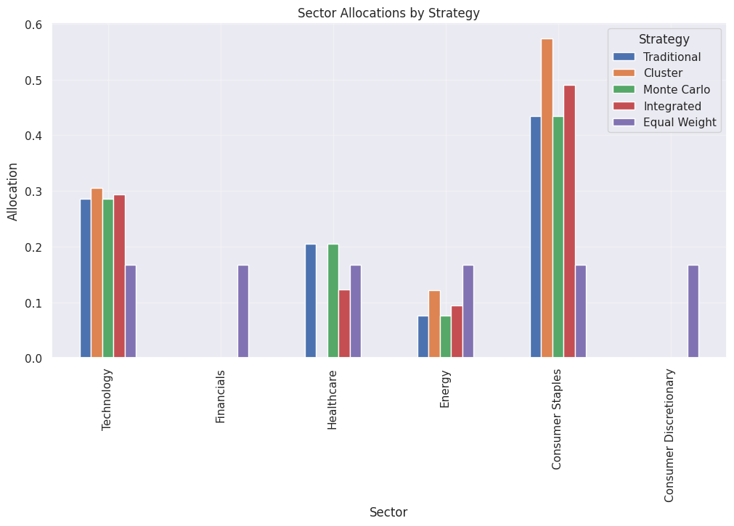
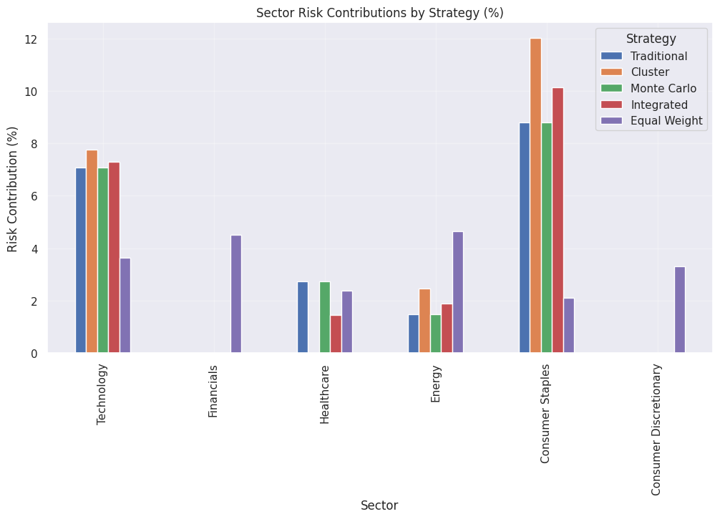
BACKTESTING PORTFOLIO STRATEGIES
Cumulative Return Comparison: The Cluster Optimized strategy consistently delivered the highest cumulative returns throughout the period, while the Equal Weight portfolio underperformed.
Performance Metrics (Sharpe, Return, Volatility, Drawdown): Cluster Optimized achieved the highest annualized return and Sharpe ratio, though it came with increased volatility. The Integrated Strategy provided a strong balance between risk and return.
Sector Allocations by Strategy: All optimization strategies favored Consumer Staples and Technology sectors, reflecting their strong historical performance and lower relative risk.
Sector Risk Contributions by Strategy: Due to their larger weight, Consumer Staples contributed the highest to portfolio risk across strategies despite their typically lower individual stock volatility.

Slide 11
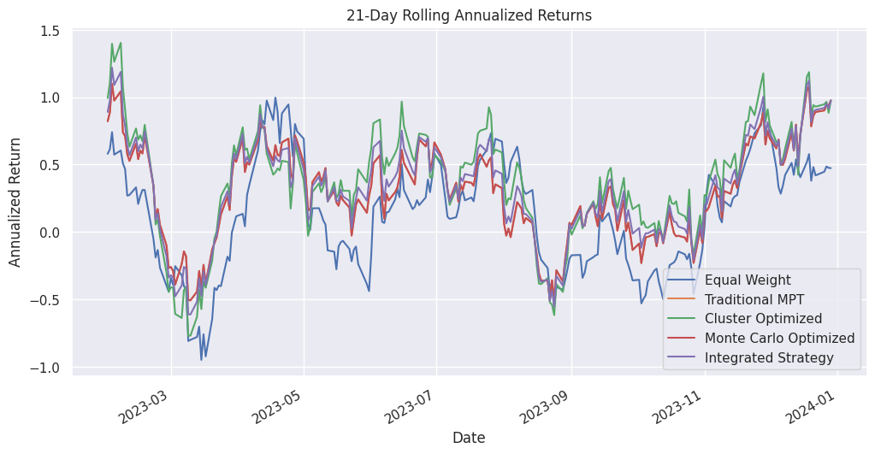
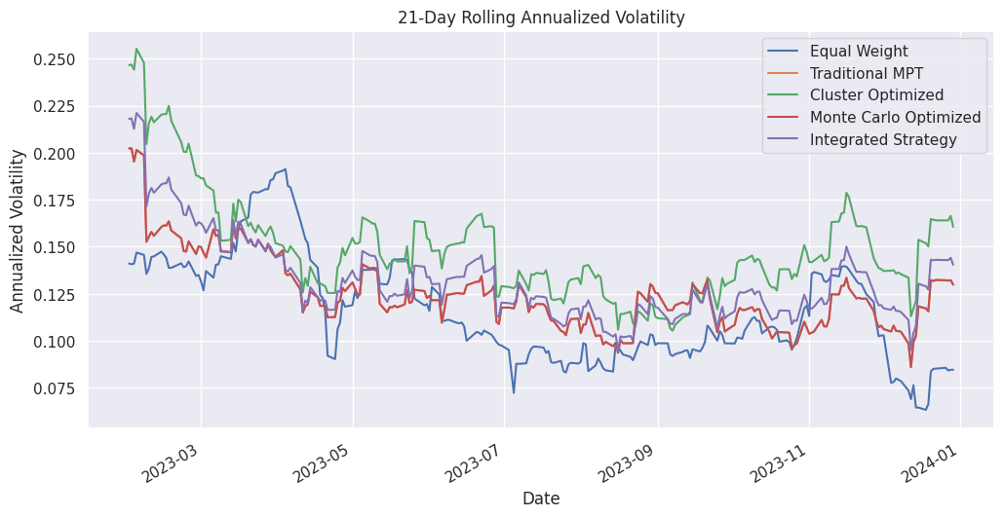
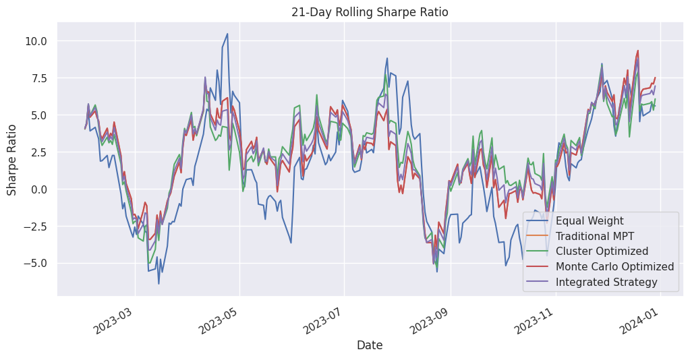
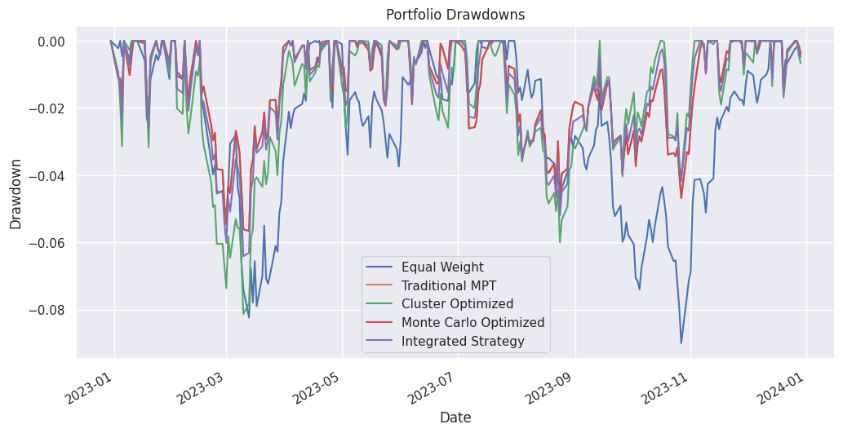
BACKTESTING PORTFOLIO STRATEGIES
Rolling Annualized Returns: Cluster Optimized and Integrated strategies demonstrated superior rolling returns, maintaining higher performance even during periods of market uncertainty.
Rolling Annualized Volatility: Monte Carlo and Integrated strategies maintained lower volatility throughout most of the period, while the Cluster Optimized strategy experienced higher fluctuations.
Rolling Sharpe Ratio: Optimized strategies sustained higher Sharpe ratios than the Equal Weight portfolio, indicating consistently better risk-adjusted performance.
8. Drawdown Analysis Cluster Optimized and Integrated strategies demonstrated better resilience during market downturns, recovering faster from losses, while the Equal Weight portfolio experienced the deepest and most prolonged drawdowns.

Slide 12
Performance Comparison
Strategy | Annual Return | Volatility | Sharpe | Max Drawdown
Equal Weight | 15.60% | 11.93% | 1.27 | -9.00%
Traditional MPT | 36.99% | 13.13% | 2.46 | -5.66%
Cluster Optimized | 47.01% | 15.66% | 2.54 | -8.14%
Monte Carlo | 36.99% | 13.13% | 2.46 | -5.66%
Integrated | 40.97% | 13.91% | 2.54 | -6.41%

Slide 13
Strategy Comparison for Different Investors
Cluster-Based: Best for Aggressive Investors
01
Traditional MPT: Best for Conservative Investors
02
Integrated: Best for Balanced Investors
03

Slide 14
Practical Applications
For Professionals:
Implement cluster-based selection
Use integrated optimization
For Individuals:
Focus on quality stocks
Avoid over-diversification.

Slide 15
Conclusions
ML techniques significantly enhance portfolio optimization
Cluster approach delivers the highest returns
Integrated strategy provides the best risk-adjusted performance
Strategic diversification outperforms naive diversification.

Slide 16
Future Research Directions
Implement concentration limits
01
Test across market regimes
02
Explore advanced time series models
03
Improve Monte Carlo simulations
04
Incorporate transaction costs and tax considerations.
05

Slide 17

Thank You!
Questions?

