Slide 1



StoreAnalysis
View in Power BI
Last data refresh:
10/22/2022 7:26:06 PM UTC
Downloaded at:
10/23/2022 12:11:02 AM UTC

Slide 2
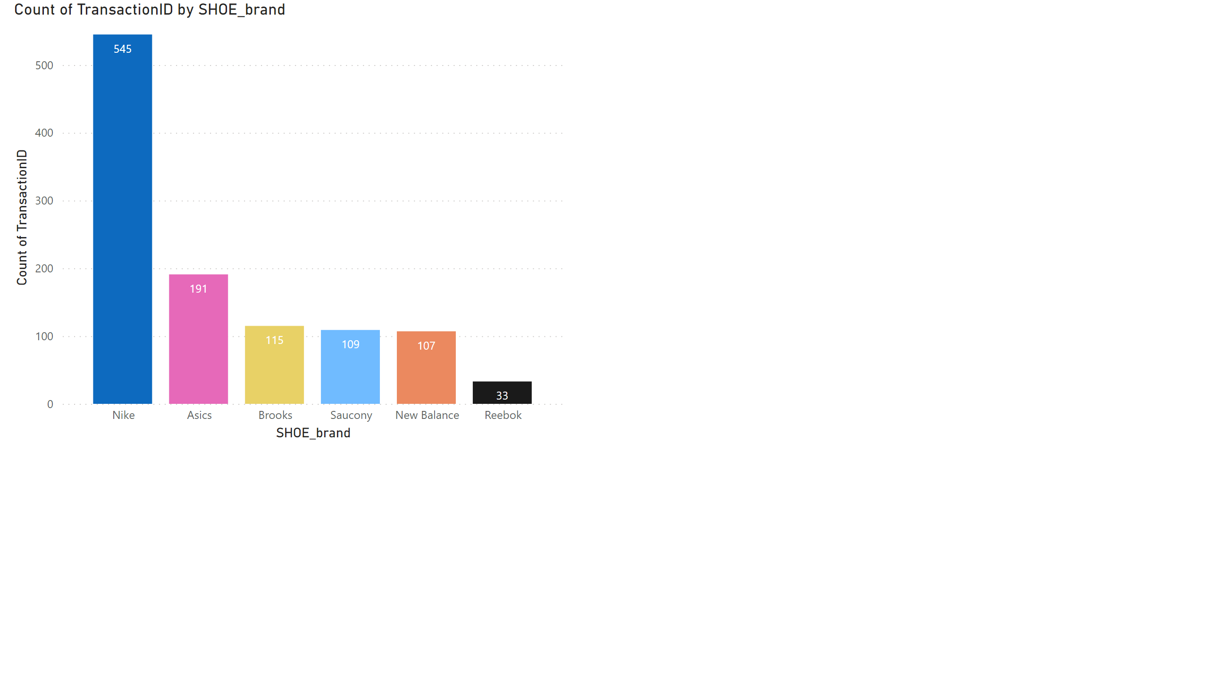
SalesVolumeByBrand
Notes:
The above chart is a column chart that shows Sales Volume by Brand.

Slide 3
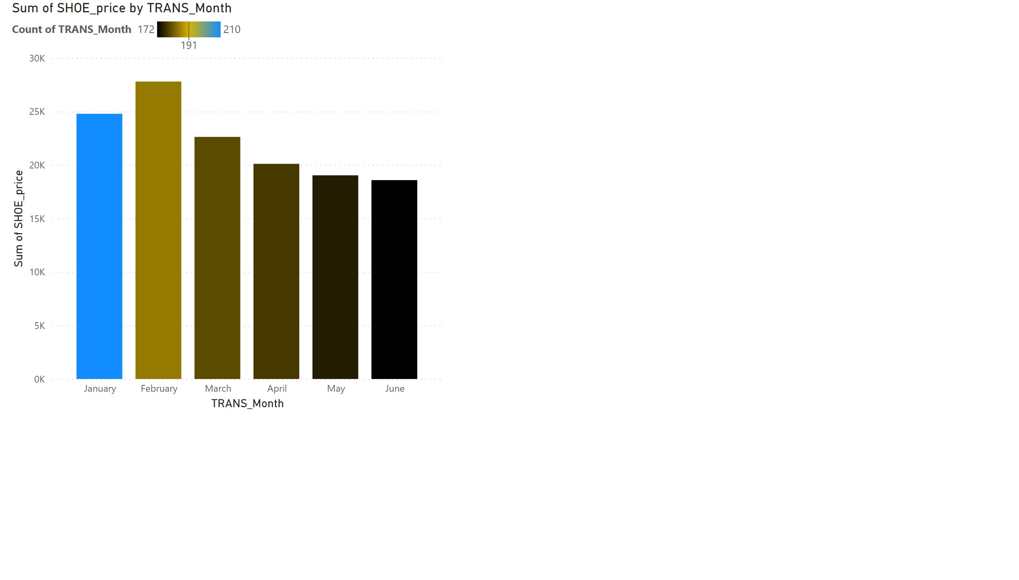
SalesRevenuebyMonth
Notes:
The above column chart shows Sales Revenue by Month.

Slide 4
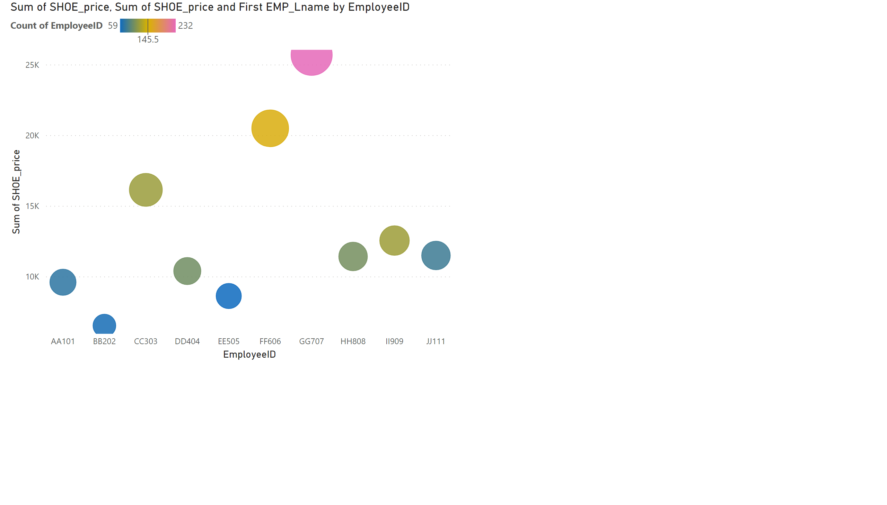
SalesRevenueBySalesPercent
Notes:
The scatter chart is similar to bubble chart and shows Sales Revenue by Sales Person.

Slide 5

MapByCustomer
Notes:
Map by Customer Revenue

