Slide 1

International Conference on Recent Advancement in Electrical, Computer and Communication Technologies
IECCT 2026
Comparative Analysis of Deep Learning Architectures for Bias-Aware Toxicity Classification.
Date – 11.04.2026
Paper ID - 352

Slide 2
Table of Contents
Abstract
Introduction
Literature Review
Objectives
System Modelling / Methodology
Results and Discussions
Conclusions
Future Scope
References

Slide 3
1. Abstract
Automated toxicity detection systems often exhibit unintended bias, falsely associating identity-related terms such as race, religion, and gender with harmful content. This paper compares two deep learning architectures, PH-MSA (Parallel Hybrid with Multi-Head Self-Attention), combining multi-scale CNNs and BiGRU, and TFRD (TinyBERT with Fairness-Regularized Distillation), a teacher-student framework with demographic fairness regularization, evaluated on the Jigsaw Unintended Bias dataset. Results show that PH-MSA achieves higher accuracy (95%) and precision (0.78), while TFRD delivers a superior macro-F1 score (0.80) with more balanced performance across identity groups, confirming that fairness-aware training is essential for equitable toxicity detection.

Slide 4
2. Introduction
Online platforms have become breeding grounds for toxic content, including hate speech and identity-based harassment, posing serious threats to vulnerable communities.
Deep learning models outperform traditional rule-based methods in toxicity detection, but two key challenges remain:
Capturing long-range contextual dependencies in text.
Mitigating unintended demographic bias, where models wrongly link identity terms (race, religion, gender) with toxicity.
Most existing models are optimized for classification accuracy alone, ignoring fairness across demographic groups. This study compares two architectures designed to tackle both challenges.
PH-MSA focuses on rich contextual feature extraction via parallel CNN and BiGRU. TFRD focuses on fairness through knowledge distillation with demographic regularization. Both models are evaluated on the Jigsaw Unintended Bias in Toxicity Classification dataset.

Slide 5
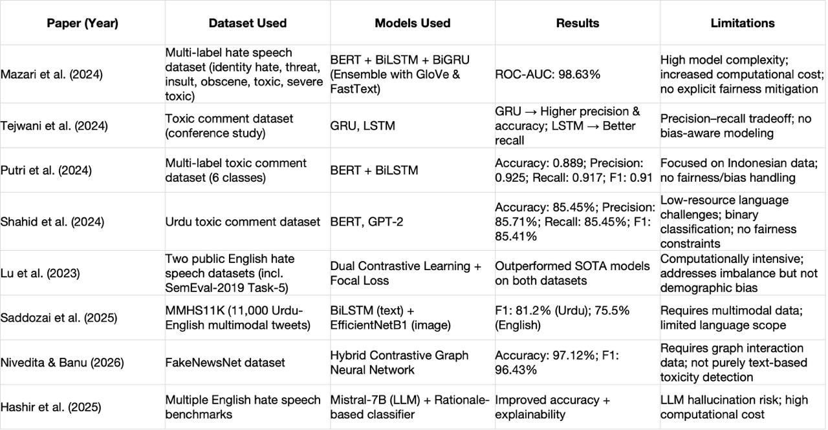
3.1 Literature Review

Slide 6
3.2 Research Gap and Key Contributions
Research Gaps:
Most existing toxicity detection models focus only on accuracy and F1-score, while largely ignoring demographic bias and offering little transparency in their decision-making process.
Although hybrid models improve classification performance, they still lack dedicated bias mitigation mechanisms, and very few studies have compared fairness-aware and architecture-driven approaches side by side.
There is also limited work on balancing precision-recall trade-offs with fairness, and almost no evaluation of these models from a real-world deployment or ethical AI standpoint.
Key Contributions:
We proposed two architectures — TFRD, which integrates fairness-regularized distillation with bias-aware loss, and PH-MSA, which captures both local and long-range contextual features using a parallel hybrid design.
Both models were systematically compared under identical experimental settings, evaluating not just classification performance but also fairness and real-world deployment trade-offs.
Our results show that TFRD performs better in Macro-F1 and minority class detection, while PH-MSA achieves higher precision, offering clear guidance on which model suits which deployment scenario.

Slide 7
4. Objectives
The key objects of this paper are to:
To design and implement a Parallel Hybrid Multi-Scale Attention (PH-MSA) architecture that captures both local lexical and long-range contextual features for toxicity classification.
To develop a Tiny BERT with Fairness-Regularized Distillation (TFRD) framework that explicitly minimizes demographic bias during training using identity-aware loss components.
To evaluate both models on the Jigsaw Unintended Bias dataset using standard metrics — accuracy, precision, recall, and macro-F1.
To assess fairness across identity subgroups by measuring FPR disparity, FNR disparity, and Equalized Odds Gap.
To perform a comparative analysis of both architectures in terms of classification performance, fairness, and deployment suitability.

Slide 8
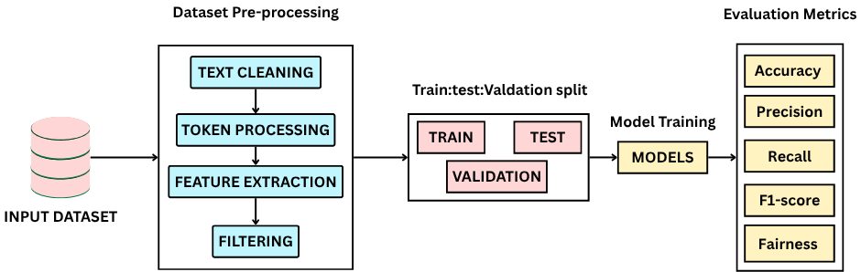
5. System Modelling / Methodology
The pipeline begins with data preprocessing — text normalization, removal of URLs, HTML tags and special characters, and binarization of toxicity scores using a threshold of 0.5
A stratified sample of 100,000 comments was drawn from the Jigsaw dataset, preserving the original 8% toxic and 92% non-toxic class distribution.
The pre-processed data was split and fed into two separate deep learning architectures, PH-MSA and TFRD, each trained under reproducible conditions with random seed 42.
Both models were evaluated using accuracy, precision, recall, macro-F1, and fairness metrics including FPR disparity, FNR disparity, and Equalized Odds Gap.

Slide 9
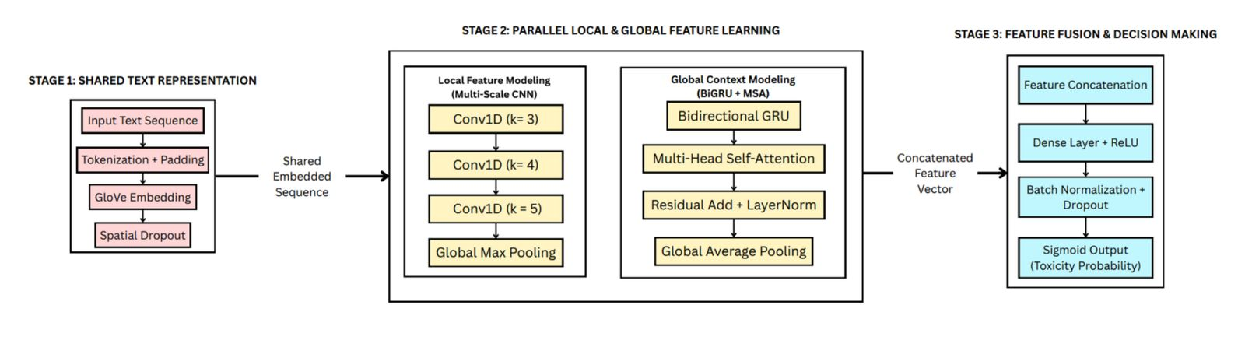
5.1 Proposed Model 1 — PH-MSA: Parallel Hybrid with Multi-Head Self-Attention
The PH-MSA (Parallel Hybrid with Multi-Head Self-Attention) model is designed to capture a comprehensive representation of text by simultaneously analyzing local patterns and global context. Unlike traditional sequential models, it uses a branched approach to ensure no critical features are lost during the encoding process.

Slide 10
Stage 1: Text Representation & Embedding:
Raw comments undergo standardized preprocessing—including normalization and URL removal—before being converted into token sequences. These sequences are mapped to 300-dimensional GloVe embeddings and passed through a Spatial Dropout layer to enhance model generalization.
Stage 2: Parallel Feature Learning (The Two-Branch Approach):
The embedded text is processed through two simultaneous channels to extract different types of linguistic information:
Local Branch (Multi-Scale CNN): Uses three parallel 1D-convolutional layers with kernel sizes of 3, 4, and 5 to identify local lexical patterns, such as specific toxic keywords or short phrases, followed by Global Max Pooling.
Global Branch (BiGRU + MSA): Employs a Bidirectional GRU to capture long-range dependencies, paired with a Multi-Head Self-Attention mechanism that weighs the importance of different words in a sentence. This branch concludes with Layer Normalization and Global Average Pooling.
Stage 3: Feature Fusion & Classification:
The outputs from both the CNN and BiGRU-Attention branches are merged into a single Concatenated Feature Vector. This integrated representation is fed through Dense layers with ReLU activation and a final Sigmoid function to determine the probability of toxicity.

Slide 11
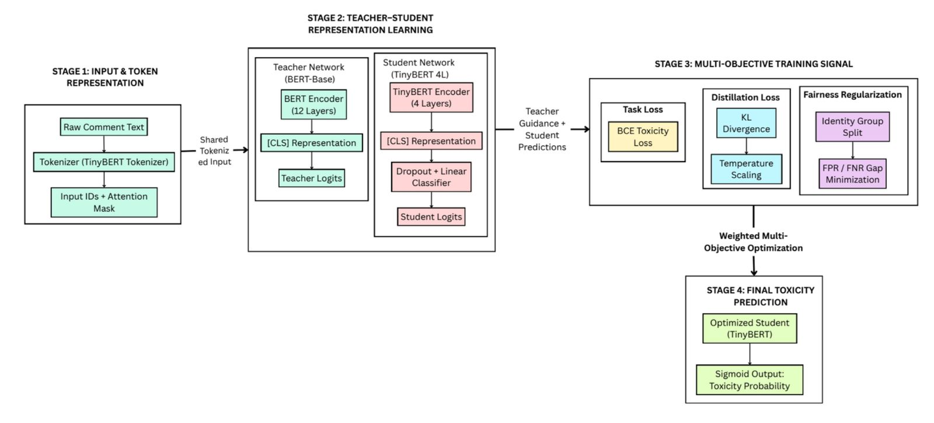
5.2 Proposed Model 2 — TFRD Methodology: Fairness-Regularized Distillation.
The TFRD (TinyBERT with Fairness-Regularized Distillation) framework focuses on creating a compact, high-performance model that actively mitigates demographic bias. It uses a teacher-student learning strategy to maintain the linguistic intelligence of large models while enforcing strict fairness constraints.

Slide 12
Stage 1: Input Representation & Teacher Guidance
Raw text is processed using the Tiny BERT tokenizer to generate input IDs and attention masks. The system employs a dual-network setup where a large, pre-trained BERT-base (12 layers) acts as a frozen teacher to provide high-level contextual logits that guide the learning of a smaller 4-layer Tiny BERT student.
Stage 2: Multi-Objective Training & Distillation:
The student model is optimized using a weighted combination of three distinct signals to balance accuracy and equity.
Task Loss: Standard binary cross-entropy to ensure correct toxicity classification.
Distillation Loss: Uses KL Divergence and temperature scaling to align the student’s predictions with the teacher's nuanced understanding.
Fairness Regularization: Specifically designed to minimize the "gap" in error rates (False Positive/Negative rates) across different identity groups, such as race or religion.
Stage 3: Optimized Prediction:
The final output is produced by the distilled Tiny BERT student, which passes the processed features through a Dropout layer and a Linear Classifier. A Sigmoid function then converts these signals into a final toxicity probability, resulting in a model that is both computationally efficient and socially responsible.

Slide 13
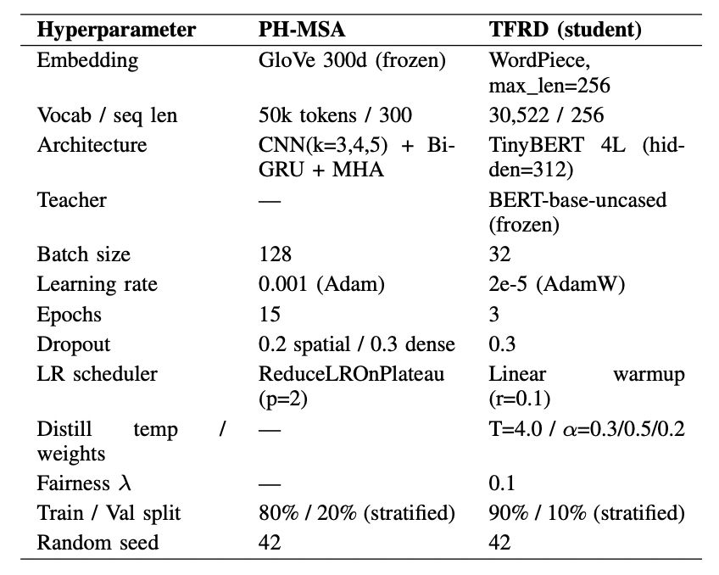
5.3 Hyperparameter Comparison
Both models trained on the same 100,000-sample Jigsaw subset with random seed = 42 for reproducibility.
Training hyperparameters differ by architectural necessity, transformer fine-tuning requires smaller learning rate and fewer epochs to avoid catastrophic forgetting of pre-trained weights.
Best checkpoint selected based on validation AUC for both models.

Slide 14
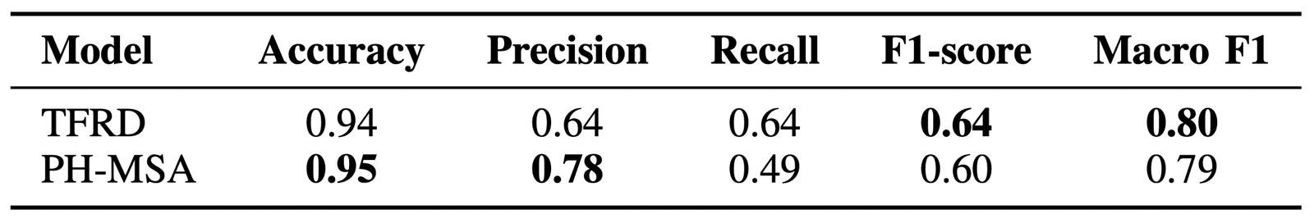
6. Results and Discussions
PH-MSA achieves higher accuracy (95%) and precision (0.78) — very few false positives but misses many toxic comments due to low recall (0.49).
TFRD achieves balanced precision and recall (both 0.64) with superior Macro-F1 (0.80) — better overall performance across both classes.
Under class imbalance, Macro-F1 is a more reliable metric than accuracy — TFRD is the stronger model by this measure.

Slide 15
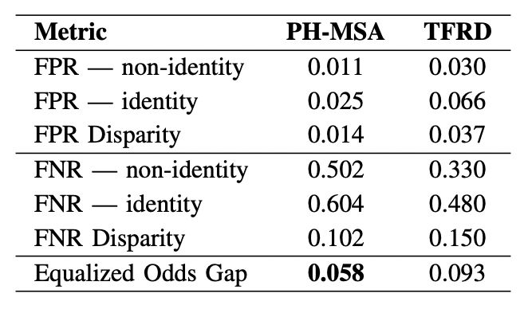
PH-MSA achieves lower Equalized Odds Gap (0.058 vs 0.093), fairer across identity groups despite having no explicit fairness loss.
TFRD's fairness regularization improved recall balance but caused higher FPR disparity — distillation loss and fairness loss competed during training.
FNR disparity exists in both models, unavoidable when detecting toxic comments referencing identity terms in the Jigsaw dataset.
Architectural hybridization and fairness regularization are complementary, neither alone fully resolves demographic bias.

Slide 16
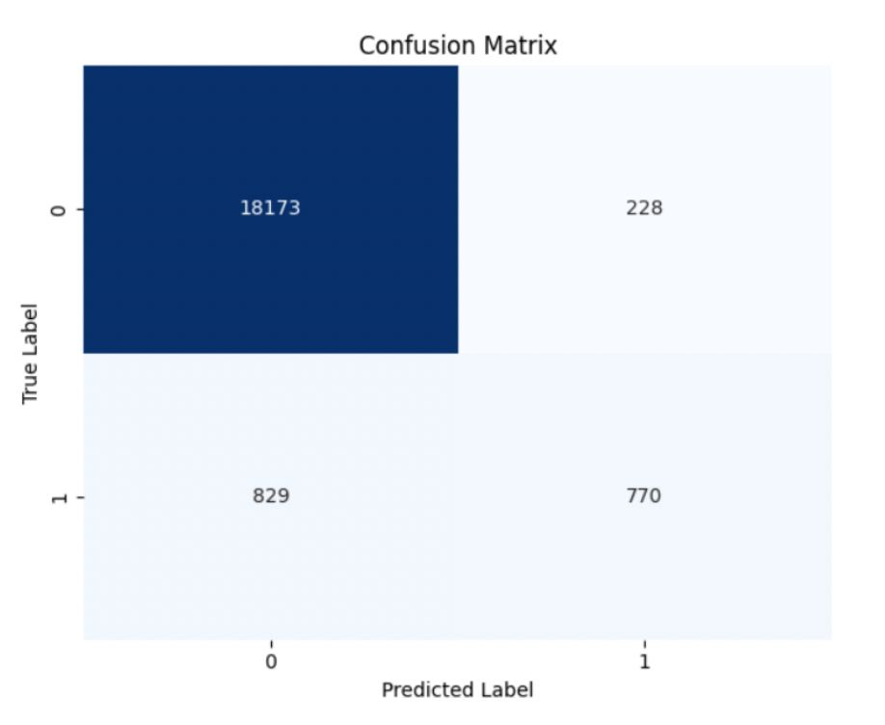
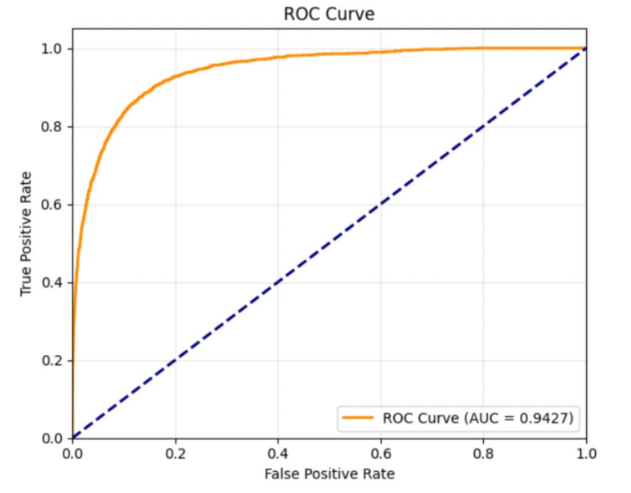
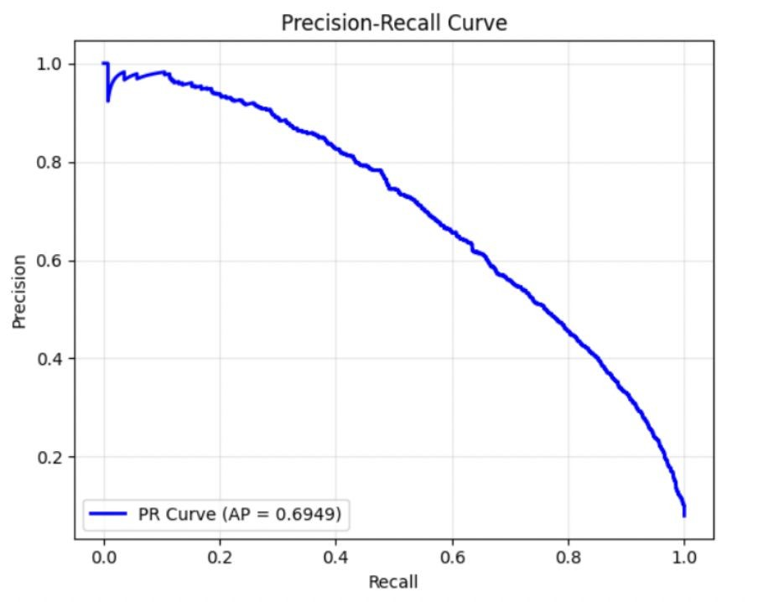
Model Behaviour Under Class Imbalance :PH-MSA
AUC = 0.9427 indicates strong but slightly lower separability than TFRD.
PR-AUC = 0.6948, precision drops sharply after recall = 0.4.
FN = 829 indicates the model misses a large portion of actual toxic content.

Slide 17
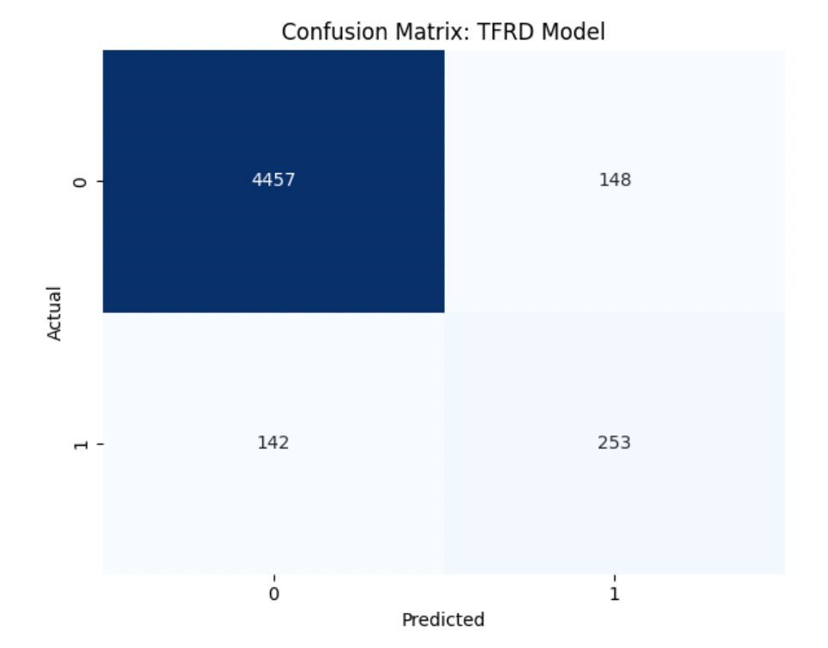
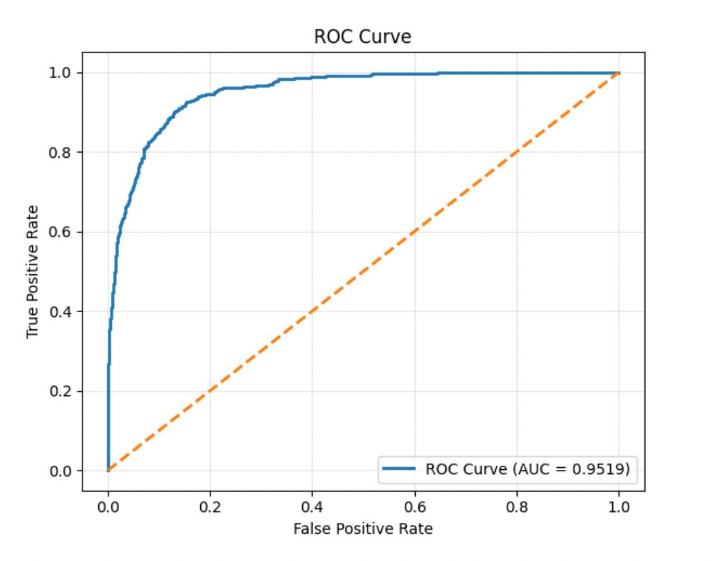
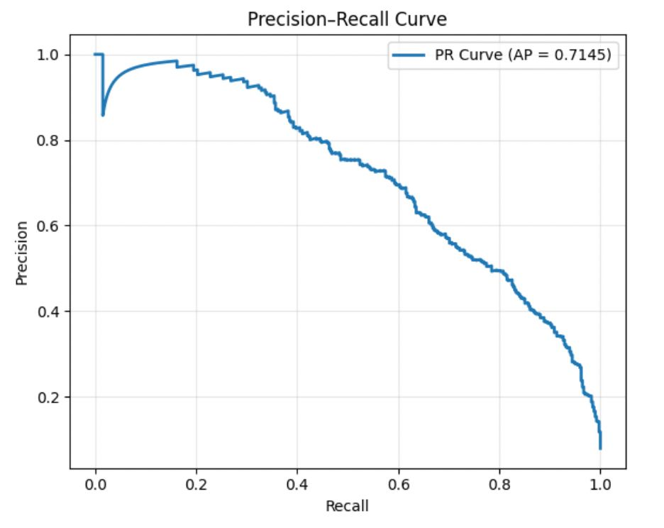
Model Behaviour Under Class Imbalance : TFRD
AUC = 0.9513, ROC curve hugs top-left corner indicating strong separability.
PR-AUC = 0.7345 shows that the proposed TFRD model maintains high precision across recall range.
FN = 142 indicates that the model misses fewer toxic comments.

Slide 18
7. Conclusions
PH-MSA achieves higher accuracy (95%) and precision (0.78), making it suitable for scenarios where minimizing false positives is critical.
However, PH-MSA's low recall (0.49) limits its ability to detect all toxic content which is a significant drawback in safety-critical deployments.
TFRD achieves superior Macro-F1 (0.80) with balanced precision and recall, demonstrating that fairness-conscious training is an effective approach for mitigating identity bias.
Fairness-regularized distillation proves to be a strong alternative to architectural complexity alone for building equitable toxicity detection systems.

Slide 19
8. Future Scope
Evaluate both models on additional benchmark datasets such as Civil Comments and HatEval to assess generalizability across domains.
Extend models to account for overlapping and intersectional identity categories as targets of hate speech often belong to multiple marginalized groups simultaneously.
Incorporate Explainable AI (XAI) techniques to improve interpretability of model predictions which is essential for transparent and trustworthy deployment in real-world moderation systems.

Slide 20
9. References
[1] S. Khapre, M. A. Mersha, H. Shakil, J. Baruah, and J. Kalita, “Toxicity in online platforms and AI systems: A survey of needs, challenges, mitigations, and future directions,” Expert Systems with Applications,
vol. 299, Part A, p. 129832, 2026.
[2] A. Abbasi, A. R. Javed, F. Iqbal, N. Kryvinska, and Z. Jalil, “Deep learning for religious and continent-based toxic content detection and classification,” Scientific Reports, vol. 12, no. 1, p. 17478, 2022.
[3] I. Garrido-Munoz, A. Montejo-R ˜ aez, F. Mart ´ ´ınez-Santiago, and L. A. Urena-L ˜ opez, “A survey on bias in deep NLP,” ´ Applied Sciences, vol. 11, no. 7, p. 3184, 2021.
[4] T. Garg, S. Masud, T. Suresh, and T. Chakraborty, “Handling bias in toxic speech detection: A survey,” ACM Computing Surveys, vol. 55, no. 13s, p. 264, 2023.
[5] A. C. Mazari, N. Boudoukhani, and A. Djeffal, “BERT-based ensemble learning for multi aspect hate speech detection,” Cluster Computing, vol. 27, pp. 325–339, 2024.
[6] Y. Wang, L. Feng, A. Liu, et al., “Dual BiGRU-CNN-based sentiment classification method combining global and local attention,” Journal of Supercomputing, vol. 80, pp. 2799–2837, 2024.
[7] S. Soni, S. S. Chouhan, and S. S. Rathore, “TextConvoNet: A convolutional neural network based architecture for text classification,” Applied Intelligence, vol. 53, pp. 14249–14268, 2023.
[8] K. B. Nelatoori and H. B. Kommanti, “Multi-task learning for toxic comment classification and rationale extraction,” Journal of Intelligent Information Systems, vol. 60, pp. 495–519, 2023.

Slide 21
9. References
[9] H. Almerekhi, H. Kwak, J. Salminen, and B. J. Jansen, “PROVOKE: Toxicity trigger detection in conversations from the top 100 subreddits,” Data and Information Management, vol. 6, no. 4, p. 100019, 2022.
[10] J. Lu et al., “Hate speech detection via dual contrastive learning,” IEEE/ACM Transactions on Audio, Speech, and Language Processing, vol. 31, pp. 2787–2795, 2023.
[11] V. S. Nivedita and A. B. Banu, “A hybrid contrastive graph neural network framework for fake news and hate speech detection using content and user interaction signals,” Scientific Reports, vol. 16, no. 1,
p. 669, 2025.
[12] F. K. Saddozai, S. K. Badri, D. Alghazzawi, A. Khattak, and M. Z. Asghar, “Multimodal hate speech detection: A novel deep learning framework for multilingual text and images,” PeerJ Computer Science, vol. 11, p. e2801, 2025.
[13] M. H. Hashir, Memoona, and S. W. Kim, “TARGE: Large language model-powered explainable hate speech detection,” PeerJ Computer Science, vol. 11, p. e2911, 2025.
[14] M. Shah and N. Sureja, “A comprehensive review of bias in deep learning models: Methods, impacts, and future directions,” Archives of Computational Methods in Engineering, vol. 32, pp. 255–267, 2025.
[15] J. Jotheeswaran, V. Geetha, M. Iyyappan, and K. G. Srinivasa, “Promoting constructive online debates through toxic comment classifier,” in Proc. International Conference on IT Innovation and Knowledge Discovery (ITIKD), Manama, Bahrain, 2025, pp. 1–6.

Slide 22
MVJ College of Engineering
Near ITPB, Whitefield
Bangalore-560 067
Mob: 6381345775
Thank You
An Autonomous Institute, Affiliated to VTU, Belagavi, Approved By AICTE, New Delhi, Recognized by UGC with 2(f) & 12(B) status, Accredited By NBA and NAAC

