Slide 1

Top 500 Instagram infulencers

Slide 2

Introduction
Case and Objective
Data Collection
`
Libraries Used
Table of contents
Summary Data
Raw Data
Data Cleaning
Explotary Data
Data Visualization
Challenges
Conclusion

Slide 3
Introduction
Instagram has evolved over the years, introducing new features such as Reels, which allow users to create short-form videos which allows for longer videos.
It has also become a key platform for businesses and influencers to promote their products and services.

Slide 4
Use Case and Objective
Fundamental analysis of instagaram influencers based on different categories,followers,likes and comments,Rank.This creteria and data serve to why those Influencers are in the top 500 in world.
1
2
This Project will helpful to those who what to became an Instagram influencers

Slide 5
Data collection
WEBSITE NAME: Hypeauditor
Link: "https://hypeauditor.com/top-instagram/"
Libraries Used
Data collection: Requests,BeautifulSoap,Pandas,Numpy
Data Cleaning: Pandas
Data Visualization: Matplotlib,Seaborn

Slide 6
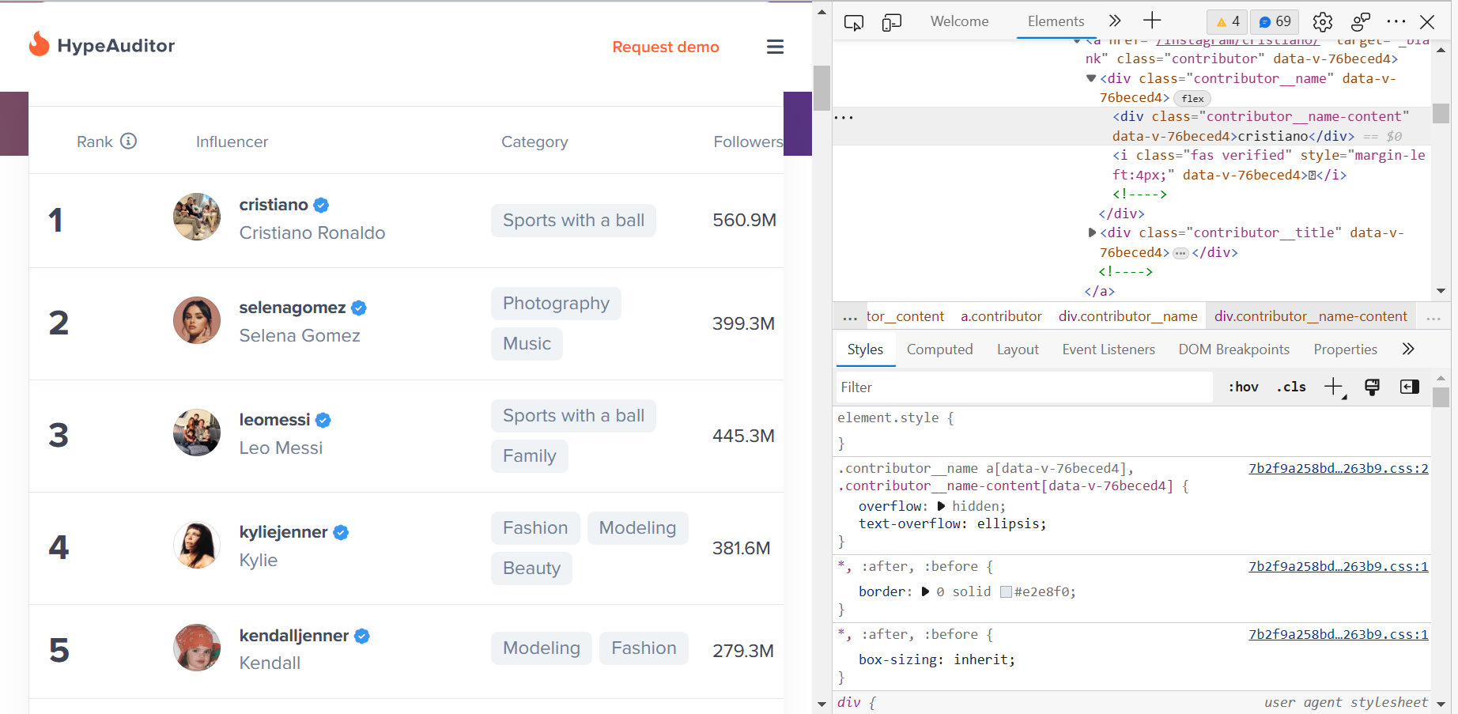
Raw Data

Slide 7
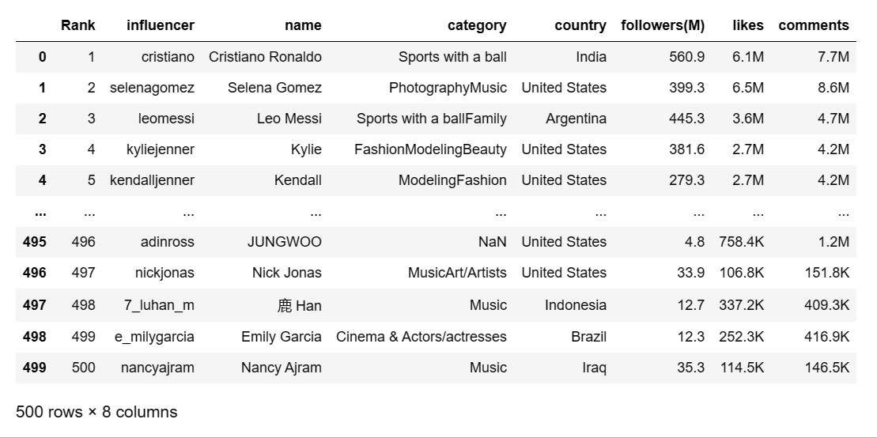
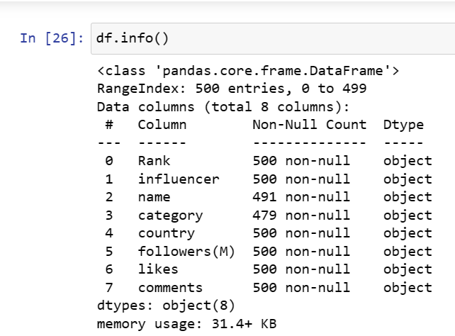
Summary of the data

Slide 8
Data Cleaning
Value conversion: All the Numerical data is converted into a single data type i.e,Float.By defing a function and applying it to the columns.
Then ‘NAN’ values in the data frame are replaced with the before cell values with the help of the “fillna”
(method:’ffill’)method.

Slide 9
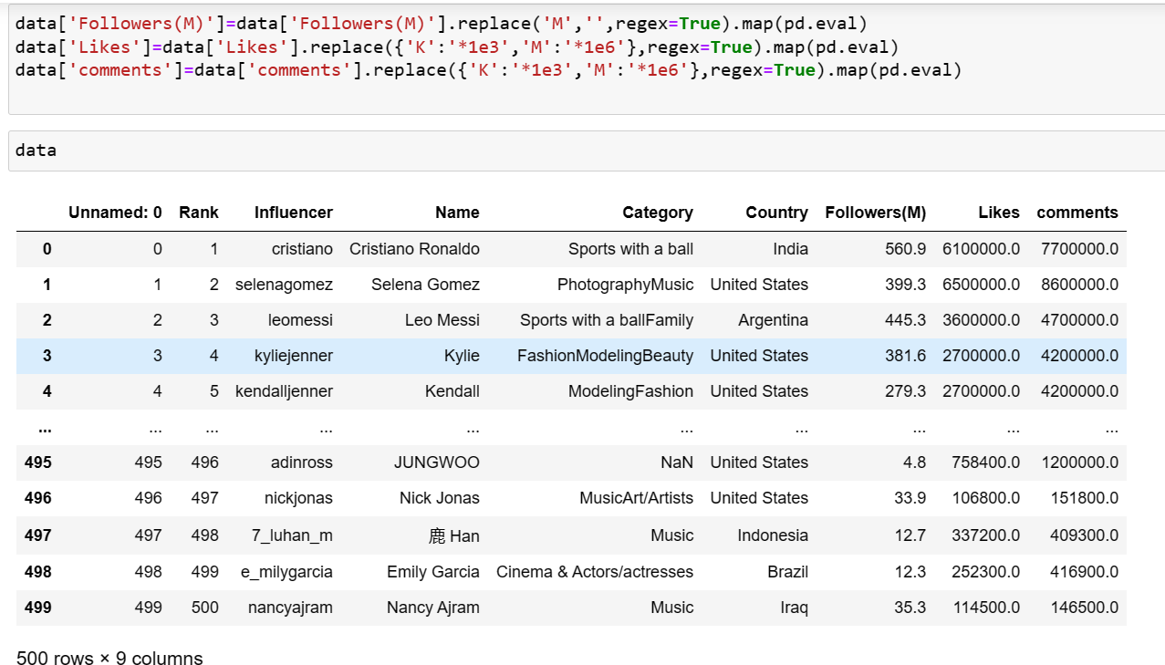
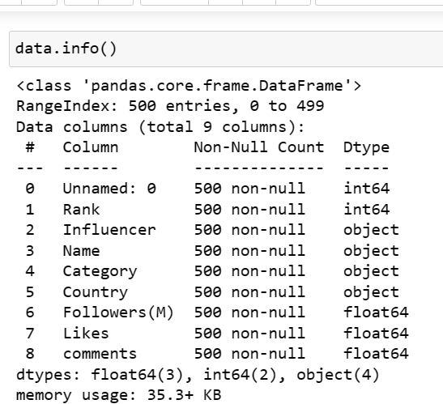
Exploratory Data Analysis

Slide 10
Data Visualization
Types of data:
1.Categorical Data: Represents the characteristics of a simple.infer the Quantitative aspects
2.Numerical Data:Represented in terms of numerical valuesor counts.
Types of Data Analysis:
Univariate
Bivariate
Multivariate

Slide 11
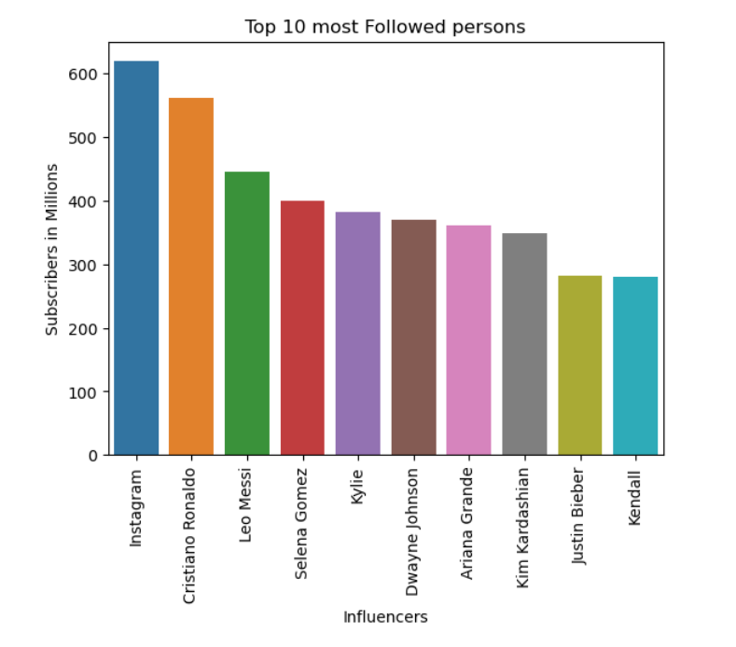
Top 10 most followed influencers
Insights: By this bar plot, we can see that the Top ten most followed influencers in the Instagram and their followers count.
Instagram has more followers around 650 M and rest is followed by cristano Ronaldo,leo Messi etc…….

Slide 12
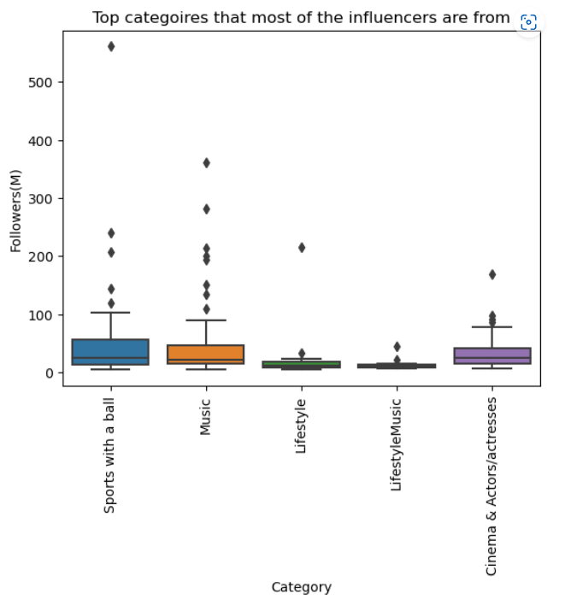
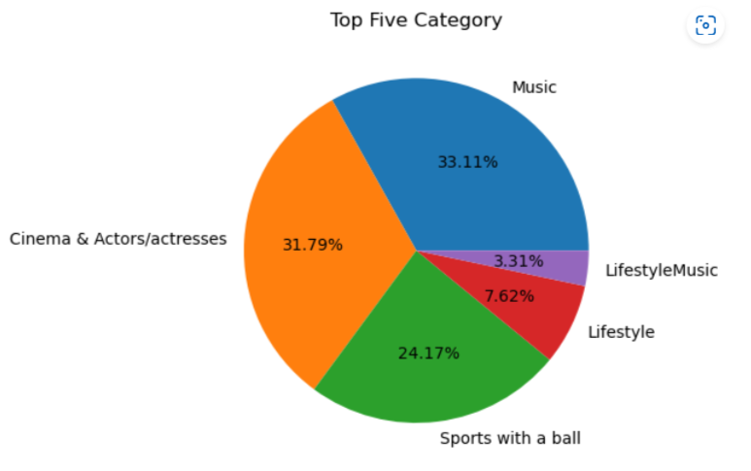
Top five category
Insight: By this pie chart,we can see the Top five categiries of the influencers.
Majority of the influencers are using Music type i.e 33.11 % followed by cinema & Actors/Actresses,sports with a ball,Lifestyle,LifestyleMusic to attract the followers for more Likes and comments.

Slide 13
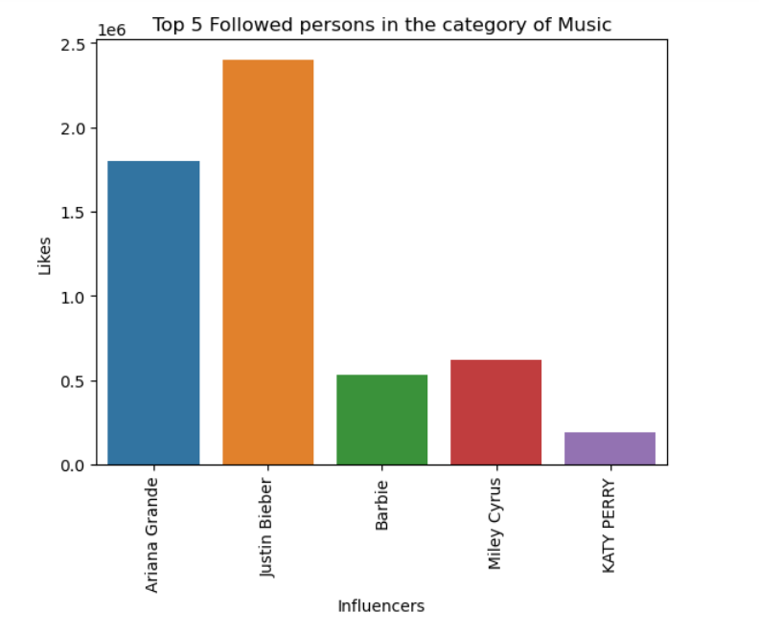
Top 5 influencers in category of Music
Insights:By this bar plot,We can see that the top five influencers in category of Music.
Here,Justin Bieber has more number of likes in category of Music around 2.5 M and rest was followed by Ariana Grande,Barbie,Miley Cyrus,Katy Perry.

Slide 14
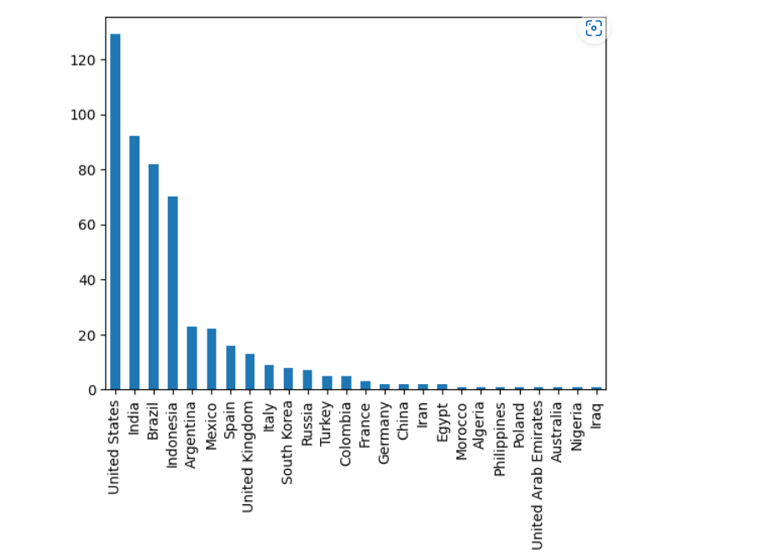
Followers Nationality
Insight:By this Bar plot, We can see the Nationality of the followers.
this data showing 26 countries where the followers are from.
But Most of the followers are from Us,india,Brazil,Indonesia,Argentina

Slide 15
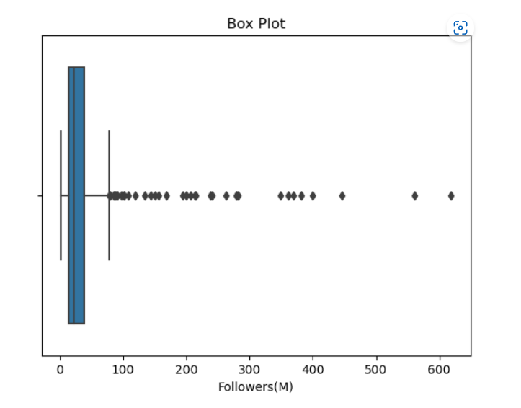
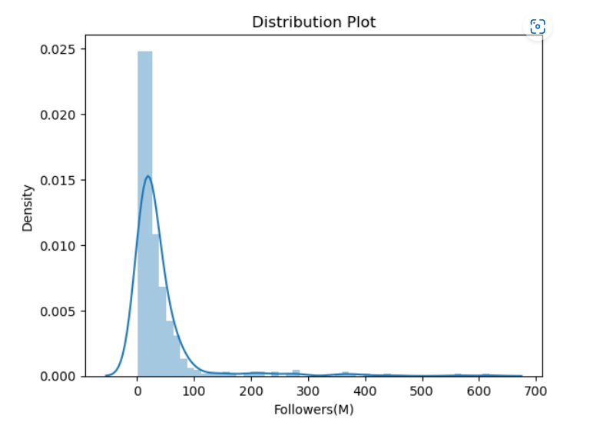
Highest Number of Followers
Insight: By this plot we can see the Highest number of followers.Most of the followers is in between 10 to 100 Millons and also we can see outliers in this plot.

Slide 16
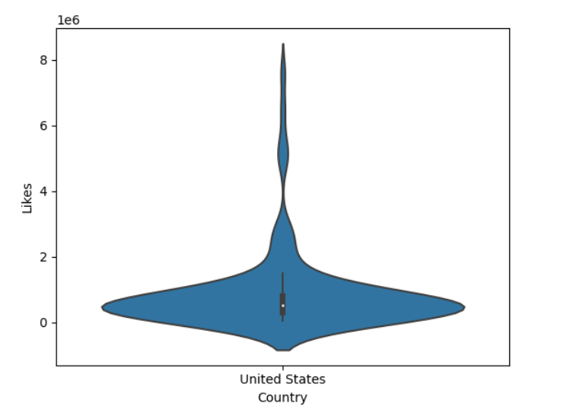
Max Likes from the country
Insight:Violin plot is a hybrid of box plot.
By this violin plot we can see that the Most of the Likes of the followers are from United states with 10 to 20 Million are more in number.

Slide 17
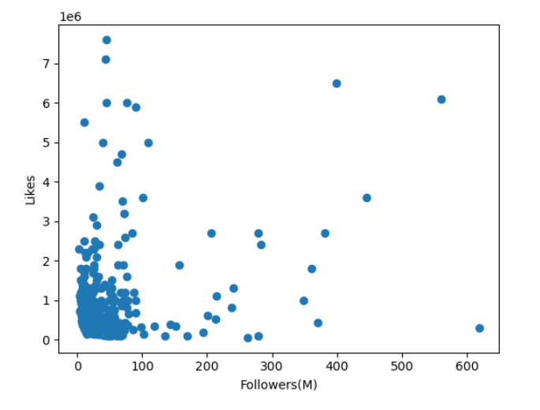
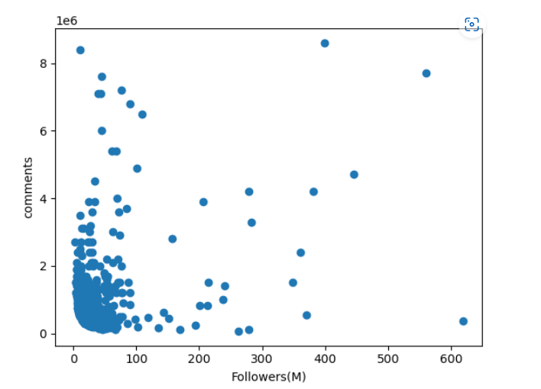
Relationship b/w followers ,Likes & Comments
Insights: scatter plot shows the positive relationship between two variables(likes with followers) and (comments with followers).Here we can see that if followers increases then likes and comments also increases.

Slide 18
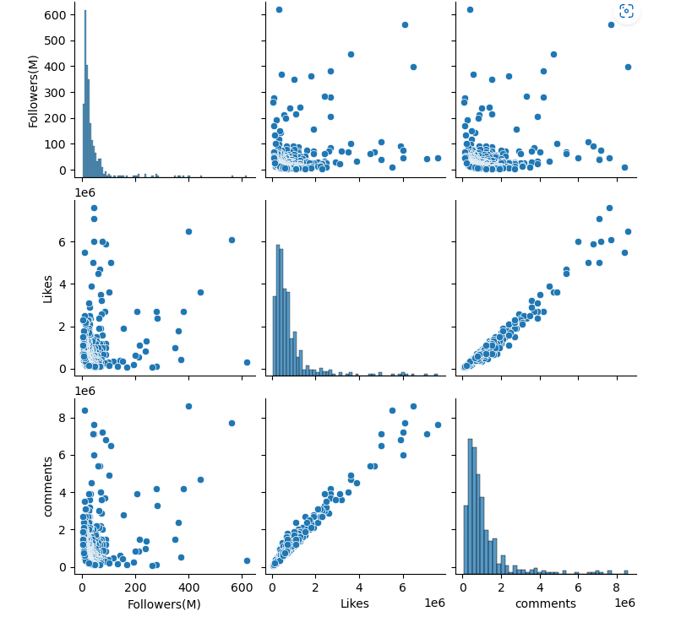
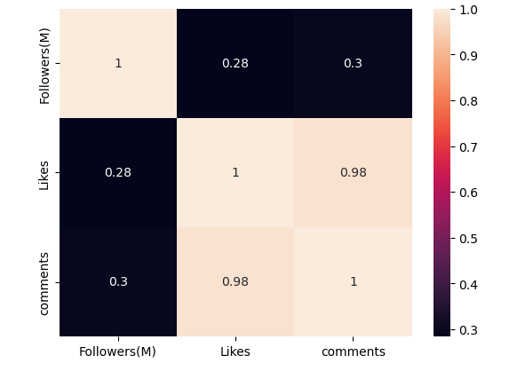
Relationship b/w followers ,Likes & Comments
“Pair plot & heatmap” shows the relationship btw Followers, likes & Comments.
Where correlation=0.28 it seems the relationship btw the Followers and likes is very weak.
Where correlation=0.3 it seems the relationship btw the Followers and Comments is moderate.
Where correlation=0.98 it seems the relationship btw the likes and Comments is strong.

Slide 19
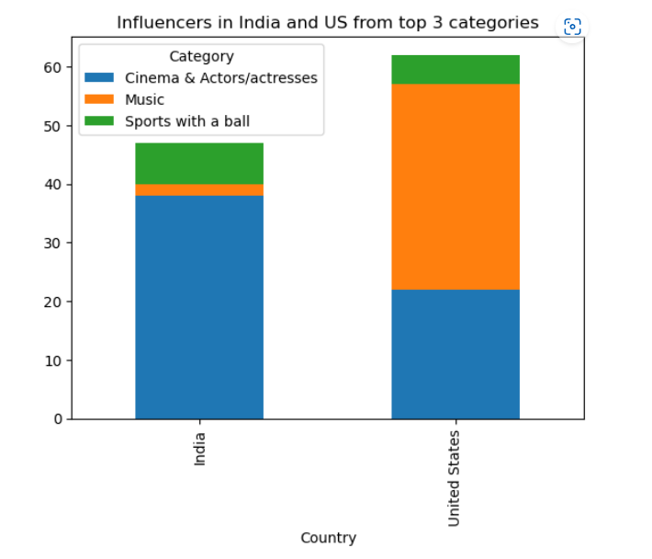
Influencers in India and Us from top 3 categories
Insight: By this plot,We can see that the influencers in india and Us from top three categories.

Slide 20
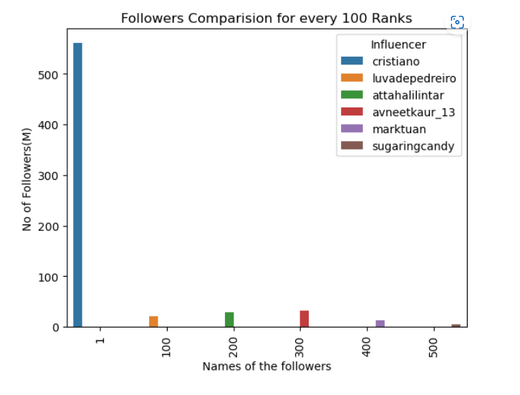
Comparision of Followers for every 100 Rank
Insight: By this plot, We can see that the comparision of followers,Likes,Views for Every 100 Rank.

Slide 21
Challenges
I need to decrease the huge data for data exploration process.For that I have to taken only 500 influencers out of 1000 influencers.
Website is getting Updated day by day.So, I have to run it every time and also treatment of null values are also changing.
Challenges faced while replacing values like K and M in the columns for the better data Understanding and visualizations.
Faced challenges while changing data type of the column from object to float.

Slide 22
conclusion
Influencers are ranked basis of Followers,no.of Likes,no.of comments,Category,Country.
Top influencers have more followers ,no.of likes and comments in the category of Music.
The maximum likes and comments are from followers of united staes respectively.
There is a strong correlation between Likes and comments.
The Data can be used for those who want to become an Instagram Influencer

Slide 23

Thank you

