Slide 1

BAN 612 DATA ANALYTICS PROJECT
Sai Sruthi Bodapati
Group – 1

Slide 2

Agenda
Problem Statement – Why & How ?
Data Source
Libraries used
Approach
Data Analysis
Conclusion

Slide 3
Why & How ?
For group project, we worked on SF bay area rental analysis by taking a large dataset. Before working on the large data set, I worked on a smaller data sub-set by comparing Fremont and Oakland cities and drew some exploratory conclusions from the data.

Slide 4

Data Source
Trulia website
https://www.trulia.com/

Slide 5
Libraries and methods used
Web Scraping
Beautiful Soup
RegEx
Matplotlib
Seaborn
Numpy
Pandas

Slide 6
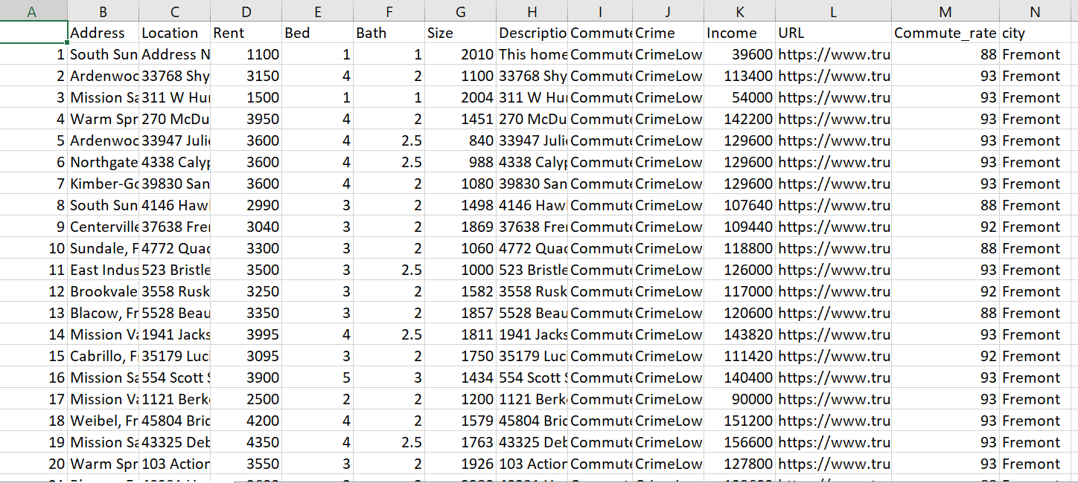
Fremont_Oakland_data .csv (few output records of the csv for sample)

Slide 7
approach
Cleaning and preprocessing data
summary of the data sets
Visualisations

Slide 8
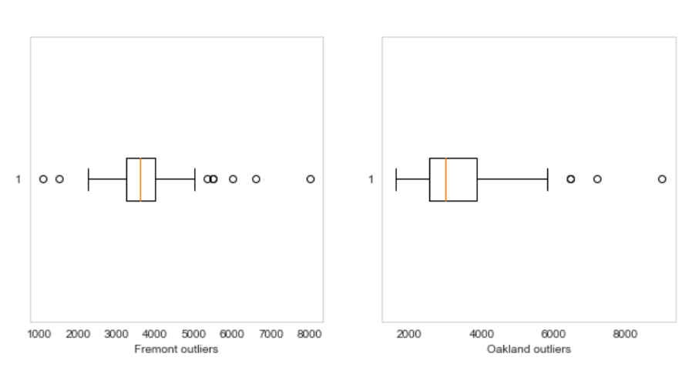
Outliers using box plot
Checked for the outliers in the Fremont and Oakland city rent data and took care.

Slide 9
Histogram to compare rents comparing rents per # of bedrooms across cities Car commute percentage across cities Comparison of unit availability wrt bedroom count
Data Analysis (Findings)

Slide 10
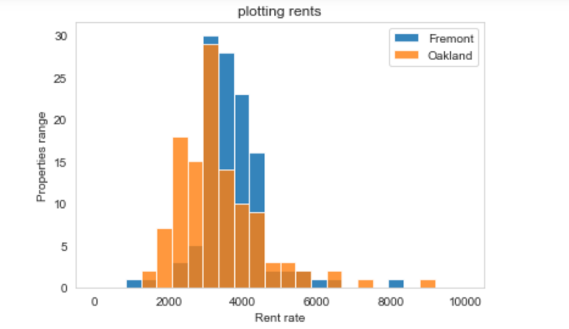
Histogram to compare rents
High concentration of rents in Fremont is between 3000 and 4500. Whereas rent concentration in Oakland is spread across a wider range, i.e. from 2000 to 4500

Slide 11
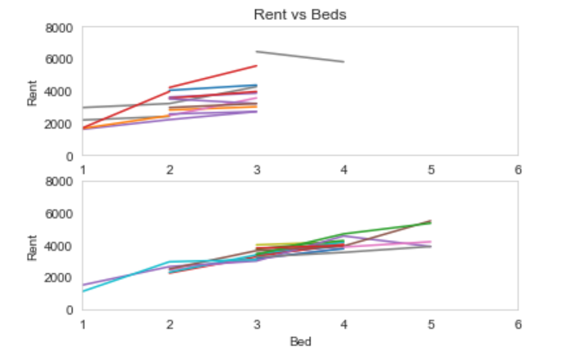
comparing rents per # of bedrooms
In Fremont, the rents are not varying too much for same number of bedrooms across different communities. Whereas in Oakland, there is a lot of variance in rents per bedrooms across different communities. This can mean there is higher degree of economic gap in Oakland.

Slide 12
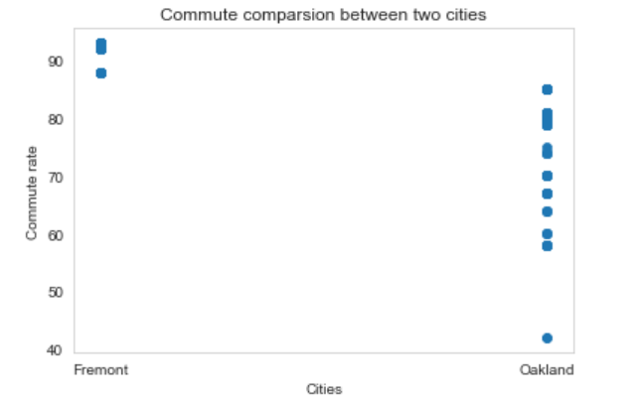
Car commute percentage
Majority of Fremont residents commute by car. Whereas in Oakland, residents relatively travel less by car, and uses other means of transportation.

Slide 13
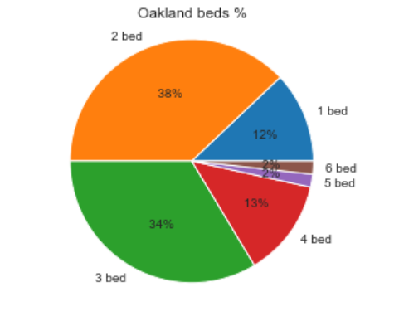
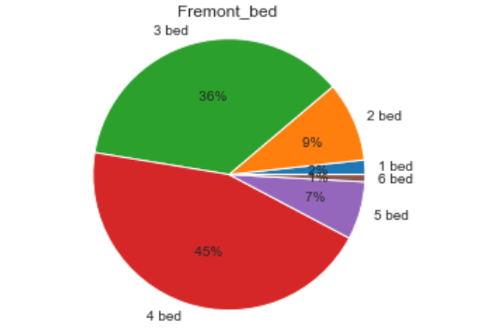
Comparison of unit availability wrt bedroom count
There seems to be lot of 3 and 4 bed units' availability in Fremont .
Whereas in Oakland, more 2 and 3 bed units are available .
Fremont seems to have more availability for bigger families.

Slide 14
Thank you!

