Slide 1

Predicting Cancer Likelihood Using Lifestyle and Health Factors
Name: Dubba Sruthi
Student id: S3544788

Slide 2

Overview
01
02
03
04
05
06
07
08
Introduction and Background
Literature Review
Dataset Overview
Data Science Processing steps
Pre-Processing Stages
Proposed Solutions
Future Work
References

Slide 3
Introduction and Background
Cancer remains one of the most significant health problems worldwide, while early diagnosis is essential for recovering patients' lives.
Advanced algorithms in machine learning are applied for the detection of cancer risk by considering not only biological but also lifestyle and demographic factors.
The research work is on predicting the probability of cancer for individuals utilizing a provided set of multi-dimensional features.
The aim is to create a trustworthy, scientifically supported classification model that will facilitate prompt detection and healthcare management decisions.

Slide 4


Literature Review
Cruz Wishart 2006 showed that ML techniques can capture complex , non linear relationships in medical data that conventional clinical tools often miss.
Kourou et al. (2015) revealed that machine learning models including SVM and logistic regression achieve better cancer prediction accuracy than conventional statistical approaches.
Shruti et al. (2022) stated that machine learning models such as SVM, CART, and KNN can accurately predict various types of cancer, proving that ML algorithms are able to handle diverse clinical datasets and capture complex risk factor interactions.

Slide 5

Dataset Overview
The dataset includes 1500 patient information with fitness, lifestyle, and genetic danger factors related to cancer.
Attributes include : Age, Gender, BMI, Smoking, Genetic Risk, Physical Activity, Alcohol Intake , Cancer History and binary target variable Diagnosis.
Reasons behind selecting this Dataset:
Incorporates Risk Factors From Both Lifestyle And Biology
Demonstrates Use Cases In Real World Healthcare

Slide 6
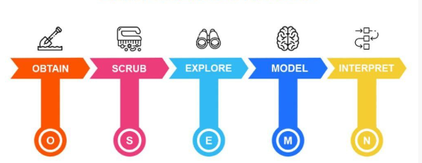
Data Science Processing steps
Import Required Libraries
Data Collection and Loading
Data Exploration Analysis
Data Cleaning
Data Preprocessing
Model Building

Slide 7
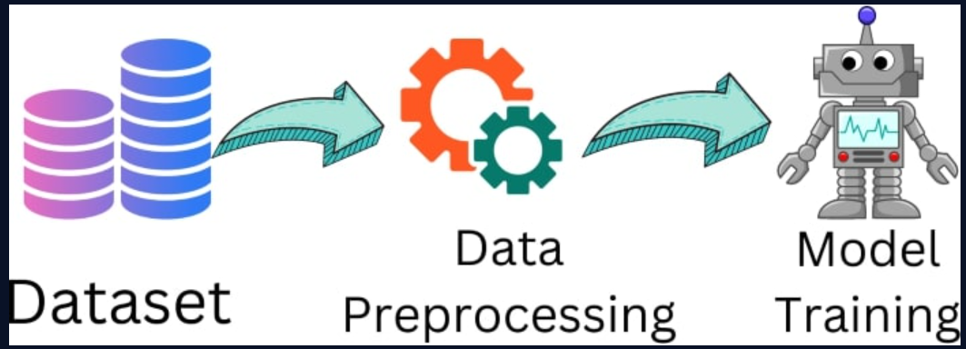
Pre-Processing Stages
Handling Missing Values
Mean and mode imputation were applied.
Removing Duplicate Records
Data quality was assured by eliminating duplicate rows
Feature Engineering
Developed a new variable Risk_Level.
Data Transformation
The numerical features were scaled.
Data Splitting
The dataset was split for an impartial model evaluation.
Target Encoding
The target variable Diagnosis was transformed into a factor

Slide 8

Proposed Solutions
To create a model for predicting cancer, different machine learning approaches were applied.
Then 3 algorithms were trained and compared:
1. Logistic Regression (LR)
2. Support Vector Machine (SVM)
3. K-Nearest Neighbors (KNN)
The performance of all models was checked through accuracy, confusion matrix, and ROC–AUC. Logistic Regression (LR) was chosen as the best model since it gave the best combination of accuracy, interpretability, and AUC performance

Slide 9

Future Work
.
Model Training – utilize the training dataset to train the chosen model.
Prediction Phase – create predictions for the test dataset.
Performance Evaluation – evaluate accuracy, ROC–AUC, and confusion matrix.
Documentation – get the final report done that covers methods and findings.

Slide 10
References
Kumari, M. and Singh, V. (2018) “Breast Cancer Prediction system,” Procedia Computer Science, 132, pp. 371–376. Available at: https://doi.org/10.1016/j.procs.2018.05.197.
Kourou, K. et al. (2015) “Machine learning applications in cancer prognosis and prediction,” Computational and Structural Biotechnology Journal, 13, pp. 8–17. Available at: https://doi.org/10.1016/j.csbj.2014.11.005.
Cruz, J.A. and Wishart, D.S. (2006) “Applications of Machine Learning in Cancer Prediction and Prognosis,” Cancer Informatics, 2, p. 117693510600200. Available at: https://doi.org/10.1177/117693510600200030.
Kadir, T. and Gleeson, F. (2018) “ cancer prediction using machine learning and advanced imaging techniques,” Translational Lung Cancer Research, 7(3), pp. 304–312. Available at: https://doi.org/10.21037/tlcr.2018.05.15.

Slide 11


