Slide 1
Analysis of link prediction in twitch using ML and graph theory algorithms
By
Manoj R - 195002071
Sruthi G - 195002117
Guided by
Dr.S.Karthika

Slide 2
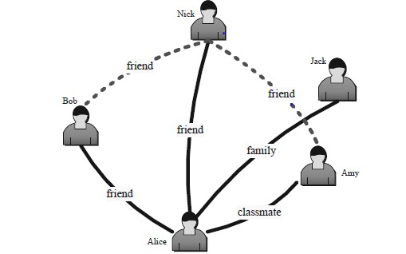
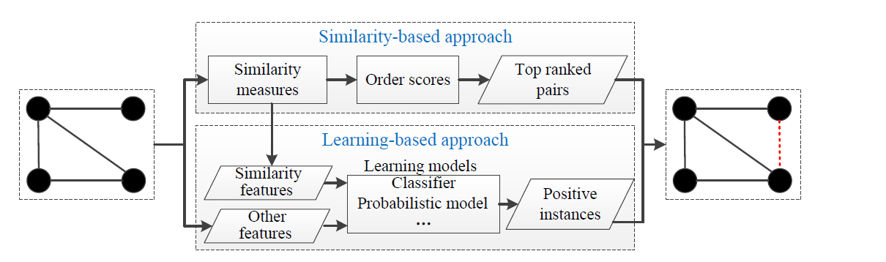
Problem Statement
Given a snapshot of a dynamic social network, represented as a directed graph of nodes and edges(where nodes represent users and edges represent follower - followee relations) is it possible to predict which new relations (links) are likely to be formed in the future.

Slide 3
Motivation
As a technical problem, the efficacy of link prediction is generally not well understood. Today, link prediction algorithms are the basis for social recommendations in a wide range of social networks and applications, ranging from Facebook and Pinterest and Q&A sites like Quora. The success of these sites and the sheer volume of prior literature lead many to believe the problem is well addressed. Only evidence to the contrary comes from failed recommendations .
Link prediction is frequently used in social networks to suggest friends to users. It has also been used to predict criminal associations.
In biology, link prediction has been used to predict interactions between proteins in protein-protein interaction networks. Link prediction has also been used to infer interactions between drugs and targets using link prediction .
Link can be used to improve marketing strategies, in particular viral marketing.

Slide 4
Literature Survey
The Link-Prediction Problem for Social Networks by Liben-Nowell and Kleinberg. This paper was a seminal work in this domain as it formalized the link prediction problem and established a fundamental concept that it is possible to infer future changes in a network based solely on features intrinsic to the network itself. From this we understood how to extract features using basic proximity measures of the network.
Link Prediction in Social Networks: the State-of-the-art, by Wang Peng et al is one of the most cited survey papers which speaks about the idea behind link prediction, its applications and different ways to tackle it. The authors have given a general framework for solving the link prediction problem which involves similarity based prediction or learning based prediction. In similarity based prediction, every possible future link is assigned a score based on similarity between the nodes and higher score edges are likely to appear in future. In learning based approach, link prediction is seen as a binary classification problem.

Slide 5
Literature Survey
Network Growth and Link Prediction Through an Empirical Lens by Liu, et al. This paper is relatively recent and less cited but it proves the importance of using machine learning models as opposed to purely mathematical and statistical distance metrics for link prediction. The authors of this paper implemented 18 link prediction algorithms each categorized as ‘metric-based’ (using a single similarity or proximity metric) or ‘classification-based’ (using machine learning classifiers with multiple metrics as input features).The authors evaluated these algorithms on large detailed network traces obtained from Facebook, Youtube and RenRen. They firmly established that SVM consistently outperforms all metric based methods across all three networks.
The method proposed in Transitive Node Similarity for Link Prediction in Social Networks with Positive and Negative Links, by Panagiotis Symeonidis et al takes into account both local and global features of a graph. It states that the probability of existence of an edge directly depends on length of pathway between the nodes and similarity between neighbours of the two nodes.

Slide 6
Literature Survey
Review on Learning and Extracting Graph Features for Link Prediction by Ece C. Mutlu, Toktam Oghaz, Amirarsalan Rajabi and Ivan Garibay.This work presents an extensive review of state-of-art methods and algorithms proposed on this subject and categorizes them into four main categories: similarity-based methods, probabilistic methods, relational models, and learning-based methods.
Grid search in hyperparameter optimization of machine learning models for prediction by Daniel Mesafint Belete, Manjaiah DH. This paper concentrated on the hyper parameter optimization using grid search methods on the dataset that contains binary class. The main objective of this paper is to generate the optimal parameter from the default parameter of each model which is used in the study using grid search methods and applying the optimal parameters to each model to test the effects of the methods for the prediction.

Slide 7
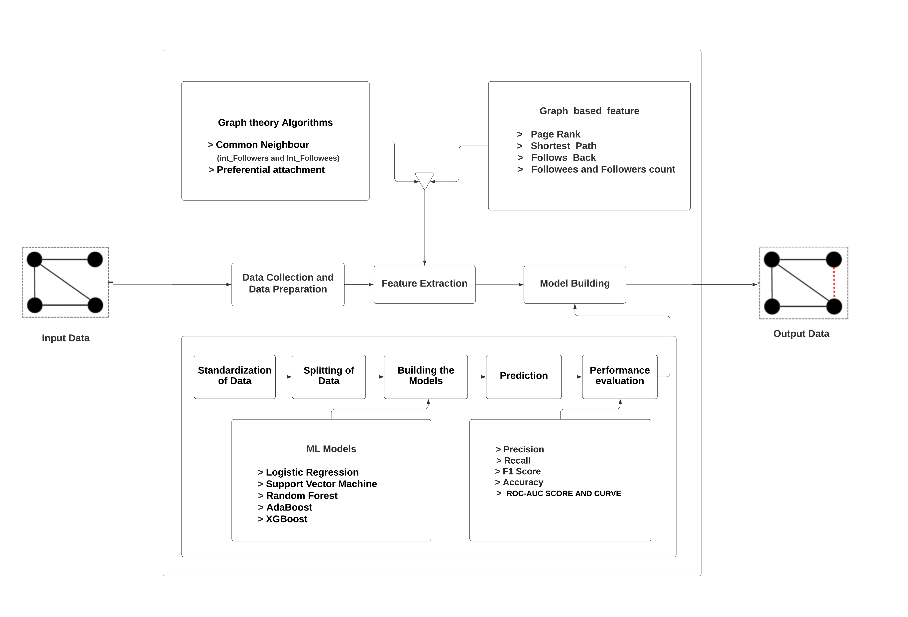
System Design

Slide 8
Proposed Methodology
The workflow consists of the following broad development phases:
Data Collection and Preparation
Feature Extraction
Model Building

Slide 9
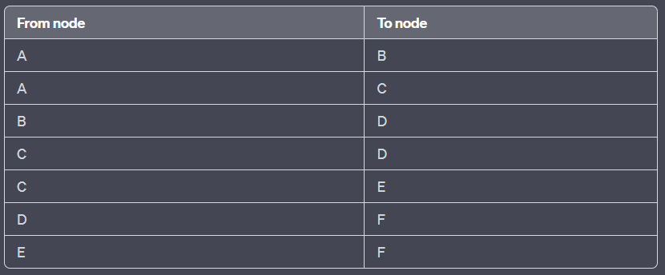
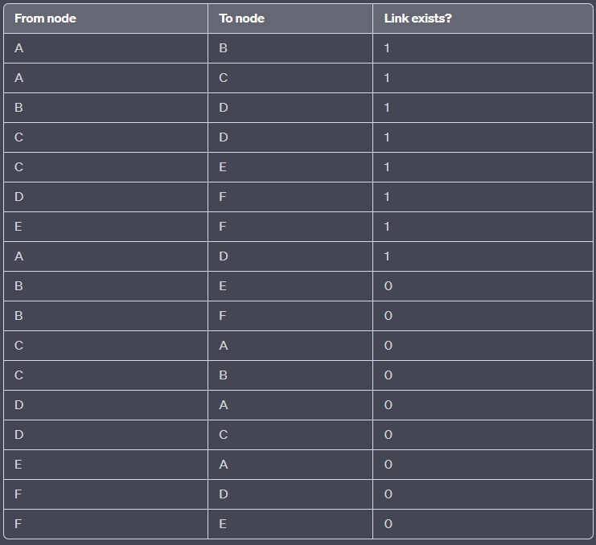
Proposed Methodology
Sample input
Sample output

Slide 10
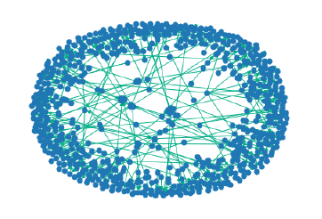
Data Collection
We are interested in solving the problem of personalized recommendations of streamers that a user can follow. This recommendation problem can be mapped to a binary classification problem wherein the two classes are - recommend or do not recommend with features extracted from the dataset.
We propose solving this by generating link predictions and then using the predicted links to recommend streamers. Thus, we aim to train the models using machine learning to predict whether a link exists between any given pair of nodes and use this prediction for recommendations.
METHODOLOGY
Dataset Description :
Twitch Dataset
Twitch is used widely by gamers to live-stream .
Obtained the dataset from the Stanford Large Network Dataset Collection
Total nodes present | 7126
Total possible edges | 50,772,750
Total edges present | 35,324
Missing edges considered | 35,324

Slide 11
Assumptions
Using all the missing edges from the graph would highly skew the dataset so we are planning to randomly sampling few missing edges to avoid skewed dataset
While sampling these missing edges, we have added a condition to only consider an edge as missing if the distance between the source and destination was more than 2 as closely connected users are likely to be mutual friends even if an edge does not already exist.
The edges that are present as 1 and the missing ones as 0. We have decided to use this presence or absence of an edge as the target class variable for prediction.
We have taken into six degree phenomenon while calculating shortest path between 2 nodes.

Slide 12
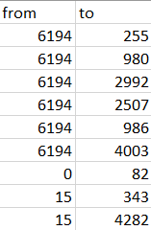
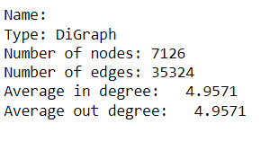
Data Preparation
Our dataset contains details about from and to nodes. In this phase we converted our dataset into directed graph.
We then found missing edges that equals the edges that are present.

Slide 13
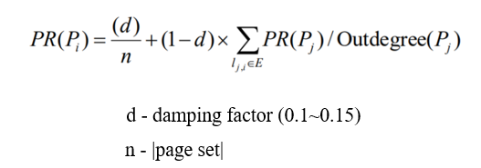
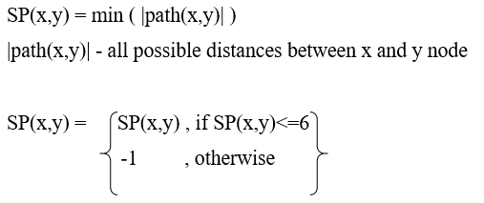
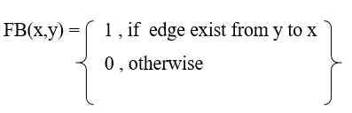
Feature Extraction
We then used the 70,648 edges to extract various features such as –
Page Rank
Shortest Path
Follows Back

Slide 14

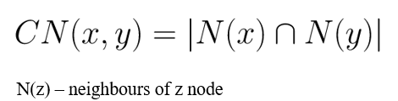
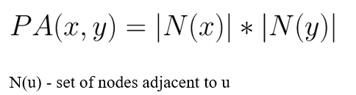
Feature Extraction
Follower & Followee Counts
Inter Followers & Followee counts (Common neighbours)
Preferential Attachment score

Slide 15
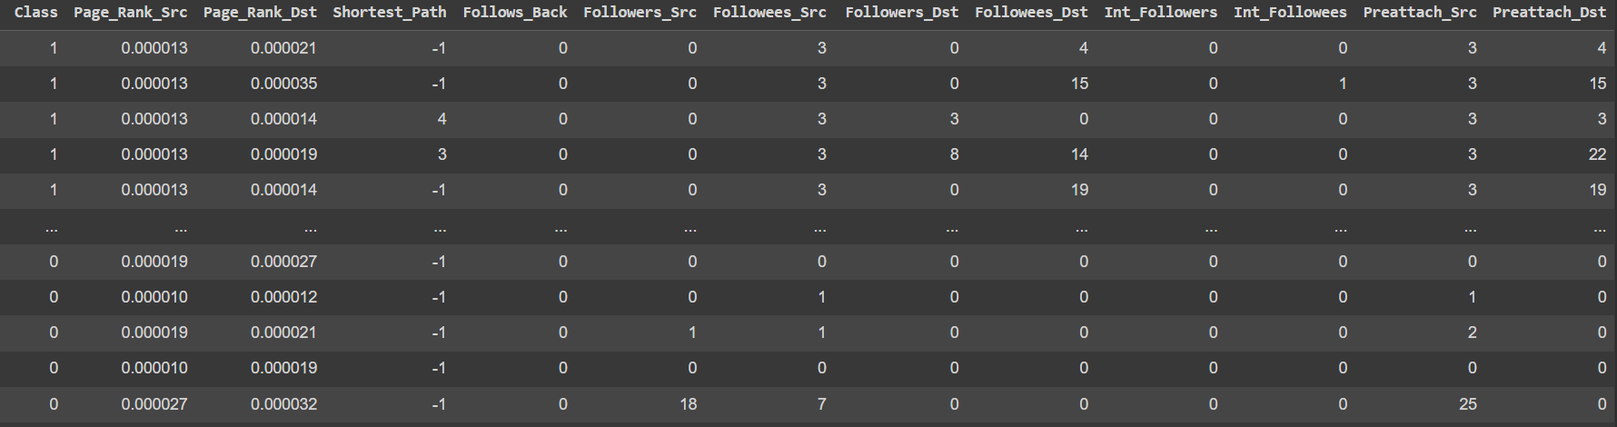
Feature Extraction
Features extracted

Slide 16
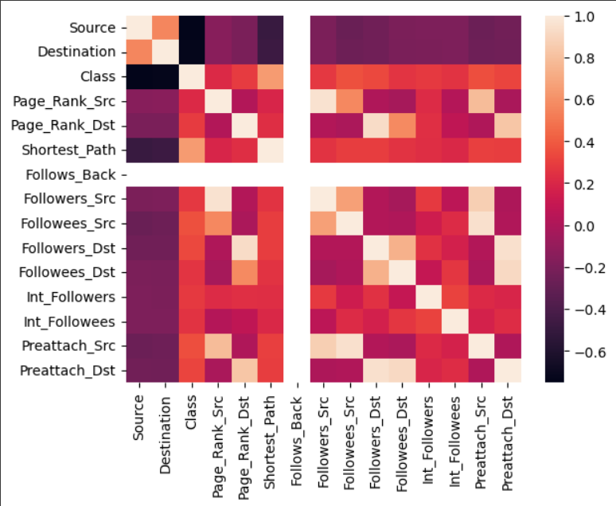
Model Building
Analysis and Standardisation of data
Heatmap of the features

Slide 17
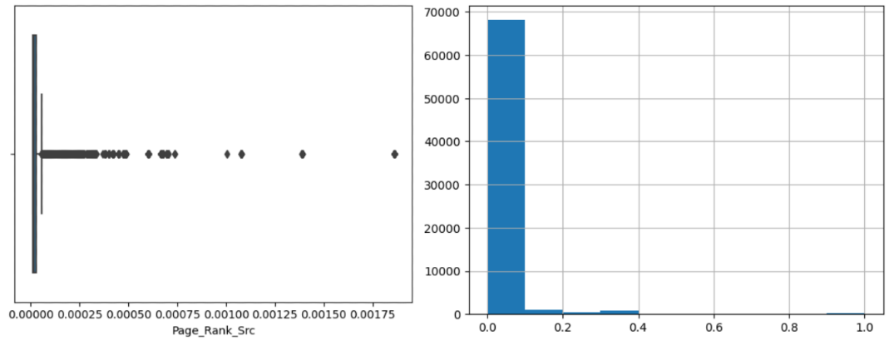
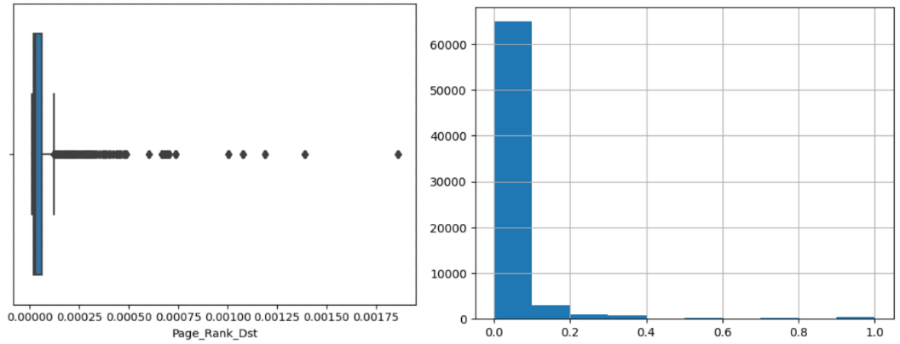
Model Building
Box plot and Histogram (after standardisation) of Page rank of source node
:
Box plot and Histogram (after standardisation) of Page rank of destination node
:
Similarly for all the features that are extracted, EDA (Box plot) is performed. Based on the results observed from EDA outliers have been identified for all the features. Thus standardization of data is implemented for all the features.

Slide 18
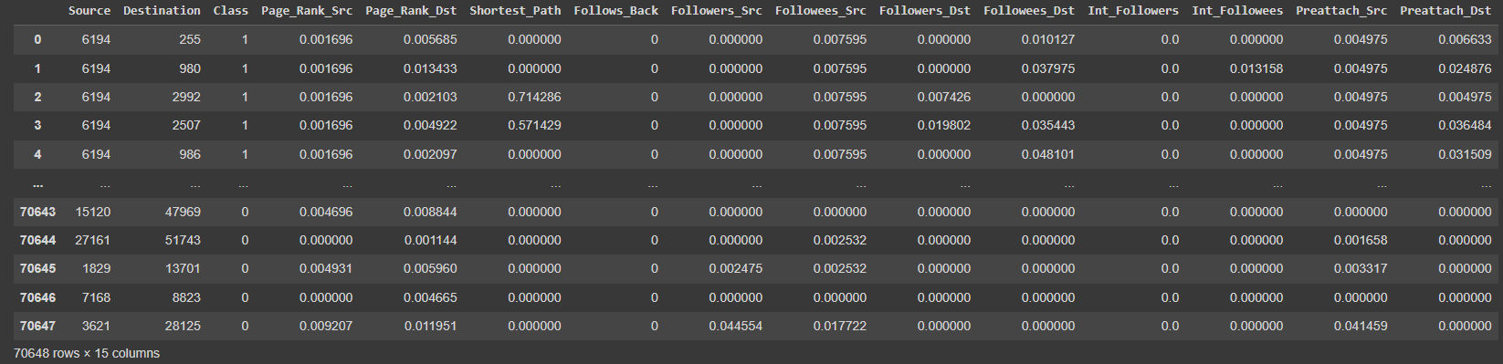
Model Building
Data after standardization

Slide 19
Model Building
Splitting of data for Training and Testing (70-30)
Building ML Models
a. Logistic Regression
b. Random Forest
c. Support Vector Machine
d. AdaBoost
e. XGBoost
Why we chose classification ML models?
There is no dependency exists between the feature variables.
We are trying to predict a categorical value
So we chose classification based ML models

Slide 20



Model Building
Logistic Regression:
BEST PARAMETERS
BEST ESTIMATORS

Slide 21
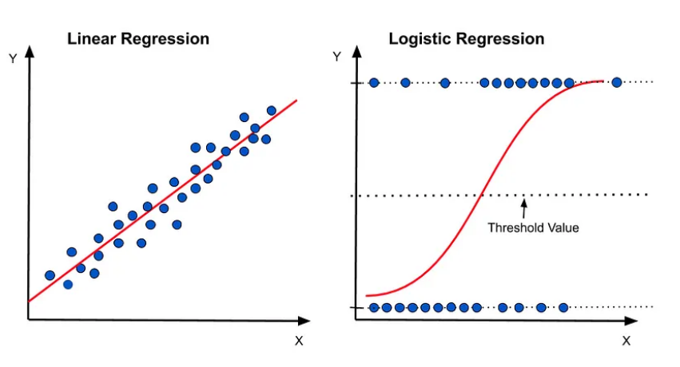
Model Building
Why we chose logistic regression instead of linear regression ?
Linear regression is utilized for regression tasks, while logistic regression helps accomplish classification tasks.
Linear regression is used to predict the continuous dependent variable using a given set of independent variables whereas Logistic Regression is used to predict the categorical dependent variable using a given set of independent variables.
Since we are trying to predict a categorical value, we chose logistic regression instead of linear regression.

Slide 22

Model Building
Random Forest:
BEST PARAMETERS
BEST ESTIMATORS

Slide 23
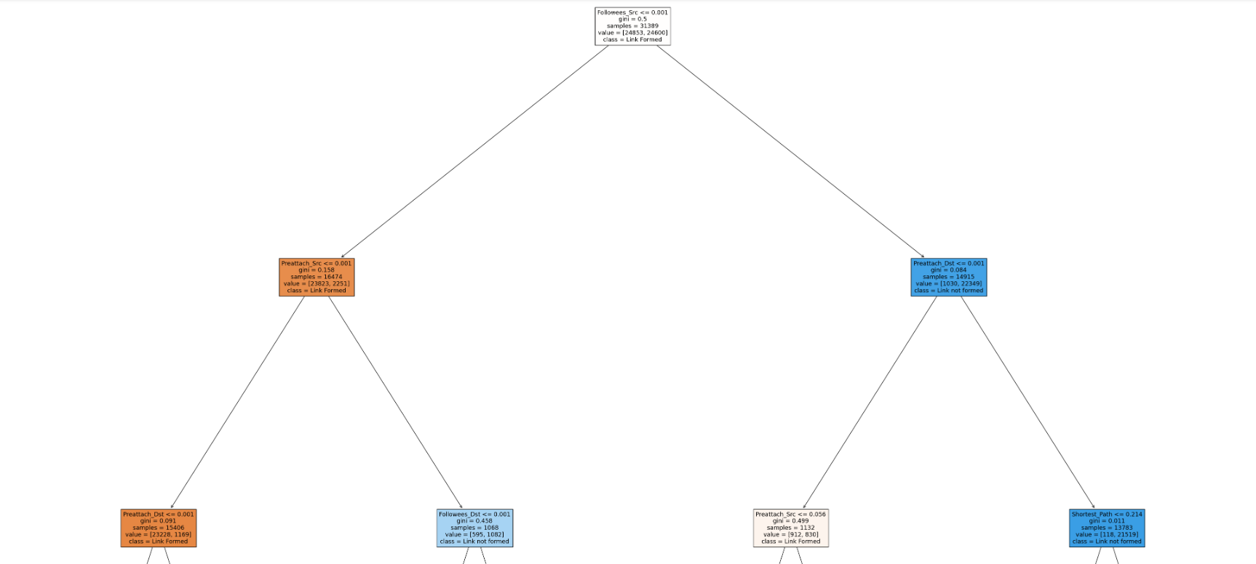
Model Building
VISUALIZATION

Slide 24

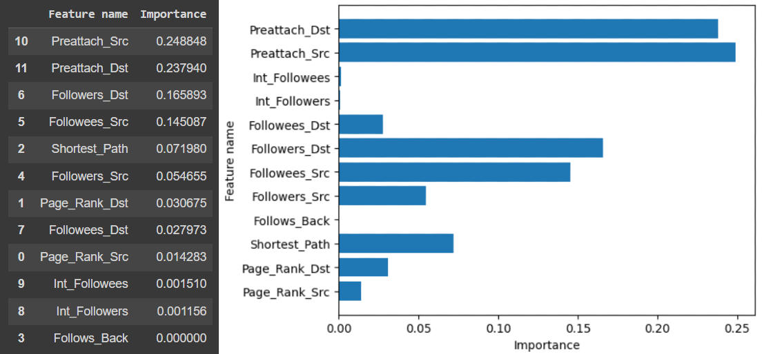
Model Building
FEATURE IMPORTANCE

Slide 25


Model Building
Support Vector Machine:
BEST PARAMETERS
BEST ESTIMATORS

Slide 26



Model Building
AdaBoost:
BEST PARAMETERS
BEST ESTIMATORS

Slide 27
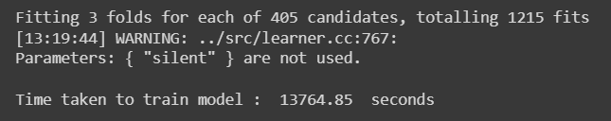
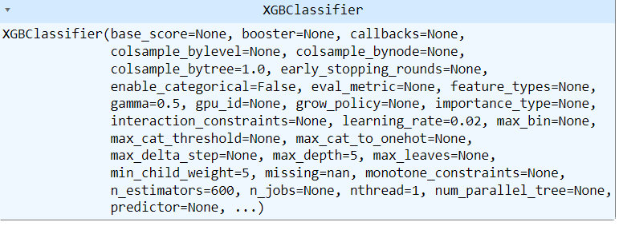
Model Building
XGBoost:
BEST PARAMETERS
BEST ESTIMATORS

Slide 28
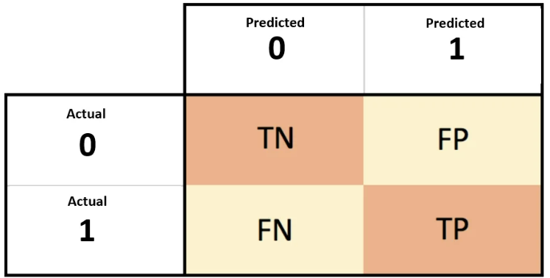
Performance Analysis
Performance Metrics:
- ROC-AUC curve and score
- Classification Metrics
Precision
Recall
F1 Score
Accuracy
- Confusion Matrix

Slide 29
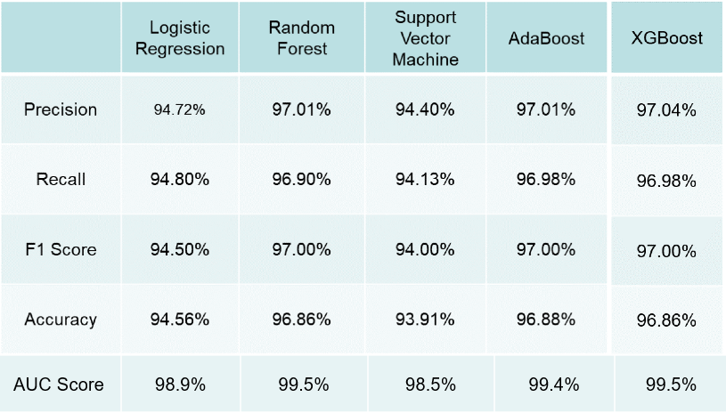
Performance Analysis
Results and Evaluation :
We observed very good accuracy for all the models, with Random Forest, XGBoost and AdaBoost performing the best. The following table shows various classification metrics for each of the machine learning models.

Slide 30
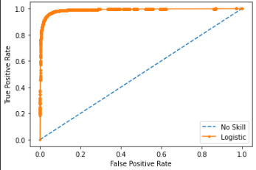
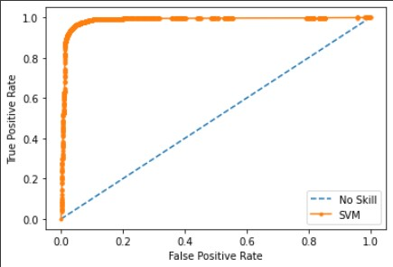
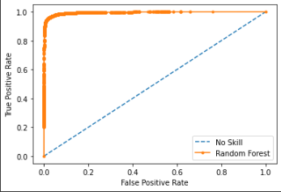
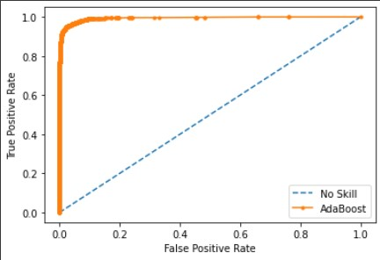
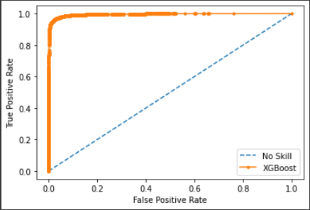
Performance Analysis
Logistic Regression
SVM
Random forest
AdaBoost
XGBoost

Slide 31
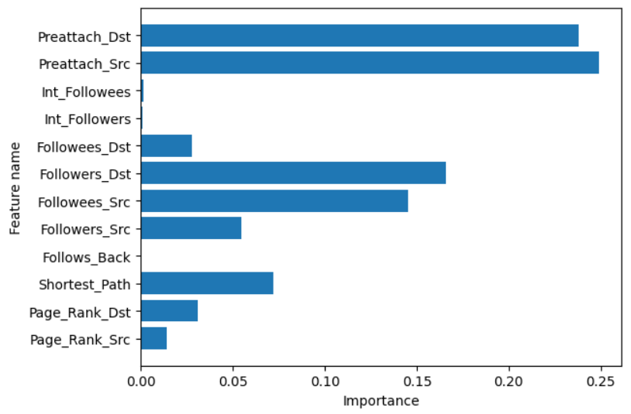
Conclusion
Feature Importance
It is evident from the above visualization that not all features have high contribution in the prediction. The contribution can depend on the application of link prediction and it is necessary to explore more features and focus on the most relevant ones.

Slide 32
Scope & Challenges
Future Scope:
Link prediction can be used for various applications; here we will address some typical applications
Recommendation in social networks
Predict interactions between proteins
Friends suggestion
Predict criminal associations
Marketing strategies

Slide 33
Scope & Challenges
Challenges :
Although numerous efforts have been made in link prediction, there are still many potential future challenges, and some new open problems require further study. Here, we address some possible challenges on the link prediction problem.
Disappearing link prediction
Link prediction under dynamic nodes
Overcoming imbalance
Incorporating social theories
Link prediction in heterogeneous social networks
Fair evaluation and benchmark datasets

Slide 34
References
[1] D. Liben-Nowell and J. Kleinberg, “The link-prediction problem for social networks,” vol. 58, no. 7, pp. 1019–1031, May 2007 [Online].
https://onlinelibrary.wiley.com/doi/abs/10.1002/asi.20591
[2] W. P. X. B. W. Y. Z. XiaoYu, “Link prediction in social networks ： the state-of-the-art,” vol. 58, no. 1, pp. 1–38,2015 [Online].
http://lib.cqvip.com/qk/84009A/201501/663405989.html
[3] Q. Liu, S. Tang, X. Zhang, X. Zhao, B. Zhao, and H. Zheng,“Network Growth and Link Prediction Through an Empirical Lens,” 2016, pp. 1–15 [Online].
http://dl.acm.org/citation.cfm?id=2987452
[4] P. Symeonidis, E. Tiakas, and Y. Manolopoulos,“Transitive node similarity for link prediction in social
networks with positive and negative links,” 2010, pp.183–190 [Online].
http://dl.acm.org/citation.cfm?id=1864744

Slide 35
References
[5] J. Leskovec, “Stanford Large Network Dataset Collection.” [Online]. http://snap.stanford.edu/data/index.html
[6] “Page Rank Algorithm and Implementation.” 2017[Online].
https://www.geeksforgeeks.org/page-rank-algorithm-implementation/
[7] “Visualization of Random Forest” [Online].
https://towardsdatascience.com/4-ways-to-visualize-individual-decision-trees-in-a-random-forest-7a9beda1d1b7
https://www.codementor.io/@mgalarny/visualizing-decision-trees-with-python-scikit-learn-graphviz-matplotlib-154mszcto7
[8] “Six Degree of Seperation” [Online].
https://www.techtarget.com/whatis/definition/six-degrees-of-separation

Slide 36
References
[9]https://www.analyticsvidhya.com/blog/2021/03/introduction-to-adaboost-algorithm-with-python-implementation/
[10] http://be.amazd.com/link-prediction/
[11] Ece C. Mutlu, Toktam Oghaz, Amirarsalan Rajabi and Ivan Garibay ‘Review on Learning and Extracting Graph Features for Link Prediction’
[12] Daniel Mesafint Belete, Manjaiah D H ‘Grid search in hyperparameter optimization of machine learning models for prediction’
[13] https://networkx.org/documentation/networkx-2.4/

Slide 37
References
[14] https://xgboost.readthedocs.io/en/stable/
[15] https://neo4j.com/docs/graph-data-science/current/algorithms/linkprediction/#:~:text=Link%20prediction%20algorithms%20help%20determine,predictions%20about%20relationships%20between%20nodes.
[16] https://vgnshiyer.medium.com/link-prediction-in-a-social-network-df230c3d85e6
[17] https://networkx.org/documentation/stable/reference/algorithms/generated/networkx.algorithms.link_prediction.preferential_attachment.html
[18] https://neo4j.com/developer/graph-data-science/link-prediction/scikit-learn/

