Slide 1
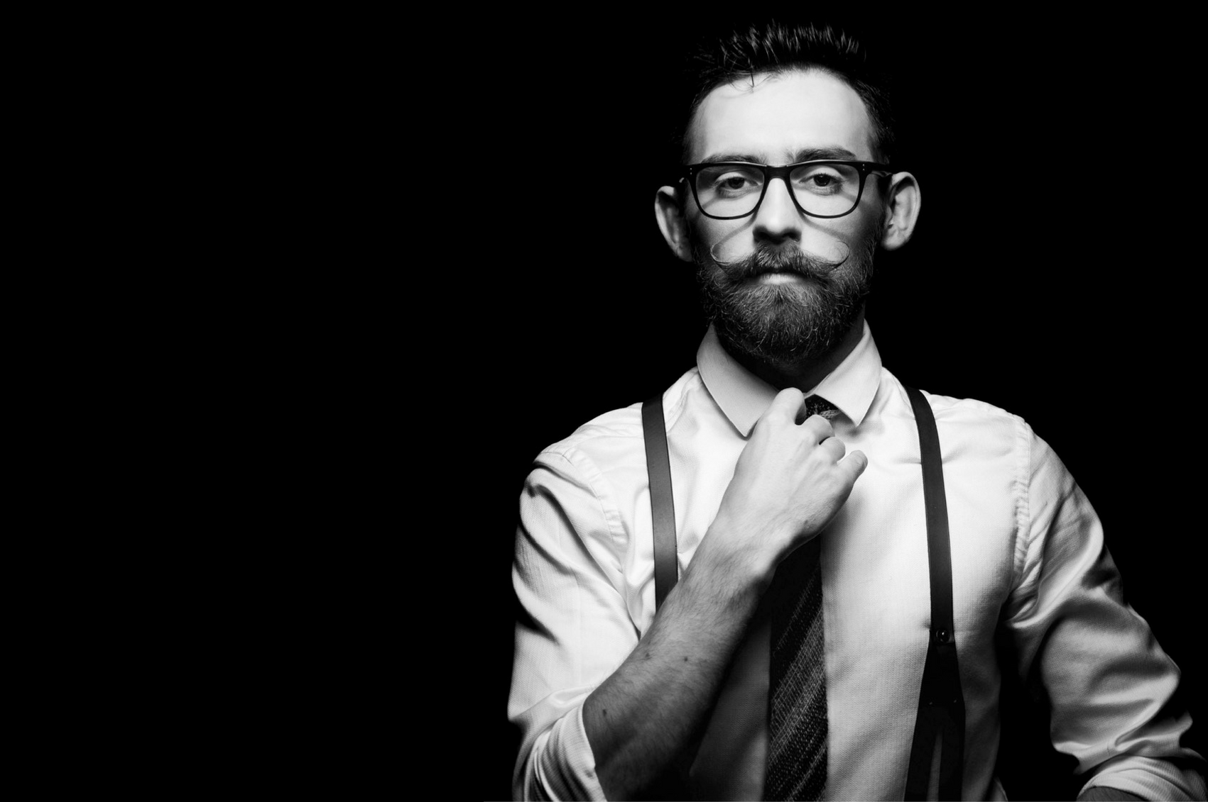

New! Every
Single Day literally!
Notes:
New!Every
Single Day literally

Slide 2

Why men is not into shopping!?
A study that says men get bored after 26 minutes of shopping.
Tight schedules and commitments
Budget constraints
the crowded malls or sheer laziness

Slide 3
What is OhLook?
OhLook is a fashion platform for men that allows users to rent trendy casual and sleek formal shirts from their website through a subscription model.
The USP of OhLook is the fact that the user wouldn’t show up to work in the same shirt, EVER.
The customers get to wear handpicked premium branded shirts every day, without the need to worry about shopping, washing or ironing

Slide 4
The monthly package of 20 shirts would cost the same as one would spend to buy a single shirt. Also, one need not worry about the choice of shirts, because all the shirts are personally picked by fashion stylists for the users and hence disappointment would hardly be the order of the day.
The service is targeted to aid the young working professionals, who have tight schedules of work. Due to this lack of time for self-grooming, have to end up repeating clothes and sometimes show up with outdated outfits.
By eliminating shopping, washing and ironing, OhLook aims to help their customers invest their time on things that matter. Also, they are eliminating one of the major challenges from one’s life: Deciding what to wear each day.

Slide 5
Working Methodology
Take The Style Quiz
Based on your responses, we learn your fit and tastes to pick the right clothes for you.
Design Your Pack
Choose the number of shirts, t-shirts and trousers you will want each month.
Receive Your Pack
Your monthly pack will be delivered over 4 weeks, i.e. 1/4th each week. Exchange the old pack for new.
Add Additional Products To Packs
Each week you will see new options in Add-Ons section. From renting accessories, a leather jacket, blazer or sherwani to purchasing other essentials like socks or underwear, you can add a variety of products to your upcoming box.

Slide 6
How does the service work?
Subscribe and connect with stylists –
OhLook’s stylists will connect with you to understand your style
Place your order –
Once the stylists help you decide on what suits you best, place the order for the week. You shall receive your weekly pack of 5 shirts every Sunday. Return the old pack on Saturday and receive a new set the next day.
Users don’t have to worry about the quality of shirts because they are all from premium brands available in the market plus once the shirts pack are collected from the customers, they are sent to the laundry partners of OhLook where the shirts are cleansed adhering to international standards. The shirts are further sanitized to make them look and feel as good as new.

Slide 7
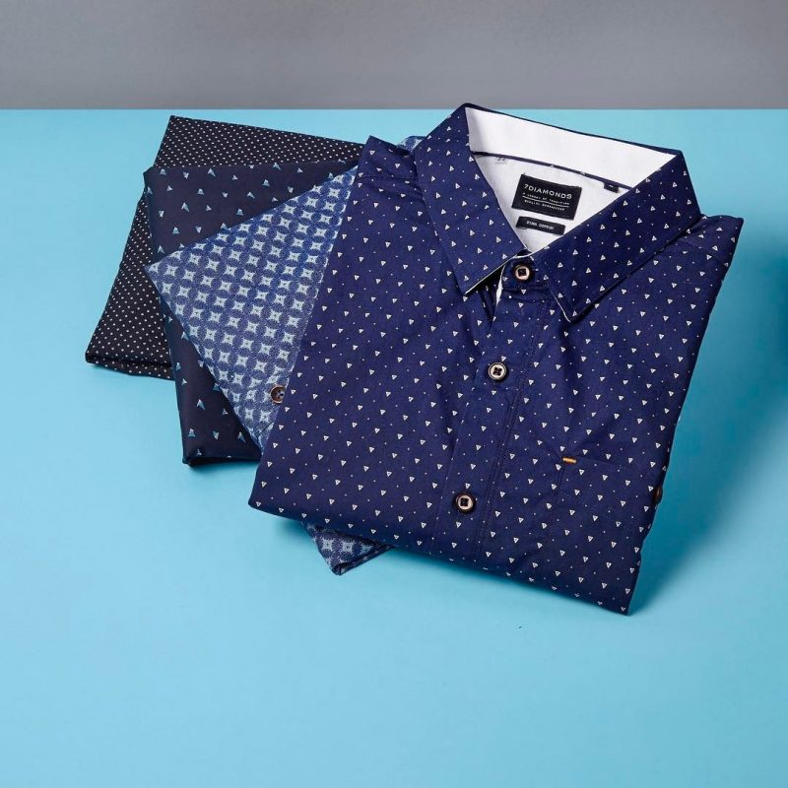
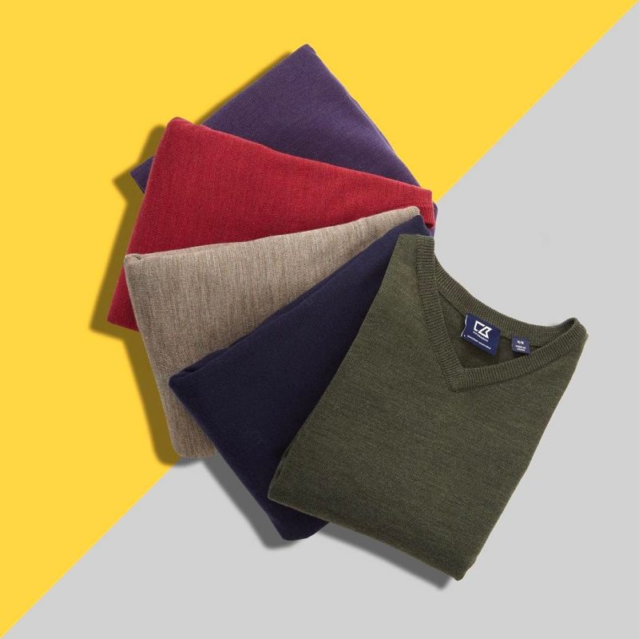
Packages
Unlimited Shirts Subscription
Unlimited Tees Subscription

Slide 8
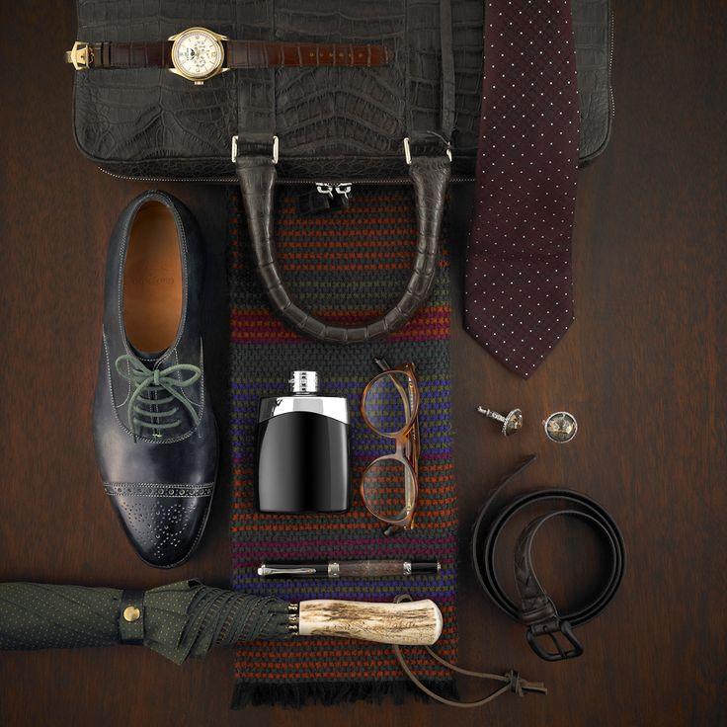
Fashion Accessories Subscription

Slide 9
Rent For An Occasion!
Here you can get luxurious party wear on rent at just 10% of the price.
Party wear includes cool Blazers of different types and different necks.

Slide 10
Talk to a Stylist
They are providing you with a very good feature that is “A stylist of your own”.
You can reach out to him for any queries related to fashion and styling.
Just ping him and he will reach out to you within 24 hours.
There is a CHAT LIVE option also available for which you have to get an appointment.

Slide 11



Achievements

Slide 12

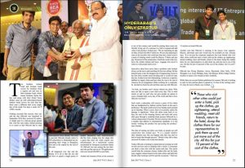

Slide 13
The team has successfully raised $30,000 from Spark10, a European Accelerator and with over 150 orders in a span of just 2 weeks and aim to reach 1000 orders in the next 4 months.
Further, they want to add party and festive wear to the catalogue making OhLook a one-point-stop for all of a men’s clothing needs.
OhLook currently is an invite-only service. Customers can choose the size and request for invite.
The current estimated wait period mentioned on the site is between 20-25 days, however, the team claims that orders will be fulfilled within 2 weeks from the time the order is placed.

Slide 14
Conclusion
They make sure that men don’t have to ever worry about their style and fashion needs
They offer 5 services like Subscription based fashion rental, On-Demand, Styling, Tailor-made Designer clothes and luggage less travel
Clothes they provide are 99% germ Free
Invested zero penny on marketing.
Good bye to hassles managing of wardrobe.

Slide 15
They have identified 6 cities where the service could be good fit that includes Hyderabad, Bangalore, Delhi NCR, Pune, Mumbai and Chennai. The target is to be active in 3 cities in the next 18 months.
They receive a minimum of 10 calls every day from Bangalore and Delhi, requesting when the services will be available in those cities.
Additionally, they estimate OhLook.in can penetrate Tier-II cities as well. However, haven’t explored the market opportunity there, as yet.

Slide 16
Thank you

