Slide 1


ANNAMACHARYA INSTITUTE OF TECHNOLOGY AND SCIENCES
UTUKUR (P), C. K. DINNE (V&M), KADAPA, YSR DIST.
Approved by AICTE, New Delhi & Affiliated to JNTUA, Anantapuramu.
Approved by S.B.T.E.T. Andhra Pradesh.
Accredited by NAAC with ‘A’ Grade, Bangalore & NBA (EEE, ECE &CSE)
Design of Hamming Code Encoding and Decoding Based on Clock Gating Technique
Presented by:
P. Sruthi | 22HM1A0447
T. Harshitha | 22HM1A0463
P. Sandya | 22HM1A0446
P. V. Deepak | 22HM1A0442
Under Guidance of:
Dr. O. Homa Kesav , M.Tech., (Ph.D) &
Associate Professor

Slide 2
ABSTRACT
Hamming code is widely used for error detection and correction in digital systems. However, conventional designs suffer from high power consumption due to continuous switching activity. Clock gating reduces power but still has limitations. This project proposes a reversible logic-based Hamming encoder and decoder to reduce power and delay. The design is implemented using Verilog HDL and simulated in Vivado. Results show improved power efficiency and performance compared to existing methods.

Slide 3
INTRODUCTION &SCOPE
Digital systems require reliable data transmission
Errors occur due to noise, interference, faults
Hamming code provides:
Single-bit error correction
Double-bit error detection
Used in:
Memory systems
Communication systems
Embedded systems

Slide 4
LITERATURE SURVEY
Year | Title / Author | Method Used | Drawbacks
2018 | Margala et al. – Low Power Arithmetic Compressor Design | Low-power compressor circuits | Focus only on arithmetic, not full Hamming system
2019 | Tongsheng Zhang & Qun Ding – FPGA Implementation of (15,11) Hamming Code | FPGA-based Hamming implementation | High complexity, not optimized for power
2020 | Liang et al. – Reliability Metrics for Approximate Computing | ECC-based reliability techniques | No complete hardware implementation
2021 | Kalaichevi – Design of Hamming Code Encoding and Decoding Parity CRC | Comparison of parity, CRC, Hamming codes | Only theoretical, no hardware design
2024 | Simmi Garg & Anuj Sharma . – Design of Hamming Code Encoder and Decoder Using Logic | Clock gating for power reduction | Still uses irreversible logic, energy loss exists

Slide 5
PROBLEM IDENTIFICATION & OBJECTIVES
Problem:
High power consumption
Continuous clock switching
Energy loss in irreversible logic
Objectives:
Reduce power
Reduce delay
Improve efficiency
Design low-power Hamming system

Slide 6
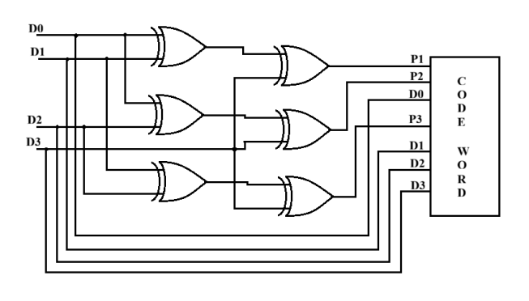
EXISTING METHODS
1. Conventional Method
Encoder

Slide 7
ENCODER
The input is an n-bit data word (shown as 4-bit).
Some bit positions are reserved for parity bits.
The XOR gates calculate parity bits.
Each parity bit checks a specific combination of data bits.
Finally, data bits and parity bits are combined in proper positions to form the Hamming codeword.

Slide 8
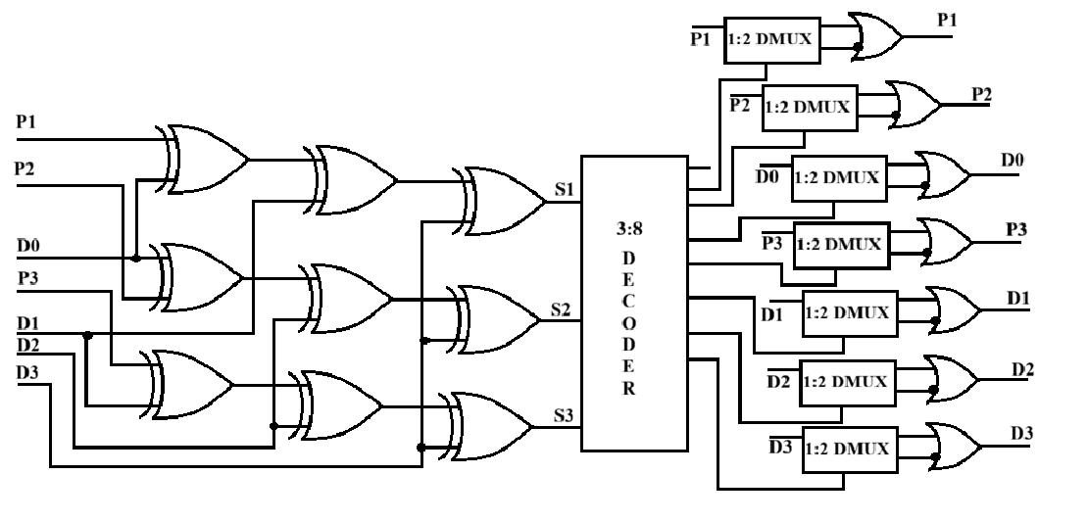
Decoder

Slide 9
DECODER
The received Hamming code is given as input.
Checker bit generator (XOR gates) recalculates parity.
The outputs of XOR gates form a syndrome.
The syndrome value indicates:
syndrome = 0(No error)
syndrome ≠ 0 Error
A decoder (like 3-to-8 decoder) identifies the faulty bit.
That bit is corrected by flipping it.
Corrected data bits are sent to the output.

Slide 10
DRAWBACKS
High dynamic power
Continuous switching
Heat generation
No power optimization
Not suitable for low-power VLSI

Slide 11
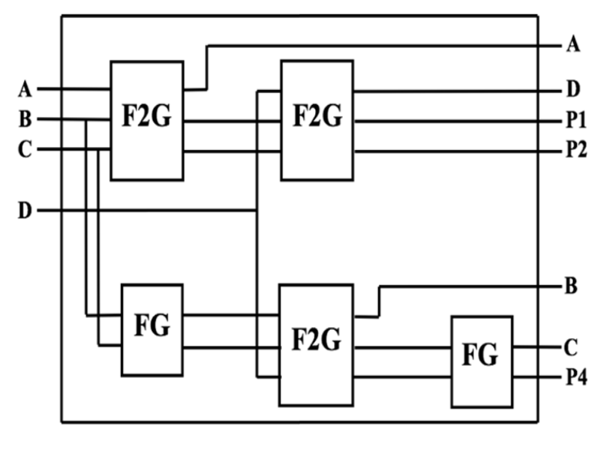
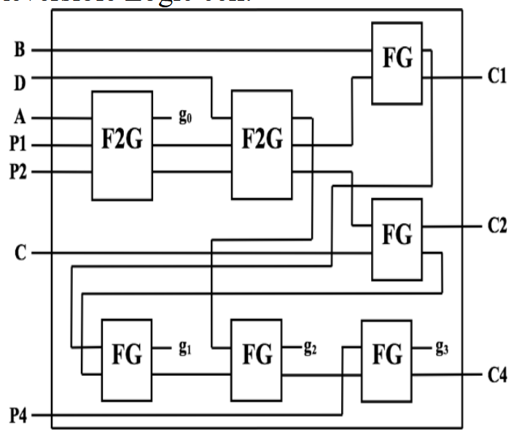
PROPOSED METHOD
Reversible Logic
Decoder
Encoder

Slide 12
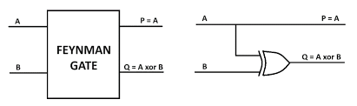
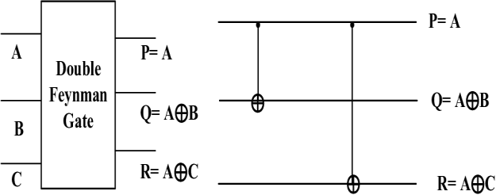
Internal structure of FG and F2G

Slide 13
The overall architecture consists of interconnected F2G and FG blocks arranged in multiple stages.
Primary inputs (D0, D1, D2, D3, P1, P2, P4, etc.) are first processed by F2G blocks to generate intermediate logic signals.
These intermediate signals are routed through the system and combined using FG blocks.
Cascaded FG blocks (g₀, g₁, g₂, g₃) allow the system to build complex logic functions step-by-step.
The final outputs (C1, C2, C4) represent the computed results of the overall logic operation.

Slide 14
METHODOLOGY
Step 1: Input data (4 bits) Step 2: Generate parity bits Step 3: Form codeword Step 4: Detect error using syndrome Step 5: Correct error

Slide 15
ADVANTAGES & APPLICATIONS
Advantages:
Low power
Less switching
High efficiency
Reduced delay
Applications:
Memory systems
Communication
FPGA systems

Slide 16
IMPLEMENTATION & TOOLS
Language: Verilog HDL
Tool: Xilinx Vivado
Platform: FPGA
Steps:
Coding
Simulation
Synthesis
Implementation

Slide 17
RESULTS
EXISTING METHOD-1
EXISTING ENCODER AND DECODER

Slide 18
EXISTING CORRECTION BLOCK

Slide 19
EXISTING METHOD-2

Slide 20
PROPOSED ENCODER AND DECODER

Slide 21
PROPOSED CORRECTION BLOCK

Slide 22
COMPARISON TABLE
PARAMETERS | EXISTING METHOD-1 | EXISTING METHOD-2 | PROPOSED METHOD
POWER(W) | 15.566 | 11.96 | 9.551
DELAY(ns) | 8.39 | 8.277 | 8.217
PDP(W. ns) | 130.56 | 98.99 | 78.49
EDP(W. ns²) | 1095.76 | 819.364 | 644.88

Slide 23
FUTURE SCOPE
Extend to higher-bit Hamming codes
Use FinFET / CNTFET
Apply in ADC systems
Use AI optimization

Slide 24
THANK YOU

