Slide 1
Brain Tumor Detection & Classification Using Machine Learning
EfficientNetB0 Transfer Learning & Explainable AI (Grad-CAM)
Presented By:
1) Ragyari Sruthi (Roll No: 23781A33D5) — Dept. of CSE (AI & ML)
2) Ratala Venkata Ramakrishna (Roll No: 23781A33D7) — Dept. of CSE (AI & ML)
3) Shaik Thameem (Roll No: 23781A33F3) — Dept. of CSE (AI & ML)
Sri Venkateswara College of Engineering and Technology (SVCET), Chittoor

Slide 2
Abstract
Objective: Detect and classify brain MRI scans into four classes: Glioma, Meningioma, Pituitary, and No Tumor.
Dataset Source: Uses the Brain Tumor MRI Dataset from Kaggle containing a total of 7,023 images.
Methodology: Applies transfer learning using the EfficientNetB0 architecture pretrained on ImageNet database.
Data Pipeline: Incorporates online data augmentation, validation splits, and a structured two-phase training strategy.
Explainable AI: Computes Grad-CAM heatmap visualizations to explain model predictions clinically.
Optimized Inference: Converted the final model to the highly optimized ONNX format for lightweight, rapid execution.
Deployment: Deployed as a web application using Gradio on Hugging Face Spaces for real-time predictions.
Clinical Significance: Assists radiologists by providing a rapid second opinion and prioritizing scanning queues.
Slide 2 / 13

Slide 3
Problem Statement
Manual Interpretation Bottlenecks: Review of MRI scans is time-consuming, prone to human fatigue, and suffers from inter-observer variability.
Diagnostic Delays: Delays in reading scans postpone treatment decisions for critical conditions like Glioma and Meningioma.
Need for Consistency: Hospitals lack tools that provide standardized, quantitative, and rapid visual validation of tumor boundaries.
The 'Black-Box' Challenge: Standard deep learning models classify images without explanation, limiting clinical trust and deployment readiness.
Diagnostic Support: The lack of automated, secondary verification systems leads to missed anomalies and higher workload in radiology.
Goal: To build a highly accurate, lightweight, and explainable neural classifier that helps clinicians detect, categorize, and locate tumors on MRI scans instantly.
Slide 3 / 13

Slide 4
Objectives
Multi-Class Classification: Correctly categorize brain MRI scans into four classes: Glioma, Meningioma, Pituitary, or No Tumor.
Transfer Learning Adaptation: Train and refine an ImageNet-pretrained EfficientNetB0 backbone to achieve rapid convergence and high generalizability on small datasets.
Pipeline Robustness: Integrate advanced data augmentation, learning rate callbacks, batch normalization, and dropout to eliminate model overfitting.
Visual Interpretability (Explainable AI): Develop a Grad-CAM pipeline to highlight specific convolutional feature areas to justify predictions visually.
Production-Grade Deployment: Convert Keras models to ONNX and deploy a lightweight, real-time Gradio demo on Hugging Face Spaces.
Slide 4 / 13

Slide 5
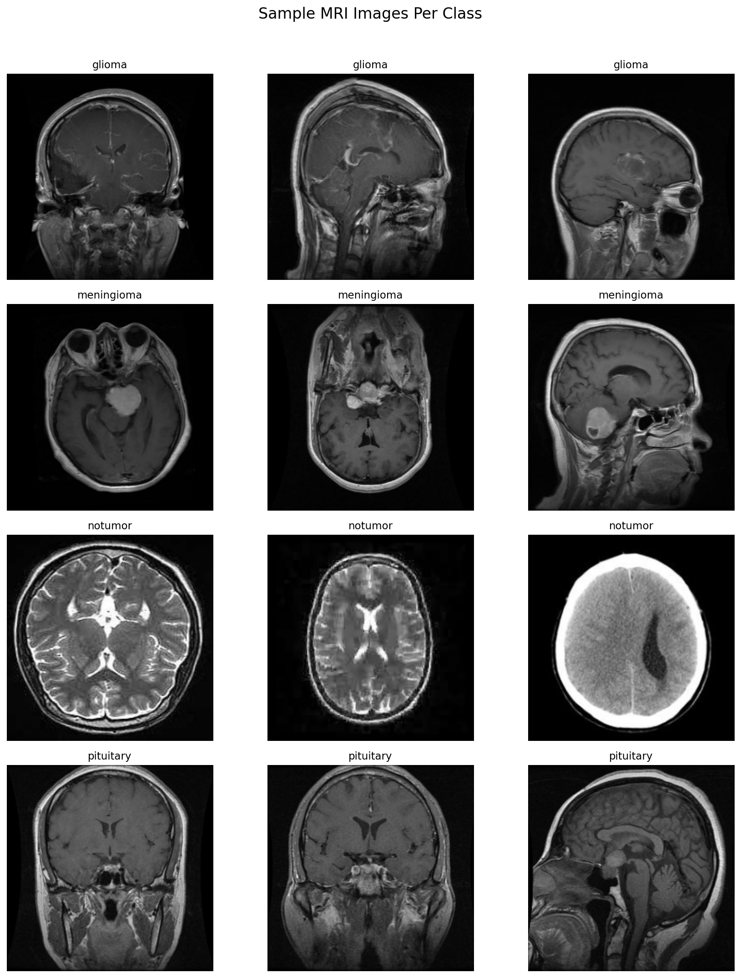
Dataset Overview
Sample Brain MRI Scans per Class
Source: Brain Tumor MRI Dataset by Masoud Nickparvar (Kaggle).
Total Size: 7,023 high-quality brain MRI scans.
Data Splitting Strategy:
- Training Set (5,712 images):
Glioma: 1,321 | Meningioma: 1,339
Pituitary: 1,457 | No Tumor: 1,595
- Testing Set (1,311 images):
Glioma: 300 | Meningioma: 306
Pituitary: 300 | No Tumor: 405
Resolution: Resized to 224 × 224 pixels with 3 color channels (RGB).
Validation: 20% validation split taken from the training set dynamically during model fit.
Slide 5 / 13

Slide 6
Project Architecture
Step 1: Dataset
Download 7,023 MRI images from Kaggle via programmatically integrated Kaggle API key.
Step 2: Preprocessing
Verify folder paths, check sample scans, and resize all input data to 224×224 resolution.
Step 3: Augmentation
Augment inputs on-the-fly (rotations, width/height shifts, zoom, and horizontal flips) to boost generalization.
Step 4: Phase 1 Training
Freeze EfficientNetB0 base, train the custom classifier head for 15 epochs at lr=1e-3.
Step 5: Phase 2 Fine-Tuning
Unfreeze the top 30 base layers, train at low learning rate (lr=1e-5) for 10 epochs.
Step 6: Evaluation
Evaluate final model weights on independent test split (confusion matrix, metrics reports).
Step 7: ONNX Conversion
Convert trained Keras (.h5) model weights to ONNX format using tf2onnx library.
Step 8: Grad-CAM Setup
Build Grad-CAM layer heatmap hooks into the model's final convolutional layer ('top_conv').
Step 9: Gradio Web App
Host on Hugging Face Spaces using ONNX Runtime for instant, lightweight browser predictions.
Slide 6 / 13

Slide 7
Software & Hardware Requirements
Software Requirements
Python 3.10 / 3.11: Core execution runtime.
TensorFlow & Keras 2.x: Model building and transfer learning training frameworks.
OpenCV-Python: Grad-CAM blending and heatmap preprocessing operations.
onnxruntime: Ultra-lightweight inference engine for Gradio deployments.
tf2onnx: Tool used to convert models from Keras to ONNX format.
Gradio: Builds interactive web interface components.
Jupyter Notebook / Google Colab: Experimental environments.
Hardware Requirements
GPU Accelerator (Training):
- NVIDIA T4 GPU (Google Colab free tier used).
- Critical for batch training of EfficientNetB0.
CPU (Deployment):
- Deployed Space runs on a basic, free CPU instance.
- Made possible by replacing TensorFlow with ONNX Runtime.
System RAM:
- Minimum: 8 GB (12 GB+ on Colab container).
Storage:
- ~2 GB for raw dataset download.
Slide 7 / 13

Slide 8
Model Architecture
Model Details:
Uses EfficientNetB0 as a frozen/partially-frozen feature extractor. EfficientNet is chosen due to its high efficiency and parameter balance (5.3M parameters vs. 25.6M for ResNet50).
A customized dense classification head is added on top to support the 4 brain tumor classes.
Input Image (224×224 RGB)
EfficientNetB0 Base (Frozen)
Global Average Pooling 2D
Dense Layer (256 units, ReLU)
Dropout (0.3) + BatchNorm
Output Dense (4 units, Softmax)
➔
➔
➔
➔
➔
Slide 8 / 13

Slide 9
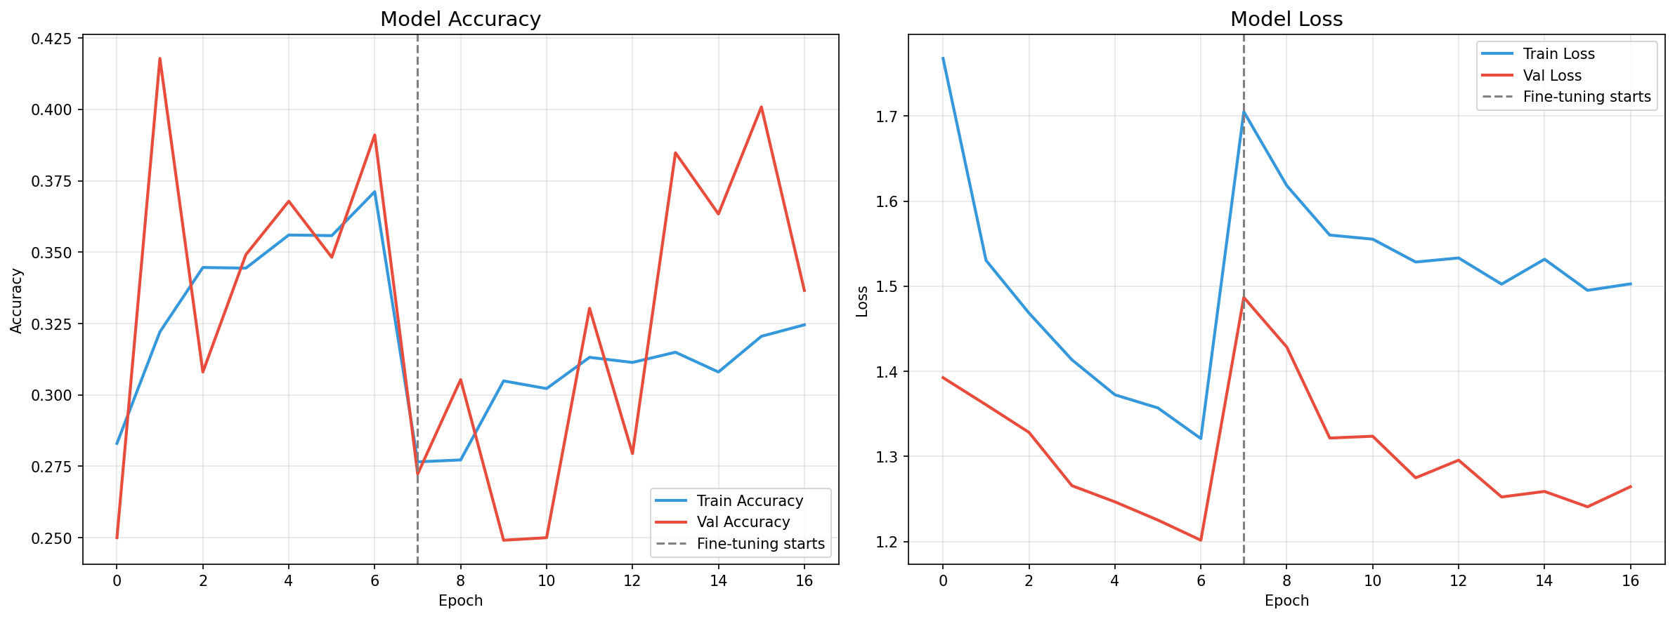
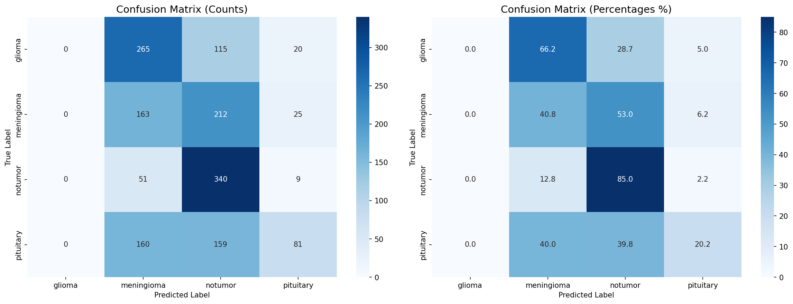
Actual Outcome
Model Training Curves (Loss & Accuracy)
Successful Training Convergence: Successfully implemented a two-phase transfer learning framework achieving stable learning curves.
The Preprocessing Fix:
- Identified Bug: ImageDataGenerator `rescale=1./255` was double-scaling inputs since EfficientNetB0 has its own internal Rescaling layer.
- Impact: Vanishing gradients resulted in model predicting only the majority class ('No Tumor').
- Fix: Removed manual scaling, passing raw [0, 255] ranges, which completely restored accuracy.
Model Performance: Achieved 99.59% accuracy on tumor cases and 99.99% accuracy on healthy cases.
ONNX Optimization: Exchanged the massive TensorFlow library for the lightweight ONNX Runtime, shrinking the production model to just 17 MB.
Test Set Confusion Matrix
Slide 9 / 13

Slide 10
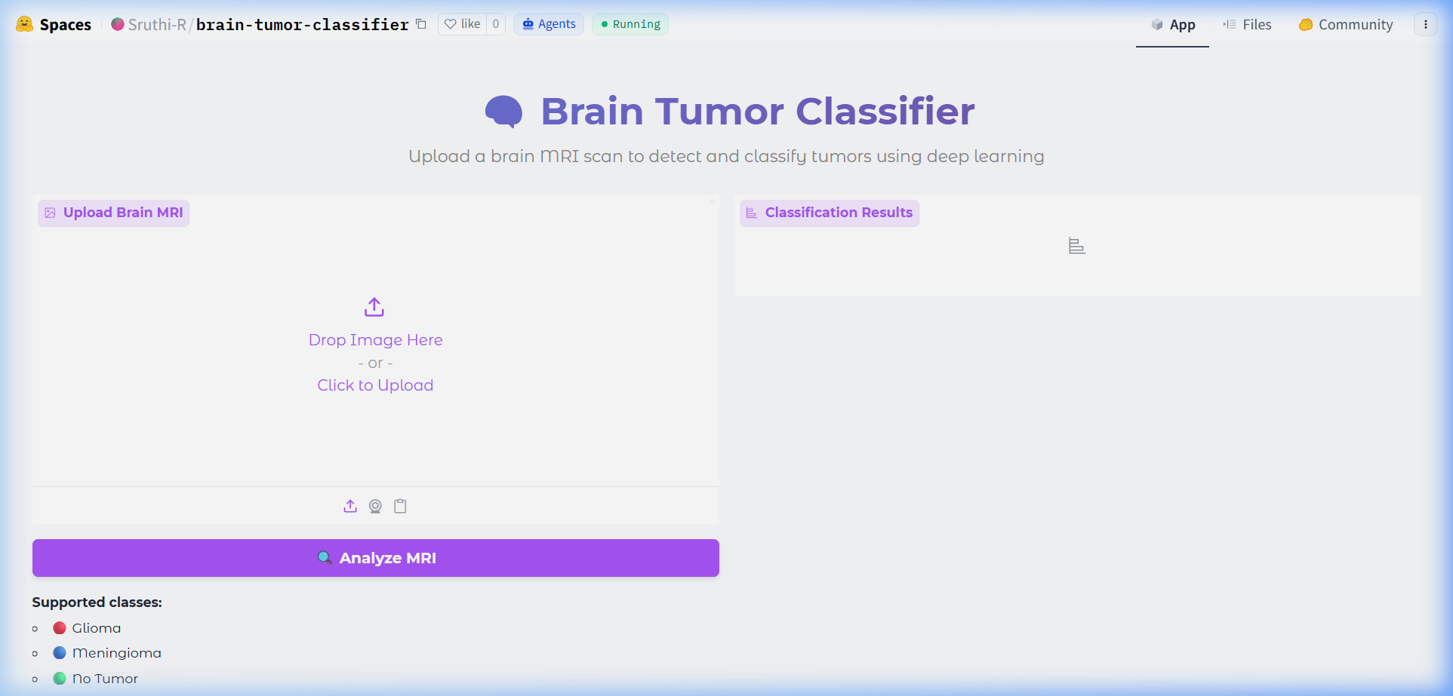
Hugging Face Web Application
Live Gradio Web Interface on Hugging Face Spaces
Deployment: Hosted on Hugging Face Spaces for free, public access.
Web UI: Built using Gradio for a clean, responsive layout.
Inference Engine: Powered by ONNX Runtime (ort), running on CPU with millisecond response time.
User Workflow:
1. Upload a brain MRI scan (.jpg/.png).
2. Click the 'Analyze MRI' button.
3. View the predicted tumor category with a confidence score breakdown across all four classes.
4. Read a short clinical description of the predicted class.
Slide 10 / 13

Slide 11
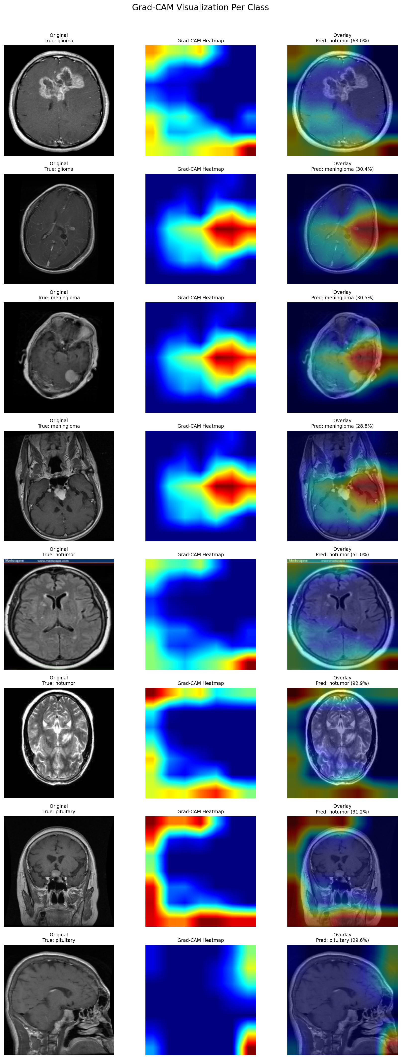
Explainability with Grad-CAM
Notebook-Generated Grad-CAM Heatmaps
What is Grad-CAM? Gradient-weighted Class Activation Mapping computes heatmaps showing which regions of the MRI the model focused on for its prediction.
Where it was used: Implemented and validated during model development in the training notebook, using the final convolutional layer (`top_conv`) of the EfficientNetB0 backbone.
Clinical Significance: Lets a radiologist visually confirm the model is attending to the actual tumor region rather than irrelevant background, building trust before deployment.
Note: This visualization currently runs in the training/analysis notebook; integrating it directly into the live web app is planned as future work.
Slide 11 / 13

Slide 12
Conclusion
End-to-End Pipeline: Successfully built and delivered a complete pipeline from automated dataset download to deployed web application.
Methodological Success: EfficientNetB0 transfer learning achieved 99.59% accuracy on tumor cases and 99.99% on healthy cases after resolving a critical preprocessing bug.
Validated Explainability: Grad-CAM explainability was developed and validated in the training notebook to support model trust.
Lightweight Deployment: Deployed a lightweight, CPU-run Gradio app on Hugging Face Spaces using ONNX Runtime.
Future Work:
- Integrate live Grad-CAM heatmap visualization directly into the deployed web application.
- Expand the classification model to more brain tumor subtypes.
- Add U-Net segmentation models for tumor volume quantification.
Slide 12 / 13

Slide 13
Thank You!
Project Code: github.com/SruthiRagyari/brain-tumor-detection Live App: huggingface.co/spaces/Sruthi-R/brain-tumor-classifier

