Slide 1
Microsoft Fabric
Data Engineering Pipeline
End-to-end daily sales data pipeline: CSV → Bronze → Silver → Warehouse → Power BI
Sruthi Vippaturi
Microsoft Fabric | PySpark | T-SQL | Power BI

Slide 2
Architecture Overview
Source CSV
Bronze Layer
Silver Layer
Gold Warehouse
Power BI
src_product
Lakehouse
lhb_Product
Raw data as-is
lhs_product
Transformed data
Dw_Bi_Reporting
Reporting layer
Sales Order
Dashboard
→
→
→
→
1
File validation & duplicate check
4
Data transformation & enrichment
2
Audit logging at every stage
5
T-SQL warehouse load with error handling
3
Schema validation via PySpark

Slide 3
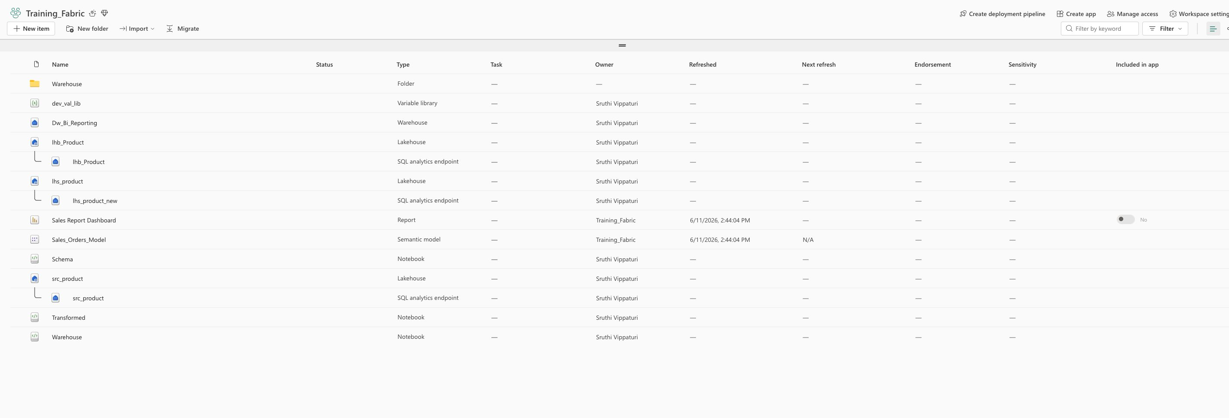
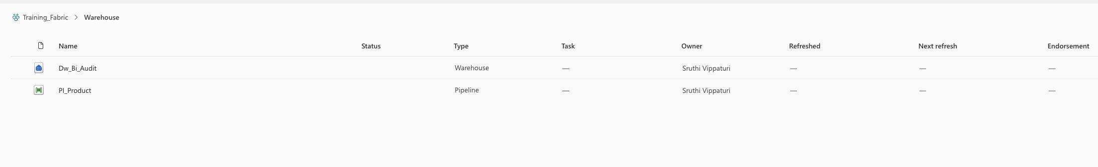
Workspace Setup — Training_Fabric
Lakehouses:
src, bronze, silver
Warehouses:
Reporting + Audit
Notebooks:
Schema, Transformed, Warehouse
Variable Lib:
dev_val_lib (DEV/TEST/PROD)

Slide 4
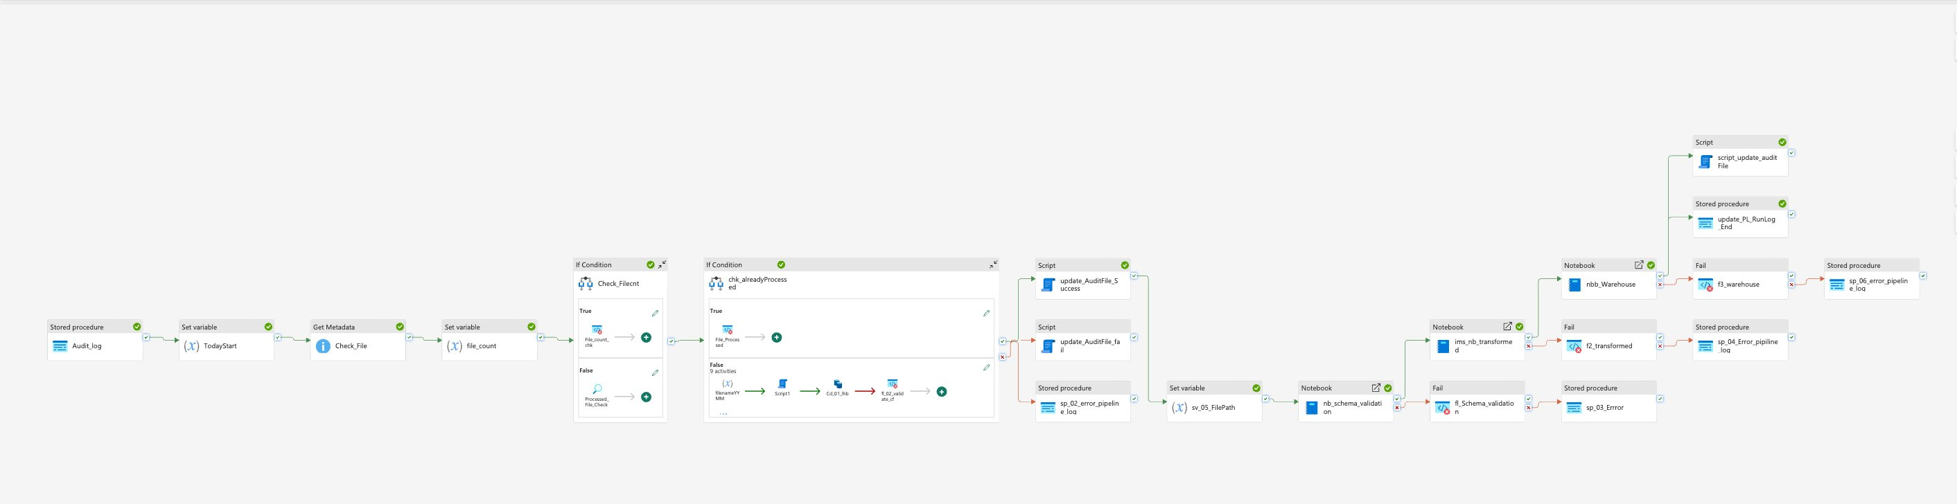
Pipeline Design — PI_Product
20 activities including file validation, schema checks, transformations, audit logging and error handling

Slide 5
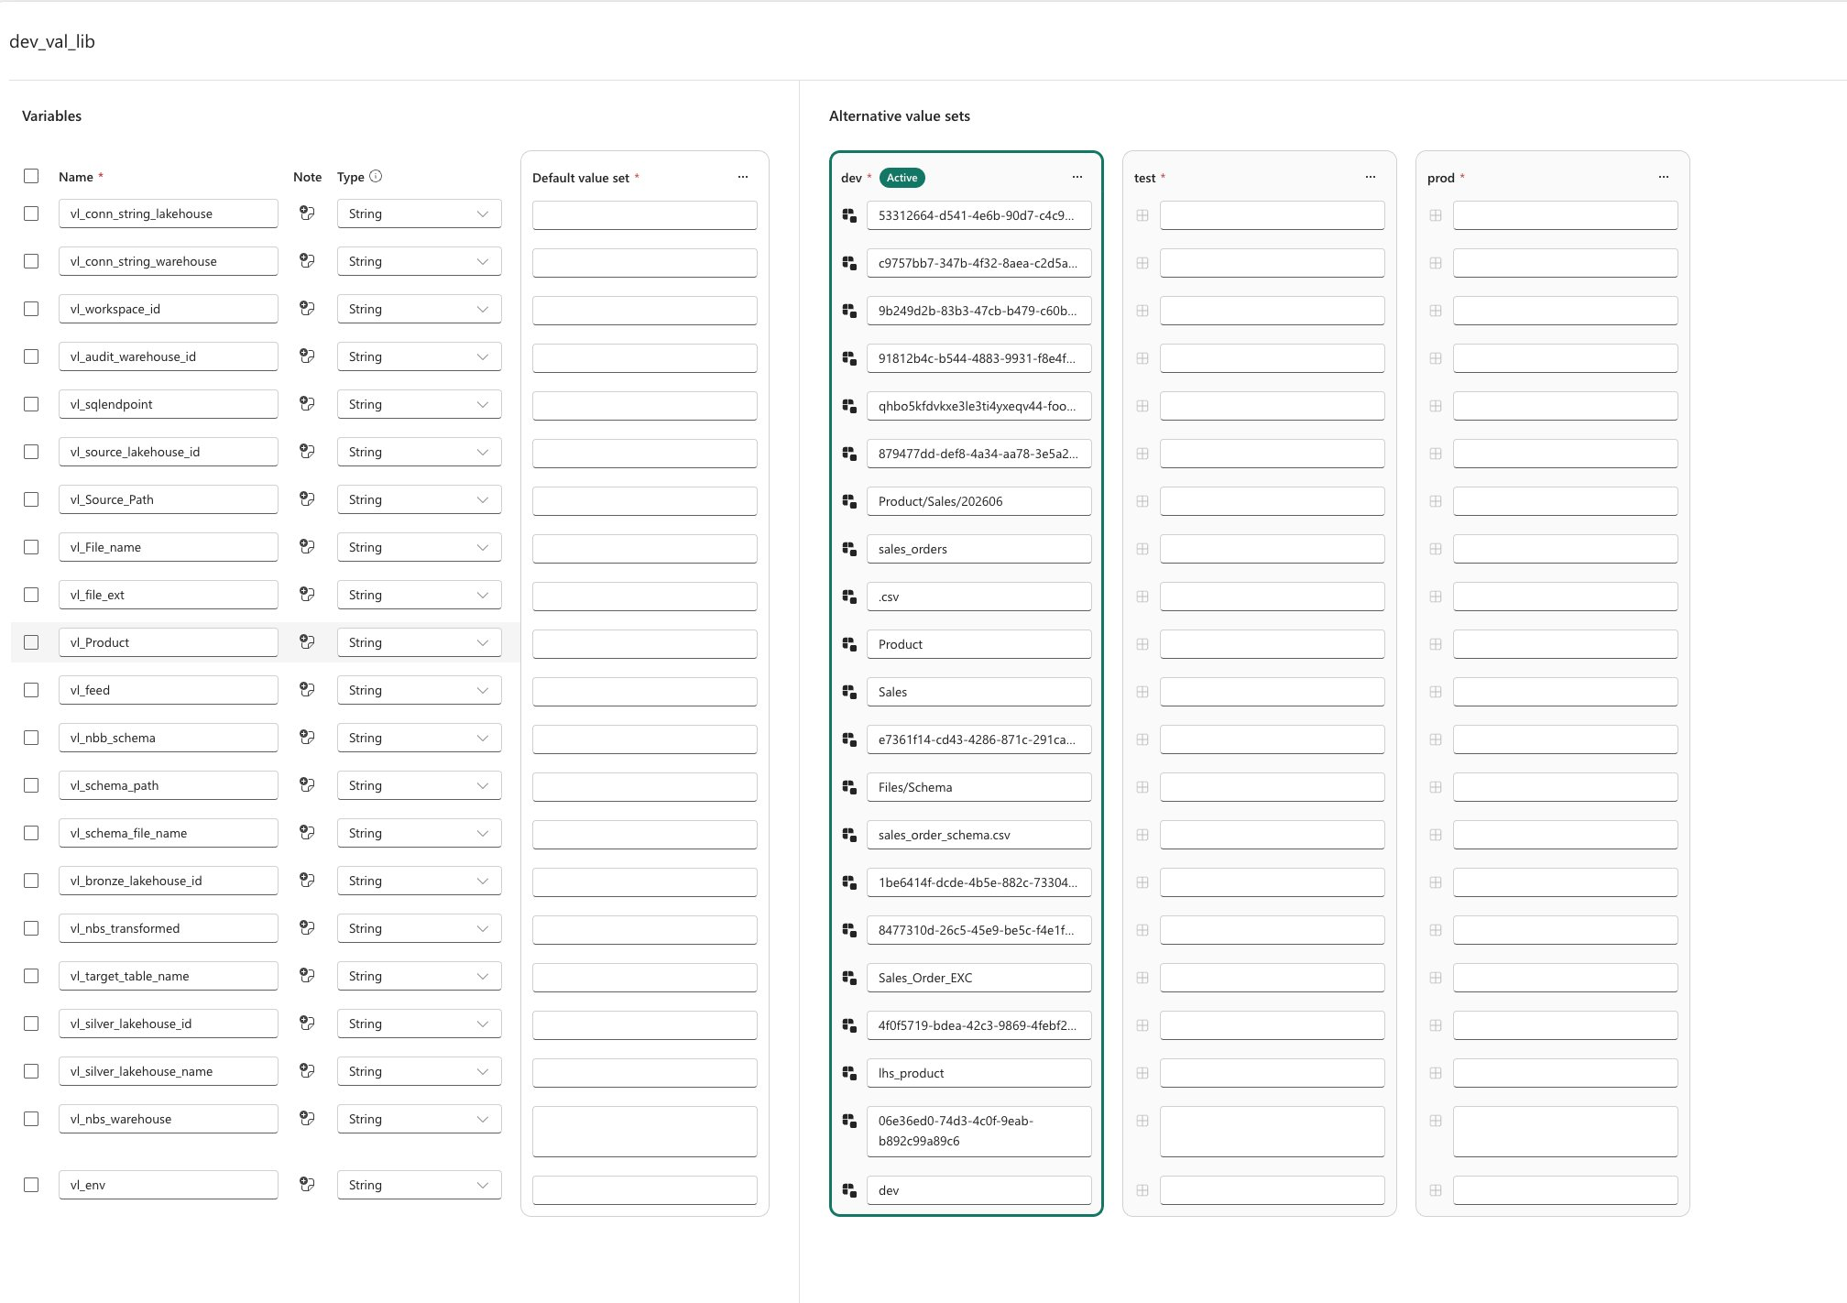
Dynamic Configuration — dev_val_lib
No Hardcoded Values
All IDs, paths and endpoints stored in variable library
Multi-Environment
DEV / TEST / PROD — same pipeline, zero code changes
Dynamic Notebooks
Notebook IDs resolved at runtime from library
Workspace Agnostic
Workspace ID parameterized for easy migration

Slide 6
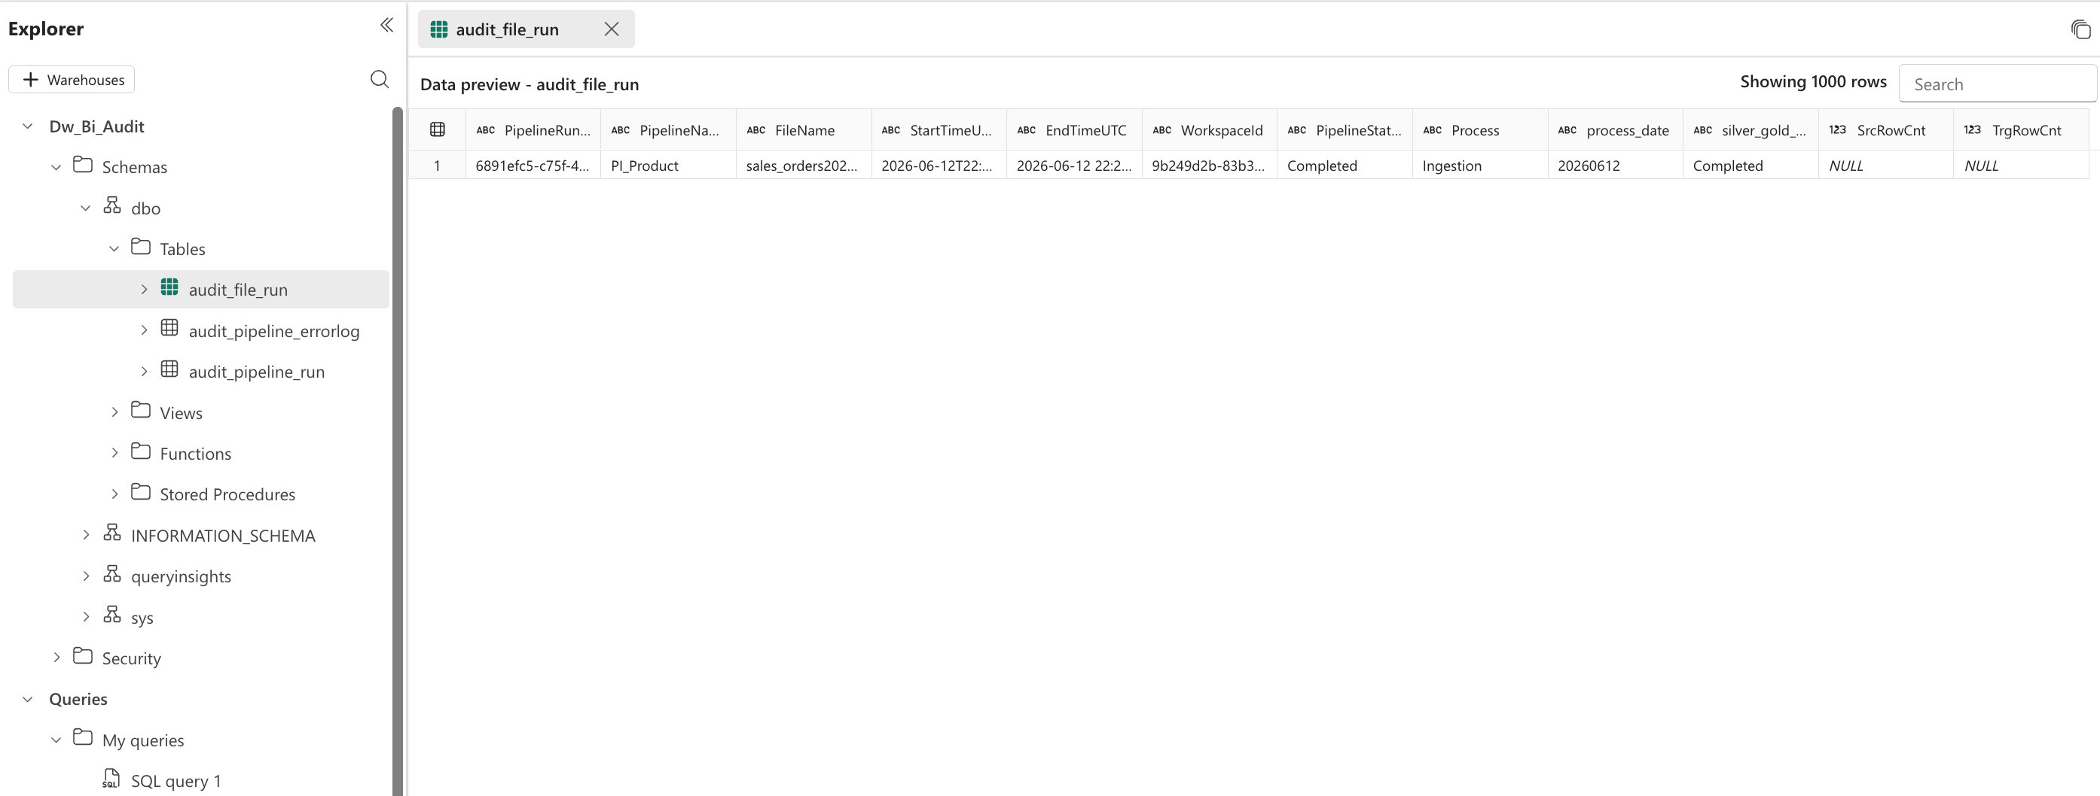
Audit Logging — Full Pipeline Tracking
Pipeline run tracked start to finish
Status: In Progress → Completed / Failed
File name, date and workspace captured
Silver/Gold load status tracked separately

Slide 7
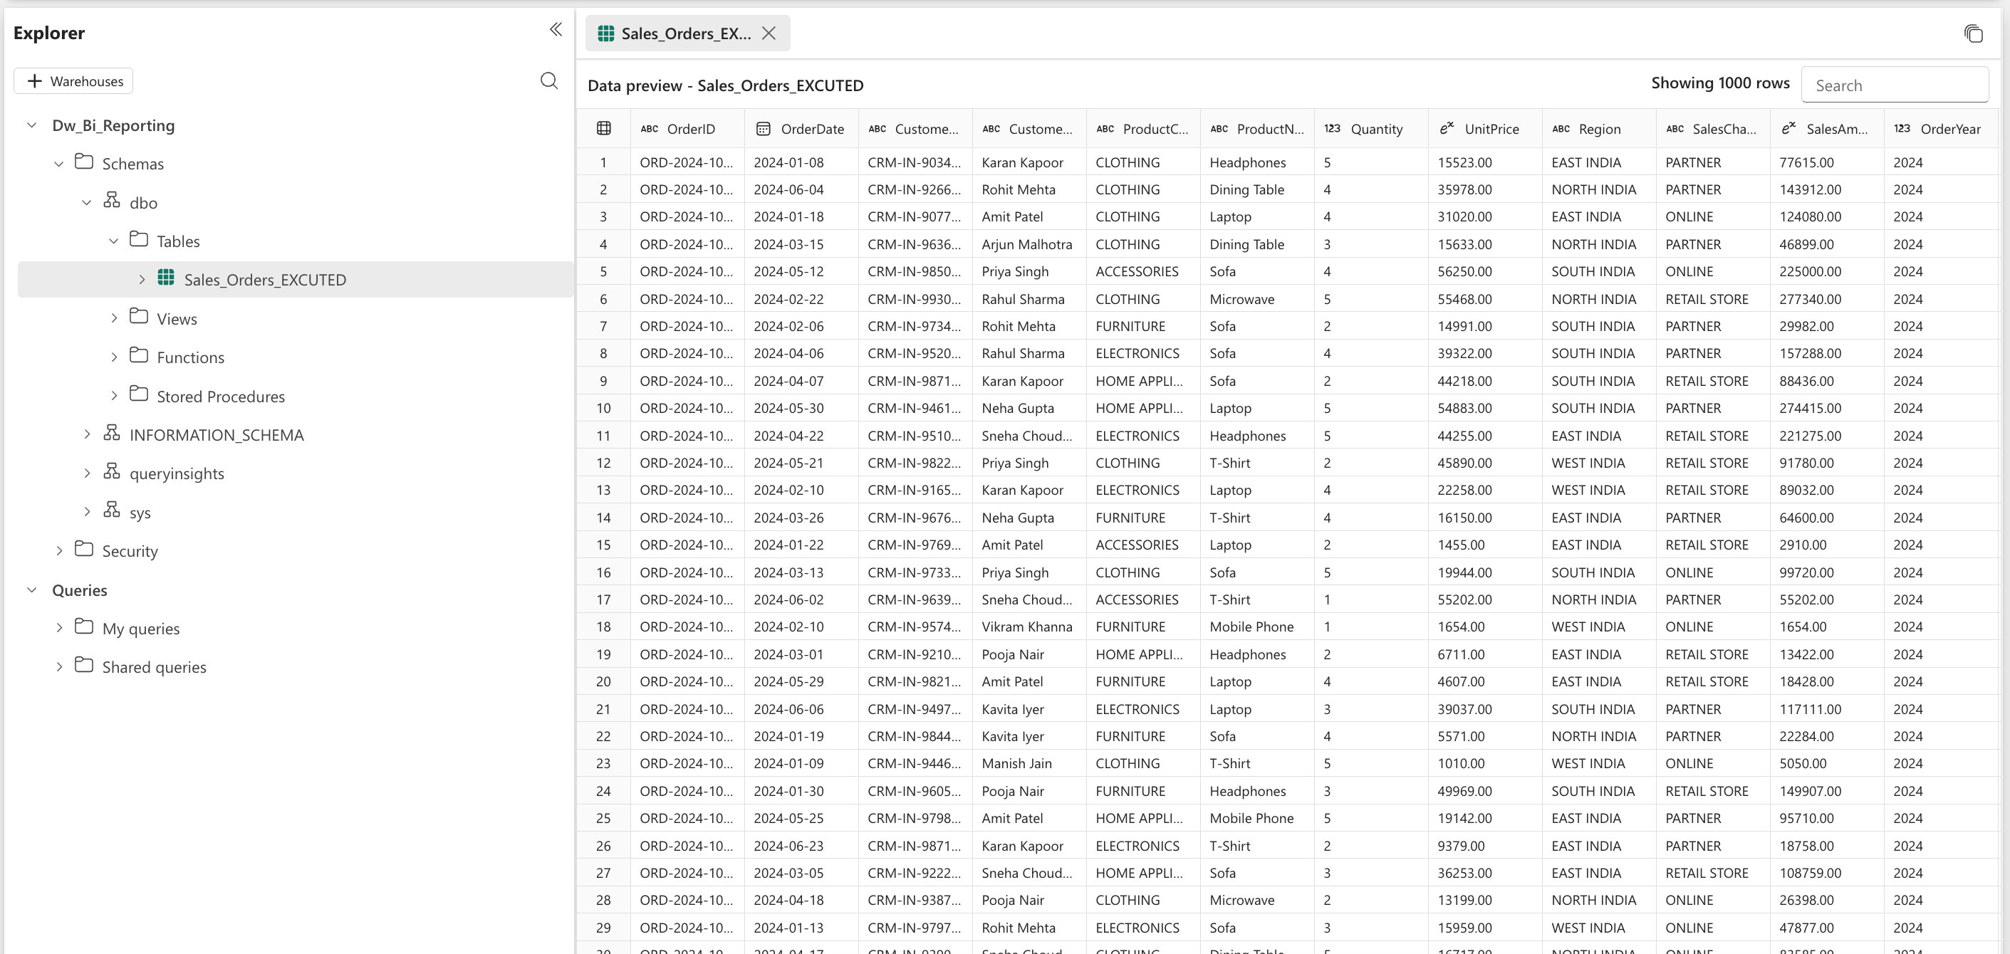
Data Loaded — Dw_Bi_Reporting
1,000
2
16
100%
Rows Loaded
Daily Runs
Columns
Success Rate

Slide 8
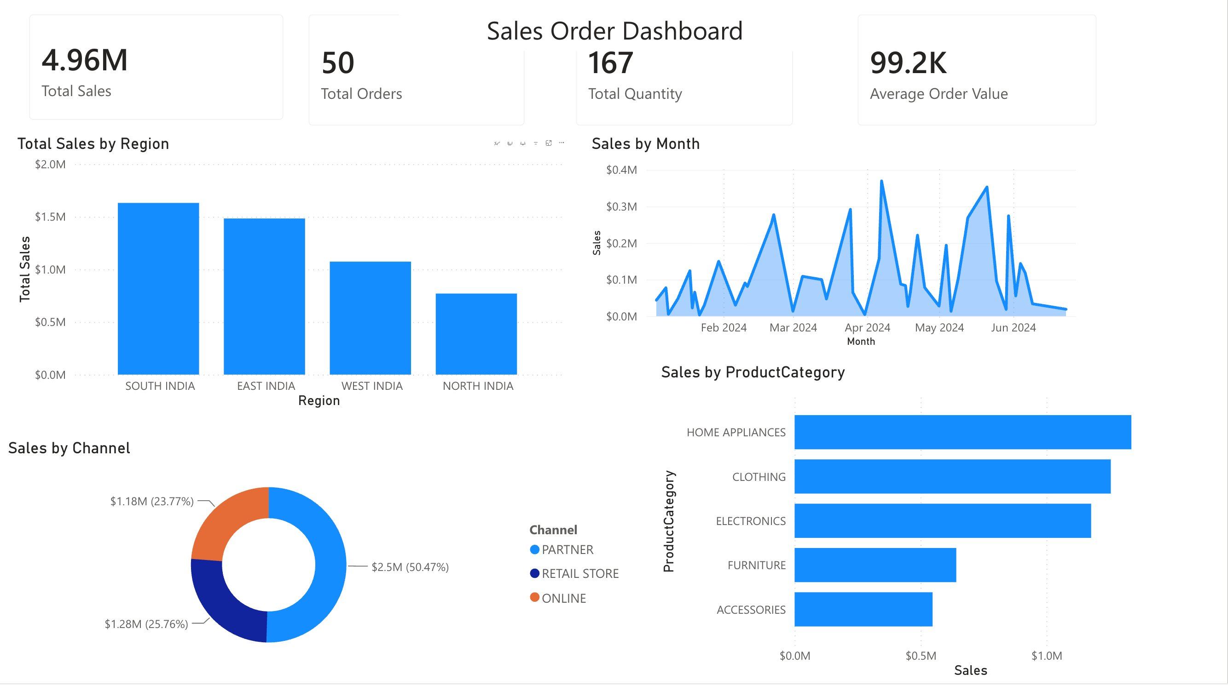
Power BI Dashboard — Sales Analytics

Slide 9
Technologies Used
Microsoft Fabric
PySpark
T-SQL
Pipelines, Lakehouses, Warehouses
Data transformation notebooks
Warehouse loading notebooks
Power BI
Variable Library
Delta Lake
Direct Lake reporting
Dynamic multi-env config
Parquet format in lakehouses
GitHub: github.com/SruthiVippaturi/Microsoft-Fabric-Sales-Pipeline

