Slide 1
Dialogue Summarizer based on Gen AI
SRUTHI H (2021506108)
3/21/2024 Annual Review

Slide 2
Dialogue Summarizer based on Gen AI
Our project introduces a Dialogue Summarizer employing a Gen AI based flan t5 model.
The Gen AI based flan t5 model learns to generate concise and contextually relevant summaries by adversarially training a generator.
Experimental evaluations demonstrate superior performance in producing coherent and informative summaries.
3/21/2024 Annual Review

Slide 3


Agenda
Problem Statement
Project Overview
End users
Solution and its Value Proposition
The Wow in a Solution
Modelling
Results
3/21/2024 Annual Review

Slide 4

Problem Statement
Existing dialogue summarization methods face difficulties in maintaining coherence and capturing contextual nuances.
To address this, we propose a Dialogue Summarizer based on the Flan generative AI model. This system aims to efficiently generate coherent and contextually relevant summaries from dialogues, enhancing conversational data analysis.
3/21/2024 Annual Review

Slide 5

Project Overview
This project has been used to perform the task of dialogue summarization using Generative AI. Through the use of different techniques to the inference process, the exploration of how different prompts (input text) affect the completion (output) of the model, was performed.
Prompt engineering was carried out, by comparing zero shot, one shot and few shot inferences, with the intention to see how to best enhance the generative output of the Large Language Model.
3/21/2024 Annual Review

Slide 6

Who are the end users?
Content Creators and Social Media Managers: Needing to distill and understand user conversations, comments, and feedback on platforms in social media.
Customer Support Teams: Seeking to summarize customer interactions and extract key information for improving services and addressing customer needs.
News Agencies and Journalists: Seeking to quickly summarize interviews, press conferences, and debates for news reports and articles.
Chatbot Developers: Utilizing summarized dialogues as training data for building and improving conversational AI systems.
News Agencies and Journalists: Seeking to quickly summarize interviews, press conferences, and debates for news reports and articles.
3/21/2024 Annual Review

Slide 7
Algorithm

Slide 8
Solution
Our solution is a Dialogue Summarizer leveraging the Flan generative AI model. It employs advanced natural language processing techniques to distill conversational exchanges into concise and contextually relevant summaries.
Value proposition
Contextually Relevant Summaries - Users can extract key insights and actionable information from complex conversational exchanges.
Scalability and Adaptability - Our solution is highly scalable and adaptable to diverse domains and use cases, accommodating varying data sources, languages, and conversation types.
Productivity and Collaboration - With the ability to generate summarized insights from large volumes of conversational data, our solution promotes collaboration.
Personalized Summarization - Users can define specific criteria or topics of interest, allowing the system to generate summaries that align with their unique requirements.
Enhanced Efficiency - It automates the labor-intensive task of manually distilling conversational data, allowing users to focus on higher-value analysis.
3/21/2024 Annual Review

Slide 9

The wow in your solution
Contextual Understanding
Our Dialogue Summarizer demonstrates an exceptional ability to understand the context of conversations, providing summaries that capture the essence of dialogues with remarkable accuracy and depth.
Real-Time Adaptability
With real-time summarization capabilities, our solution adapts dynamically to evolving conversations, delivering instant insights and keeping users informed.
Interactive Engagement
By offering an interactive interface for summarization refinement, our solution enables users to actively engage with summaries, fostering collaborative refinement and ensuring relevance and accuracy.
Emotional Intelligence
Incorporating emotional analysis techniques, our solution goes beyond surface-level understanding to capture the underlying sentiments and emotional.
Multimodal Fusion
Through multimodal summarization capabilities, our solution seamlessly integrates text, audio, and visual data into summaries, offering a rich and immersive summarization experience that enhances comprehension and engagement.
3/21/2024 Annual Review

Slide 10
Modelling (Algorithm followed here)
INPUT ENCODING:
Conversational data, such as dialogues or transcripts, is tokenized and encoded into a format suitable for input into the Flan generative AI model.
FLAN MODEL:
The Flan model serves as the core component of our architecture, leveraging its text-to-text transfer learning capabilities to generate summaries from the encoded conversational data.
FINE-TUNING:
The Flan model may undergo fine-tuning on domain-specific datasets or conversational corpora to adapt its parameters to the task of dialogue summarization, improving performance and relevance.
POST-PROCESSING:
Generated summaries undergo post-processing steps, such as filtering out irrelevant information, ensuring coherence, and incorporating additional features like emotional analysis or actionable recommendations, to enhance the quality and utility of the final summaries.
3/21/2024 Annual Review

Slide 11
5.EVALUATION:
Summaries produced by the model are evaluated using metrics such as ROUGE (Recall-Oriented Understudy for Gisting Evaluation) scores or human evaluation to assess their coherence, informativeness, and overall quality.
6.DEPLOYMENT:
The trained model and associated components are deployed in a production environment, where users can interact with the Dialogue Summarizer system through APIs, web interfaces, or integrated applications, accessing summarized insights from conversational data in real-time.
7.ATTENTION MECHANISM:
The architecture may incorporate attention mechanisms to allow the model to focus on relevant parts of the conversation during the summarization process, improving the accuracy and relevance of the generated summaries.
8.BEAM SEARCH OR SAMPLING:
During inference, beam search or sampling techniques may be employed to explore multiple possible summary sequences and select the most fluent and informative one, enhancing the diversity and quality of the generated summaries.

Slide 12
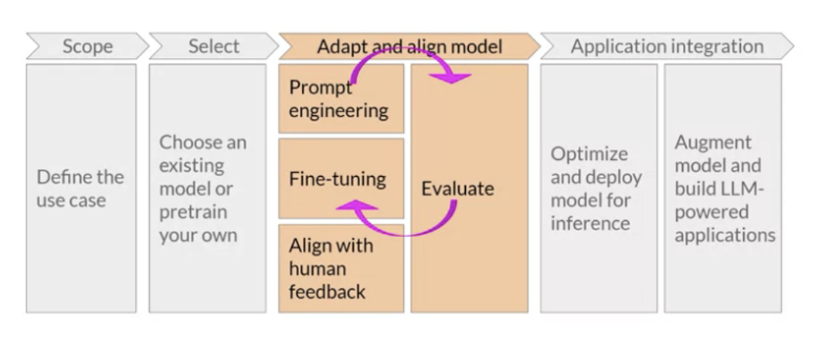
Project lifecycle

Slide 13
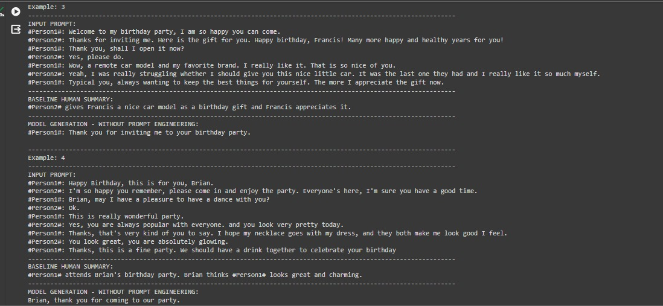
Result
MODEL GENERATION - WITHOUT PROMPT ENGINEERING:

Slide 14
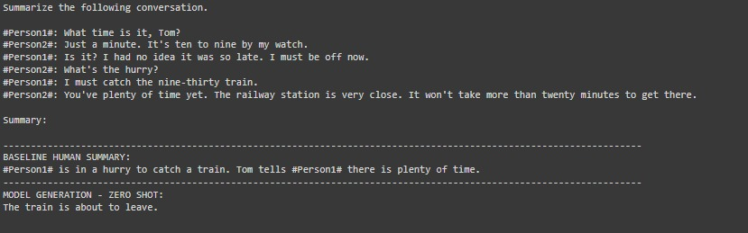
Zero shot inference with an instruction Prompt

Slide 15
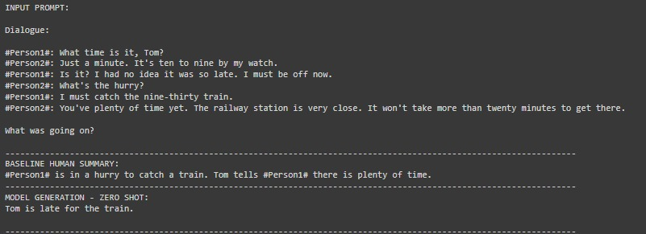
Zero shot inference with prompt template

Slide 16
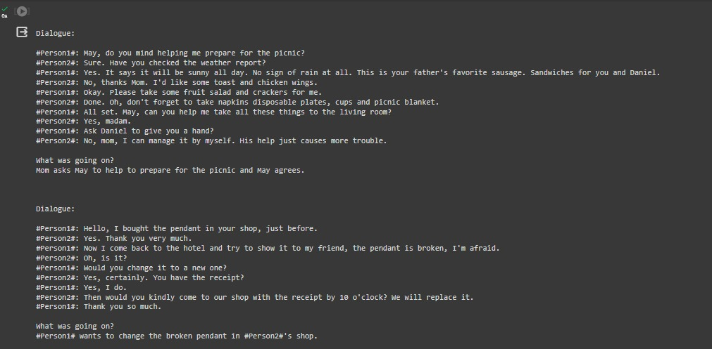
Few shot inference

Slide 17
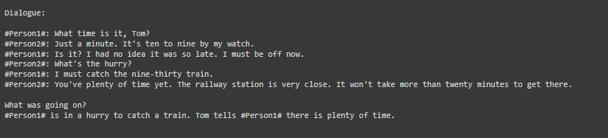
One shot inference
Click here for Demo video link
Click here for GITHUB LINK
Conclusion:
Our project has demonstrated the effectiveness of using Flan T5 for efficiently extracting relevant information from dialogues. The model's ability to generate concise and contextually relevant summaries has streamlined the process of analyzing large volumes of conversational data.
3/21/2024 Annual Review

