Slide 1
AI – powered Fake news detection

Slide 2
The Misinformation Crisis
6×
70%
0
Spread Speed
Blind Trust
Claim-Level Tools

Slide 3
Our Solution
Four-stage pipeline delivering per-claim credibility scores
Claim Splitter
NER Engine
Breaks articles into verifiable sub-claims
Extracts entities from each claim
Multi-API Verify
Score Report
Queries 3 trusted source types
Per-claim verdict + total credibility score

Slide 4
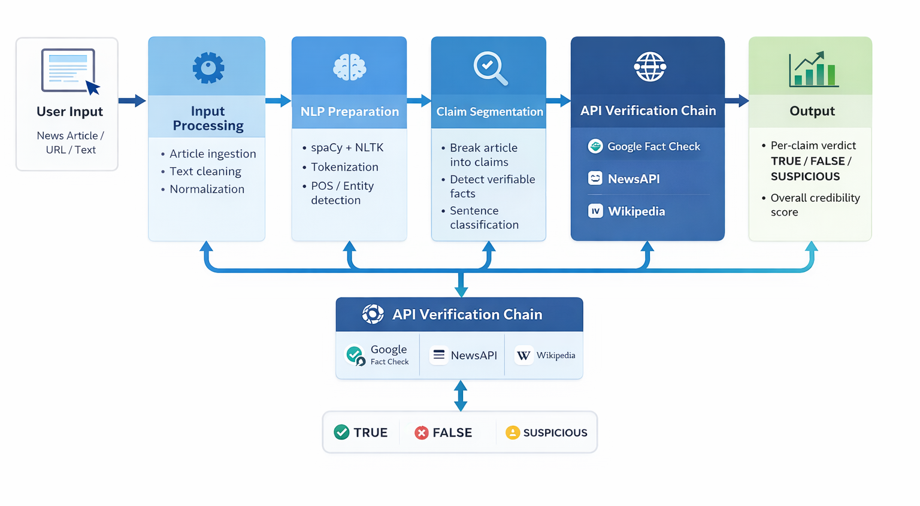
System Architecture

Slide 5
Sample Output
Claim 1
Claim 2
Claim 3
"PM announced a package"
"Package worth ₹5000 Cr"
"Announced on March 10"
LIKELY TRUE [0.72]
UNVERIFIED [0.41]
SUSPICIOUS [0.29]
Overall: 47% Credibility → LIKELY MISLEADING

Slide 6
Advantages & Limitations
Strengths
Constraints
Granular claim-level analysis
Real-time processing
Multi-source scoring
Transparent reasoning
API rate limit dependencies
Context-irony blind spots
Limited non-English support
Not all claims verifiable

Slide 7
THANK YOU

