Slide 1
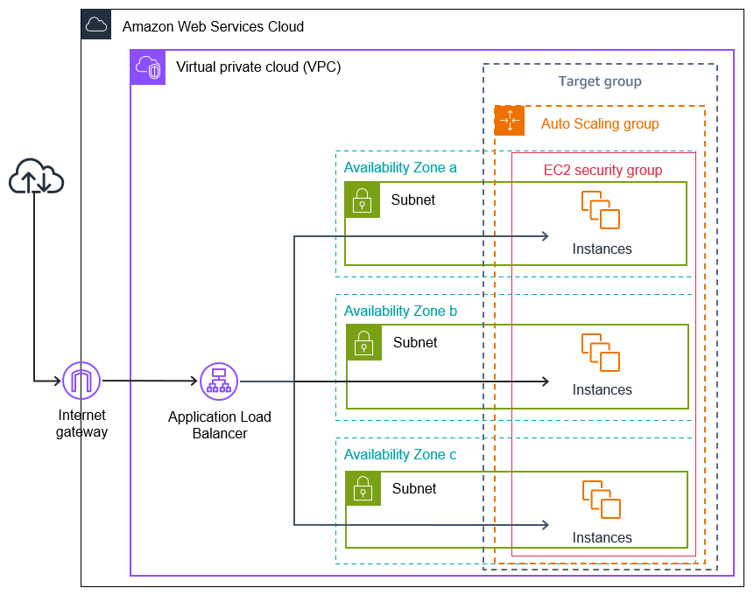
VPC(Virtual private cloud)

Slide 2
What is VPC?
A Virtual Private Cloud (VPC) is a private network within a public cloud that helps organizations control and secure their resources.
Benefits of a VPC
Security
VPCs isolate data from other companies, and provide security for IP addresses, subnets, and network gateways
Control
VPCs give organizations full control over their network size, and the ability to deploy and scale resources
Scalability
VPCs take advantage of the scalability of public cloud infrastructure
Cost efficiency
VPCs take advantage of the cost efficiencies of public cloud infrastructure

Slide 3
VPC Network
The basic architecture of a properly functioning VPC consists of many distinct services such as Internet-Gateway, Subnets, Route tables, Load Balancer, Target Group, Security Groups, NAT gateway, Network ACLs etc. Altogether, these resources are clubbed under a VPC to create an isolated virtual environment.

Slide 4
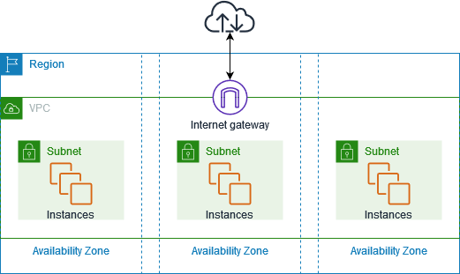
Subnet
A subnet is a smaller portion of the network that typically includes all the machines in a certain area.
We can add as many as subnets we need in one availability zone. Each subnet must reside entirely within one availability zone.
The public subnets will be attached to Internet Gateway which enables Internet access.
The private subnets will not have internet access.
Each and every subnet which is presented in VPC must be associated with the routing table.

Slide 5
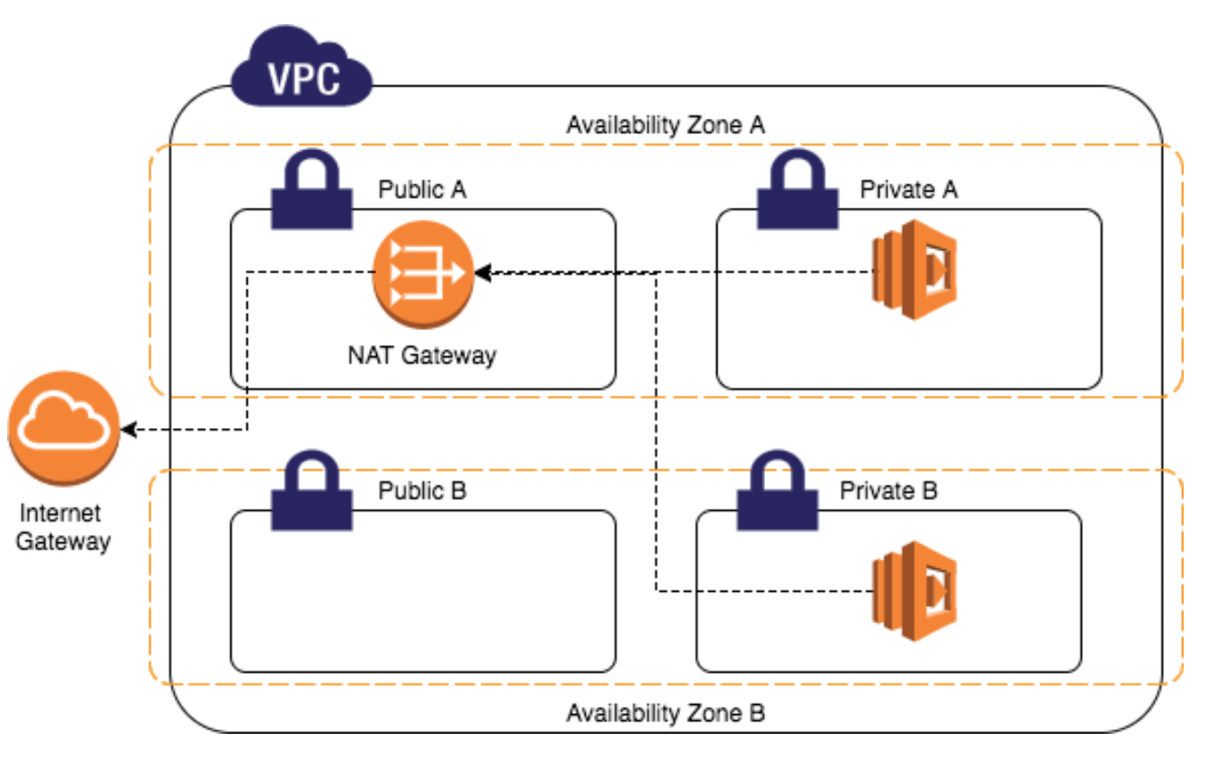
Internet Gateway
With the help of IGW (Internet Gateway), the resources present (e.g: EC2) in the VPC will enable to access the Internet.
One VPC can’t have more than one IGW
NAT Gateway
A Network Address Translation (NAT) gateway is a service that allows private network instances to access the internet while keeping them secure. It translates private IP addresses to public IP addresses.

Slide 6
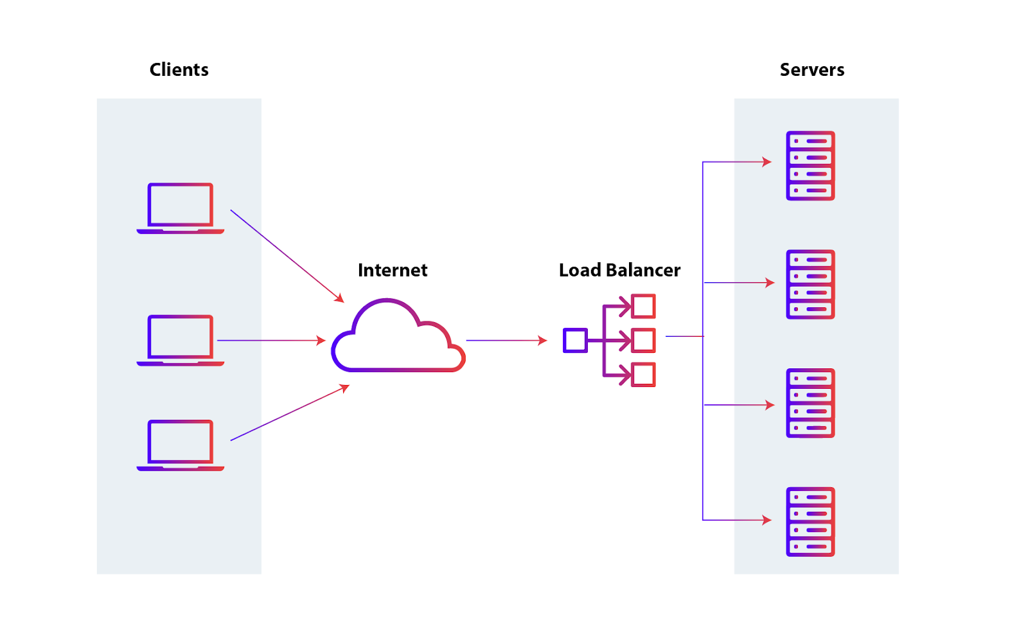
Load Balancer
A load balancer is a device that distributes network traffic across multiple servers to support an application.
A load balancer acts as a traffic proxy.
It distributes network traffic across endpoints on a number of servers.
It can redirect traffic to other instances on another server when a server fails.

Slide 7
Route Table
AWS route tables are essential for directing network traffic within a VPC, using rules called routes to determine where packets go. Each subnet is associated with a route table, defining its traffic flow. Routes specify a destination (IP range) and a target (like an Internet Gateway or another subnet). Default route tables are created automatically, but custom ones allow for complex routing scenarios, enabling secure and controlled network communication. Effectively, route tables act as traffic controllers, ensuring data reaches its intended destination within and beyond the VPC.

Slide 8
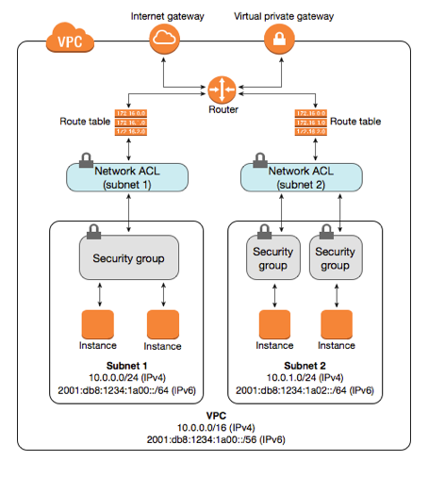
Security Groups:
These act as virtual firewalls for your EC2 instances, controlling inbound and outbound traffic.
They operate at the instance level.
They are "stateful," meaning if you allow inbound traffic, the return traffic is automatically allowed.
They support "allow" rules only.
NACLs:
These act as virtual firewalls for your subnets, controlling inbound and outbound traffic.
They operate at the subnet level.
They are "stateless," meaning you must explicitly define rules for both inbound and outbound traffic.
They support both "allow" and "deny" rules.

Slide 9
DHCP(Dynamic Host Configuration Protocol)
DHCP automatically assigns IP addresses and other network configuration parameters to devices on a network. This eliminates the need for manual configuration, reducing errors and saving time.

Slide 10
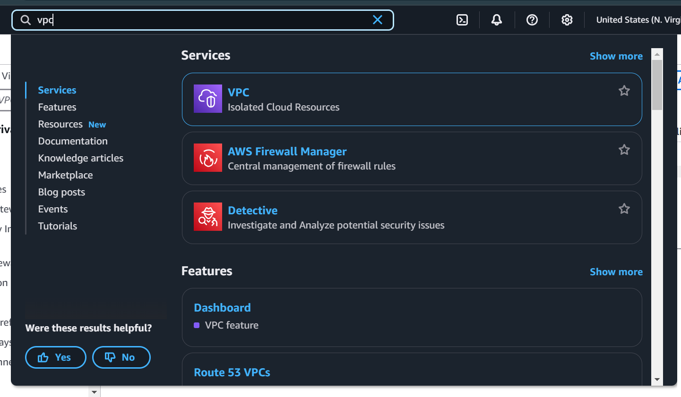
Steps to create VPC

Slide 11
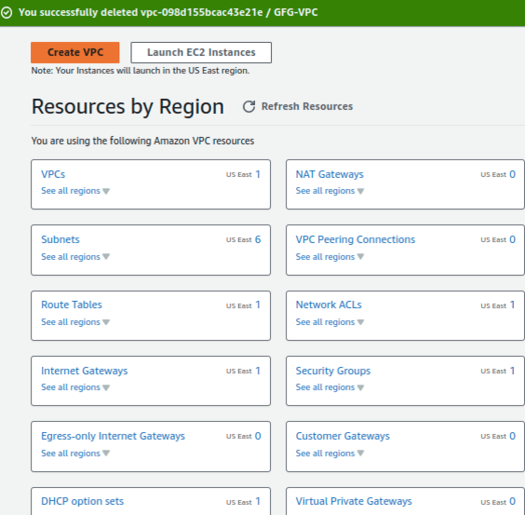

Slide 12
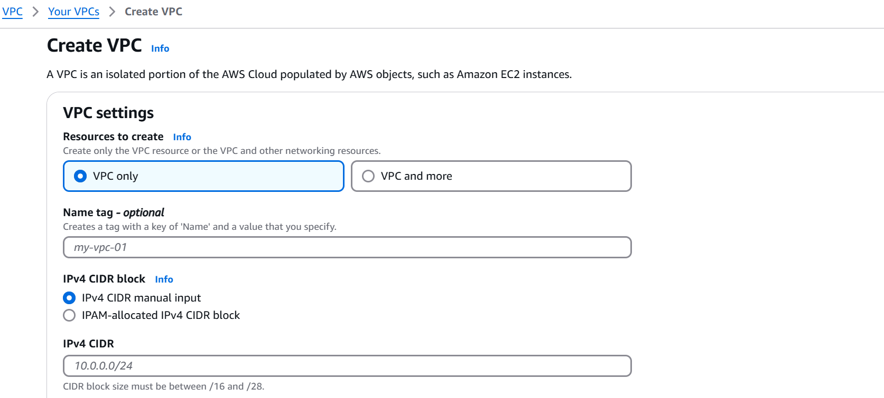

Slide 13
