Slide 1

What is EBS? How to Create and Attach an EBS Volume to an EC2 Instance

Slide 2
What is Amazon EBS (Elastic Block Store)? Amazon Elastic Block Store (EBS) is a scalable, high-performance block storage service designed for use with Amazon EC2 instances. It provides persistent storage, meaning data remains even if the instance is stopped or terminated.

Slide 3
Key Features of EBS Persistent Storage: Data is retained even when EC2 instances are stopped. Scalability: Can increase volume size without downtime. Performance: Supports SSD (gp3, gp2, io1, io2) and HDD (st1, sc1) storage. Snapshots: Backup EBS volumes using Amazon S3. Encryption & Security: Supports AWS KMS-based encryption.

Slide 4
Steps to Attach an EBS Volume to an EC2 Instance Step 1: Create an EBS Volume (if not already created) Open AWS Management Console. Navigate to EC2 Dashboard > Volumes (under Elastic Block Store). Click Create Volume. Configure: Volume Type (e.g., gp3, io1, etc.). Size (e.g., 10 GiB). Availability Zone (AZ) (Must be the same as your EC2 instance's AZ). Enable Encryption (optional). Click Create Volume.

Slide 5
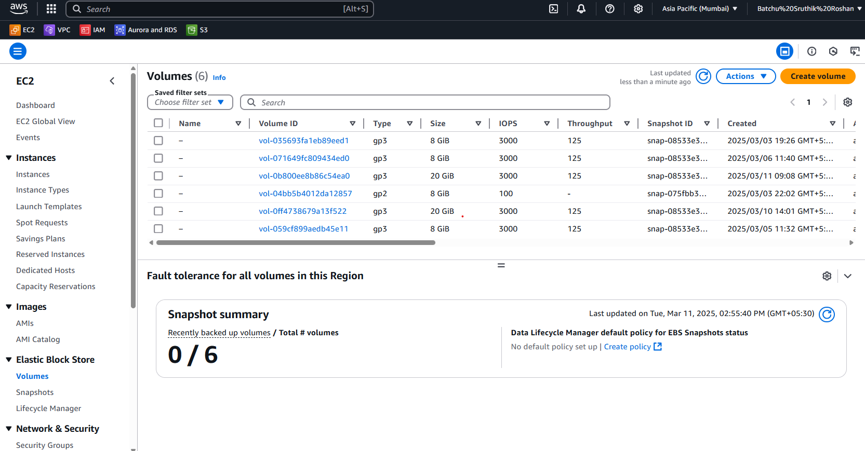

Slide 6
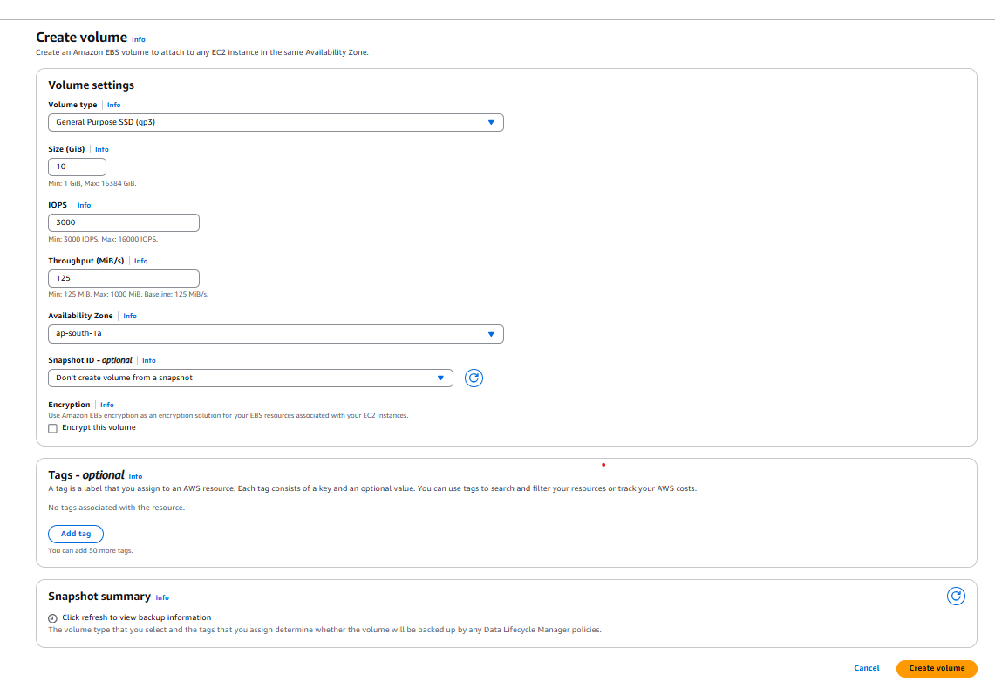

Slide 7
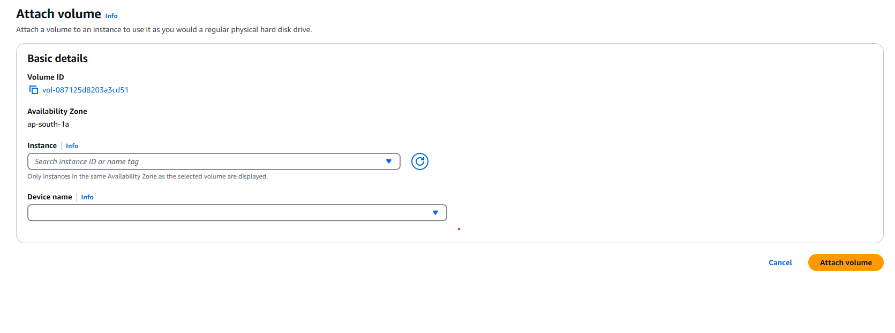

Slide 8
