Slide 1

GOKARAJU RANGARAJU INSTITUTE OF ENGINEERING AND TECHNOLOGY Department of Information Technology Mini Project Review-1
SwiftML
Accelerating machine learning journeys.
Under the esteemed guidance of
- P.Bharathi
Assistant Professor
D.Harshitha -22241A1280
Batch No: B3 K.Sruthika -22241A1296
K.Varsha -22241A1295

Slide 2
Abstract
SwiftML is an interesting tool designed to simplify the process of automated machine learning models. It is a tool that is accessible even to non-experts. It is a user-friendly tool where users can evaluate the performance of different algorithms based on their datasets and choose a best-suited model. SwiftML performs essential tasks such as preprocessing, model training and testing. SwiftML supports both supervised and unsupervised learning tasks. With an intuitive Streamlit interface, users can easily upload datasets, choose algorithms, and view real-time results. The Pickle library integration allows users to save and download trained models for offline use, making it ideal for production deployment or personal use.SwiftML supports a wide range of 10-15 machine-learning algorithms. After training, it provides detailed performance metrics such as Mean Absolute Error, R2, Mean Square Error, and Root Mean Square Error, which helps users easily compare and select the best model. Using the Pycaret library, SwiftML processes the training and evaluating models, which helps save time and effort.SwiftML has become a valuable resource for data scientists, analysts, and anyone looking to implement machine learning models without any domain experts or extensive coding.
Keywords: Automated machine-learning, Pycaret, Streamlit, Pickle.

Slide 3
Literature Survey
Ref No | Author and Journal/Year | Methodology | Advantages | Disadvantages
[1] | Shubhra Kanti Karmaker Santu Md. Mahadi Hassan ArXiv, 2020 | Proposed a seven-tier taxonomy to classify AutoML systems based on their autonomy. | Identifies manual bottlenecks in AutoML, examines challenges in achieving full automation. | Taxonomy may not generalize well; lacks practical implementation details.
[2] | Xiang Wang *Volume 212, 5 January 2021 | AutoML techniques, categorizing them by pipeline stages. | Enables ML application in diverse domains with minimal expert knowledge. | Limited real-world applicability; lacks domain-specific refinements.
[3] | Journal of Information and Intelligence 2024 | Analyzed data processing requirements and existing NAS algorithms. | Improves model selection and hyperparameter tuning. | No empirical validation; outdated AutoML strategies.

Slide 4
Literature Survey
Ref No | Author and Journal/Year | Methodology | Advantages | Disadvantages
[4] | Youngho Park Journal of Minimally Invasive Surgery,2024 | Offering code-based instructions, to demonstrate the application of AutoML tools in R. | Automates complex tasks such as data preprocessing, model selection, and hyperparameter tuning. | R-specific; not user-friendly for non-programmers.
[5] | Gilbert Lim Daniel Ting Scientific Reports,2024 | AutoKeras (AK) is compared against custom deep learning models. | AutoKeras performs well compared to handcrafted deep learning models. | AutoKeras may not always outperform manual models; risk of overfitting.
[6] | Springer,2024 | AutoML automates the process of model creation by defining a search space, using a search strategy, optimizing | AutoML makes machine learning accessible, efficient, and optimized, reducing manual effort and enabling | Limited flexibility in complex, domain-specific problems and may require manual fine-tuning for optimal results.

Slide 5
System Architecture

Slide 6
Use case Diagram
Upload Dataset
Perform Data Preprocessing
Perform Data Ingestion
Run Model Selection
(Classification/Regression
User
Perform Clustering
Download Processed Data

Slide 7
Sequence Diagram
User
Streamlit App
Data Preprocessor
Cluster Analyzer
Upload dataset
Perform preprocessing-(null handling,etc.)
Perform data ingestion-data cleaning,splitting
Choose ML task
Run model selection
Show results
Download results
User
Streamlit App
ML Model Selector
File System

Slide 8
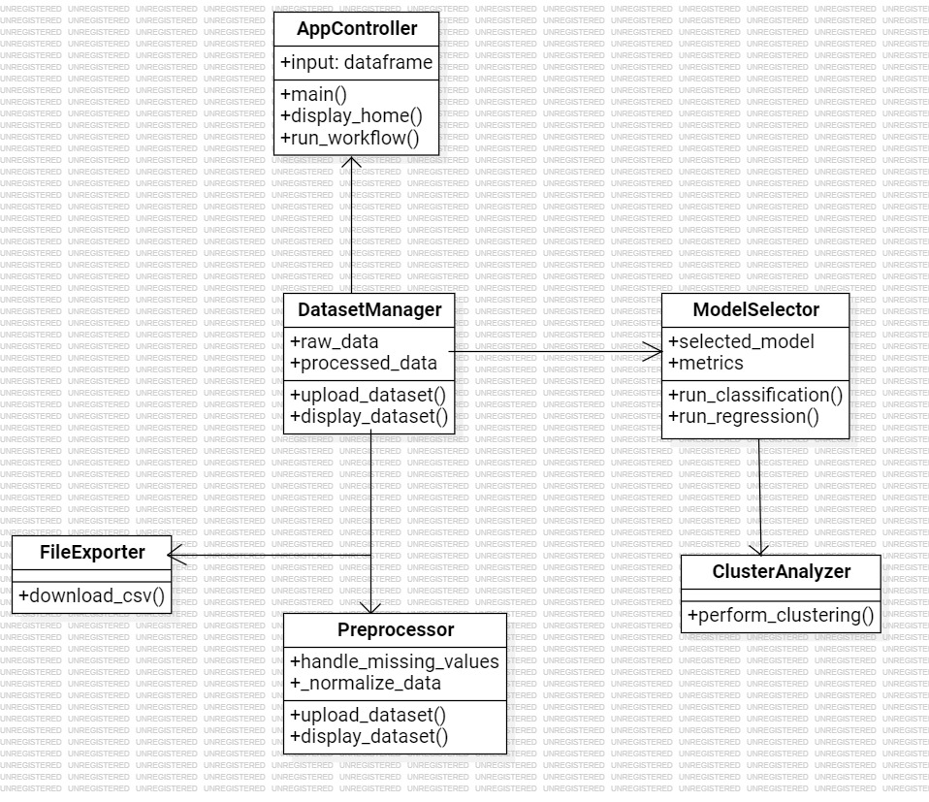
Class Diagram

Slide 9
Activity Diagram

Slide 10
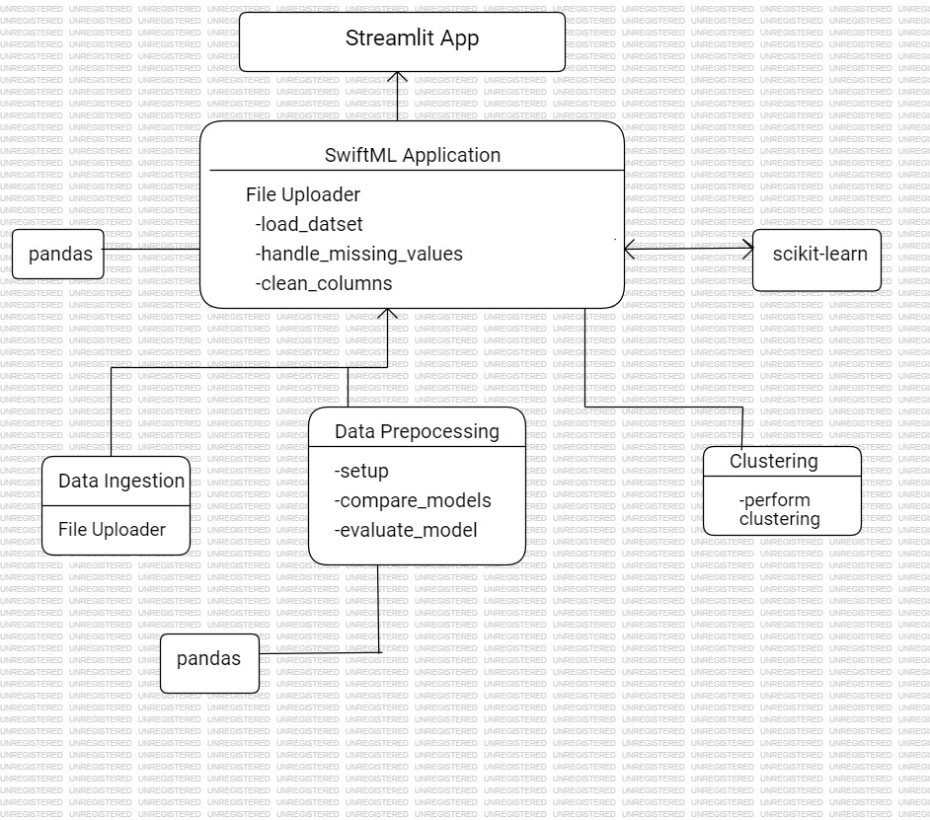
Component Diagram

Slide 11
Deployement Diagram

Slide 12
THANK YOU!

