Slide 1
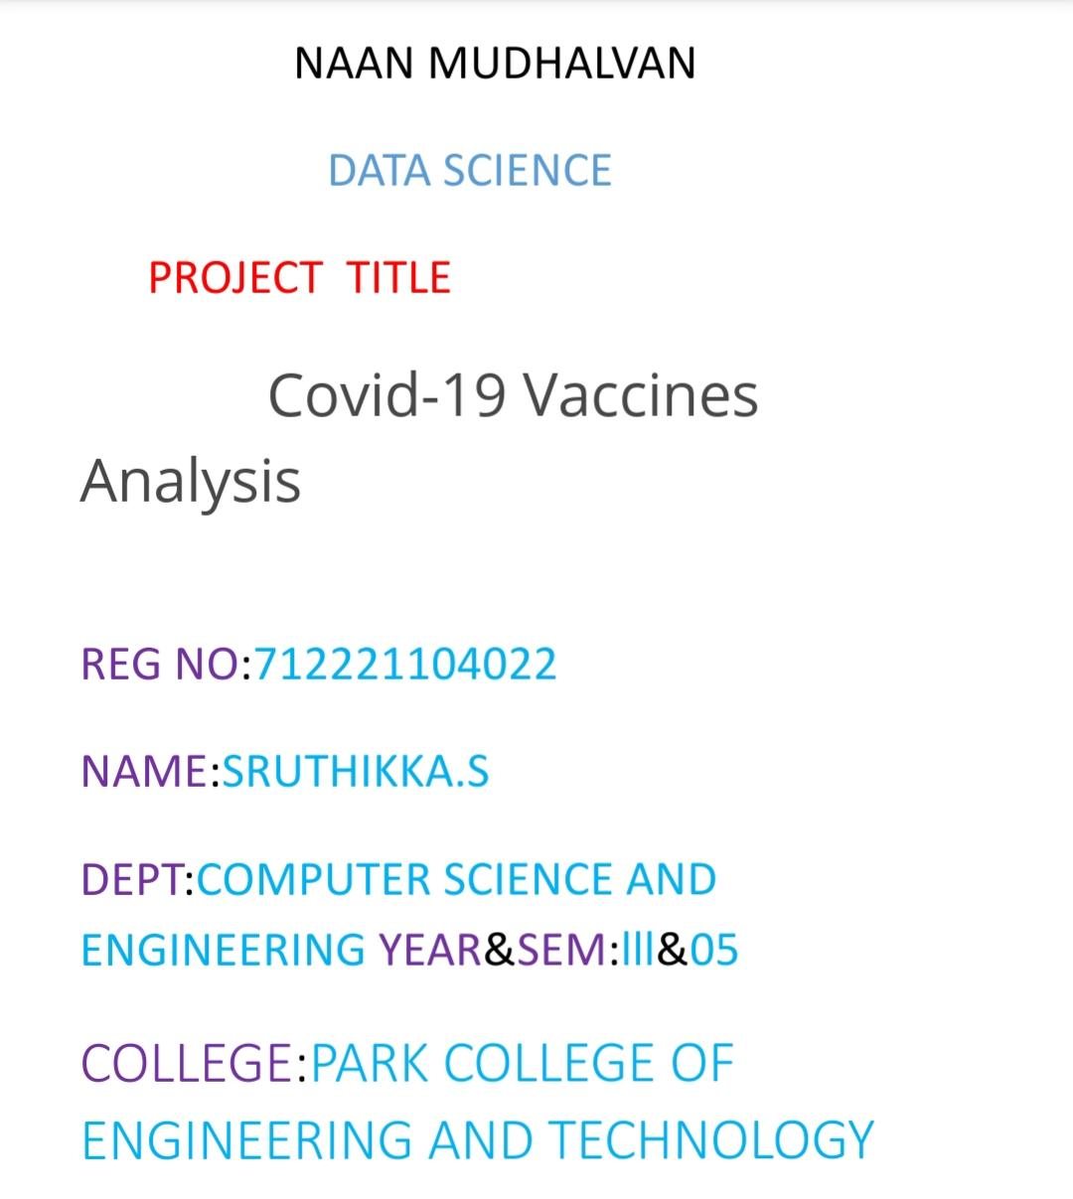

Slide 2

DATA SCIENCE

Slide 3
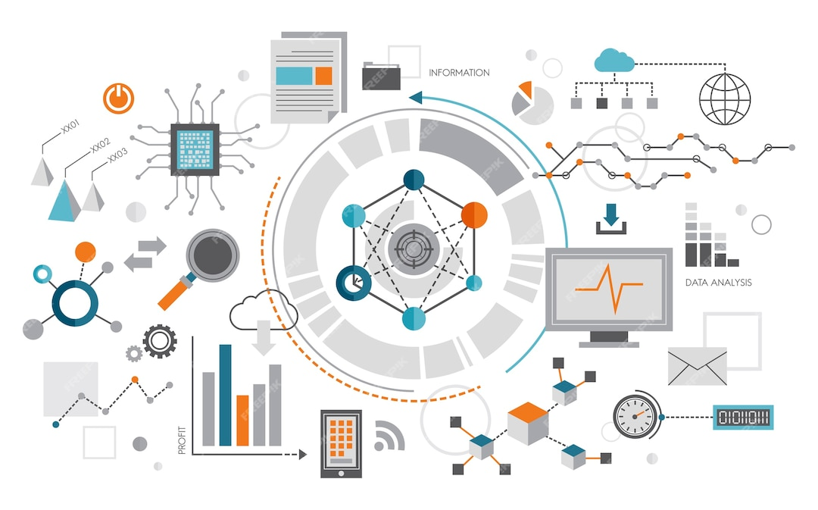
Problem Definition :
The problem is to conduct an in-depth analysis of Covid-19 vaccine data, focusing on vaccine efficacy, distribution, and adverse effects. The goal is to provide insights that aid policymakers and health organizations in optimizing vaccine deployment strategies. This project involves data collection, data preprocessing, exploratory data analysis, statistical analysis, and visualization.

Slide 4


Design Thinking
Data Collection: Collect customer data, including attributes like purchase history, demographic information, and interaction behavior.
Data Preprocessing: Clean and preprocess the data, handle missing values, and convert categorical features into numerical representations.
DesignClustering Algorithms: Apply clustering algorithms like K-Means, DBSCAN, or hierarchical clustering to segment customers.

Slide 5

Data set:
https://www.kaggle.com/datasets/gpreda/covid-world-vaccination-progress

