Slide 1
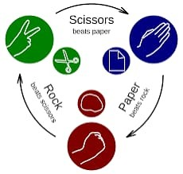
Rock Paper scissors
Mini Project Presentation
Game project
`

Slide 2
Libraries Used in the Project
🌐 Flask → Used to create and run the web application
🖥️ render_template_string (Flask) → Renders HTML directly from Python code
📥 request → Handles user input from the browser
✊✋✌️ random → Generates random computer choices (rock, paper, scissors)

Slide 3
Project Overview
Rock Paper Scissors is a simple web-based game built using Flask
User plays against the computer by choosing Rock, Paper, or Scissors
Computer makes a random choice
Winner is decided using standard game rules
Helps to understand basic web development and Python logic

Slide 4
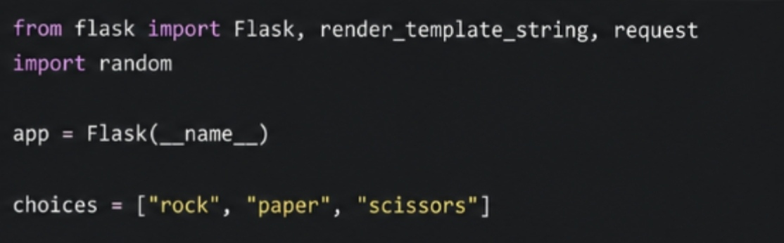
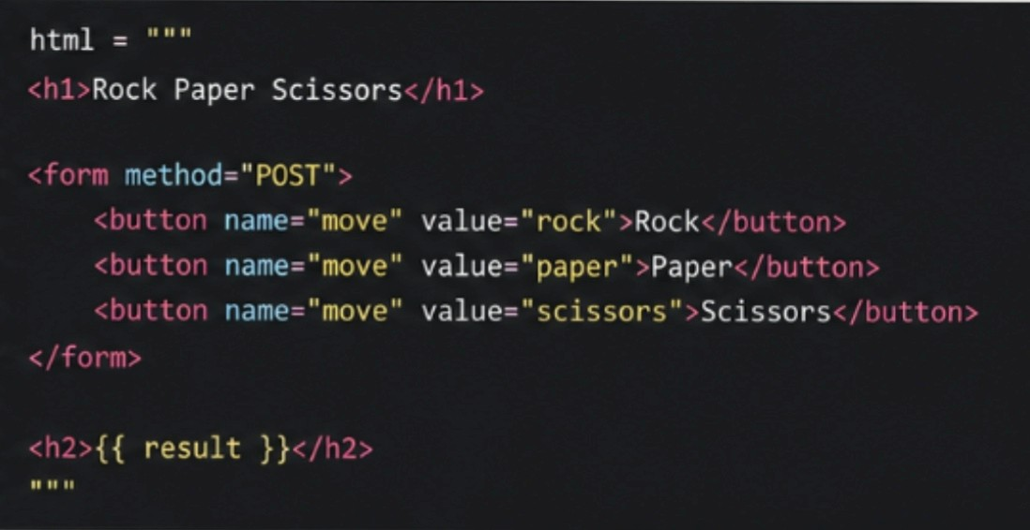
Application Setup:

Slide 5
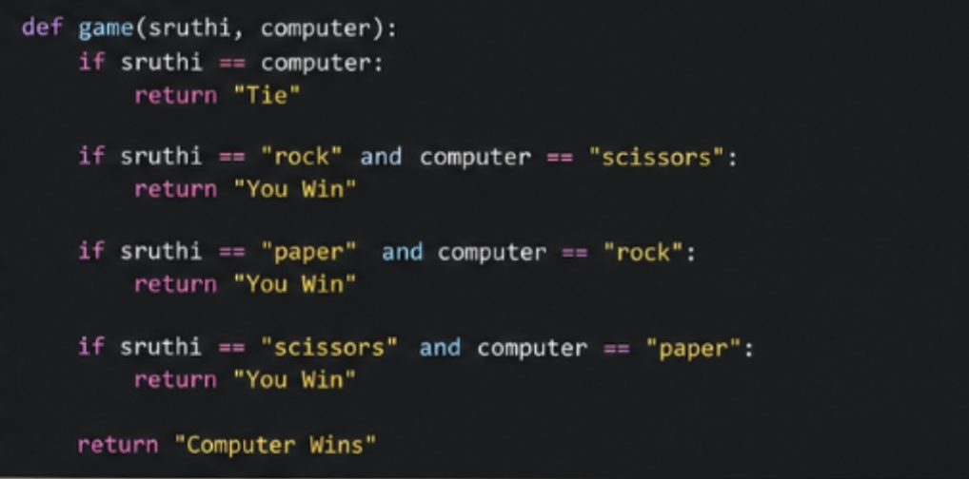
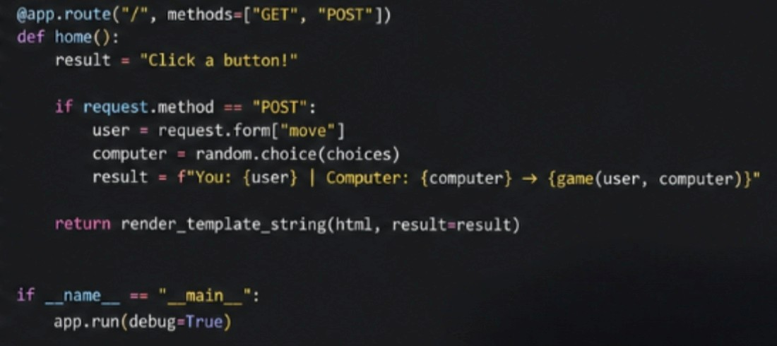
Game Logic

Slide 6
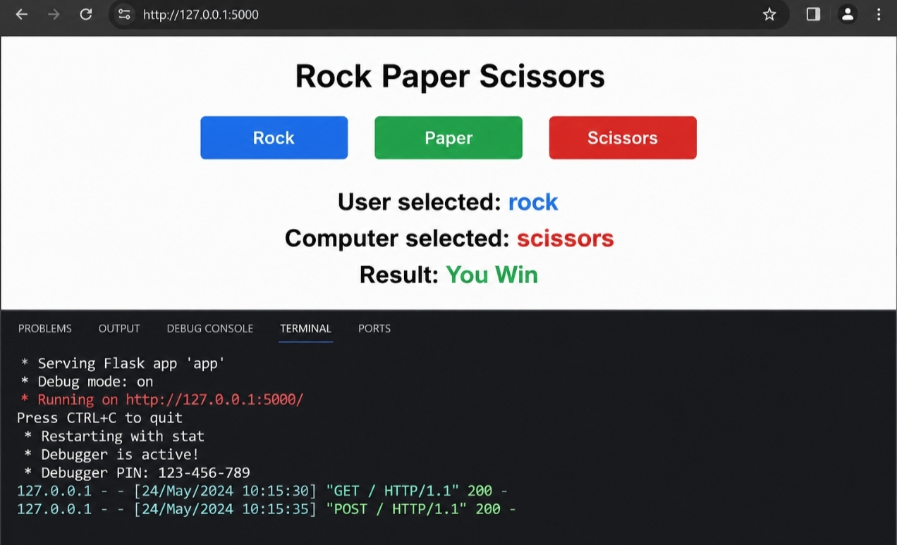
Output for Code

Slide 7
LEARNING OUTCOMES FROM THE PROJECT
Learned basics of Flask web development and creating a web application
Understood handling user input and implementing game logic using Python
Gained experience in using random module and building an interactive project
Improved problem-solving and debugging skills while developing the project
PROJECT BY:
N. Ramya Sruthi
Section-4
CSD/2025/1407

