Slide 1
Big Data Hadoop and Spark Developer

Slide 2
Introduction to Big Data and Hadoop

Slide 3

Define the concepts of Big Data
Explain Hadoop and how it addresses Big Data challenges
Illustrate the components of the Hadoop Ecosystem
Notes:
Trainer Notes:
Explain the learning objectives at the start of the session

Slide 4
Introduction to Big Data and Hadoop

Slide 5







Big Data Overview
Big Data is data that has high volume, variety, velocity, veracity, and value.
Manufacturing
Banking
Consumer
Healthcare
Technology
Energy
According to the US Bureau of Labor Statistics, Big Data alone will fetch 11.5 million jobs by 2026.

Slide 6
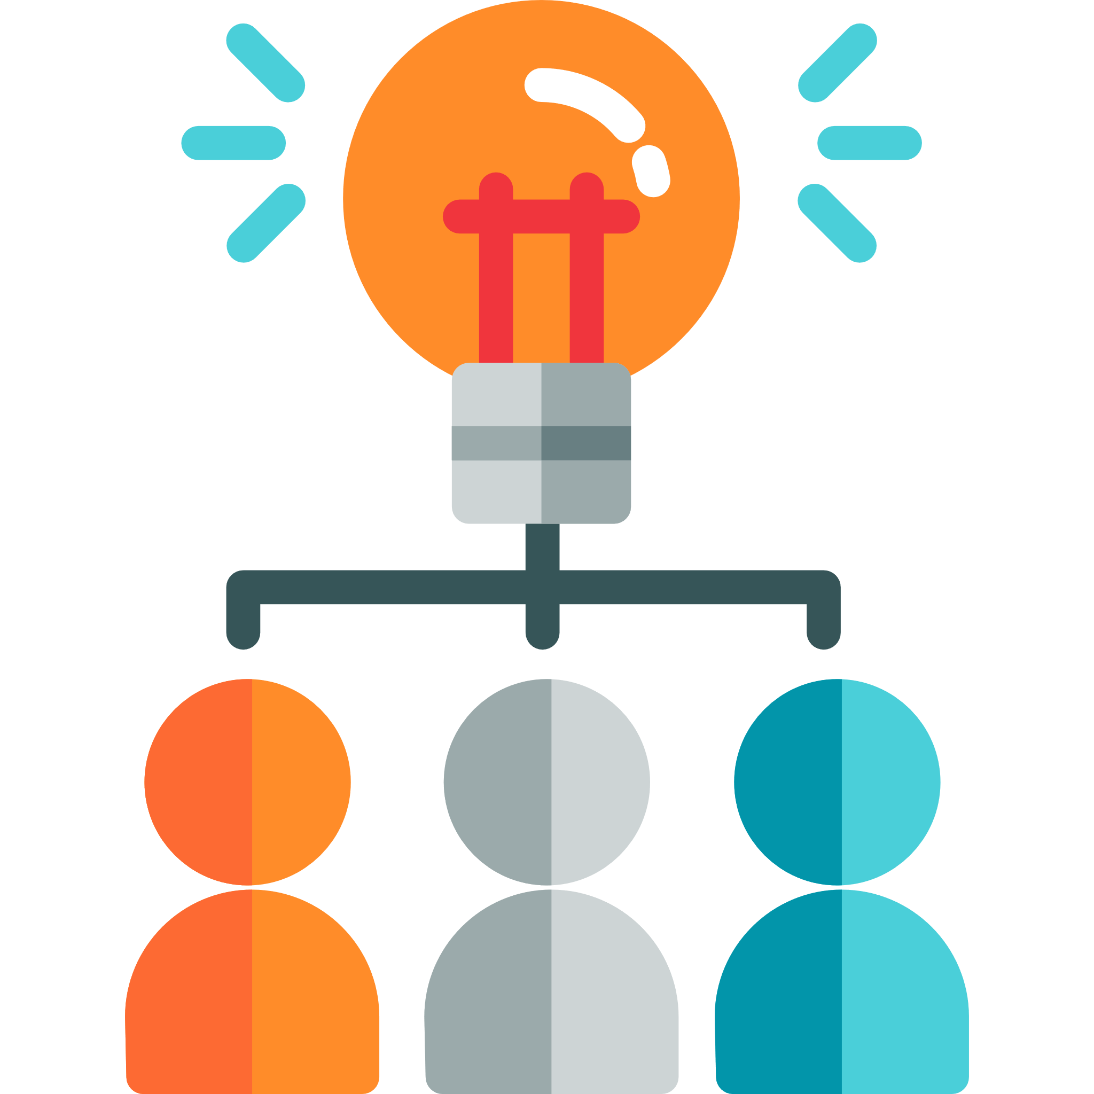
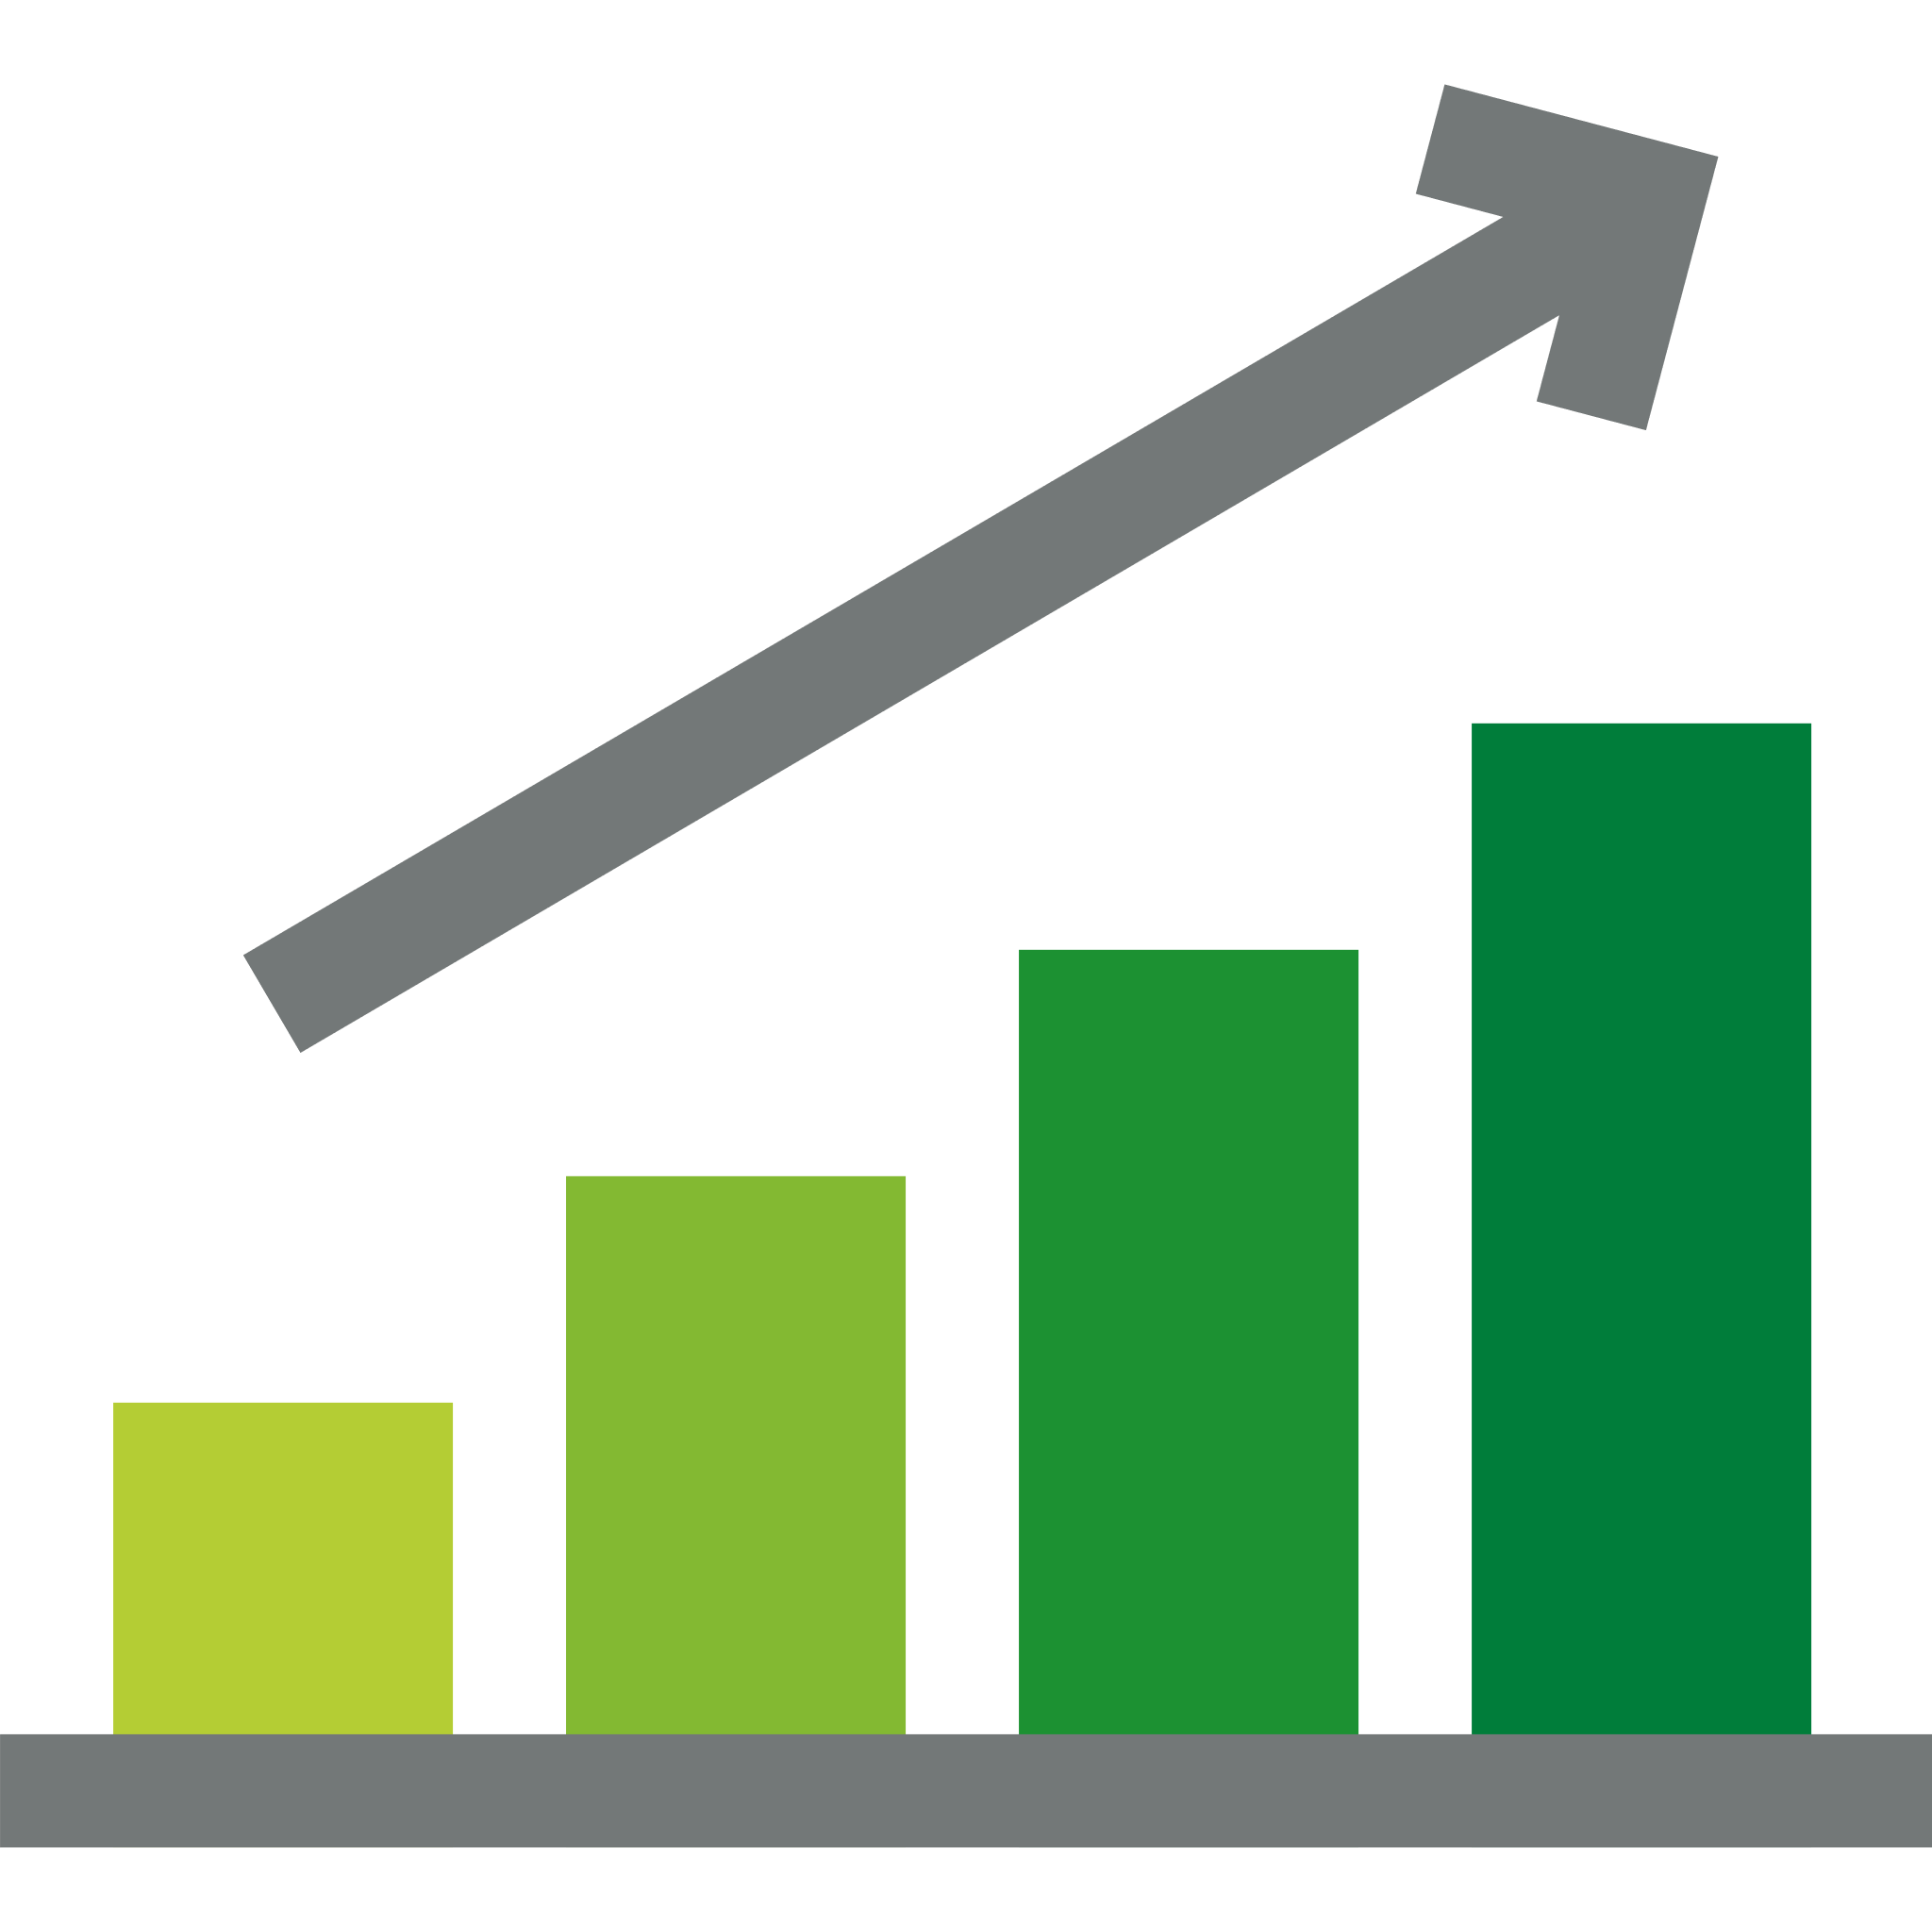

Traditional Decision-Making
Different ways of traditional decision-making are:
What We Think
Experience and Intuition
Rule of Thumb
Notes:
Trainer Notes:
Explain the 3 points
a. What we think i.e. our perception of the task at hand
b. Experience and Intuition - decisions are made based on past experiences and personal instincts
c. Rule of thumb - decisions are made based on pre-conceived guidelines rather than facts

Slide 7





Challenges of Traditional Decision-Making
Takes a long time to arrive at a decision, therefore losing the competitive advantage
Requires human intervention at various stages
Lacks systematic linkage among strategy, planning, execution, and reporting
Provides limited scope of data analytics, that is, it provides only a bird’s
eye view
Obstructs company’s ability to make fully informed decisions
Notes:
Trainer Notes:
Explain the challenges by giving real-time examples.

Slide 8
Big Data Analytics

Slide 9

The Solution: Big Data Analytics
The decision-making is based on what users know which in turn is based on data analytics.
It provides a comprehensive view of the overall picture which is a result of analyzing data from various sources.
It provides streamlined decision-making from top to bottom.
Big data analytics helps in analyzing unstructured data.
It helps in faster decision-making thus improving the competitive advantage and saving time and energy.
Notes:
Trainer Notes:
Explain the role of Big Data Analytics

Slide 10
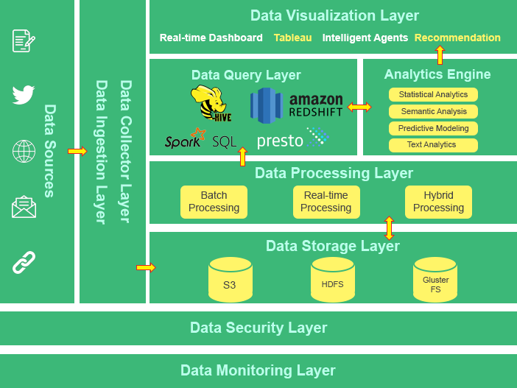
Big Data Analytics Pipeline
A data pipeline is a series of steps that ingest raw data from multiple sources and transfer the data to a destination for storage and analysis.
Notes:
Trainer Notes:
Explain in brief the role and importance of each layer

Slide 11
Case Study: Big Data Using NVIDIA Jetson Camera

Slide 12

Big Data Using NVIDIA Jetson Camera
A semiconductor manufacturing firm is testing chips in traditional ways. A total of 1.3 million chips are made, and a person is required to test and validate if the chips are ready to be dispatched to dealers.
It takes nearly 8 minutes to test a chip, and the company wants to reduce this time to increase production.

Slide 13
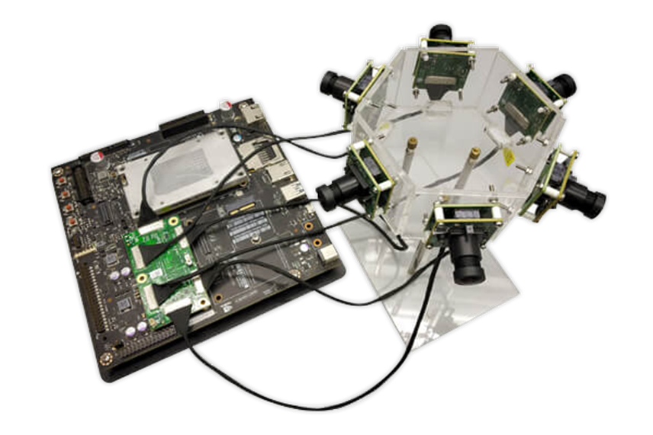
Big Data Using NVIDIA Jetson Camera
The company installed six NVIDIA Jetson cameras in the testing utility to create a fully automated system for
fast processing.
It captures real-time photos of chips and sends them to the Hadoop Big Data pipeline for processing.

Slide 14
Big Data Using NVIDIA Jetson Camera
When images are received into the system, ETL is performed on them to remove noise and transform them into fixed pixel length images.
The images are then dumped into the Hadoop system for further processing.

Slide 15
Big Data Using NVIDIA Jetson Camera
If the Hadoop system rejects some images, the batch of chips is manually checked by humans to remove any defects.
It is estimated that Hadoop system testing was nearly 95% accurate, with 5% requiring manual intervention, which is a significant advancement in chip manufacturing.

Slide 16
What Is Big Data?

Slide 17

What Is Big Data?
Big data refers to large data sets that may be analyzed computationally to reveal patterns, trends, and associations, especially relating to human behavior and interactions.
Notes:
Trainer Notes:
Read and explain the definition

Slide 18



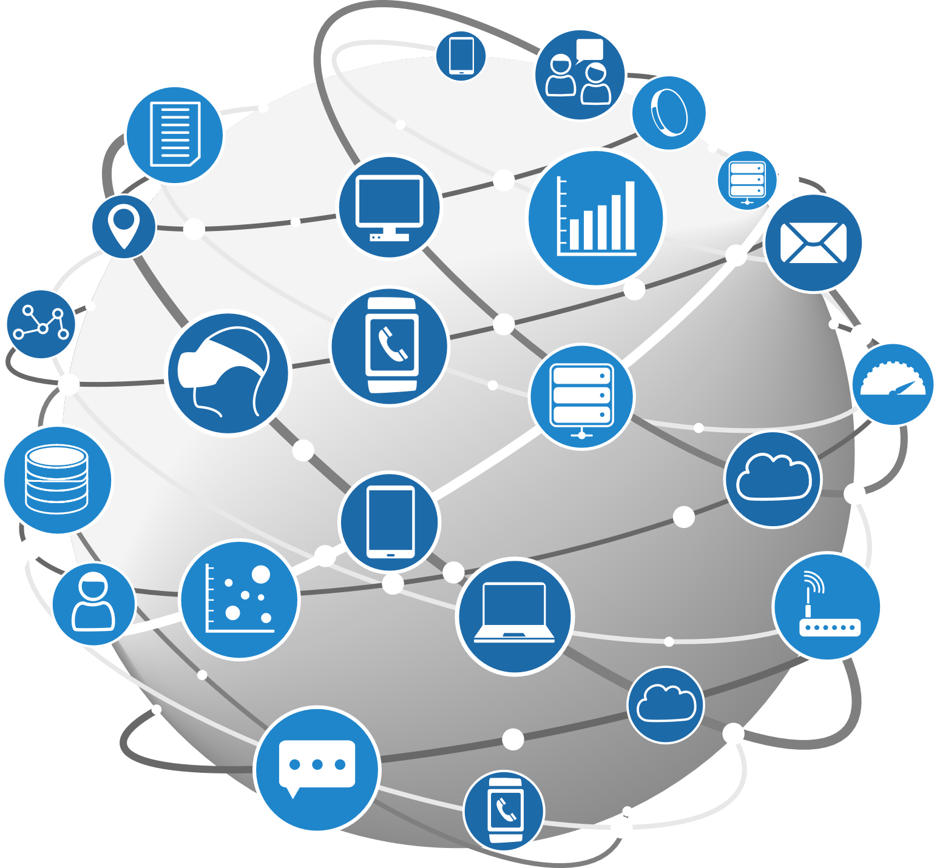








Big Data at a Glance
28,000
Subscribers watching
2 million
Views
695,000
Stories shared
1.6 million USD
Spent online
9,132
Connection made
2 million
Swipes
69 million
Messages sent
197.6 million
Emails sent
5,000
Downloads
500 hours
Content uploaded
Notes:
Trainer Notes:
Unstructured data is exploding.
Humans and machines generate data every minute.
The accelerated growth of unstructured data is what turned into Big Data.
Use the example of the Internet and its services to explain how and where Big data is generated

Slide 19
Different Types of Data
Following are the types of data:
Data that has no inherent structure and is
usually stored as different types of files
Example: Text documents, PDFs, images, and videos
Unstructured
Textual data with erratic formats that can be
formatted with efforts and software tools
Example: Clickstream data
Quasi-structured
Increasing growth
Textual data files with an apparent pattern,
enabling analysis
Example: Spreadsheets and XML files
Semi-structured
Data having a defined data model, format,
and structure
Example: Database
Structured
Notes:
Trainer Notes:
Explain the various types of data using examples.

Slide 20
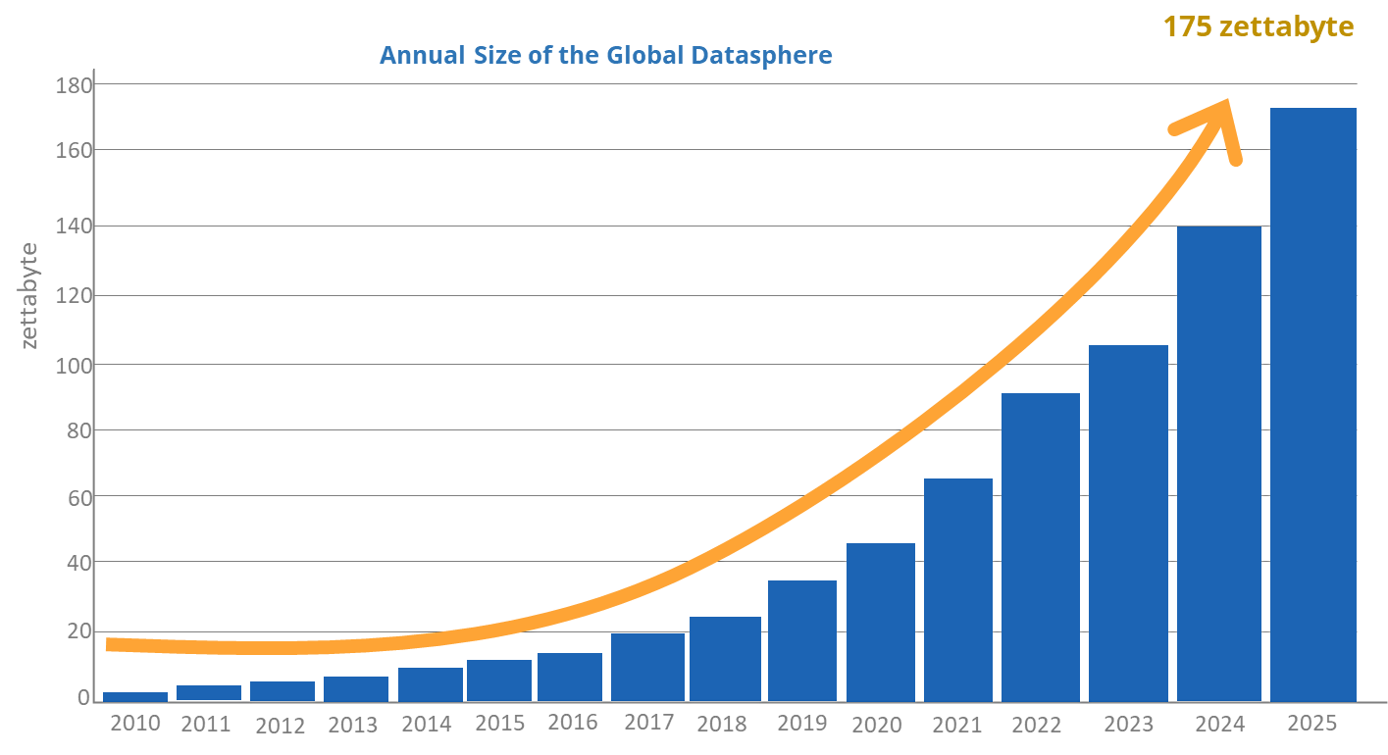
Growth in Data
It is estimated that the data will rise exponentially by 2025.
Notes:
Trainer Notes:
Explain how and why in recent years the amount of unstructured data generated has grown tremendously.

Slide 21
Five V’s of Big Data

Slide 22
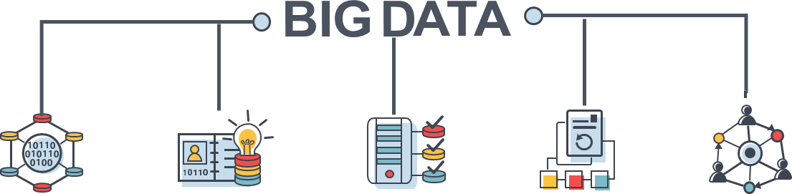
Five V’s
Volume
Value
Veracity
Variety
Velocity

Slide 23

Volume
Volume refers to the massive amounts of data generated by social media every second.
Facebook generates about a billion messages which can only be handled by Big Data Technologies.

Slide 24

Velocity
Velocity is the rate at which data is generated and transferred.
Big Data provides data on demand and at a faster pace.
Amazon records every click made when customers browse the website.

Slide 25

Variety
Variety refers to all structured and unstructured data that can be generated by humans or machines.
Social media, CRM systems, e-mails, audio, and video forms produce varied data.
Analytics tools are used to segregate groups based on the type of data generated.

Slide 26

Veracity
Veracity refers to the consistency, accuracy, and trustworthiness of data.
It is required to filter and process unstructured and irrelevant data using analytics and algorithms to reveal meaningful information.

Slide 27

Value
Value refers to the quality and accuracy of data.
Data could be incomplete, erroneous, or incapable of providing genuine or useful information.
Due to inherent discrepancies in the data collected, inaccurate predictions are made.

Slide 28





Unstructured Data Conundrum
The advent of big data seemed to rise to a new way of dealing with unstructured data. It allows to centralize the data and apply big data analytics to the problem.
Unstructured Data
Semi-structured Data
Web Logs
Multimedia
JSON
XML
Social Media
Notes:
Trainer Notes:
Explain
-the fundamental challenge of unstructured data analytics
-why unstructured data analytics is soaring in popularity

Slide 29
Case Study: Royal Bank of Scotland

Slide 30

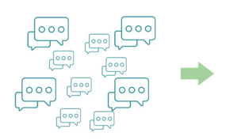

Case Study: Royal Bank of Scotland
100% of this data could be processed, whereas only 3% could be processed earlier with traditional systems.
250,000
Customer chats per month launched for multiple banking needs
200
Chats manually extracted per month and analyzed for quality assurance
Large volumes of unstructured web chat data
Previous Web Chat Analysis Approach
Notes:
Trainer Notes:
Explain
how unstructured data analytics helped in better understanding of customer behavior.
how Big Data processing allowed RBS to optimize their processes and direct their customer service agents on how to best interact with customers online.

Slide 31
Challenges of Traditional System

Slide 32



Challenges of Traditional Systems (RDBMS And DWH)
There are three challenges in working with a Relational Databases and data warehousing systems:
01
Growth rate
RDBMS systems are designed for steady data retention rather than rapid growth.
Data size
Data ranges from terabytes (10^12 bytes) to exabytes (10^18 bytes).
Unstructured data
Relational databases can not categorize unstructured data.
03
Notes:
Trainer Notes:
Explain why traditional systems (RDBMS and DWH) are not of much help ?

Slide 33

Advantages of Big Data
Big Data provides users with the following advantages:
Can run anywhere and hardware can be added
Processes all types of data
Has better decision-making
Processes huge data quickly in
real time
Notes:
Trainer Notes:
Explain the points using real-time examples

Slide 34









Companies Using Big Data
Some of the companies which use Big Data are as follows:
Notes:
Trainer Notes:
Give e case study of some of the businesses integrating big data to boost their brand success.

Slide 35
Case Study: Big Data in Netflix

Slide 36

Case Study: Big Data in Netflix
Netflix's enormous user base of over 148 million users offers it a big advantage when it comes to data collection. The following metrics are then focused on:
When do users watch a show?
1
Where do they watch it?
2
On which device do they watch the show?
3
How often do they pause a program?
4
How often do they re-watch a program?
5
Do they skip the credits?
6
What are the keywords searched?
7
Notes:
Trainer Notes:
Behavioral data at Netflix is growing faster than ever before.
So is there a solution to manage this ever-growing data?

Slide 37


Case Study: Big Data in Netflix
Traditionally, the analysis of such data was done using a computer algorithm that was designed to produce a correct solution for any given instance.
As the data started to grow, a series of computers were employed to do the analysis.
They are also known as distributed systems.
Solution
Multiple systems
Notes:
Trainer Notes:
Explain how solutions for big data processing came about

Slide 38
Distributed Systems

Slide 39
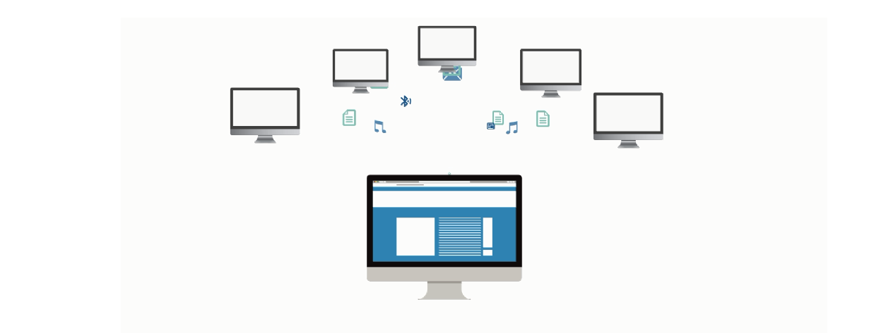
Distributed Systems
A distributed system is a model in which components located on networked computers communicate and coordinate their actions by passing messages.
Notes:
Trainer Notes:
Read out the definition

Slide 40
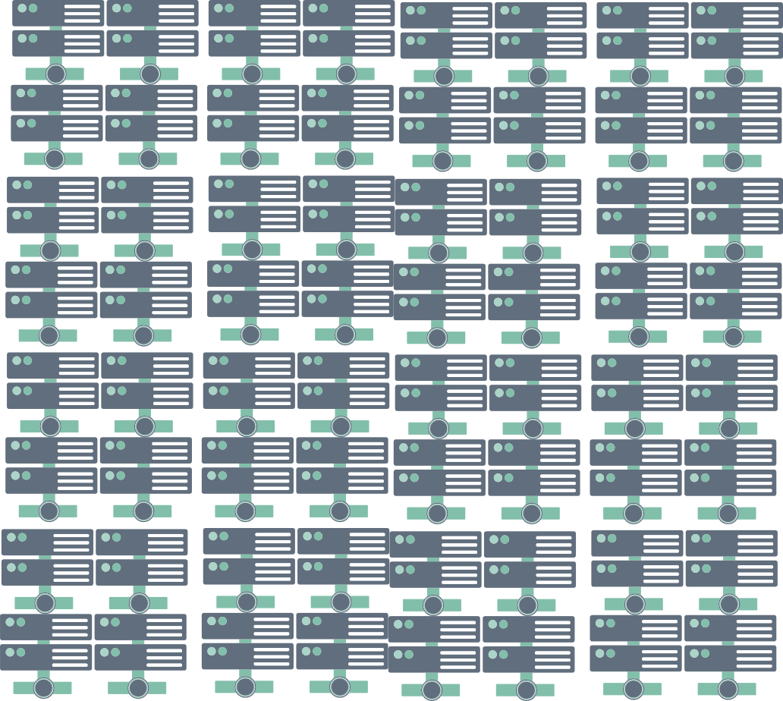

How Does a Distributed System Work?
In recent times, distributed systems have been replaced by Hadoop.
1 Machine 4 I/O Channels Each Channel – 100 MB/s
100 Machine 4 I/O Channels Each Channel – 100 MB/s
Data =1 Terabyte
Data =1 Terabyte
Notes:
Trainer Notes:
Explain the working of a distributed system.

Slide 41
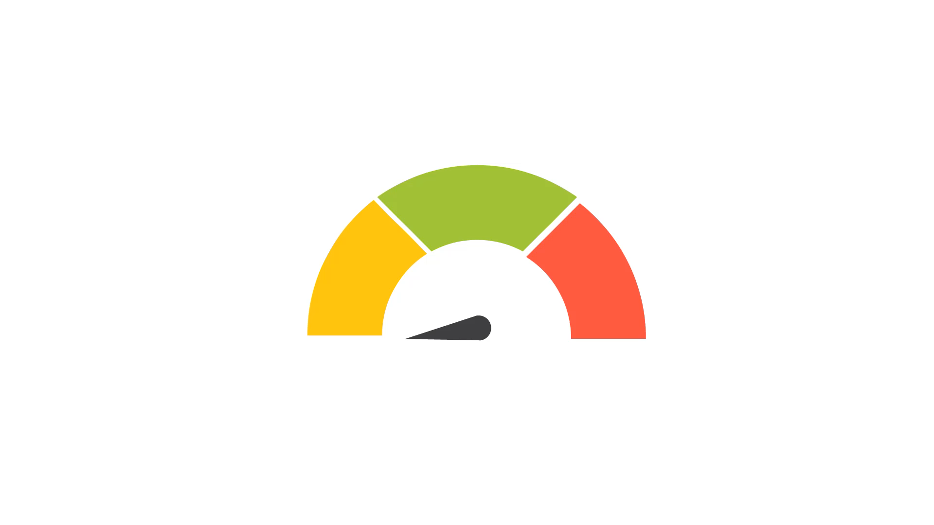
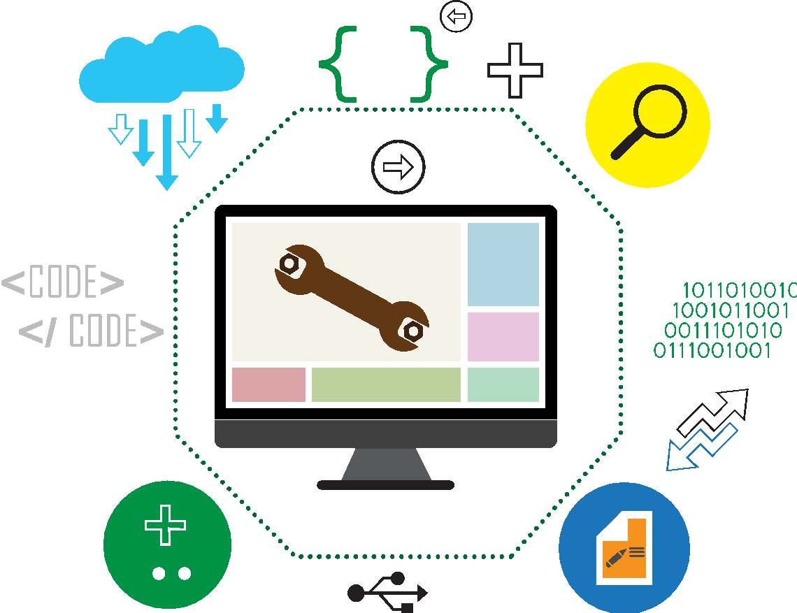
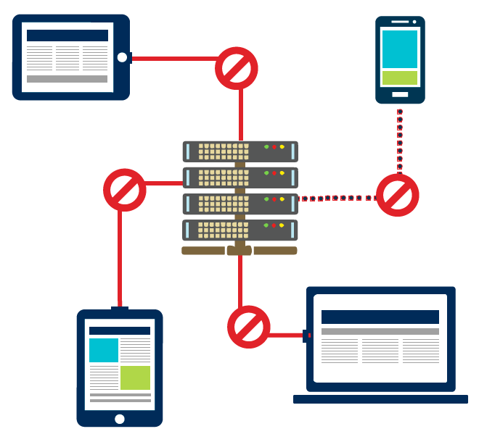
Challenges of Distributed Systems
Since multiple computers are used in a distributed system, there are high chances of:
System failure
High programming complexity
Limited bandwidth
Notes:
Trainer Notes:
Explain the challenges associated with Distributed systems.
Did you know the solution to these challenges?
To overcome these challenges we use Hadoop!

Slide 42
Solution
Hadoop overcomes these challenges.
Notes:
Trainer Notes:
Explain the challenges associated with Distributed systems.
Did you know the solution to these challenges?
To overcome these challenges we use Hadoop!

Slide 43
Introduction to Hadoop

Slide 44
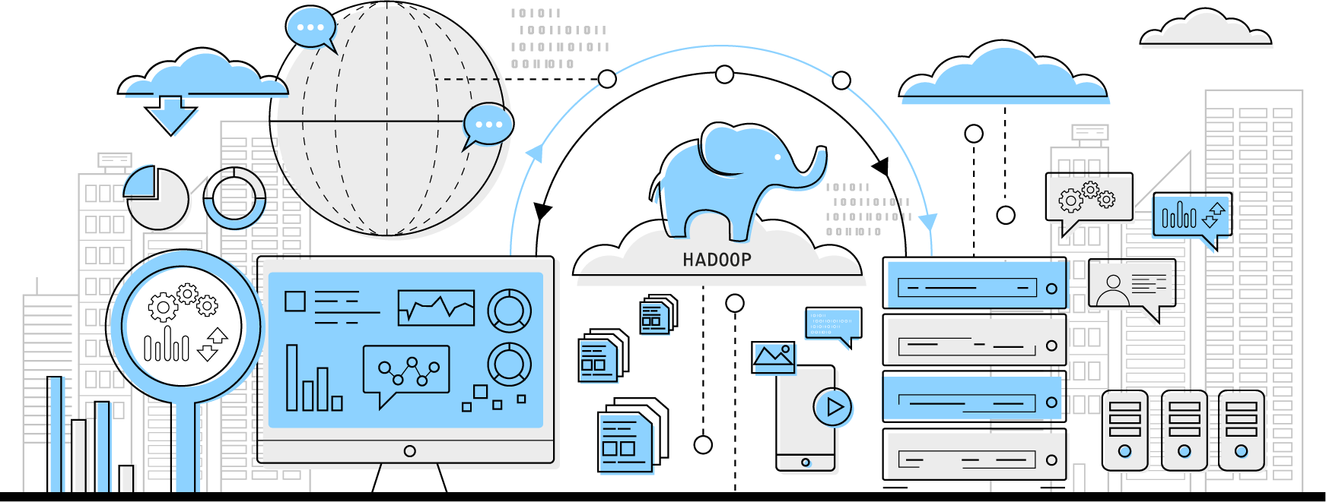
What Is Hadoop?
Hadoop is a framework that allows distributed processing of large datasets across clusters of commodity computers using simple programming models.
Notes:
Trainer Notes:
Doug Cutting discovered Hadoop and named it after his son’s yellow toy elephant. It is inspired by the technical document published by Google.
Read out the definition and give a brief history of how Hadoop was created

Slide 45





Characteristics of Hadoop
The four key characteristics of Hadoop are:
Reliable
Scalable
Stores copies of the data on different machines and is resistant to hardware failure
Can follow both horizontal and vertical scaling
Economical
Flexible
Can use ordinary computers
for data processing
Can store huge data and decide to use it later
Notes:
Trainer Notes:
Explain the four key characteristics of Hadoop.

Slide 46
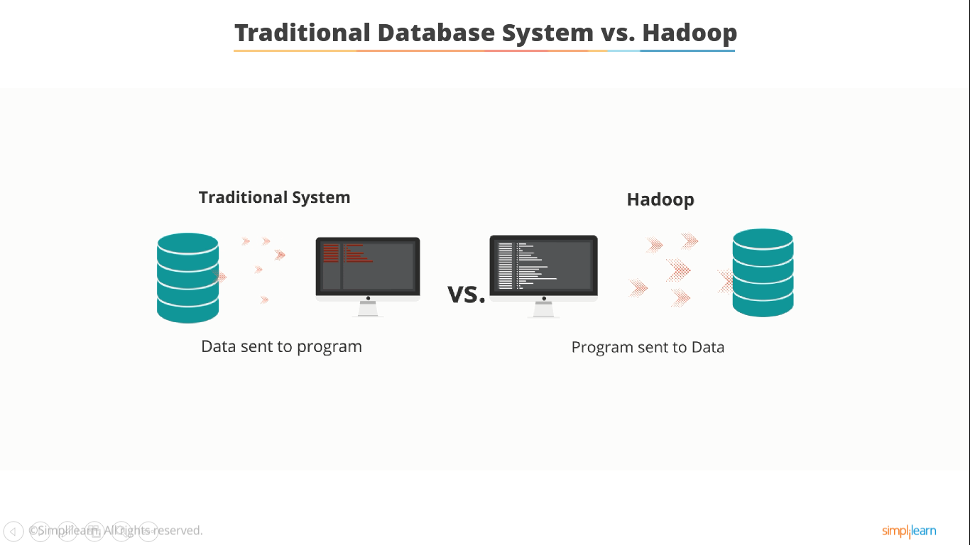
Traditional Database Systems vs. Hadoop
The basic difference in functionality between traditional
database systems and Hadoop are:
Traditional System
Hadoop
VS.
Data sent to the program
Program sent to the data
Notes:
Trainer Notes:
Explain in brief traditional database systems vs. Hadoop

Slide 47
Traditional Database Systems vs. Hadoop
 | RDMS | Hadoop
Data Types | Structured | Multi and unstructured
Processing | Limited, No data processing | Processing data in a distributed manner
Governance | Standards and structured | Loosely structured
Schema | Required on write | Required on read
Speed | Reads are fast | Writes are fast
Cost | Software license | Supports only
Resources | Known entity | Growing, Complexities, and wide
Best fit use | OLTP, Complex ACID Transactions, and operational data store | Data discovery, processing unstructured data, and massive storage or processing
Notes:
Trainer Notes:
Explain traditional database systems vs. Hadoop using the table

Slide 48
Components of Hadoop Ecosystem

Slide 49



Hadoop Core Components
Hadoop is composed of three major components: HDFS, MapReduce, and YARN.
Data Processing
YARN
Resource Management
Storage
Hadoop Core
Notes:
Trainer Notes:
Explain the role and importance of Hadoop’s three core components: processing, resource management, and storage.

Slide 50





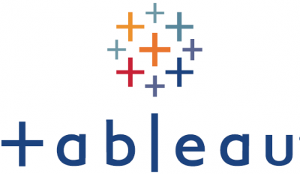

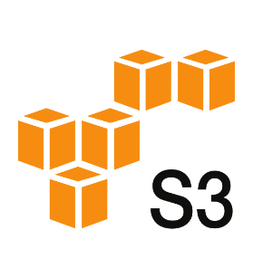



Components of Hadoop Ecosystem
These are the various components of the Hadoop ecosystem, which works together to provide data absorption, analysis, storage, and maintenance.
Data Analysis
Data Exploration
Data Ingestion
Data Storage
Data Processing
Data Visualization
Data Visualization
Sqoop
(Deprecated)
YARN
Cluster Resource Management
YARN
Flume
Notes:
Trainer Notes:
Explain the role of each component of the Hadoop ecosystem.
HDFS, MapReduce, YARN, and Hadoop Common are the four core components of Hadoop.

Slide 51
HDFS (Hadoop Distributed File System)
HDFS is a distributed file system that runs on commodity hardware and can handle massive data collections. Salient features of HDFS are as follows:
Provides a storage layer for Hadoop
Allows availability of command-line interface from Hadoop
Is suitable for the distributed storage and processing
Provides file permissions and authentication
Allows streaming access to file system data
Notes:
Trainer Notes:
Explain the HDFS component

Slide 52






HBase
HBase is a column-oriented non-relational database management system that runs on top of the HDFS. Some of the features of Hbase are as follows:
Stores data in HDFS
Works on NoSQL database or non-relational database
Is used when a random, real-time, read or write
access is needed in Big Data
Provides support to high volume of data and high throughput
Supports thousands of columns in a table
Notes:
Trainer Notes:
Explain the HBase component

Slide 53


SQOOP
Sqoop is a tool designed to transfer data between Hadoop and relational database servers, such as Oracle and MySQL to HDFS, and export data from HDFS to relational database.
The order of columns in both MySQL and Hive should be the same while importing or exporting.
Notes:
Trainer Notes:
Explain the Sqoop component

Slide 54
KAFKA
Kafka is an open-source distributed event stream platform that provides high-performance data pipelines, streaming analytics, and data integration for critical applications.
Kafka has a modern, cluster-centric design that offers strong durability and fault-tolerance guarantees.
Producers
App
App
App
DB
App
Consumers
Kafka
Cluster
Stream
Processors
DB
App
App
App
App
Consumers
Notes:
Trainer Notes:
Producer
The producer sends data directly to the broker that is the leader for the partition
Consumer
Requests to the brokers leading the partitions to consume
Control over this position and can rewind it to re-consume data if need be

Slide 55
Flume
Flume is used to ingest event data, such as streaming data, sensor data, and log files.
Distributed service for ingesting streaming data
Ideally suited for event data from multiple systems
Notes:
Trainer Notes:
Explain the Flume component

Slide 56

Spark
It is an open-source cluster computing framework.
Spark provides 100 times faster performance than MapReduce.
Supports machine learning, business intelligence, streaming, and batch processing
Notes:
Trainer Notes:
Explain the Spark component

Slide 57
Hadoop MapReduce
Some of Hadoop MapReduce features are:
Original Hadoop processing engine which is primarily Java-based
Commonly used
Based on the map and reduce programming model
An extensive and mature fault tolerance framework
Notes:
Trainer Notes:
Explain the Map-Reduce component

Slide 58

Pig
Pig is a high-level data flow framework for executing Hadoop MapReduce programs. Pig Latin is the language used in Pig.
An alternative to write MapReduce code
An open source
dataflow system
Best for ad-hoc queries such as join and filter
Converts pig script to MapReduce code
Notes:
Trainer Notes:
Explain the Pig component

Slide 59
Impala
Impala is a SQL query engine that uses MPP (Massive Parallel Processing) to process large amounts of data stored in a Hadoop cluster.
Is a high-performance SQL engine that runs on the Hadoop cluster
Is ideal for interactive analysis
Has very low latency –measured in milliseconds
Supports a dialect of SQL (Impala SQL)
Notes:
Trainer Notes:
Explain the use of Impala

Slide 60
Hive
Hive is a data warehouse system that is used to analyze structured data. It is built on the top of Hadoop.
Executes queries using MapReduce
Is similar to Impala
Is best for data processing and ETL
Notes:
Trainer Notes:
Explain the Hive component

Slide 61

Cloudera Search
It is an Apache Solr that is fully integrated into the Cloudera platform, taking advantage of the flexible, scalable, and robust storage system and data processing frameworks included in the Cloudera Data Platform (CDP).
Is one of Cloudera's near-real-time access products
Eliminates the need to move large datasets across infrastructures to address business tasks
Enables nontechnical users to search and explore data stored in or ingested into Hadoop and HBase
Provides a fully integrated data processing platform
Notes:
Trainer Notes:
Explain the use of Cloudera Search component

Slide 62

Oozie
Oozie is a workflow or coordination system that manages the Hadoop jobs.
Oozie coordinator engine
Oozie workflow engine
Start
B
Action
A
Action1
C
Action2
Action3
End
Notes:
Trainer Notes:
Explain the use of Oozie component

Slide 63

Hadoop User Experience (HUE)
Hue is an acronym for Hadoop User Experience.
It provides SQL editors for Hive, Impala, MySQL, Oracle, PostgreSQL, Spark SQL,
and Solr SQL.
Hue is an open-source Web interface for analyzing data with Hadoop.
Notes:
Trainer Notes:
Explain the use of Hue component

Slide 64
Commercial Hadoop Distributions

Slide 65





Various Commercial Hadoop Distributions
Following are some of the commercial Hadoop Distributions:
HDInsight
Notes:
Trainer Notes:
Illustrate the various Hadoop Distributions and their features

Slide 66
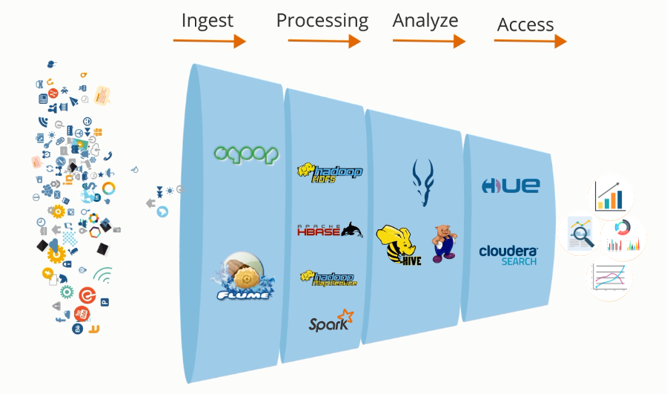
Big Data Processing
Components of Hadoop ecosystem work together to process big data. There are four stages of big data processing:
Notes:
Trainer Notes:
Discuss how the components work together to process Big Data.

Slide 67
Assisted Practice: Walk-Through of the Simplilearn Cloud Lab
Duration: 10 Minutes
Problem Statement: In this demonstration, you will walk-through through the Simplilearn cloud lab.
Objective: In this Assisted Practice, You will learn how to log in to the Simplilearn lab.
Tasks to Perform:
Step 1: Click on the Practice Labs tab on the left side panel of the LMS
Step 2: Copy the username and password that are generated
Step 3: Click on the Launch Lab button
Step 4: Enter the username and password in the respective fields on the page and click Login
Notes:
Trainer Notes:
Perform each step along with the learner.

Slide 68
Big Data has high volume, variety, velocity, veracity, and value.
Hadoop is a framework that allows the distributed processing of large datasets across clusters of commodity computers using simple programming models.
The Hadoop Ecosystem is a platform that offers a variety of services to address big data issues. It consists of Apache projects and a variety of commercial tools and solutions.

Slide 70
Which Hadoop tool is an alternative to writing MapReduce code in a high-level language?
1
Pig
Hive
Spark
Impala

Slide 71
Which Hadoop tool is an alternative to writing MapReduce code in a high-level language?
1
Pig
Hive
Spark
Impala
A
Pig Latin is a high-level language for writing data analysis programs that are converted into MapReduce jobs through Pig.

Slide 72
Which tool can perform random read and write operations on datasets of petabyte size?
2
Hive
Impala
HBase
HDFS

Slide 73
Which tool can perform random read and write operations on datasets of petabyte size?
2
Hive
Impala
HBase
HDFS
C
HBase is a database that leverages milliseconds of delay to read and write data even at a petabyte scale.

Slide 74
Which of the following is a source of unstructured data?
3
Data from social media websites
Transactional data in Amazon’s database
Web and server logs
All of the above

Slide 75
Which of the following is a source of unstructured data?
3
Data from social media websites
Transactional data in Amazon’s database
Web and server logs
All of the above
A
Unstructured data comprises data that is usually not easily searchable, including formats like audio, video, and social media postings.

Slide 76
What is Hadoop?
4
It is an in-memory tool used in Mahout algorithm computing.
It is a computing framework used for resource management.
It is a framework that allows distributed processing of large datasets across clusters of commodity computers using a simple programming model.
It is a search and analytics tool that provides access to analyze data.

Slide 77
What is Hadoop?
4
It is an in-memory tool used in Mahout algorithm computing.
It is a computing framework used for resource management.
It is a framework that allows distributed processing of large datasets across clusters of commodity computers using a simple programming model.
It is a search and analytics tool that provides access to analyze data.
C
Hadoop is a framework that allows distributed processing of large datasets across clusters of commodity computers using a simple programming model.

Slide 78
Thank You

