Slide 1
Big Data Hadoop and Spark Developer

Slide 2
HDFS: The Storage Layer

Slide 3

Summarize how the Hadoop Distributed File System (HDFS) stores data across a cluster
Illustrate the HDFS architecture and its components
Demonstrate the use of the HDFS Command Line Interface (CLI)
Notes:
Trainer Notes:
Explain the learning objectives at the start of the session

Slide 4
Hadoop Distributed File System (HDFS)

Slide 5

What Is HDFS?
HDFS is a distributed file system that provides access to data across Hadoop clusters.
It manages and supports the analyses of large volumes of big data.
Notes:
Trainer notes:
Explain the following
what is HDFS
what is a Hadoop cluster

Slide 6


Challenges of Traditional Systems
In the traditional system, storing and retrieving volumes of data had three major issues:
Cost
Speed
Reliability
$10,000 to $14,000
per terabyte
Search and analysis
is time-consuming
Fetching data is difficult
Notes:
Trainer notes:
Explain the challenges of traditional systems

Slide 7

Need for HDFS
HDFS resolves all the three major issues of the traditional file system.
Cost
Reliability
Has zero licensing and support costs
Copies
data multiple times
Speed
Reads or writes more than one terabyte of data per second
Notes:
Trainer notes:
Explain the need for HDFS w.r.t traditional file systems

Slide 8


HDFS Storage
HDFS is a distributed file system that uses NameNode and DataNode architectures to allow high-performance data access across highly scalable Hadoop clusters.
Data is divided into 128 MB blocks.
Metadata
Metadata keeps the information about the block and its replication.
It is stored in the NameNode.
HDFS stores files in a number of blocks.
NameNode
Node A
Node D
Large data file
B1
B2
B3
B1
B2
B4
B2
B3
Node B
Node E
B4
Node E
B1
B3
1
2
B2
B4
3
4
B4
Each block is replicated on a few separate computers.
Node C
B1
B3
Notes:
Trainer notes:
Explain how HDFS storage works

Slide 9
Characteristics of HDFS
Fault-tolerant system
1
5
2
Rack-aware
Scalable
Support for
heterogeneous clusters
4
3
Built for large datasets
Notes:
Trainer notes:
Explain characteristics of HDFS using real-time examples

Slide 10
HDFS Architecture and Components

Slide 11


HDFS High-Availability Architecture
Hadoop's high-availability functionality ensures that the Hadoop cluster remains operational despite unfavorable conditions, such as NameNode failure, DataNode failure, or computer crashes. It indicates that the data will be available through a standby NameNode when the NameNode fails.
NameNode
high-availability
Hadoop
high-availability
What is
Failover?
Notes:
Trainer notes:
- Explain the HDFS HA architecture
- Also, briefly explain the role of the components.

Slide 12


HDFS High-Availability Architecture
Zookeeper Service
(leader election)
Heartbeat
Heartbeat
Failover Controller Active
Failover Controller Standby
Metadata
(shared edit logs)
Monitor health
Monitor health
Active
NameNode
Standby
NameNode
Data Node 1
Data Node 2
Data Node 3
1
3
1
3
1
3
Notes:
Trainer notes:
- Explain the HDFS HA architecture
- Also, briefly explain the role of the components.

Slide 13


Types of HDFS Architectures
There are two types of HDFS high-availability architectures:
Quorum-based storage
  Shared storage using NFS
Shared dir
on NFS
All namespace edits
logged to shared storage
Active
NameNode
Standby
NameNode
Quorum Journal Manager
Quorum Journal Manager
Active
NameNode
Standby
NameNode
Block reports are sent
to both NameNodes
DN
DN
DN
DN
DN
DN
DN
DN
JournalNode
JournalNode
JournalNode
DD
DD
DD
Notes:
Trainer notes:
Explain the 2 types of HDFS HA architecture and how different components work together.
DD stands for Data Disk
DN stands for DataNode
Quorum-based Storage refers to the HA implementation that uses a Quorum Journal Manager and JournalNode whereas the NFS Gateway for HDFS allows clients to mount HDFS and interact with it through NFS, as if it were part of their local file system.

Slide 14

HDFS Component: NameNode
The HDFS components comprise different servers like NameNode, DataNode, and
Secondary NameNode.
Metadata
File system
DN1
DN2
DN3
1
3
File.txt = AC
1
3
NameNode
1
3
Data Node 1
Data Node 2
Data Node 3
Data Node N
……
1
3
1
3
1
3
The NameNode server— core component of an HDFS cluster
Notes:
Trainer notes:
Explain the working of NameNode

Slide 15

HDFS Component: DataNode
The DataNode is a multiple instance server. DataNode servers are responsible for storing and maintaining the data blocks.
Metadata (Name, replicas, …):
/home/foo/data, 3, …
Metadata ops
NameNode
Client
Block ops
Read
DataNode 1
DataNode 2
DataNode 3
DataNode 4
DataNode 5
Block
Replication
Rack 1
Write
Rack 1
Client
Notes:
Trainer notes:
Explain the working of DataNode

Slide 16
HDFS Component: SNN
In the event of data loss or any disaster, NameNode acts as a backup node.
FsImage and edit logs
Metadata (Name, replicas, …):
/home/foo/data, 3, …
Metadata ops
NameNode
Secondary NameNode
Merged FsImage
Client
Block ops
Read
DataNode 1
DataNode 2
DataNode 3
DataNode 4
DataNode 5
Block
Replication
Rack 1
Client
Write
Rack 1
It takes hourly snapshots of data stored by an active NameNode and stores it in FsImage.
Notes:
Trainer notes:
Explain the working of DataNode

Slide 17
HDFS Component: ZooKeeper
ZooKeeper allows distributed processes to coordinate with each other through a shared hierarchical namespace.
ZooKeeper Service
Leader
Server
Server
Server
Server
Server
Client
Client
Client
Client
Client
Client
Client
Client
The ZooKeeper implementation is simple and replicated, which puts a premium on high performance, high availability, and a strictly ordered access.
Notes:
Trainer notes:
Explain the working of Zookeeper
Leader: One of the servers is designated a Leader. It gives all the information to the clients as well as an acknowledgment that the server is alive. It would performs automatic recovery if any of the connected nodes failed.

Slide 18




HDFS Component: ZooKeeper
Automatic HDFS Failover relies on ZooKeeper for the following:
Failure detection
Active NameNode election
Notes:
Trainer notes:
Explain the importance of Zookeeper

Slide 19
HDFS Component: File System Namespace
NameNode
The HDFS file system:
Allows user data to be stored in files
Follows a hierarchical file system with directories and files
Supports operations like create, remove, move, and rename
/
/Dir 1
/Dir 1
/Dir 1.1
File A
/Dir 2.1
File B
Notes:
Trainer notes:
Explain the characteristics of HDFS file system

Slide 20


NameNode Operation
The NameNode maintains two persistent files:
DataNodes
A transaction log called EditLog
A namespace image called FsImage
Load into memory
NameNode
Retrieves the EditLog at startup
Updates with EditLog information
EditLog
FsImage
Blocks
Files
Notes:
Trainer notes:
Explain how the NameNode operates

Slide 21

Data Block Split
Each file is split into one or more blocks that are stored and replicated in DataNodes.
NameNode
DataNode 1
DataNode 2
DataNode 3
DataNode 4
A file split into blocks
b1
b2
…
b2
b3
…
b1
b3
…
b1
b2
…
DataNodes managing blocks
The data block approach provides simplified replication, fault tolerance, and reliability.
Notes:
Trainer notes:
Explain how the data blocks are split, stored and replicated in DataNodes

Slide 22
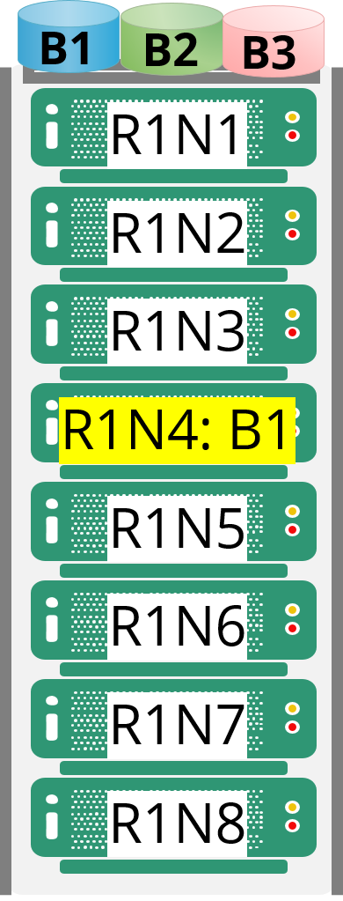
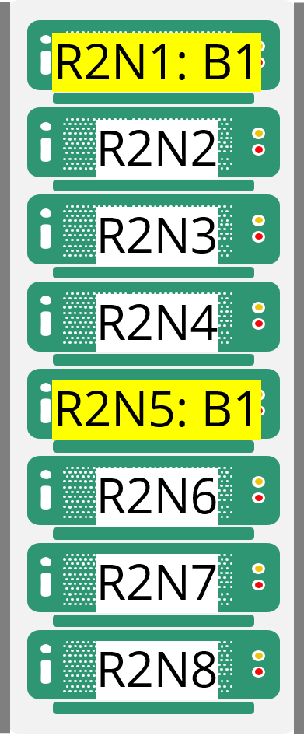
Block Replication Architecture
HDFS represents the unstructured data in the form of data blocks. It performs block replication on multiple DataNodes.
NameNode
JobTracker
B1
B2
B3
Job 1
DataNode server1
Block replication
DataNode server 2
Resubmit job 1
Server error
Notes:
Trainer notes:
Explain how the block replication architecture

Slide 23
Replication Method
Each file is split into a sequence of blocks. Except for the last one, all blocks in the file are of the same size.
/foo/data0, replication:2, {1, 4}
/foo/data1, replication:2, {2, 3}
Blockreport
Block operations
(create block #,
delete block #,
replicate block #, …)
Heartbeat
NameNode
DataNode
DataNode
DataNode
DataNode
/foo/data0
1
2
3
3
4
2
1
4
/foo/data1
3
1
4
1
2
4
2
3
Notes:
Trainer notes:
Explain how the replication of blocks works

Slide 24
Data Replication Topologies
One of the suggested replication topologies is as follows:
Client
Rack 1
R3N1
R3N2
R1N3: B1
Notes:
Trainer Notes:
Explain how the replication of blocks works
Place the first replica on the same node as that of the client.
Place the second replica on a different rack from that of the first replica.
Place the third replica on the same rack as that of the second one, but on a different node.

Slide 25
HDFS: Erasure Coding
It is a data protection technique where data is broken into fragments, expanded, encoded with redundant information, and stored in different locations or storage media.
Reduced storage overhead
As 1 parity block stored for
2 data blocks
Block Ap
Block A1
Block A2
Block B1
Block Bp
Block B2
Block C1
Block C2
Block Cp
= Block C1 + Block C2
Disk 1
Disk 2
Disk 3
If a storage medium fails or data is corrupted, the data can be reconstructed from parts stored on other storage media.

Slide 26




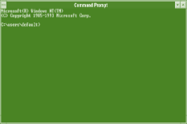

HDFS Access
HDFS provides the following access mechanisms:
Python access and C wrapper for non-Java applications
Java API for applications
Web GUI utilized through an HTTP browser
FS shell for executing commands
on HDFS
Notes:
Trainer Notes:
Explain the various ways HDFS can be accessed

Slide 27
HDFS Command Line
Copies simplilearn.txt from the local disk to the user’s directory in HDFS
$hdfs dfs -put simplilearn.txt simplilearn.txt
Displays a list of the contents of the directory path provided by the user, and shows the names, permissions, owner, size, and modification date for each entry
$hdfs dfs –ls /user/simpl/test
Creates a directory called test under the user’s home directory
$hdfs dfs –mkdir /user/simpl/test
Delete the directory test and all content within
$hdfs dfs -rm -f test
Notes:
Trainer Notes:
Explain some of basic commands of HDFS
Run these commands in the Simplilearn Lab

Slide 28
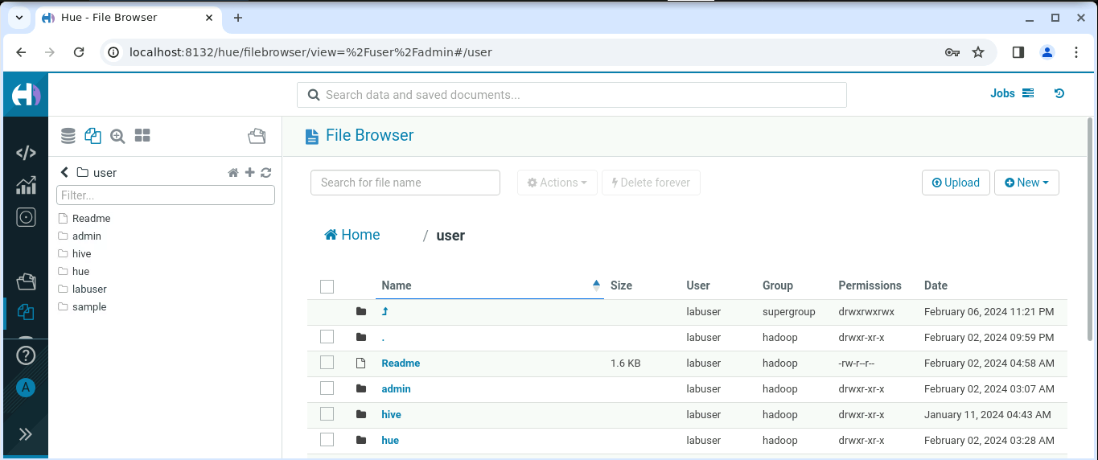
Hue File Browser
The file browser in Hue lets you view and manage your HDFS directories and files.
Additionally, you can create, move, rename, modify, upload, download, and delete directories and files.
Notes:
Trainer Notes:
Demo the Hue file browser in the Simplilearn Lab

Slide 29
Case Study: Analyzing Uber Datasets Using Hadoop Framework

Slide 30

Analyzing Uber Datasets Using Hadoop Framework
Uber started by using RDBMS for storage, but there was a need for scalability and reliability after a few years, which increased by 400% every year. In 2016, there were about 100 petabytes of data, which was mixed, i.e., batch and real-time. After the previous solution failed, they began utilizing HDFS and then PRESTO.
They began using HDFS for batch and streaming analytics in a variety of applications, including fraud detection, machine learning, and ETA calculation.

Slide 31
Assisted Practice: HDFS commands
Duration: 10 Minutes
Problem Scenario: Write commands to manage HDFS by creating Sample.txt, establishing the
Simplilearn directory, transferring the file, displaying content, retrieving block details, and removing
the file.
Objective: To master HDFS file management, create a text file, establish a Simplilearn directory,
transfer a sample file, display its content, retrieve block details, and remove the file from HDFS.
Steps Overview:
Step 1: Create a text file named Sample.txt in the vi editor
Step 2: Create a directory named Simplilearn in HDFS
Step 3: Transfer a sample text file from your local filesystem to the HDFS director

Slide 32
Assisted Practice: HDFS commands
Duration: 10 Minutes
Step 4: Show the content of the HDFS file uploaded on the command prompt
Step 5: Get details of all replicated blocks of the sample file uploaded
Step 6: Remove the text file from the HDFS directory
Note: The solution to this assisted practice is provided under the Reference Materials section.

Slide 33
HDFS is a distributed file system that provides access to data across Hadoop clusters.
The HDFS components comprise different servers, like NameNode, DataNode, and Secondary NameNode.
HADOOP CLI is an interactive command-line shell that makes
working with Hadoop's Distributed File System (HDFS) easier and more intuitive than the traditional Hadoop command-line tools.

Slide 35
Which of the following statements best describes how a large (100 GB) file
is stored in HDFS?
1
  The file is replicated three times by default. Each copy of the file is stored on a separate DataNode.
  The master copy of the file is stored on a single DataNode. The replica copies
  are divided into fixed-size blocks which are stored on multiple DataNodes.
  The file is divided into fixed-size blocks which are stored on multiple DataNodes. Each block is replicated three times by default. Multiple blocks from the same file might reside on the same DataNode.
  The file is divided into fixed-size blocks which are stored on multiple DataNodes.
  Each block is replicated three times by default. HDFS guarantees that different blocks from the same file are never on the same DataNode.

Slide 36
Which of the following statements best describes how a large (100 GB) file
is stored in HDFS?
1
  The file is replicated three times by default. Each copy of the file is stored on a separate DataNode.
  The master copy of the file is stored on a single DataNode. The replica copies
  are divided into fixed-size blocks which are stored on multiple DataNodes.
  The file is divided into fixed-size blocks which are stored on multiple DataNodes. Each block is replicated three times by default. Multiple blocks from the same file might reside on the same DataNode.
  The file is divided into fixed-size blocks which are stored on multiple DataNodes.
  Each block is replicated three times by default. HDFS guarantees that different blocks from the same file are never on the same DataNode.
D
The large file is divided into fixed-size blocks which are stored on multiple DataNodes. Each block is replicated three times by default. HDFS guarantees that different blocks from the same file are never on the same DataNode.

Slide 37
How many blocks are required to store a file that is 514 MB in size in HDFS using default block size configuration?
2
4
5
6
7

Slide 38
How many blocks are required to store a file that is 514 MB in size in HDFS using default block size configuration?
2
4
5
6
7
B
The default block size in Hadoop 3. x is 128 MB. So, a file of size 514 MB will be divided into 5 blocks, where the first four blocks will be 128 MB and the last block will be 2 MB.

Slide 39
Which of the following statements is NOT true about HDFS?
3
We cannot modify files already present in HDFS
Multiple clients can write into an HDFS file concurrently
Both A and B
None of the above

Slide 40
Which of the following statements is NOT true about HDFS?
3
We cannot modify files already present in HDFS
Multiple clients can write into an HDFS file concurrently
Both A and B
None of the above
B
HDFS follows the write once, read many model. So, multiple clients cannot write into an HDFS file concurrently.

Slide 41
Thank You

