Slide 1
Big Data Hadoop and Spark Developer

Slide 2
Distributed Processing: MapReduce Framework

Slide 3

Perform distributed processing in MapReduce
Illustrate how MapReduce deals with distributed processing issues
Control the flow of mappers and reducers
Optimize MapReduce jobs
Notes:
Trainer Notes:
Explain the learning objectives at the start of the session

Slide 4
Distributed Processing in MapReduce

Slide 5

Introduction to MapReduce
MapReduce is a programming model that simultaneously processes and analyzes huge data sets logically into separate clusters.
Map sorts the data, whereas Reduce segregates it into logical clusters, thus removing the bad data and retaining the necessary information.
Notes:
Trainer Notes:
Explain what is MapReduce

Slide 6
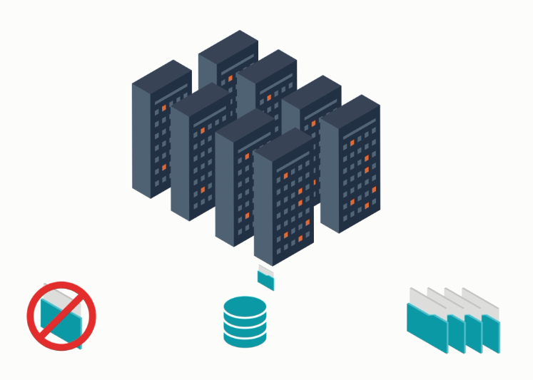
Why MapReduce?
Huge amounts of data were stored on single servers before 2004.
Notes:
Trainer Notes:
Explain why MapReduce is required

Slide 7


MapReduce: Analogy
Here is a diagram for an analogy of how MapReduce works.
Election results
Polling booth ballots
Tellers
Poll count
in each booth
Total count for each candidate
Notes:
Trainer Notes:
Explain why MapReduce is required using the analogy

Slide 8




MapReduce: Analogy
Here is an example of election results to understand how MapReduce works.
One month to receive the election results
Results obtained in one or two days
Individual work
Parallel work
Notes:
Trainer Notes:
Explain why MapReduce is required using the analogy

Slide 9
MapReduce: Word Count Example
The overall MapReduce word count process is shown below:
Input
Splitting
Mapping
Shuffling
Reducing
This quick brown fox jumps over the lazy dog. A dog is a man’s best friend.
This quick brown fox jumps over the lazy dog.
This, 1
A, 1
This, 1
dog, 1
This, 1
dog, 2
quick , 1
dog, 1
quick , 1
dog, 1
quick , 1
a, 2
brown, 1
fox, 1
is, 1
brown, 1
a, 1
brown, 1
is, 1
A dog is a man’s best friend.
jumps, 1
a, 1
fox, 1
a, 1
fox, 1
over, 1
jumps, 1
is, 1
jumps, 1
man’s, 1
man’s, 1
the, 1
over, 1
man’s, 1
over, 1
best, 1
lazy, 1
best, 1
the, 1
best, 1
the, 1
dog, 1
friend, 1
lazy, 1
friend, 1
lazy, 1
friend, 1
Notes:
Trainer Notes:
Explain how MapReduce works using the wordcount example

Slide 10
Case Study: Flipkart Dodged WannaCry Ransomware

Slide 11

Case Study: Flipkart Dodged WannaCry Ransomware
Ransomware caused a stir by infiltrating Windows systems and encrypting data. To recover the data, the owner or organization was forced to pay a ransom in Bitcoin.

Slide 12
Case Study: Flipkart Dodged WannaCry Ransomware
The WannaCry ransomware was rapidly spreading across systems in 2018, particularly on
Windows-based OS. Flipkart (backed by Walmart) ran 90 percent of its servers on Windows, increasing the probability of an attack.

Slide 13

Case Study: Flipkart Dodged WannaCry Ransomware
Flipkart managed to acquire a security patch from Microsoft to fix the vulnerabilities. However, the main issue was how and when to apply the patch to the systems.
There were almost 10,000 servers that needed to be patched. The biggest question was at what time the patching should happen.
Challenges

Slide 14
Case Study: Flipkart Dodged WannaCry Ransomware
Server logs were analyzed to find the precise time when traffic on the servers was low and the patch could be applied.
MapReduce, a Hadoop component, was selected to analyze and process server logs.
Solution

Slide 15


Case Study: Flipkart Dodged WannaCry Ransomware
Using MapReduce on 200 terabytes of data, Flipkart found that the request count was lowest at 4 a.m. every day and decided to shut down the servers to apply the Microsoft patch.

Slide 16
MapReduce Terminologies

Slide 17
MapReduce Terminologies
It is a recording entity received at the mapper given by RecordReader.
For example, in (country,1), country is a key. Keys are driven by use case and are selected by users.
Keys
  It is a part of a recording entity and holds data for computing.
  For example, in (country,1), 1 is a value.
Value
It's a logical representation of data that InputFormat generates and maps to a single task that a mapper will execute.
It describes a unit of work that contains a single map task in MapReduce.
InputSplit

Slide 18
MapReduce Terminologies
  It is an internal framework that converts the byte-oriented view of data from InputSplit to key-value pairs and passes them on to the Map.
RecordReader
It is a self-sustained function that takes input from RecordReader and processes it.
The input for Mapper is a Map (K, V), and the output is a Map (K1, V1). It is stored on HDFS in the temp directory.
Mapper
  It is a function that takes input from the Mapper output.
  Then, it performs computations, such as sum, filter, and aggregation, on them and provides a Map (K2, V2) as an output.
Reducer

Slide 19
MapReduce Terminologies
It decides the partitioning of keys for the intermediate
map outputs.
It also controls the middle map output segment.
Partitioner
  It is a function to gather statistics about the MapReduce job.
  These are inbuilt but can be user-defined as well.
Counter
It is also known as a mini-reducer.
It works at the mapper level and optimizes data transfer to reduce congestion before passing it to the reducer.
Combiner

Slide 20

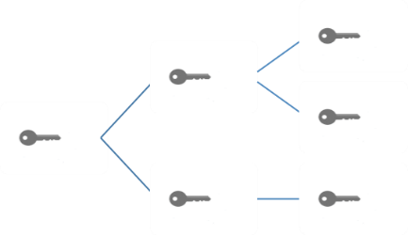
MapReduce Essentials
The job input is specified in key-value pairs:
A user-defined map function is applied to each input record to produce a list of intermediate
key-value pairs.
A user-defined reduce function is called once for each distinct key in the map output.
Notes:
Trainer Notes:
Explain the MapReduce essentials

Slide 21

MapReduce Essentials
The essential steps of each MapReduce phase include:
The number of reduce tasks can be defined by the users.
Each reduce task is assigned a set of record groups, that is, intermediate records corresponding to a group of keys.
For each group, a user-defined reduce function is applied to the recorded values.
The reduce tasks are read from every map task, and each read returns the record groups for that reduce task.
Reduce phase cannot start until all mappers have finished processing.
Notes:
Trainer Notes:
Explain each MapReduce phase

Slide 22
Map Execution Phases

Slide 23


Map Execution Phases
Map phase
Partition phase
Shuffle phase
Sort phase
Reduce phase
Reads assigned input split
from HDFS
Parses input into records as
key-value pairs
Applies map function to each record
Informs master node of its completion
Each mapper must determine which reducer will receive each of the outputs
For any key, the destination partition is the same
Number of partitions is equal to the number of reducers
Fetches input data from all map tasks for the portion corresponding to the reduce
tasks' bucket
Merge sorts all map outputs into a single run
Applies
user-defined reduce function to the
merged run
Notes:
Trainer Notes:
Explain in brief the Map execution phases

Slide 24
Map Execution: Distributed Two-Node Environment
Here is a diagram representing a two-node distributed environment.
Node 1
Node 2
Files loaded from local HDFS stores
Files loaded from local HDFS stores
InputFormat
InputFormat
file
file
file
Split
Split
Split
Split
Split
Split
file
RecordReaders
RR
RR
RR
RR
RR
RR
RecordReaders
Input (k, v) pairs
Input (k, v) pairs
map
map
map
map
map
map
Intermediate (k, v) pairs
Shuffling process
Intermediate (k, v) pairs
Partitioner
Partitioner
(sort)
Intermediate (k, v)
pairs exchanged
by all nodes
(sort)
reduce
reduce
Writeback to local HDFS store
Final (k, v) pairs
Final (k, v) pairs
Writeback to local HDFS store
OutputFormat
OutputFormat
Notes:
Trainer Notes:
Explain in brief the Map execution phases

Slide 25
MapReduce Jobs

Slide 26

MapReduce Jobs
A job is a MapReduce program that causes multiple map and reduce functions to run parallelly over the life of the program.
ApplicationMaster and NodeManager functions:
ApplicationMaster
NodeManager
Is responsible for the execution of a single application or MapReduce job
Divides job requests into tasks and assigns them to NodeManagers running on the slave node
Has many dynamic resource containers
Executes each active map or reduce task regularly with the ApplicationMaster
Notes:
Trainer Notes:
Explain the MapReduce Jobs

Slide 27
MapReduce and Associated Tasks
Map process
  Is an initial ingestion and transformation step where initial input records are processed parallelly
ApplicationMaster
Keeps track of a MapReduce job
Reduce process
Is an aggregation or summarization step in which all associated records are processed together
NodeManager
Keeps track of individual map tasks and can run in parallel to other NodeManager
Notes:
Trainer Notes:
Explain the associated tasks with MapReduce

Slide 28
Hadoop MapReduce Job Work Interaction
Job submission
  Hadoop MapReduce job is submitted by a client in the form of an input file or a number of input split of files containing data.
Input split distribution
MapReduce ApplicationMaster distributes the input split to
separate NodeManagers.
Success or failure status
ResourceManager gathers the final output and informs the client of the success or failure status.
Resubmission of tasks
MapReduce ApplicationMaster resubmits the tasks to an alternate NodeManager if the DataNode fails.
Coordination with
NodeManager
MapReduce ApplicationMaster coordinates with the NodeManagers.
Notes:
Trainer Notes:
Explain Hadoop MapReduce Job Work Interaction

Slide 29
Characteristics of MapReduce
Handles large-scale data
Attends to split and
move data
Works well on write once read many (WORM) data
MapReduce characteristics
Leverages commodity hardware and storage
Allows parallelism
Provides operations near the data
Performs operations by the same processor
Notes:
Trainer Notes:
Explain the characteristics of MapReduce using real-time examples

Slide 30








Real-Time Uses of MapReduce
Algorithms
Sorting
Data mining
Search engine operations
Enterprise analytics
Gaussian analysis
Semantic web 3.0
Notes:
Trainer Notes:
- Explain the real-time uses of MapReduce
- Give examples

Slide 31
Building a MapReduce Program

Slide 32
Building a MapReduce Program
The steps to build a MapReduce program are:
1
Determine the data
Design and implement a solution
2
3
Compile the source code
Package the code
4
5
Configure the application
Load the data
6
7
Launch the job and monitor
Study the result
8
Notes:
Trainer Notes:
Explain the steps required to build a MapReduce program

Slide 33
Hadoop MapReduce Requirements
  The user or developer is required to set the framework with the following parameters:
Locations of the job input
Locations of the job output
Input format
Output format
Class containing the map function
Class containing the reduce function
Notes:
Trainer Notes:
Explain the basic MapReduce requirements

Slide 34
Set of Classes
  The image below shows the set of classes under user supply and the framework supply.
Job configuration
Input settings and distribution
  ResourceManager accepts the input and hands over the job to ApplicationMaster, which divides the job into tasks.
  NodeManager completes the assignment by executing the map task as part of container execution.
  The reducer starts the merging process.
  The output is collected.
Input format
Input location
Start of individual map task
Map function
Shuffle, partition/sort, and map output
Number of reduce
task
Reduce function
Merge sort for map output for each reduce task
Output key type
Output value type
Start of individual reduce task
Output format
Collection of final output
Output location
User supply
Framework supply
Notes:
Trainer Notes:
Explain the set of classes under the user supply and the framework supply

Slide 35


MapReduce - Responsibilities
Responsibilities
Developer
Framework
Setting up the job
Distributing the job
Specifying the input location
Running the map operation
Ensuring correct format and location of input
Performing shuffling and sorting
Reducing phases
Placing the output
Informing the user of job completion status
Notes:
Trainer Notes:
Explain the responsibilities of the developer and the framework

Slide 36
Creating a New Project on MapReduce

Slide 37
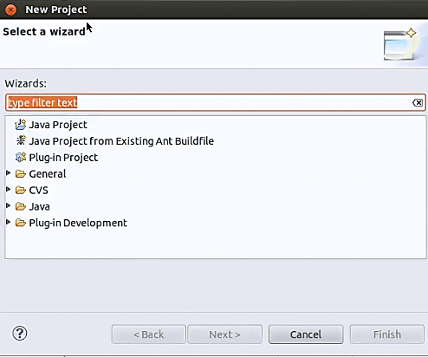
Create a New Project: Step 1
Create a new project and add essential JAR files to run MapReduce programs
Notes:
Trainer Notes:
Demo the activity in session

Slide 38
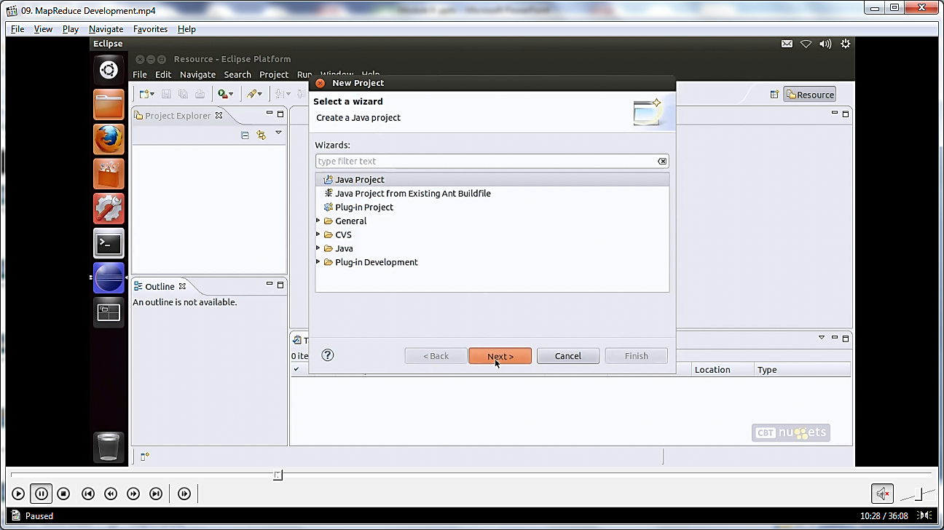
Create a New Project: Step 2
Select Java Project, and then click the Next
Notes:
Trainer Notes:
Demo the activity in session

Slide 39
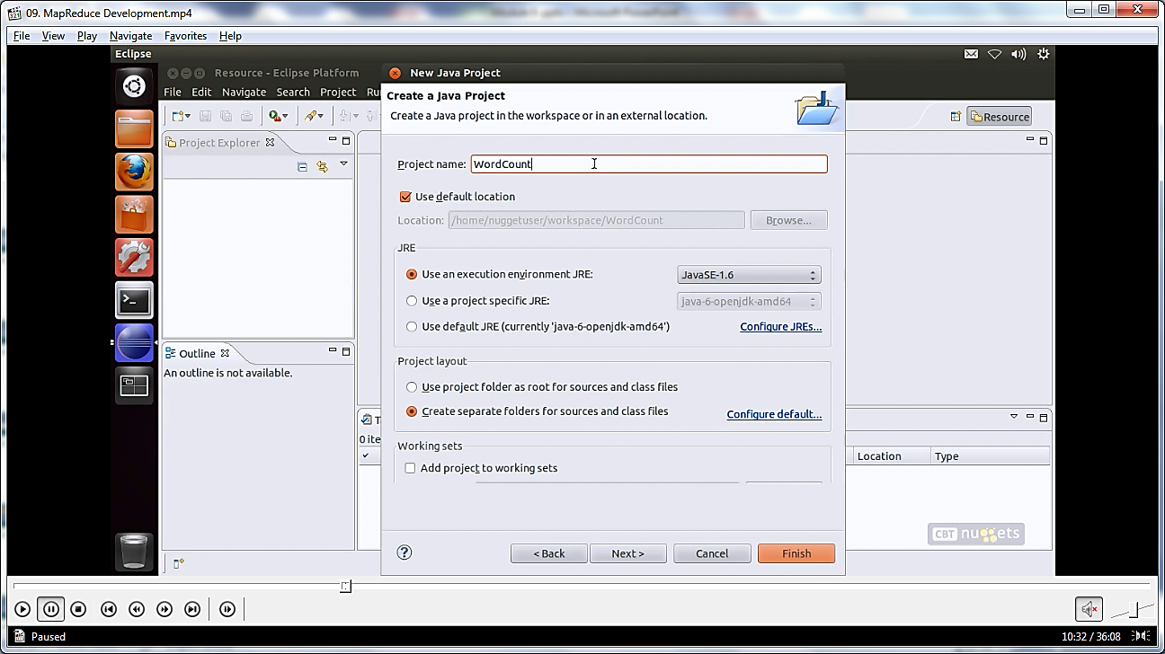
Create a New Project: Step 3
Enter the project name
Notes:
Trainer Notes:
Demo the activity in session

Slide 40
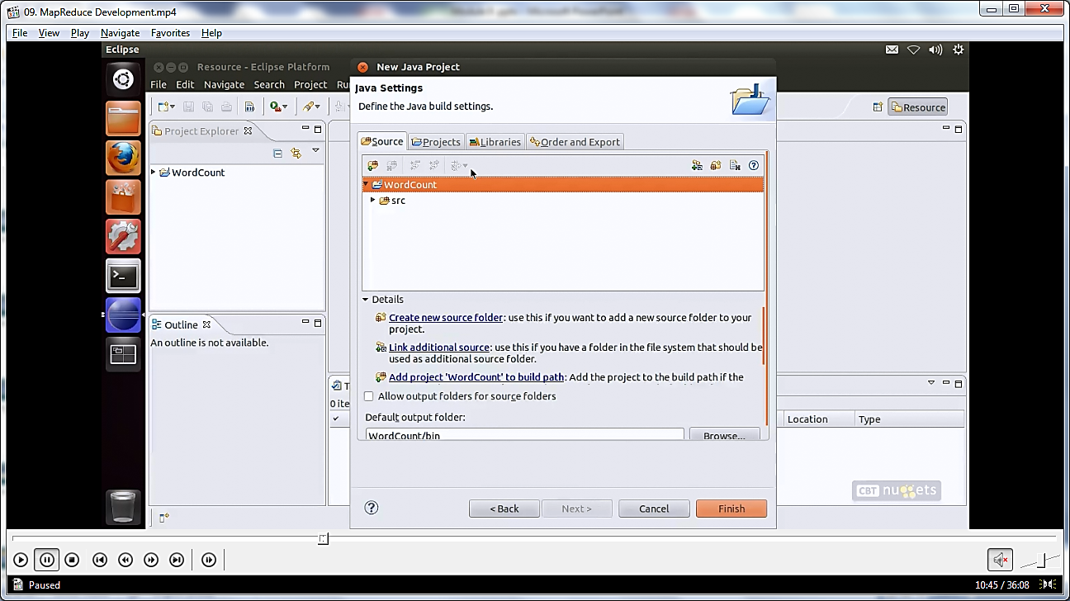
Create a New Project: Step 4
Include JAR files from the Hadoop framework to ensure that the programs locate the dependencies in one location
Notes:
Trainer Notes:
Demo the activity in session

Slide 41
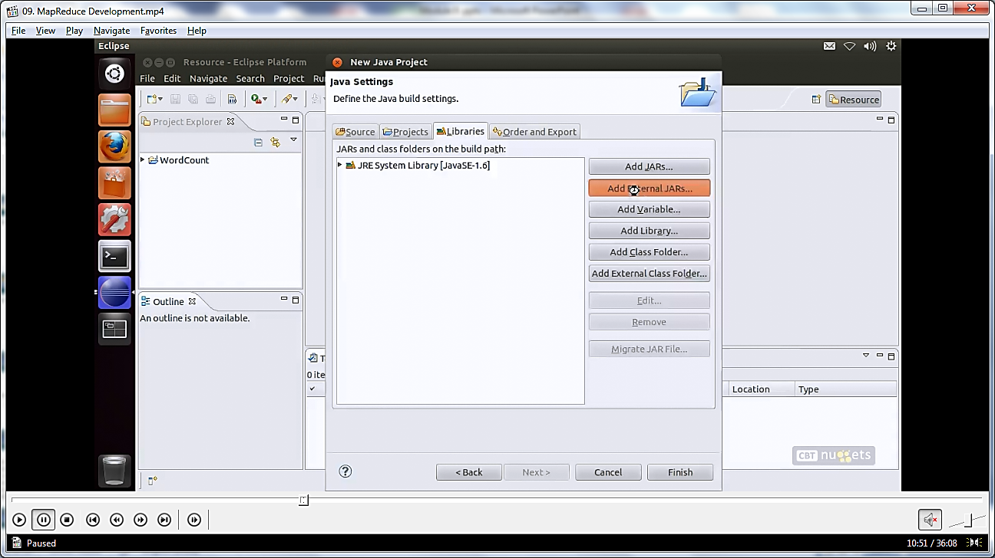
Create a New Project: Step 5
Add the essential JAR files
Notes:
Trainer Notes:
Demo the activity in session

Slide 42
Checking Hadoop Environment for MapReduce
Ensure that the machine setup can perform MapReduce operations
C:\>_
Command Prompt
hadoop jar hadoop”examples*.jar WordCount /data/first/words.txt /data/first/output
Notes:
Trainer Notes:
Demo the activity in session

Slide 43
Controlling the Flow of Mapper and Reducer
Number of Maps
The number of maps is dependent on the total number of blocks in the input dataset.
Having 10 to 100 maps per node is a common rule.
Number of Reducers
The reducer uses a formula that multiplies 0.95 or 1.75 by the product of the number of nodes and the maximum number of containers per node.
0.95* (number of nodes multiplied by the maximum number of containers per node)
The reducer can also be set to none.

Slide 44
Optimization of MapReduce Jobs
Follow the techniques to achieve maximum performance from the MR cluster:
Proper configuration of cluster
1
2
Use of combiners
Reuse Writable objects
6
LZO compression
3
Use of appropriate Writable interface for data
5
4
Tune Hadoop parameters
Notes:
Trainer Notes:
Use of Combiners : Combiners are like reducers running at mapper side , they greatly help to reduce shuffling as on mapper side they apply reduce logic and then send data to reducers. A lot of performance improvement can be achieved.
LZO compression : we know mapreduce writes to disk so its better to apply compression through LZO , yes it adds load to CPU but it saves time by reducing the amount of disk IO during the shuffle.
Tune Hadoop Parameters: io.sort.factor, io.sort.mb, io.sort.spill.percent, mapred.reduce.tasks, mapreduce.tasktracker.map.tasks.maximum, mapred.child.java.opts. mapred.inmem.merge.threshold : each to these factor plays a major role in map reduce task. More the shuffling more will be the hit same way more spills add to performance pressure. So having a right value is an ask .
Prefer using Writable interface for data: Hadoop provide serializable framework to compress/decompress data while writing to intermediate output to disk. Writable interface does that same in Hadoop. It’s inefficient to convert numeric data to and from UTF8 strings. And can actually make up a significant portion of CPU time.
Reuse Writable Objects whenever necessary: Many times, for task every time a new Writable object for every output from a mapper/reducer. This causes allocation of thousands of short-lived objects and Java garbage collector does a reasonable job at dealing with this. Its better to use the existing ones.
Proper Configuration of cluster: Try to avoid the RAID on datanode machines. This generally reduces performance. Make sure that syou have configured mapred.local.dir and dfs.data.dir to point to one directory on each of your disks. This is to ensure that all of your I/O capacity is used.

Slide 45

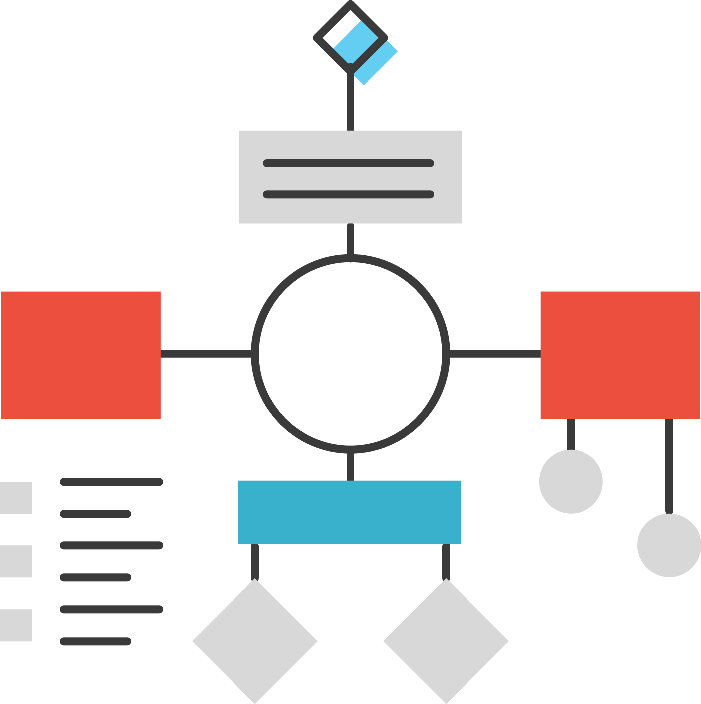
Fault-Tolerance and Data Locality
Fault tolerance refers to the system's capacity to continue running without interruption when one or more of a system's components fail.
Data locality is a way to move job computation close to where the actual data resides instead of moving a large amount data to computation.
It helps to minimize the overall network congestion and increases the overall throughput of the system.
As we can see in the graphic, the data has not been distributed in the last node. When MR runs, it ignores the last node and no task is sent. Hence, there is no output from that node.
No data,
No Task
Algo
Algo
Data
Data
Algo
Algo
Algorithm
Data
Data
Servers
Notes:
Data Locality: This is way to move the job(computation) close to where data resides. Here in this diagram, we can see that in 5 data nodes. Data has not been distributed in last node so when MR runs it just ignore last node and there is no task which is sent. Hence no output from that node.

Slide 46
Working with Map-Only Jobs
It is a process in which the mapper executes the tasks without a reducer. This performs well when one transformation is required without shuffling. Hence, the performance improves.
Input Split
Output
Split - 1
Mapper
Output - 1
Split - 2
Mapper
Output - 2
HDFS
HDFS

Slide 47

Combiners in MapReduce
Combiners are local Reducer.
It reduces network congestion by acting as a bridge between the Mapper and Reducer.
The output produced by the Mapper is the intermediate output in terms of
key-value pairs.
If the output is large, it cannot be directly fed to the Reducer as it would cause
Network Congestion.
Mapper 1
Mapper 2
Combiner 1
Combiner 2
Combiner In
Hadoop
Reducer 1
Reducer 1
Notes:
Combiner always works in between Mapper and Reducer. The output produced by the Mapper is the intermediate output in terms of key-value pairs which is massive in size. If we directly feed this huge output to the Reducer, then that will result in increasing the Network Congestion. So to minimize this Network congestion we have to put combiner in between Mapper and Reducer.

Slide 48
Combiners in MapReduce
A Combiner is used to minimize congestion.
It is also known as a semi-reducer.
It is optional in the MapReduce program.
It provides a summary of large datasets.
It improves the overall performance while dealing with large datasets.
Mapper 1
Mapper 2
Combiner 1
Combiner 2
Combiner In
Hadoop
Reducer 1
Reducer 1
Notes:
Combiner always works in between Mapper and Reducer. The output produced by the Mapper is the intermediate output in terms of key-value pairs which is massive in size. If we directly feed this huge output to the Reducer, then that will result in increasing the Network Congestion. So to minimize this Network congestion we have to put combiner in between Mapper and Reducer.

Slide 49
MapReduce Program with Combiner
In a program, the combiner accepts inputs from the Map class and then passes the output key-value pairs to the Reducer class.
Simplilearn for training for Simplilearn
Offline online Offline Online training
Mapper 1
Mapper 2
(Simplilearn,1)
(for,1)
(training,1)
(for,1)
(Simplilearn,1)
(Offline,1)
(online,1)
(Offline,1)
(online,1)
training,1)
(Simplilearn,2)
(for,2)
(training,1)
(Offline,2)
(online,2)
(training,1)
Combiner 1
Combiner 2
Reducer
(Simplilearn,2)
(for,2)
(training,1)
(Offline,2)
(online,2)
Notes:
Trainer Notes:
Explain the MapReduce Program with the functions of Mapper, Combiner, and Reducer.
Explain the working of this program.
A Combiner, sometimes known as a semi-reducer, is a class that accepts inputs from the Map class and then passes the output key-value pairs to the Reducer class. A Combiner's primary job is to summarise map output records with the same key.

Slide 50
Assisted Practice: Execution of MapReduce Job
Duration: 10 Minutes
Problem Scenario: Write the commands to perform partitions using the JAR files
Objective: In this demonstration, you will use JAR files and the wordcount.txt file to perform the partitions using the MapReduce job.
Dataset Name: “wordcount.txt”
Notes:
Trainer Notes:
Perform each step along with the learner.

Slide 51
Assisted Practice: Execution of MapReduce Job
Tasks to Perform:
Step 1: Download the Hadoop-mapreduce-example.jar file and wordcount.txt file
Step 2: Log in to the FTP using the username and password from the lab and upload the file
Step 3: Log in to the console using the username and password from the lab and create a new directory demo in HDFS using the mkdir command
Step 4: Push the wordcount.txt file into the directory using the put command
Step 5: Execute the command to move the Hadoop-mapreduce-example.jar file to the HDFS directory
Step 6: View the files in the Output folder with the part files
Note: The solution to this assisted practice is provided under the Reference Materials section.
Notes:
Trainer Notes:
Perform each step along with the learner.

Slide 52
MapReduce divides and analyzes large data sets into logical clusters.
A job is a MapReduce program that generates multiple maps and reduces functions throughout the program's lifetime.
Tested techniques must be used to achieve maximum performance from the MR cluster.
The MapReduce job divides the input dataset into separate chunks, which are then processed in parallel by the map jobs.

Slide 54
Which of the following defines the data locality feature of MapReduce?
1
Reduce task in MapReduce is performed using the map() function
Reduce task in MapReduce is performed using the mapper() function
Placing data close to NameNode and computing it over DataNodes
Compute data by placing it as close as possible

Slide 55
Which of the following defines the data locality feature of MapReduce?
1
Reduce task in MapReduce is performed using the map() function
Reduce task in MapReduce is performed using the mapper() function
Placing data close to NameNode and computing it over DataNodes
Compute data by placing it as close as possible
D
  Data locality is the process of moving the computation close to where the actual data resides on the node instead of moving large data sets to the computation.

Slide 56
What is the num parameter in the below line of code:
conf.setNumMapTasks(int num)
2
Number of map tasks for this job
Number of reducer tasks for this job
Number of splits for this job
None of the above

Slide 57
What is the num parameter in the below line of code:
conf.setNumMapTasks(int num)
2
Number of map tasks for this job
Number of reducer tasks for this job
Number of splits for this job
None of the above
A
  The num parameter defines the number of map tasks for this job. This is only a hint at the framework. The actual number of spawned map tasks depends on the number of InputSplits generated by the job.

Slide 58
How many phases exist in MapReduce?
3
4
5
6
2

Slide 59
How many phases exist in MapReduce?
3
4
5
6
2
B
  MapReduce consists of five phases: map phase, partition phase, shuffle phase, sort phase, and
  reduce phase.

Slide 60
Which of the following cannot be used as an optimization technique in MapReduce?
4
Use of combiners
LZO compression
Prefer not to use writable interface for data
Proper configuration of cluster

Slide 61
Which of the following cannot be used as an optimization technique in MapReduce?
4
Use of combiners
LZO compression
Prefer not to use writable interface for data
Proper configuration of cluster
C
  Prefer not to use writable interface in MapReduce is the correct option as it is not used as an optimization technique in MapReduce.

Slide 62
Lesson-End Project: Count the Number of Words Using MapReduce
Problem Scenario:
Philip is working in a company as a Data Engineer whose focus is to count the number of times a word occurs in a corpus. He has a copy of sample data from the internet. He wants to perform a computation with a list of words and understand how many times it occurred. This can be achieved using MapReduce.
Objective:
The objective is to use MapReduce to count the number of words from a text file.
Dataset Name: wordcount.txt
hadoop-mapreduce-example.jar
Notes:
Trainer Notes:
Explain the problem statement
Ask the learners to finish the activity before the start of the next session
3. Resolve all queries and doubts raised by learners

Slide 63
Lesson-End Project: Count the Number of Words Using MapReduce
Tasks to Perform:
Create a sample file with the name mapreducedemo.java
Create two functions Mapper and Reduce with the main method
Now, convert JAVA files into JAR files and give it the name
“hadoop-mapreduce-example.jar”
After this, upload the JAR file into FTP
Upload the “wordcount.txt” file into HDFS and ensure to copy the path where it has been uploaded
Run the MapReduce code in Terminal
Notes:
Trainer Notes:
Explain the problem statement
Ask the learners to finish the activity before the start of the next session
3. Resolve all queries and doubts raised by learners

Slide 64
Thank You

