Slide 1
Big Data Hadoop and Spark Developer

Slide 2
YARN: Introduction

Slide 3

Describe YARN and its features along with advantages
Explain the elements of YARN architecture
Identify how YARN runs on applications
Classify tools for YARN developers
List useful YARN commands
Notes:
Trainer Notes:
Explain the learning objectives at the start of the session

Slide 4
YARN: Yet Another Resource Negotiator

Slide 5
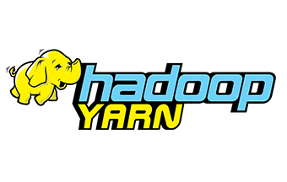
What Is YARN?
YARN is the acronym for Yet Another Resource Negotiator.
YARN is a Hadoop ResourceManager that was established by dividing the MapReduce processing engine and management function.
The basic idea behind YARN is to separate the resource management and task scheduling, also monitor functions in independent daemons.
Notes:
Trainer Notes: Explain what is YARN?

Slide 6

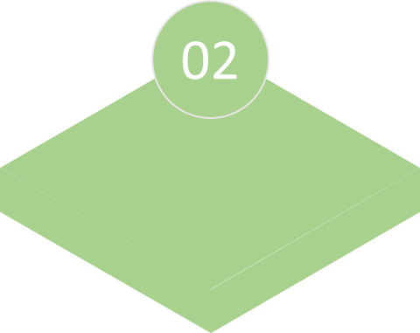


Why Was YARN Implemented?
It is essential to know the limitations of the Hadoop 1.0 framework to understand the advantages of YARN.
Running non-MapReduce applications
Resource utilization
Failure in cascading
Availability
Notes:
Trainer Notes: Explain why was YARN implemented?

Slide 7
Why Was YARN Implemented?
Availability: In Hadoop 1.0, the job tracker is the only point of availability. This means if the job tracker fails, all tasks are automatically restarted.
Resource utilization: There are two predefined slots. If one of the slots is full and the others are empty, the empty slots will be reserved and remain idle. This could result in a resource utilization problem.
Notes:
Trainer Notes: Explain why was YARN implemented?

Slide 8
Why Was YARN Implemented?
Failure in cascading: When the number of nodes in this framework exceeds 4000, one of the primary challenges arises. That is cascading failure occurs in this situation.
Running non-MapReduce applications: Job tracker is a MapReduce framework-based application. The problem arises when a non-MapReduce application tries to execute in this framework. Some of the most typical challenges that develop will include ad-hoc inquiry and real-time analysis.
Notes:
Trainer Notes: Explain why was YARN implemented?

Slide 9
Advantages of YARN
Following are the few advantages of YARN:
Scalability​
Cluster utilization​
Compatibility​
Multi-tenancy​
Notes:
Trainer Notes: Explain advantages of YARN

Slide 10
Advantages of YARN
01
Scalability: Hadoop can extend and manage thousands of nodes and clusters due to the Scheduler in the YARN architecture’s Resource Manager.
02
Compatibility: YARN maintains the functionality of the existing MapReduce applications while also making them compatible with Hadoop 1.0.
Notes:
Trainer Notes: Explain advantages of YARN

Slide 11
Advantages of YARN
03
Cluster utilization: As YARN supports dynamic cluster utilization in Hadoop, it will also enable optimized cluster utilization.
04
Multi-tenancy: It enables multiple engine access, providing organizations with the benefit of multi-tenancy.
Notes:
Trainer Notes: Explain advantages of YARN

Slide 12
Need for YARN
YARN tends to make Hadoop more available by allowing users to process.
YARN runs data that are stored in HDFS like a batch, stream, interactive, and graph processing.
YARN helps the execution of many distributed applications other than MapReduce.
Notes:
Trainer Notes: Explain need for YARN

Slide 13
Need for YARN
Users could develop MapReduce applications using scripting languages before 2012.
Users were able to work with different processing models in addition to MapReduce since 2012.
HADOOP 1.0
HADOOP
MapReduce
(data processing)
Others
(data processing)
MapReduce
(cluster resource management
and data processing)
YARN
(cluster resource management)
HDFS
(redundant, reliable storage)
HDFS
(redundant, reliable storage)
Notes:
Trainer Notes: Explain need for YARN

Slide 14
Use Case: YARN

Slide 15

YARN: Use Case
Yahoo was the first company to implement Hadoop, and it continues to set the standard high in the Hadoop ecosystem. Due to MapReduce limitations, Yahoo struggled to handle iterative and stream processing of data on the Hadoop infrastructure in late 2012.
Notes:
Trainer Notes: Explain the Use case of YARN.

Slide 16
YARN: Use Case
After implementing YARN in the first quarter of 2013, Yahoo has installed more than 30,000 production nodes on:
    Spark for iterative processing
    Storm for stream processing
    Hadoop for batch processing
Such a solution was possible only after YARN was introduced and multiple processing frameworks were implemented.
Notes:
Trainer Notes: Explain the Use case of YARN.

Slide 17
YARN Infrastructure

Slide 18
YARN Infrastructure
The YARN Infrastructure is responsible for delivering computational resources for application execution, such as CPUs and memory.
HADOOP 2.7
MapReduce
(data processing)
Others
(data processing)
YARN
(cluster resource management)
HDFS
(redundant, reliable storage)
Notes:
Trainer Notes: Explain YARN infrastructure

Slide 19
YARN Infrastructure
HDFS and the YARN infrastructure are fully independent. The former gives resources for an application to run, while the latter provides storage.
The MapReduce framework is one of many that can run on YARN.
The core idea behind MapReduce version 2 is to separate the two key functions of resource management and job scheduling.
Notes:
Trainer Notes: Explain YARN infrastructure

Slide 20
YARN Architecture

Slide 21
YARN Architecture
The following diagram shows the YARN architecture:
NodeManager
Container
Application
Master
Client
NodeManager
ResourceManager
Application
Master
Container
Scheduler
Application
Master
Client
NodeManager
Container
Container
Notes:
Trainer Notes: Explain YARN architecture

Slide 22
YARN Architecture
The following are the main components of the YARN architecture:
Components
1
2
3
4
5
Client
ResourceManager
NodeManager
ApplicationMaster
Container
Notes:
Trainer Notes: Explain YARN architecture

Slide 23
Client
The client contacts the ResourceManager in the process.
The client is used for submitting the MapReduce jobs and reading the result.
The client also monitors the status of the application.
Notes:
Trainer Notes: Explain client

Slide 24
ResourceManager
The ResourceManager is the master daemon of YARN.
The ResourceManager is responsible for assigning and managing resources across all applications.
Whenever ResourceManager receives a processing request, it sends
it to the appropriate NodeManager, who then assigns resources
to complete the request.
Notes:
Trainer Notes: Explain resource manager

Slide 25
ResourceManager
The ResourceManager is consists of the following two parts:
Scheduler
Application manager
Notes:
Trainer Notes: Explain resource manager

Slide 26
Scheduler
The Scheduler performs scheduling based on the application and the available resources.
It is a pure scheduler, which means it does not do anything else like monitoring or tracking, and it does not guarantee a task restart if it fails.
Notes:
Trainer Notes: Explain Schedular

Slide 27
Scheduler
The scheduler assigns resources for running applications based on capacity and queue.
To partition cluster resources, the YARN Scheduler includes plugins like a Capacity Scheduler and a Fair Scheduler.
Notes:
Trainer Notes: Explain Schedular

Slide 28
Application Manager
The responsibilities of an Application Manager include accepting job submissions and negotiating the first container with resource management.
If a job fails, the Application Manager additionally restarts the ApplicationMaster container.
The Application Manager oversees the operation of the ApplicationMasters in a cluster and offers support for restarting the ApplicationMaster container in the event of a failure.
Notes:
Trainer Notes: Explain application manager

Slide 29
NodeManager
NodeManager is responsible for each node in the Hadoop cluster and administers the application and workflow for that node.
It is the primary responsibility is to keep track of the ResourceManager.
Notes:
Trainer Notes: Explain node manager

Slide 30
NodeManager
It connects to the ResourceManager and sends heartbeats with the node's health status.
It tracks resource utilization, manages logs, and destroys Containers at the request of ResourceManager.
It is also in charge of starting the Container process when the ApplicationMaster requests it.
Notes:
Trainer Notes: Explain node manager

Slide 31
ApplicationMaster
A single job is submitted to a framework as an application.
Each of these applications has its own ApplicationMaster, which is a framework-specific entity.
It is the procedure that controls faults and coordinates an application's execution in a cluster.
The ApplicationMaster is responsible for negotiating resources with the ResourceManager, tracking the status of a specific application, and monitoring its progress.
Notes:
Trainer Notes: Explain application master

Slide 32
ApplicationMaster
The ApplicationMaster sends a Container Launch Context (CLC) to the node management to request the Container.
The CLC contains everything required for an application to run. When the program is launched, it sends a health report to the ResourceManager regularly.
Notes:
Trainer Notes: Explain application master

Slide 33

Container
                On a single node, a Container is a collection of physical resources such as RAM, CPU cores, and disc.
          A Container lifecycle record contains information such as a map of environment variables, dependencies stored in remotely accessible storage, security tokens, the payload for NodeManager services, and the command required to create the process for YARN Containers.
          It enables an application to access a set number of resources (memory, CPU, and others) on a given host.
Notes:
Trainer Notes: Explain container

Slide 34
Application Workflow
The following diagram represents the application workflow:
Application
client
ResourceManager
1: Submit YARN
application
Client node
ResourceManager node
2a: Start container
3: Allocate resources (heartbeat)
NodeManager
2b: Launch
Container
4b: Start
Container
Node Manager
Application
process
4b: Launch
NodeManager node
Container
Application
process
NodeManager node
Notes:
Trainer Notes: Explain application workflow stepwise

Slide 35
Application Workflow
Running a YARN application involves five steps:
1
  The ResourceManager receives an application from the client.
2
The ResourceManager assigns a Container.
3
  The ApplicationMaster contacts the NodeManager.
Notes:
Trainer Notes: Explain application workflow stepwise

Slide 36
Application Workflow
4
  The NodeManager launches the Container.
5
  The Container executes the ApplicationMaster.
Notes:
Trainer Notes: Explain application workflow stepwise

Slide 37


Application Workflow
Step 1: The ResourceManager receives an application from the client.
By entering the Hadoop jar command, users can submit applications to the ResourceManager.
$ my-Hadoop-app
Client
NodeManager
DataNode
NodeManager
DataNode
ResourceManager
NodeManager
DataNode
Application Master
NameNode
NodeManager
DataNode
Notes:
Trainer Notes: Explain application workflow stepwise

Slide 38
Application Workflow
On the NodeManager, the ResourceManager keeps track of the cluster's applications and available resources.
The ResourceManager selects the next application in line for a share of the cluster's resources.
Many factors influence the decision, including queue capacity, access control lists, and fairness.
Notes:
Trainer Notes: Explain application workflow stepwise

Slide 39
Application Workflow
Step 2: The ResourceManager assigns a Container.
One of the first decisions the Scheduler takes when the ResourceManager accepts a new request is to choose a Container. Then, the ApplicationMaster takes over and is responsible for the application's lifecycle.
$ my-Hadoop-app
Client
NodeManager
DataNode
NodeManager
DataNode
ResourceManager
Resources Request:
-1xNode1/1GB/1 core
-1xNode2/1GB/1 core
NodeManager
DataNode
Application Master
NameNode
NodeManager
DataNode
Notes:
Trainer Notes: Explain application workflow stepwise

Slide 40
Application Workflow
The Container makes resource requests to the ResourceManager, requesting Containers to run the app's tasks.
A resource request is essentially a request for a set of Containers that meet certain resource requirements, such as the amount of memory and CPU shares stated in MB.
Notes:
Trainer Notes: Explain application workflow stepwise

Slide 41
Application Workflow
Hostname specifies the preferred location. Priority is only given in this application and not to other applicants.
The ResourceManager assigns a Container to the ApplicationMaster by giving it a Container ID and a hostname that meets the ApplicationMaster’s requirements.
Notes:
Trainer Notes: Explain application workflow stepwise

Slide 42
Application Workflow
Step 3: The ApplicationMaster contacts the NodeManager.
Application Manager informs NodeManager to start the Containers.
$ my-Hadoop-app
Client
NodeManager
DataNode
NodeManager
DataNode
ResourceManager
NodeManager
DataNode
Here are your containers
Application Master
NameNode
NodeManager
DataNode
Notes:
Trainer Notes: Explain application workflow stepwise

Slide 43
Application Workflow
Following the allocation of a Container, the ApplicationMaster requests that the NodeManager is in charge of the host where the Container was assigned and uses these resources to run an application-specific task.
Any process developed in any framework, such as a MapReduce task, can be used for this purpose.
Notes:
Trainer Notes: Explain application workflow stepwise

Slide 44
Application Workflow
Step 4: The NodeManager launches the container.
The NodeManager does not keep track of tasks; instead, it keeps track of resource utilization in the Containers.
$ my-Hadoop-app
Client
NodeManager
DataNode
NodeManager
DataNode
ResourceManager
NodeManager
DataNode
Here are your containers
Application Master
NameNode
NodeManager
DataNode
Notes:
Trainer Notes: Explain application workflow stepwise

Slide 45
Application Workflow
If a Container consumes more memory than it was assigned, it will be removed.
The ApplicationMaster negotiates Containers during its life to launch all the tasks required to accomplish its application.
It also keeps track of applications and the task's progress, restarts unsuccessful tasks in freshly requested Containers, and updates the client who applied its progress.
Notes:
Trainer Notes: Explain application workflow stepwise

Slide 46
Application Workflow
Step 5: The Container executes the ApplicationMaster.
The ApplicationMaster closes itself and releases its Container after the application is completed.
$ my-Hadoop-app
Client
NodeManager
DataNode
NodeManager
DataNode
ResourceManager
NodeManager
DataNode
“I’m done!”
Application Master
NameNode
NodeManager
DataNode
Notes:
Trainer Notes: Explain application workflow stepwise

Slide 47
Application Workflow
The ResourceManager does not monitor the tasks within an application, though it verifies the ApplicationMaster’s health.
If the ApplicationMaster fails, the ResourceManager can restart it in a new Container.
As a result, the ResourceManager is responsible for the ApplicationMaster, while the ApplicationMaster is responsible for the tasks.
Notes:
Trainer Notes: Explain application workflow stepwise

Slide 48
Tools for YARN Developers

Slide 49
Tools for YARN Developers
Hadoop has three tools for YARN developers:
YARN Web UI
01
02
Hue Job Browser
03
YARN Command Line
Notes:
Trainer Notes: Explain Tools for YARN developers

Slide 50
YARN Web UI
By default, the YARN web UI runs on port 8088.
By default, the YARN web UI runs on port 8088.
By default, the YARN Web UI runs on port 8088.
By default, the YARN web UI runs on port 8088.
It offers a better perspective than Hue. The online UI does not allow to control or configure YARN.
The YARN web user interface maintains a record of clusters, queues, applications, services, and flow operations.
Notes:
Trainer Notes: Explain Tools for YARN developers

Slide 51
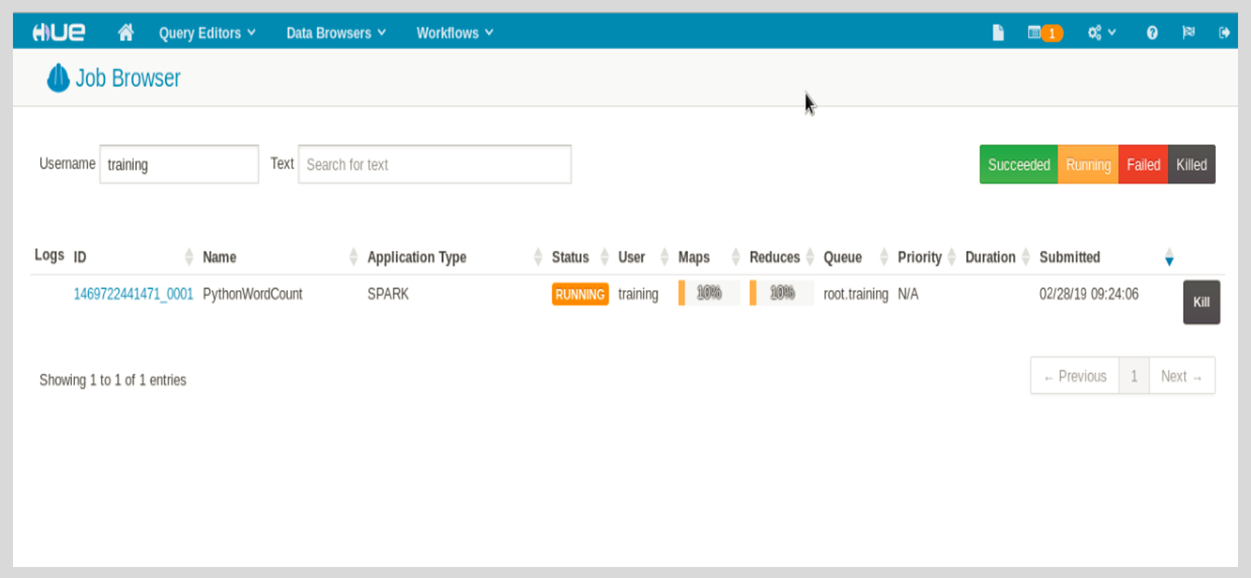
HUE Job Browser
Use the Hue task browser to check on the status of a job and see the logs
Notes:
Trainer Notes: Explain Tools for YARN developers

Slide 52
HUE Job Browser
One can use the job browser application to look at the Hadoop MapReduce jobs that are currently executing on the Hadoop cluster.
The job and tasks are presented in tiers in the job browser.
The job and tasks can be linked to a list of the job duties from the top layer.
Notes:
Trainer Notes: Explain Tools for YARN developers

Slide 53
HUE Job Browser
The properties of each try, such as status, start, end times, and output size, can then be viewed for a task's attempts.
Also look at the logs of each attempt to troubleshoot failed jobs.
Notes:
Trainer Notes: Explain Tools for YARN developers

Slide 54
YARN Command Line
Yarn includes several command-line tools to assist with various parts of the Yarn package, such as installation, administration, and publishing.
Most YARN commands are intended for administrators rather than developers.
The developer will find the following few commands useful:
- yarn logs -applicationId <app-id>
views logs of specified application ID
- yarn –help
lists all commands of yarn
- yarn –version
prints the version
Notes:
Trainer Notes: Explain Tools for YARN developers

Slide 55
YARN Command Line
yarn add: This command adds a package to the current package.
yarn init: This command starts the package development process.
yarn install: This command installs all of the package's dependencies in a file in JSON.
Notes:
Trainer Notes: Explain Tools for YARN developers

Slide 56
YARN Command Line
yarn publish: This command sends a package to the package manager.
yarn remove: This command removes an unused package from the current package.
Notes:
Trainer Notes: Explain Tools for YARN developers

Slide 57
YARN is a Hadoop ResourceManager that was established by dividing the MapReduce processing engine and management function.
YARN was implemented due to the limitations of Hadoop 1.0.
YARN architecture consists of client, ResourceManager, NodeManager, ApplicationMaster, and Container.
Hadoop has 3 tools for YARN developers, which are YARN Web UI, Hue job browser, and YARN command line.

Slide 59
Which of the following scheduling policies can be implemented in YARN?
1
FIFO scheduler
Capacity scheduler
Fair scheduler
All the above

Slide 60
Which of the following scheduling policies can be implemented in YARN?
1
FIFO scheduler
Capacity scheduler
Fair scheduler
All the above
D
YARN provides three scheduling options: FIFO Scheduler, Capacity Scheduler, and a Fair Scheduler for scheduling resources to user applications.

Slide 61
_______ negotiates resources from the ResourceManager.
2
NodeManager
ResourceManager
ApplicationMaster
None of the above

Slide 62
_______ negotiates resources from the ResourceManager.
2
NodeManager
ResourceManager
ApplicationMaster
None of the above
C
Each ApplicationMaster is responsible for negotiating resources with the ResourceManager.

Slide 63
Lesson-End Project
Problem Statement:
  PV Consulting is one of the top consulting firms for big data projects. They help big and small companies to analyze their data.
They began using YARN as a ResourceManager for Spark and Hadoop MR applications. You must include the following information for any job submitted to YARN using the YARN console or the YARN Cluster UI.
Objective:
The objective is to identify jobs submitted using the yarn application.

Slide 64
Lesson-End Project
Tasks to Perform:
Open the Readme file on the Web desktop
Start the JobHistory daemon by using the command from the Readme file
Check the list of applications in YARN
Open the JobHistory server and check the list of applications running
on it

Slide 65
Thank You

