Slide 1

Social And Information Networks Review – 2
Movie Recommendation and Rating Website
Project by:
K.G.Nithesh Gurudaas, 18BCE1101
Sruti Verma, 18BCE1005

Slide 2
AIM
The aim of MOVIE RECOMMENEDATION AND RATING WEBSITE is to RECOMMEND THE USER MOVIES BASED UPON HIS INTEREST using HTML,CSS,JS,PHP,PYTHON,JUPYTER,NOTEBOOK,NOTEPAD.

Slide 3
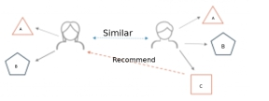
A recommender system is a simple algorithm whose aim is to provide the most relevant information to a user by discovering patterns in a dataset.
The algorithm rates the items and shows the user the items that they would rate highly.
An example of recommendation in action is when you visit Amazon and you notice that some items are being recommended to you or when Netflix recommends certain movies to you.
They are also used by Music streaming applications such as Spotify and Deezer to recommend music that you might like.

Slide 4
METHODOLOGY
Cosine similarity is a similarity function that is often used in information retrieval, and it is also one of the most popular similarity calculations applied to text documents, for numerous information retrieval applications , as well as clustering . When documents are represented as vectors, the similarity in two documents corresponds to the correlation between the vectors. This is quantified as the cosine of the angle between vectors. Given two documents ta→ta→ and tb→tb→, their cosine similarity can be represented as SIMC(ta→,tb→)=ta→.tb→∣∣∣ta→∣∣∣×∣∣∣tb→∣∣∣SIMC(ta→,tb→)=ta→.tb→|ta→|×|tb→| (1) where ta→ta→ and tb→tb→ are m-dimensional vectors over the term set T = {t1,…, tm}.

Slide 5
Each dimension represents a weight in the document, which is non-negative and bounded between [0, 1]. For example, when combining two identical copies of document d to get a new pseudo document d’, the cosine similarity between d and d’ is 1, which means that these two documents are regarded to be identical. At the same time, given another document l, d and d’ will have the same similarity value as that of l, that is SIM(td→,tl→)=SIM(td′−→,tl→)SIM(td→,tl→)=SIM(td′→,tl→). Otherwise, documents with the same composition but different totals will be treated identically. When the term vectors are normalized to a unit length such as 1, the representation of d and d’ will be the same. Movies with high cosine similarity is very similar to the one entered by user Then, we sort the movies based on this value and, the movies with the top ten values are displayed on screen from a dataset of almost 5000 movies .

Slide 6
OVERVIEW OF LANGUAGES USED
Hypertext Markup Language (HTML) is the standard markup language for documents designed to be displayed in a web browser. It can be assisted by technologies such as Cascading Style Sheets and scripting languages such as JavaScript.
Cascading Style Sheets (CSS) is a style sheet language used for describing the presentation of a document written in a markup language like HTML. CSS is a cornerstone technology of the World Wide Web, alongside HTML and JavaScript.
JavaScript, often abbreviated as JS, is a programming language that conforms to the ECMAScript specification. JavaScript is high-level, often just-in-time compiled, and multi-paradigm. It has curly-bracket syntax, dynamic typing, prototype-based object-orientation, and first-class functions.

Slide 7
jQuery is a JavaScript library designed to simplify HTML DOM tree traversal and manipulation, as well as event handling, CSS animation, and Ajax. It is free, open-source software using the permissive MIT License.
PHP is a popular general-purpose scripting language that is especially suited to web development for back end. It was originally created by Rasmus Lerdorf in 1994; the PHP reference implementation is now produced by The PHP Group.
Python is an interpreted, high-level, general-purpose programming language. Created by Guido van Rossum and first released in 1991, Python's design philosophy emphasizes code readability with its notable use of significant whitespace.

Slide 8
OVERVIEW OF SOFTWARE USED
XAMPP – for running localhost is a free and open-source cross-platform web server solution stack package developed by Apache Friends, consisting mainly of the Apache HTTP Server, MariaDB database, and interpreters for scripts written in the PHP and Perl programming languages. WE HAVE USED XAMPP FOR RUNNING OUR WEBSITE.
Notepad is a simple text editor for Microsoft Windows and a basic text-editing program which enables computer users to create documents. It was first released as a mouse-based MS-DOS program in 1983, and has been included in all versions of Microsoft Windows since Windows 1.0 in 1985.

Slide 9
WE HAVE USED NOTEPAD FOR WRITING HTML, CSS, JS, AND SUBLIME TEXT EDITOR FOR PHP CODE. PyCharm-Python web server is an integrated development environment used in computer programming, specifically for the Python language. It is developed by the Czech company JetBrains.
Project Jupyter is a nonprofit organization created to "develop open-source software, open-standards, and services for interactive computing across dozens of programming languages". Spun-off from IPython in 2014 by Fernando Pérez, Project Jupyter supports execution environments in several dozen languages.

Slide 10
HOW IT IS RELATED TO SOCIAL NETWORKING?
This project is extrapolated to social networking
because several websites use similar recommendation algorithms
such as YouTube and Facebook and Instagram
as they suggest friends based on ur circle, videos based on what you have watched.

Slide 11

Parts completed in Review 1
Idea for the project was developed
Outlook of the website and some basic HTML codes were written
Tables for storing data were created, but no link between frontend and backend

Slide 12

Objectives reached
Successfully created a program for recommending movies similar to the movie entered
Database connection to website done

Slide 13
Explanation of backend
We have created a table that contains all the information about the movies, such as title, release date, actors, director, rating, etc
PHP code extracts all the movies and displays it in the homepage.
PHP code also has a sort function to filter movies based on criteria

Slide 14
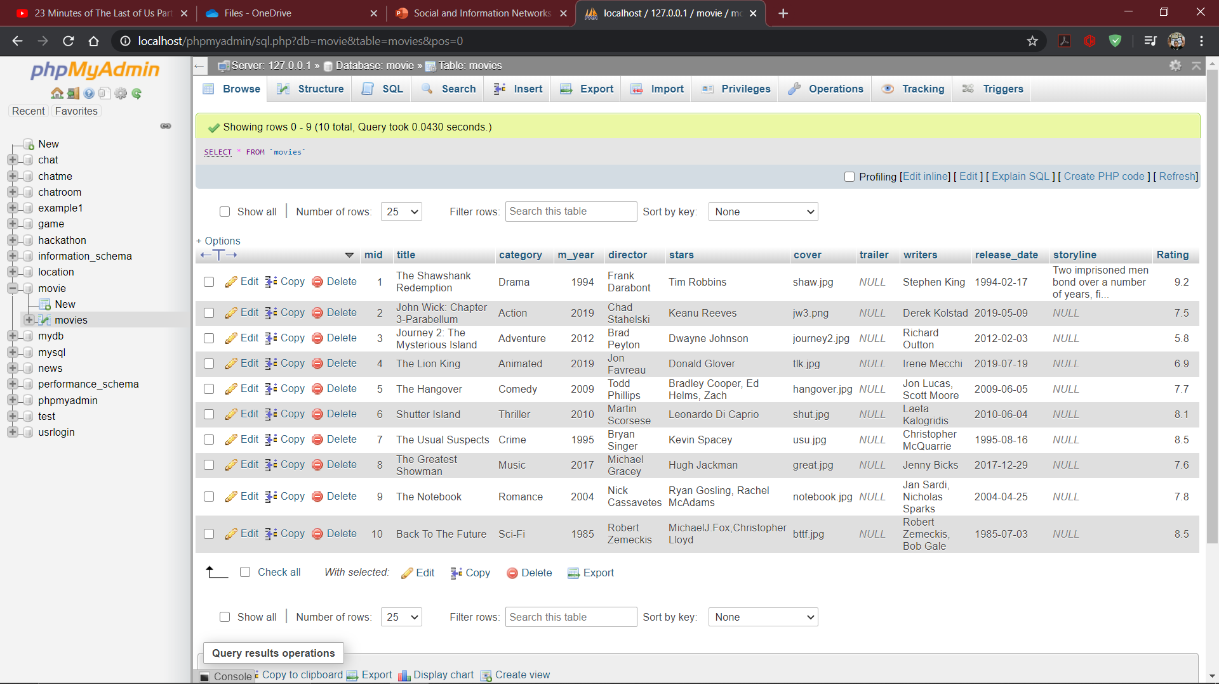
Movies database

Slide 15
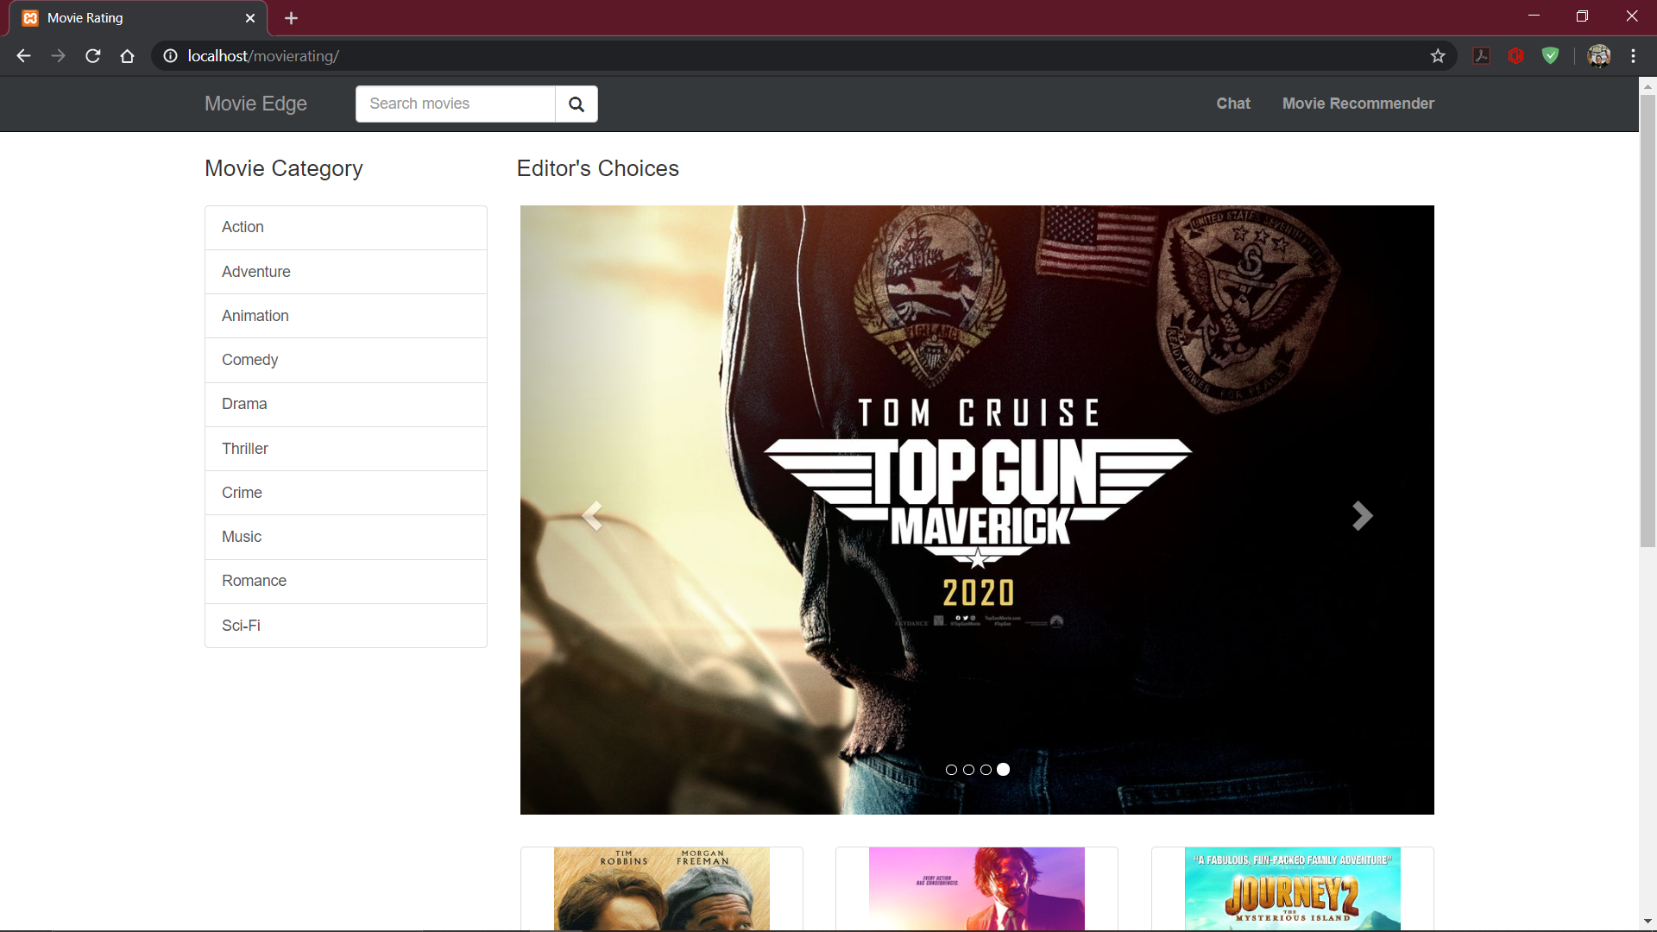
Movie Rating homepage

Slide 16
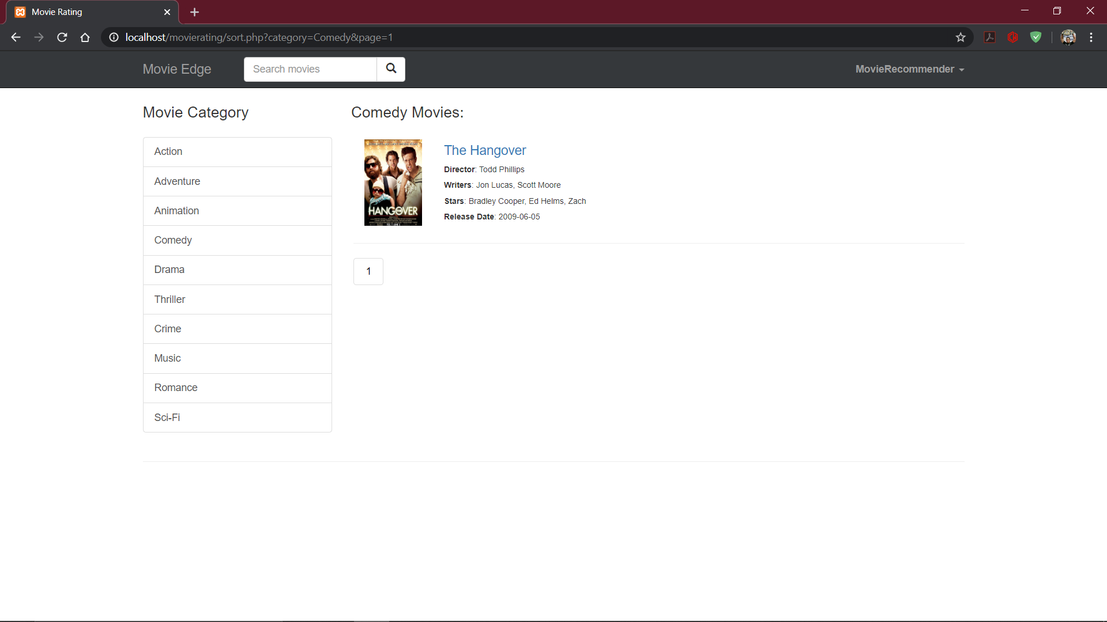
Movies sorted according to filter

Slide 17
Execution and explanation of Jupyter notebook
Each movie has a set of keywords, cast, genre and director, and some more attributes.
The attributes listed above are used along with a similarity cosine function to find out a value that can be used for finding out how interrelated the movies are.

Slide 18
Movies with high cosine similarity is very similar to the one entered by user
Then, we sort the movies based on this value and, the movies with the top ten values are displayed on screen from a dataset of almost 5000 movies .
Jupyter notebook( Python) is being used for this calculation. Google Colab is being used for this particular Jupyter notebook.

Slide 19
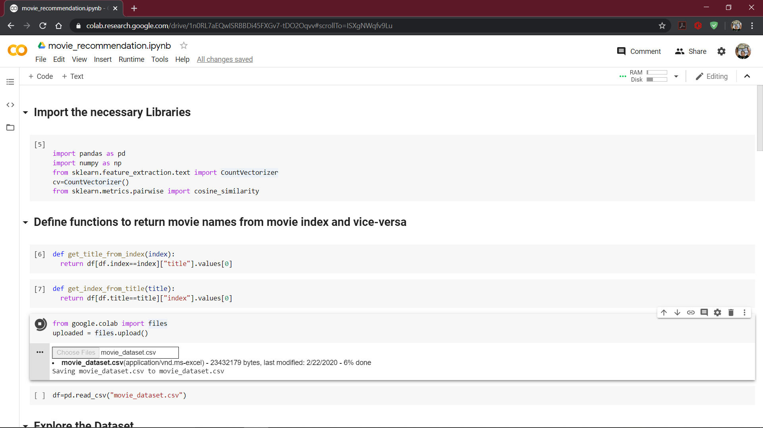
Jupyter notebook for Movie Recommendation

Slide 20
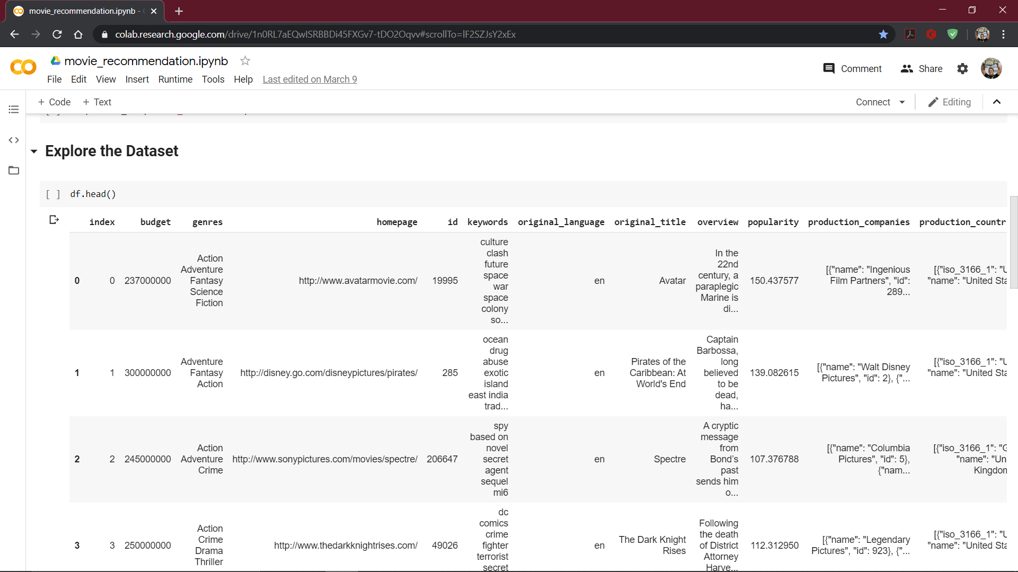
Dataset attributes

Slide 21
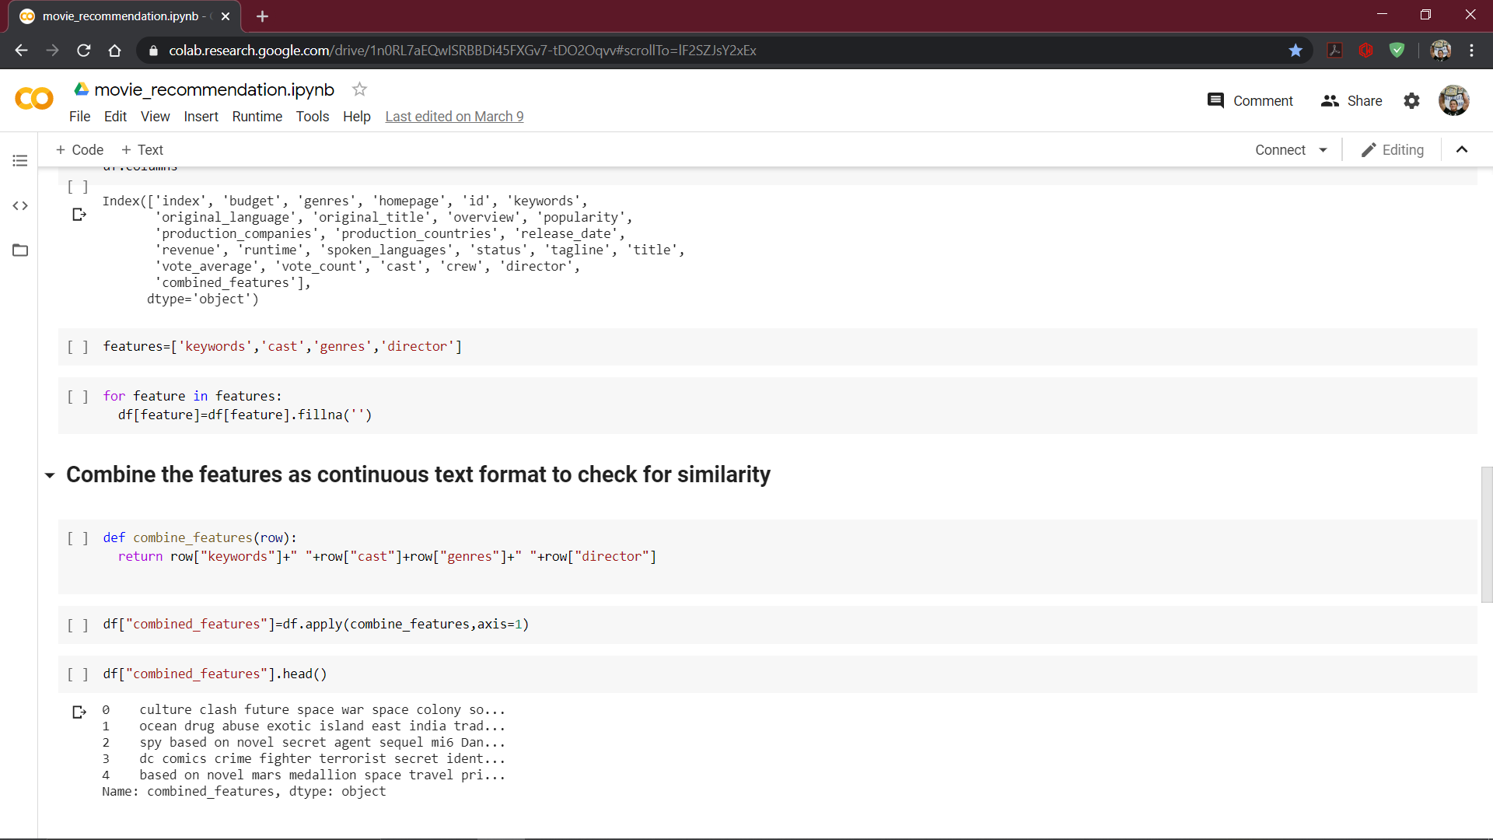
Code

Slide 22
Full code:
import pandas as pd
import numpy as np
from sklearn.feature_extraction.text import CountVectorizer
cv=CountVectorizer()
from sklearn.metrics.pairwise import cosine_similarity
def get_title_from_index(index):
return df[df.index==index]["title"].values[0]
def get_index_from_title(title):
return df[df.title==title]["index"].values[0]
from google.colab import files
uploaded = files.upload()
df=pd.read_csv("movie_dataset.csv")
df.head()
df.columns
features=['keywords','cast','genres','director']
for feature in features:
df[feature]=df[feature].fillna('')
def combine_features(row):
return row["keywords"]+" "+row["cast"]+row["genres"]+" "+row["director"]
df["combined_features"]=df.apply(combine_features,axis=1)
df["combined_features"].head()
count_matrix=cv.fit_transform(df["combined_features"])
cosine_sim=cosine_similarity(count_matrix)
movie_user_likes="Spectre"
movie_index=get_index_from_title(movie_user_likes)
similar_movies=list(enumerate(cosine_sim[movie_index]))
sorted_similar_movies=sorted(similar_movies,key=lambda x:x[1],reverse=True)
i=0
for movie in sorted_similar_movies:
print(get_title_from_index(movie[0]))
i=i+1;
if i>10:
break;

Slide 23
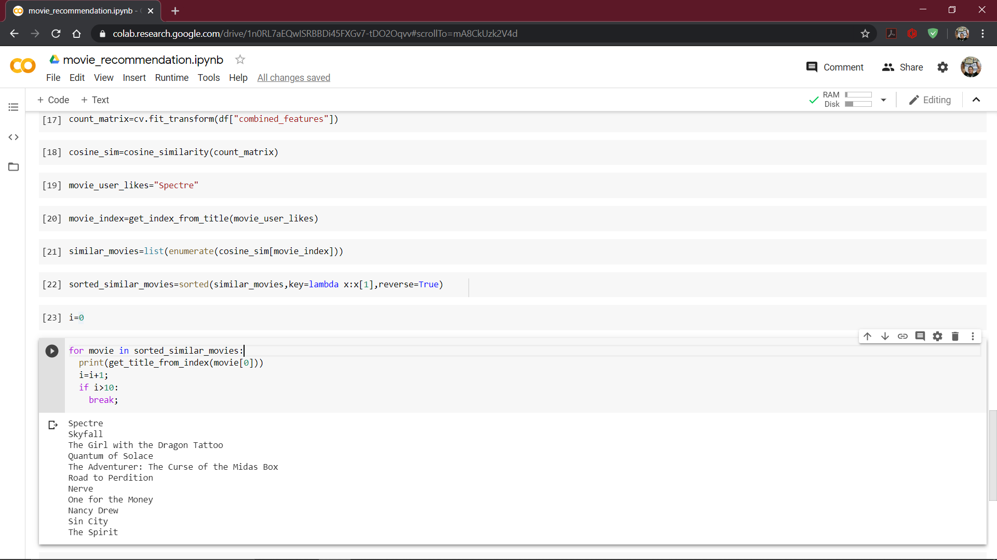
Output

Slide 24
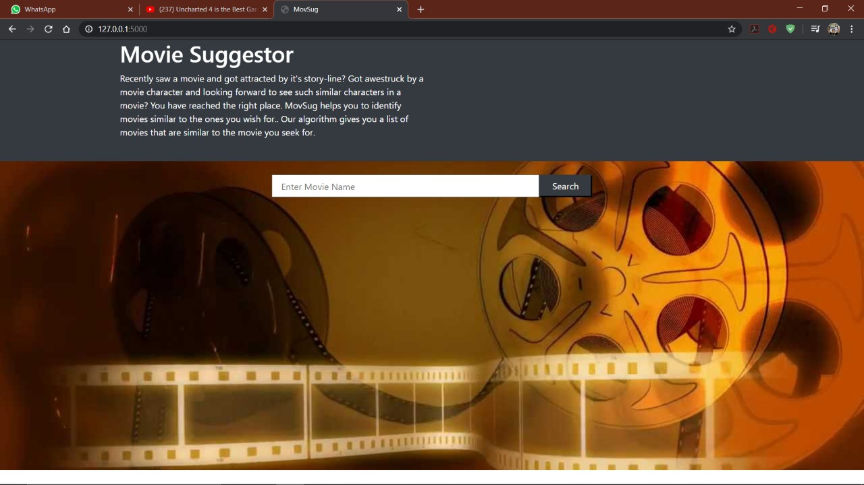

Slide 25


Slide 26
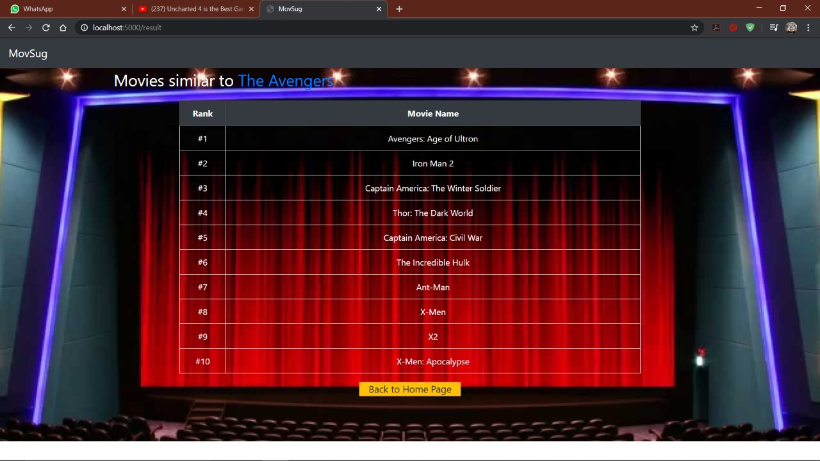

Slide 27
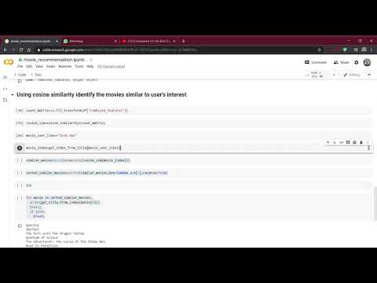
Execution video
Kindly follow this link if video is not playing:
https://youtu.be/-BxUCweyRAs

Slide 28
Contribution up till now
Sruti: Front end of website and movie recommendation system
Nithesh: Back end of website(database handling), connection between front end and tables
Python’s recommendation program had to be made by both of us, as it was a new concept entirely.

Slide 29

TASKS LEFT FOR REVIEW 3
1.Chat forum
2.connection between xampp server and Python server

Slide 30

Thank You

