Slide 1
Capstone Project
Airbnb Bookings Analysis by – Sourav Chowdhury

Slide 2
Points for Discussion
Data Summary
Top most booking location
Customer preferable price
Most review earning hotel names with location
Top most busiest host name
Most demanded room type
Conclusion

Slide 3
Data Summary
new_airbnb_df: This data frame contains all the necessary information regarding Airbnb bookings.
host_areas: It contains top most booking counts with location and host name.
areas_reviews: It contains information about high price bookings with hotel name, location, room type, stay nights, reviews.
price_reviews: It contains information about most number of earning reviews with hotel name, location, room type, stay nights, price.
busiest_hosts: It contains top most busiest host name with host night counts.
traffic_areas: It contains most preferable room type with location, booking nights.

Slide 4
Top most booking location
After analyzing this we will answered the following questions.
Which all areas generated most business for Airbnb?
Booking counts of those areas.
Top most host name.
Highest booking number correspond with host name and area.

Slide 5
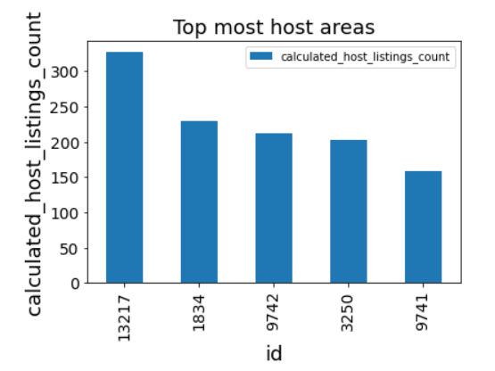
Top most booking location
Manhattan, Brooklyn are the top most business generated area for Airbnb. As per booking report around 650 bookings come from Manhattan and 159 booking comes from Brooklyn.
Sonder (NYC), Blueground, Michael, David are hosted most number of nights. Sonder (NYC) hosted 327 nights in Manhattan, Blueground hosted 212 nights in Manhattan, Michael hosted 202 nights in Manhattan and 159 nights in Brooklyn.
Highest booking number comes from Manhattan and hosted by Sonder (NYC).

Slide 6
Customer preferable price and Most review earning hotel names with location
In this section we will try to find the below questions answer:
High charges hotel list.
Customer preferable price.
Most review earning hotel.

Slide 7
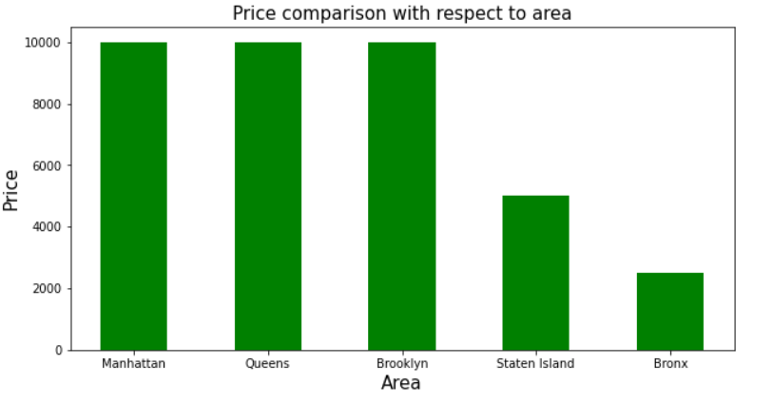
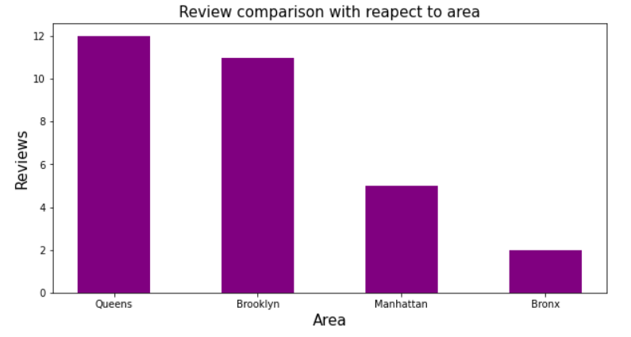
Customer preferable price and Most review earning hotel names with location
Manhattan, Queens and Brooklyn are the most costly area for hotels and price is 10000.
Most customer are prefer to stay in low price hotel which are belong to Queens, Brooklyn, Manhattan.
Top most review earning hotels are Hillside , Loft Suite @ The Box House Hotel, Artsy Private BR in Fort Greene Cumberland which are present in Queens and Brooklyn.

Slide 8
Top most busiest host name
In the section we will analysis the below report card:
Most busiest host names.
Number of hosted nights.
Number of nights hosted with areas.

Slide 9
Top most busiest host name
In this observation we will find the below questions answer:
Busiest host names.
Maximum hostess nights.
Most number of hostess area with hosts name.

Slide 10
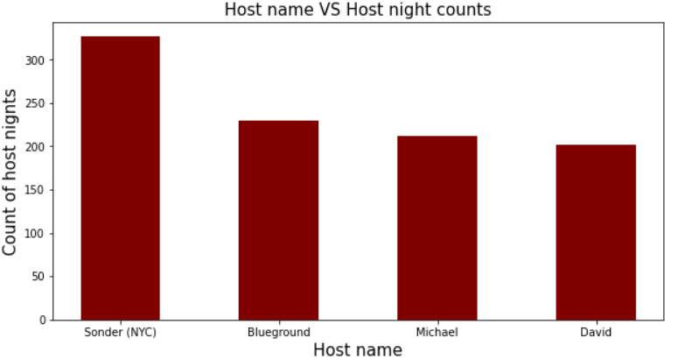
Top most busiest host name
Sonder (NYC), Blueground, Michael and David are top most busiest host and their hostess nights are 327, 230, 371, 202.
Above these host are hosting their nights in Manhattan, Brooklyn.

Slide 11
Most demanded room type
In this analyze report we will analysis the below observation:
Maximum stay nights.
Most choices room type.
Top booking areas.

Slide 12
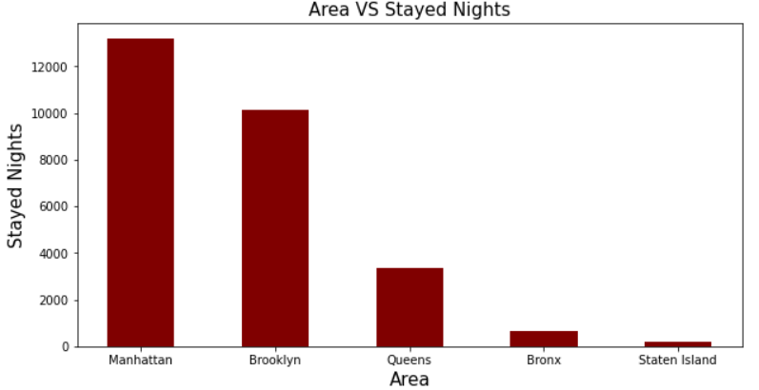
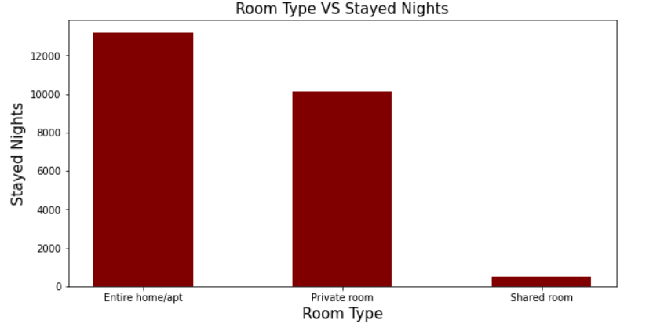
Most demanded room type
Manhattan, Brooklyn, Queens and are the maximum booking nights areas and quantities are 13199, 10132, 9559, 652 correspond with room type.
Most of people are prefer to stay in Entire home/apt, Private room.

Slide 13
Conclusion
Manhattan and Brooklyn are the top most booking generated area for Airbnb.
High price hotels available in Manhattan, Queens and Brooklyn.
People prefer to stay in low price hotel.
Sonder (NYC), Blueground, Michael and David are the top most busiest host.
People prefer to stay in Entire home/apt or Private room.

