Slide 1
CREDIT CARD SPEND PREDICTION & DRIVERS IDENTIFICATION FOR SPEND
Project output

Slide 2
Business Problem :
One of the global banks would like to understand what factors driving credit card spend are.
The bank want use these insights to calculate credit limit
Business Goal :
Predict the total spend for customer (total of primary & secondary card)
Identify the key drivers which help in prediction of the credit limit

Slide 3
Project Solution Approach :
The statistical solution for predicting a value is Linear Regression, so we will make us of Linear Regression methodology
After importing the data we will perform Exploratory Data Analysis which will give us the sense about data this involves Univariate & Bivariate analysis
After EDA, we will impute the missing value, treat outliers
Now, we will perform feature engineering methodology to select the important features for our modelling purpose, these methods are : Correlation, One Variable Regression, RFE, PCA, Select K Best.
After, Selecting final variables we will build different model, and compare their R-Square, error matrices to finalize the model for prediction purpose

Slide 4
Exploratory Data Analysis:
There are total 5000 rows and 130 columns (X – Variables)
36 Continuous variables, 7 Ordinal Categorical & 79 Nominal Categorical Variable
For exploratory data analysis we have separated data into two different data set ”Data_Num” and “Data_Cat”
Univariate and Bi-variate analysis of variables have been performed by using Histogram, Scatterplot and Boxplot

Slide 5
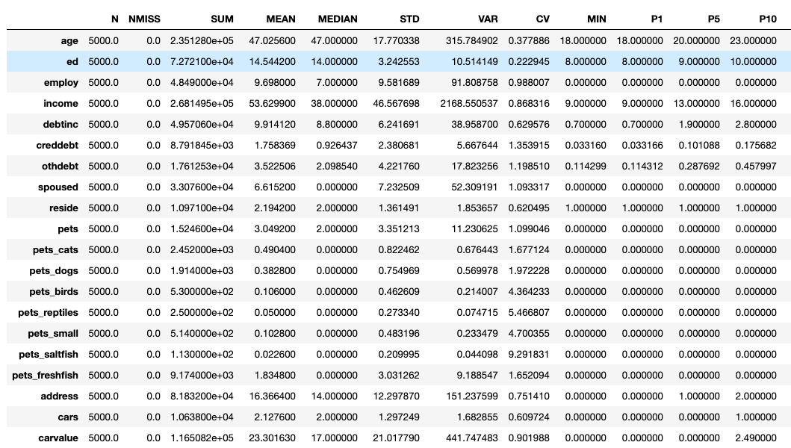
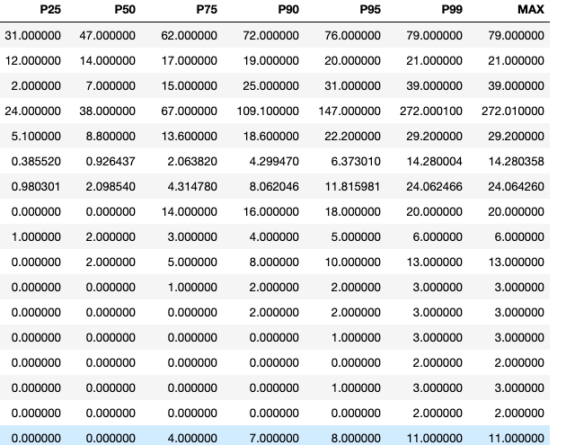
Exploratory Data Analysis :

Slide 6
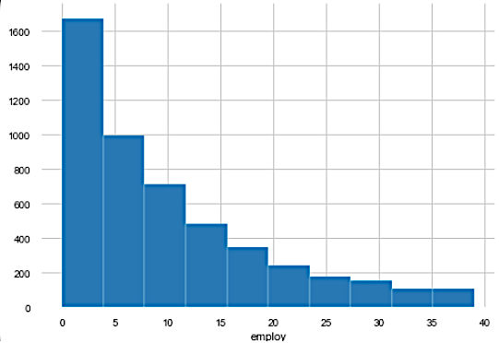
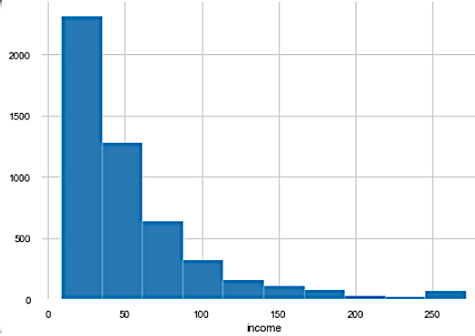
Univariate Analysis Numerical Variable :
1. More than 30% customers have job experience less than 5 years
2. 50% of the customers have income less than equal to 50K
Employ Years
Income (in thousand)

Slide 7
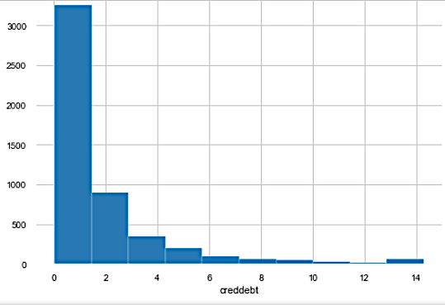
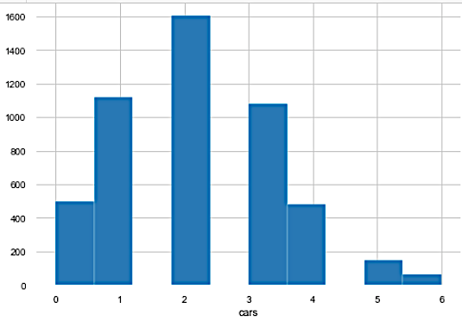
3. 60% customers have credit debt less than 2K
4. Customers genrally have 2 cars
Credit Card Debt (in thousand)
Number of Cars Own

Slide 8
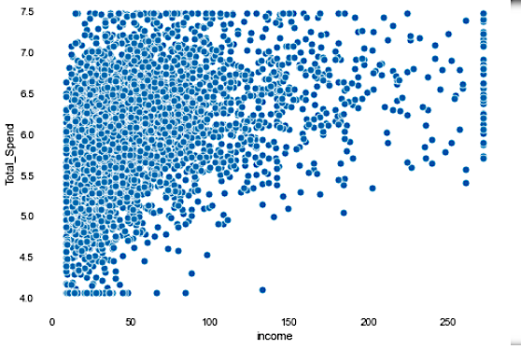
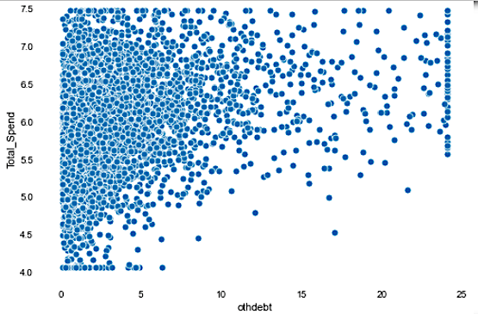
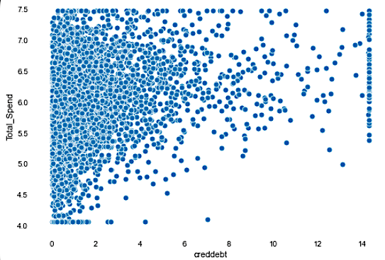
Bivariate Analysis Numerical Data
1. As income increases their is a increase in the total_spend, cred debt & other debt also have same relation with income
Total_Spend
Total_Spend
Income
Other Debt
Total_Spend
Cred Debt

Slide 9
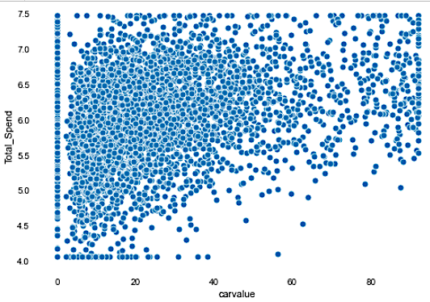
2. Carvalue have a positive correlation with total_spend
Total Spend
Car Value

Slide 10
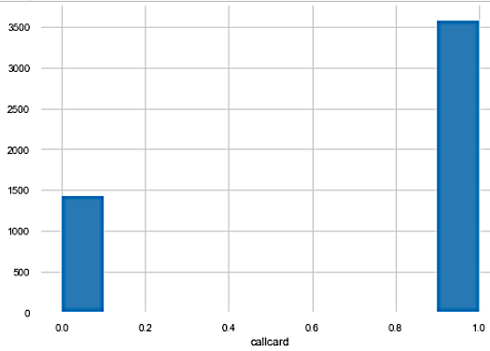
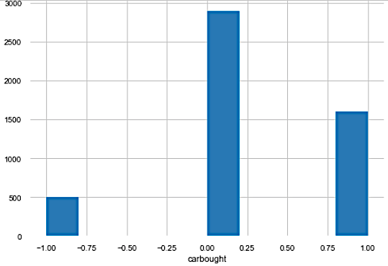
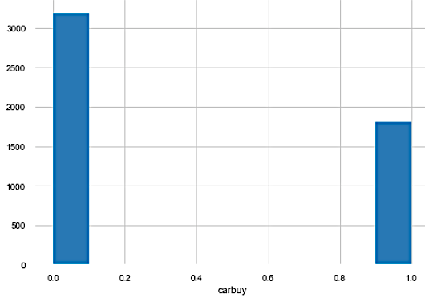
Univariate Analysis Categorical Variable :
More than 70% of customers uses CallCard Service
60% of the customers have not leased/bought the car in previous years and they are not planning to buy in coming year as well
Call_Card
Car_Bought
Car_Buy

Slide 11
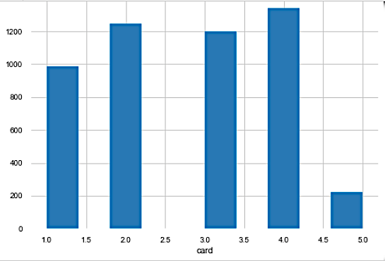
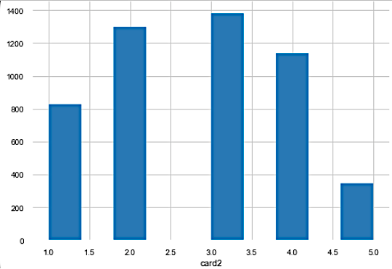
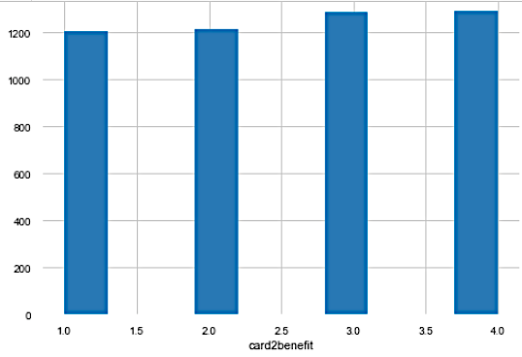
Approx. 50% of customers have Discover and Visa as their primary card
Nearly 50% customers have Visa and Mastercard as their secondary card
Customer tend to prefer have "other & Airline Miles" as benefits in their secondary card
Primary Card
Secondary Card
Secondary Card
Benefit

Slide 12
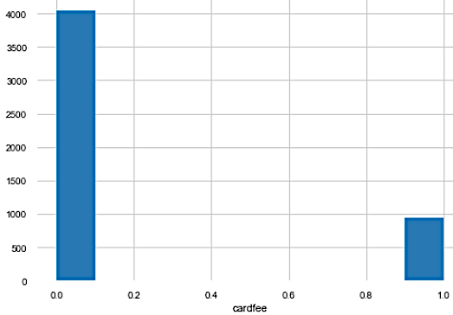
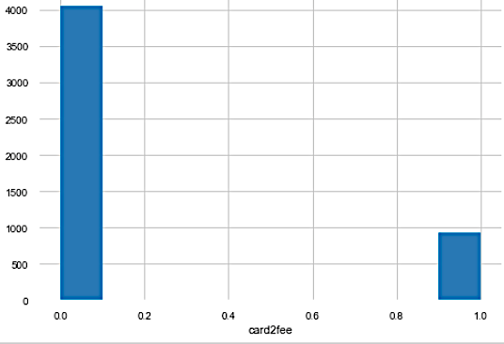
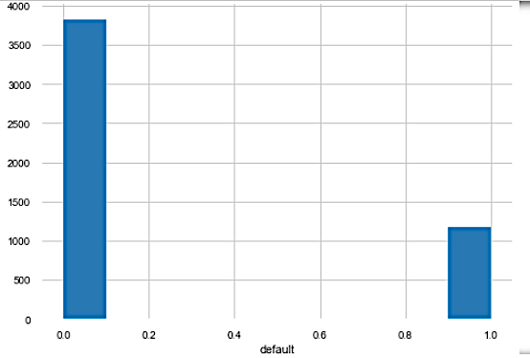
80% customer prefer to have no fees on the card be it secondary or primary card
More than 70% of customers have not defaulted in any loan
Primary Card Fee
Secondary Card Fee
Defaulted Loan

Slide 13
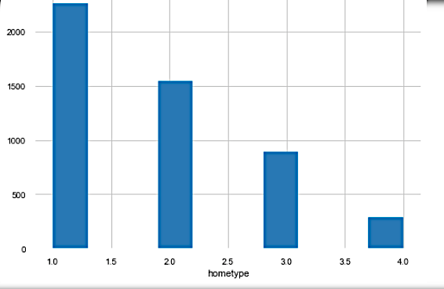
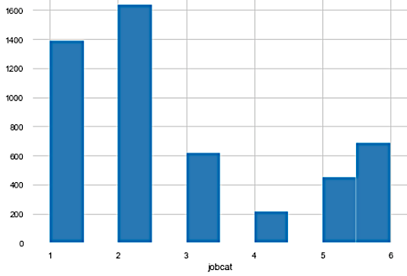
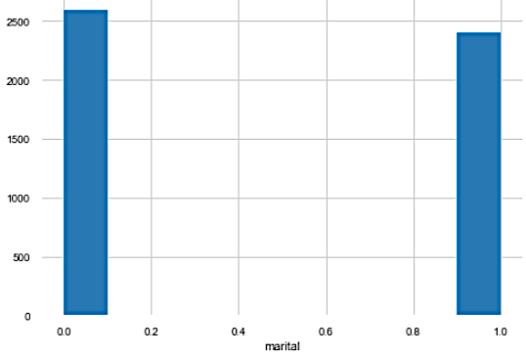
Most of the customer have "Single type" family
30% of the customer belong to "Sales & office" job category
50% of the customer are not married
Type of Home
Job Category
Marital Status

Slide 14
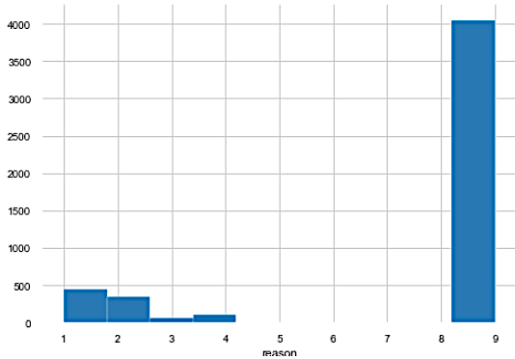
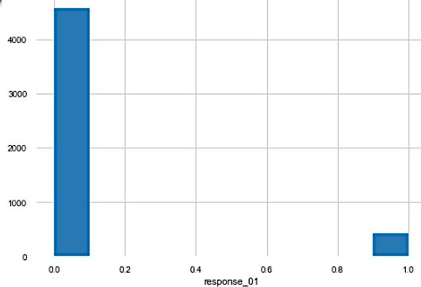
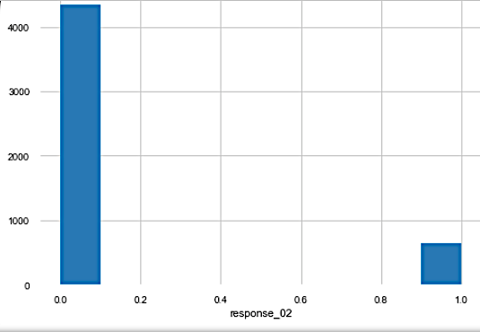
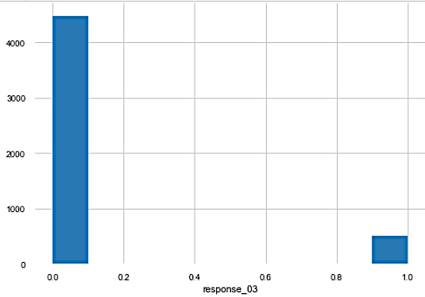
Nearly 80% of the customer have not stated their reason for being a customer
90% of the customers have not responded to any of the product offered to them
Reason
Response_01
Response_02
Response_03

Slide 15
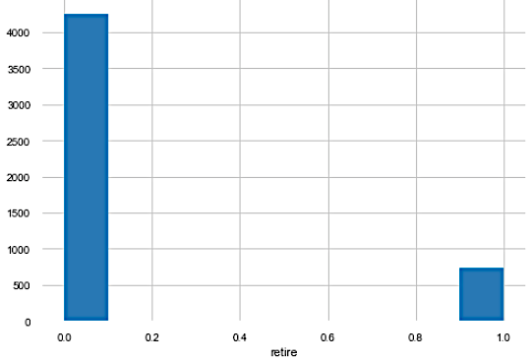
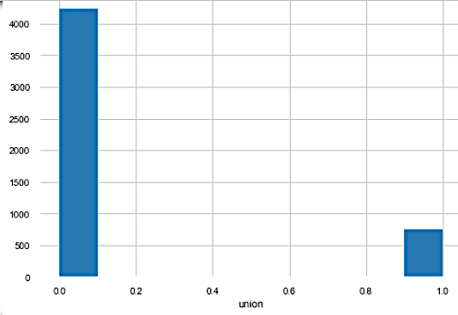
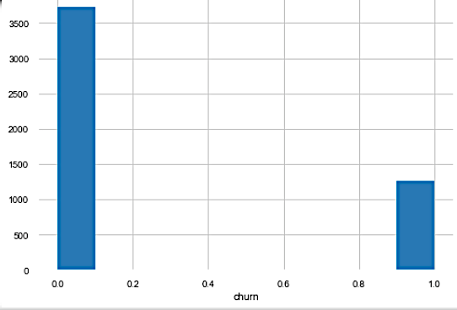
90% of the customer don't belong to any union and are not retired
Nearly 20% of customers have changed their provider in last month
Retire
Union
Churn

Slide 16
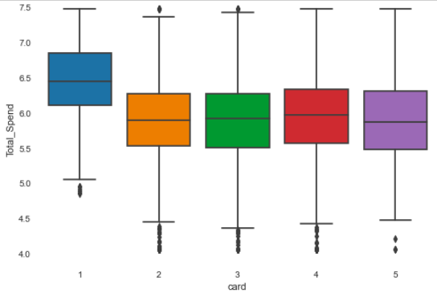
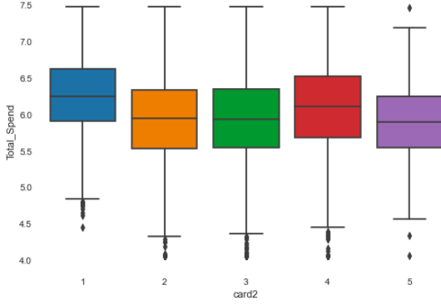
Bivariate Analysis Categorical Variable :
Out of Card (1,2,3,4,5), Card 1 customers have more credit limit then other card type
Out of Card2 (1,2,3,4,5), Card 1 & 4 have more credit limit then other card type
Primary Card
Secondary Card

Slide 17
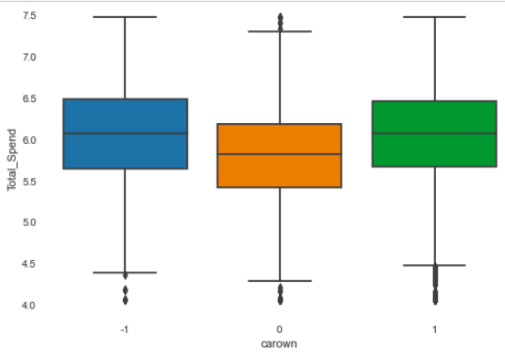
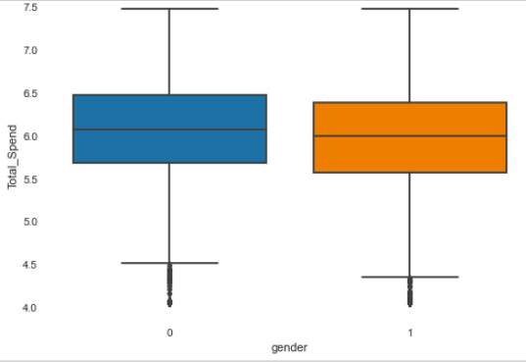
People who lease Car have low credit limit as compare to those who own the car
Male have higher credit limit then female
Car Own
Gender

Slide 18
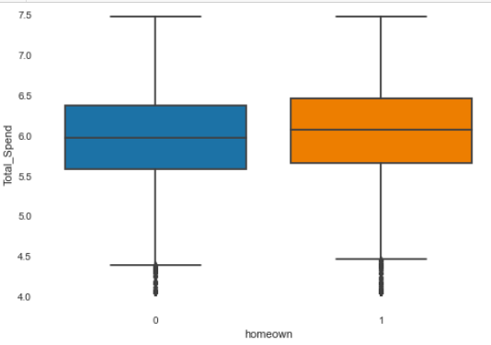
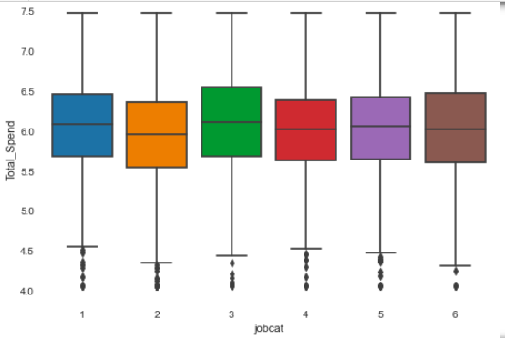
People who own home have higher total_spend then people who live in rented house
People who are in Service of Job Category have more credit limit then other job categories
Home Own
Job Category

Slide 19
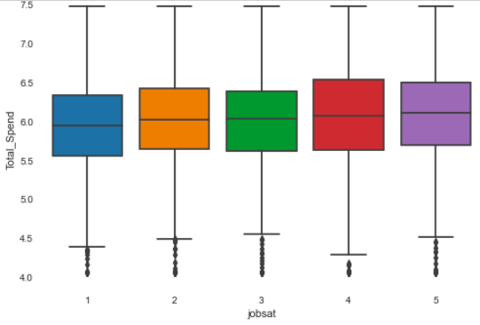
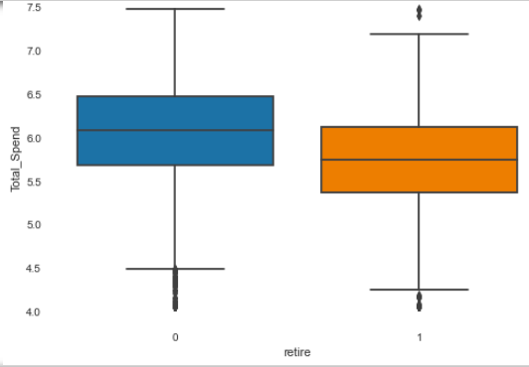
Customers who are "Somewhat Satisfied" With their job have higher total spend
Customers who are not retired are given more total_spend limit
Job Satisfaction
Retire

Slide 20
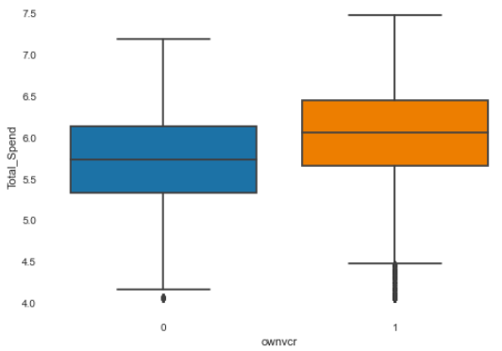
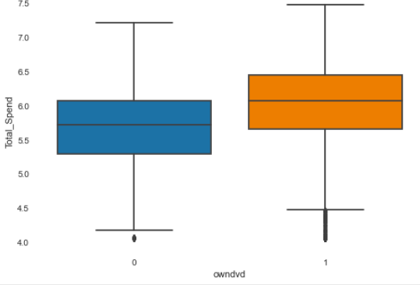
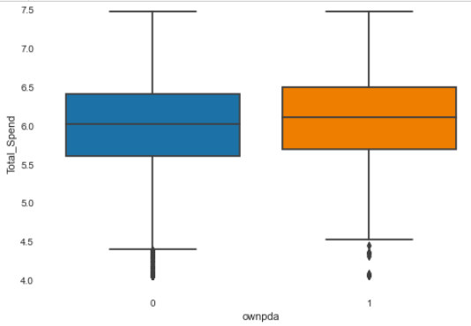
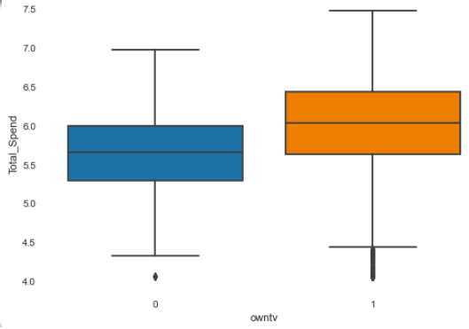
Customers who owns' OwnCd, OwnDvd, OwnPda, OwnTv, OwnVcr have higher total_spend
Own VCR
Own Dvd
Own Pda
Own Tv

Slide 21
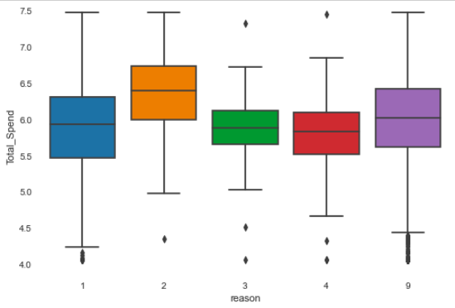
People who are customers of bank because of "Convenience" have much higher total_spend as compare to other customers
Reason for being the customer

Slide 22
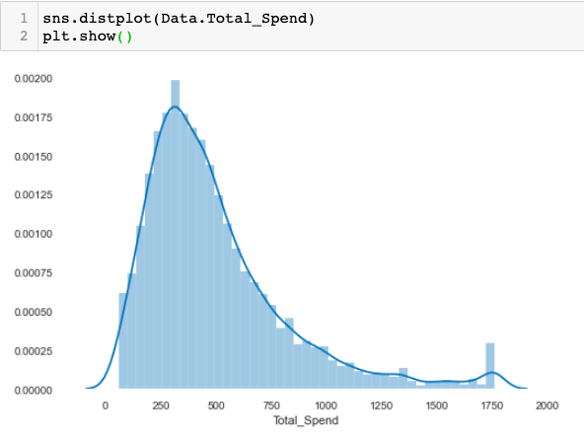
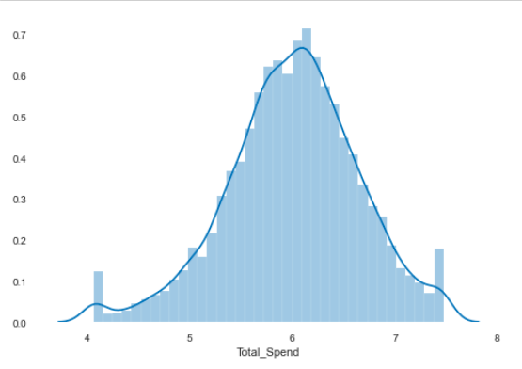
Target Variable (Y) :
Total Spend is skewed toward Right due to outlier, therefore we need to transform it to get the normal distribution of the target variable.
Log Transformation happens to be the one which gives us normal distribution of the target variable
Total Spend Before Transformation
Total Spend After Transformation

Slide 23
Data Preparation :
Created the Target variable (Total_Spend) by combining CardSepnt and Card2Spent
Dropped these two variables from the data set
Dropped those variables which are duplicate of numerical variables and present in data-set as their categorical version and also in Log transformed form ("agecat","edcat","empcat","lninc","inccat","lncreddebt","lnothdebt","spousedcat","addresscat","commutecat","cardtenurecat","lnlongmon","lnlongten","lntollmon","lntollten","lnequipmon","lnequipten","lncardmon","lncardten","lnwiremon","lnwireten”,” carcatvalue”, “card2tenurecat”)

Slide 24
In columns “Spoused” and “Carvalue” replaced -1 with 0
In columns “cardten” and “longten” missing value is replaced with 0.0
Two variables “Custid” and “Birthmonth” were dropped as they represented the personal information
Missing Variable Treatment :
For Numerical variables we have replaced the missing with the mean value
For Categorical features we have replaced it with mode

Slide 25
Outlier Treatment :
The data is clipped at 1% and 99%
One-Hot-Encoding :
In our data we have 87 nominal categorical variable, for each of them the dummy categorical variable have been created.
Normalization of Data :
The final data have been normalized so that the equal weights can be assigned at the time of modelling.

Slide 26
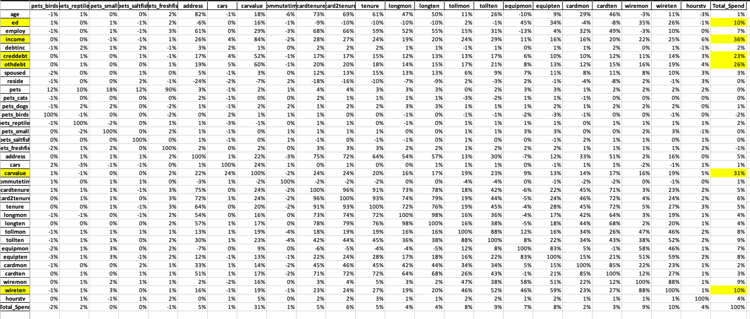
Feature Engineering :
For Numerical Variable we are finding correlation matrix with the target variables and shortlist the variables which have at least or more than 10% correlation with the target variable.

Slide 27
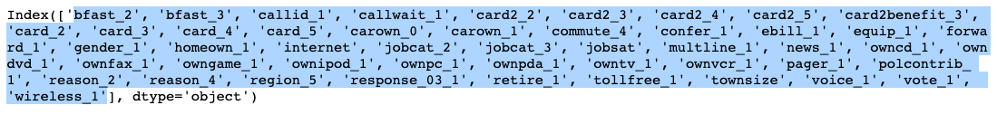
Numerical Variables selected from correlation are :
“ed”,”income”,”creddebt”,”otherdebt”,”carvalue”,”wireten”
For Categorical Variable we will do One Variable Regression, select the variable which have p_value less than 0.05
Variables selected from above method are :
Recursive Feature Elimination :
RFE on entire data set, where we selected 30 variables from it are :

Slide 28
RFE on variables selected from Correlation Matrix and One Variable regression :
Select K Best :
On Entire Data-Set
On Selected Variables from Correlation & One Variable regression

Slide 29
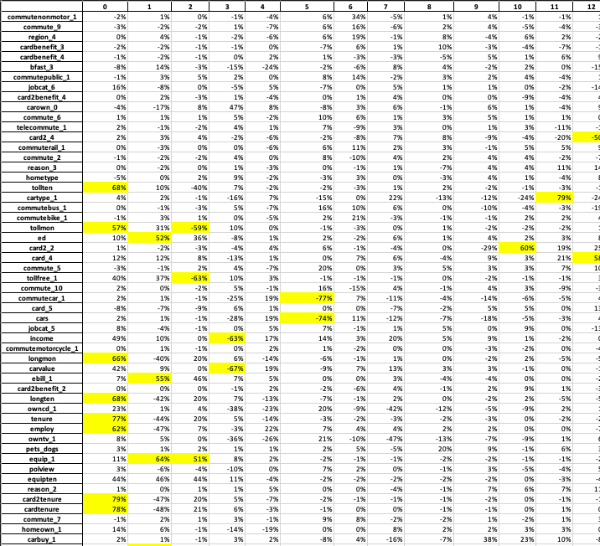
Principal Component Analysis :

Slide 30
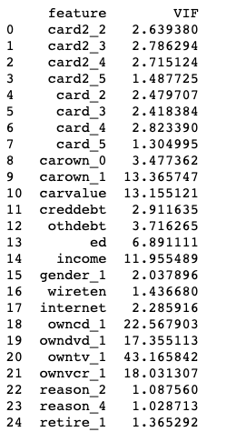
Variable selected from the above methods are :
"card2_2","card2_3","card2_4","card2_5","card_2","card_3","card_4","card_5","carown_0","carown_1","carvalue","creddebt","othdebt","ed","income","gender_1","wireten","internet","owncd_1","owndvd_1","owntv_1","ownvcr_1","reason_2","reason_4","retire_1”
Performing VIF to remove the variables which are multi-collinear to each other :
Variables having VIF Score more than 5 are removed one by one

Slide 31
Final Variables Selected for Modelling are :
card2_2
card2_3
card2_4
card2_5
card_2
card_3
card_4
card_5
carown_0
creddebt
gender_1
income
internet
othdebt
reason_2
reason_4
retire_1
wireten

Slide 32
Model Building :
Methods used for building different models are :
Linear Regression
KNN Regressor
Decision Tree Regressor
Bagging Regressor
Random Forest Regressor
Adaboost Regressor
Gradient Boost Regressor
Boost Regressor

Slide 33
Data Split and Model Execution :
Data is split into train (70%) and test (30%)
The K-fold validation is performed where k = 3
All the techniques mentioned in previous slides are used to compare the R2 and error matrices i.e MAPE & RMSE
Refer to code for the execution of each model

Slide 34
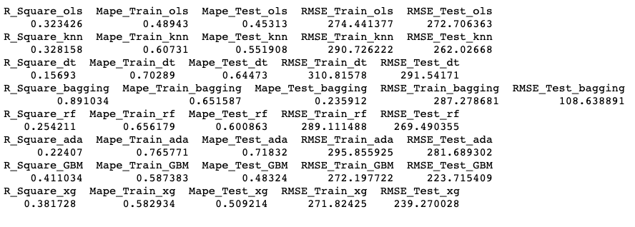
Model Comparison – Metrics :
Out of all the Model the Linear regression model have the best accuracy, the difference between the test and train metrics is very less hence this is our best model

Slide 35
Key Drivers :
Y = 6.6855-0.4036*card2_2-0.3763*card2_3-0.4255*card2_4-0.2967*card2_5-0.5860*card_2-0.6073*card_3-0.7080*card_4-0.5245*card_5-0.0669*carown_0-0.0464*gender_1+1.1351*income+0.2671*reason_2-0.2065*retire_1
Income is the major positive key driver for predicting the credit limit
Male customer are given higher credit limit
Customer having reason of ”Convenience” get higher credit limit

Slide 36
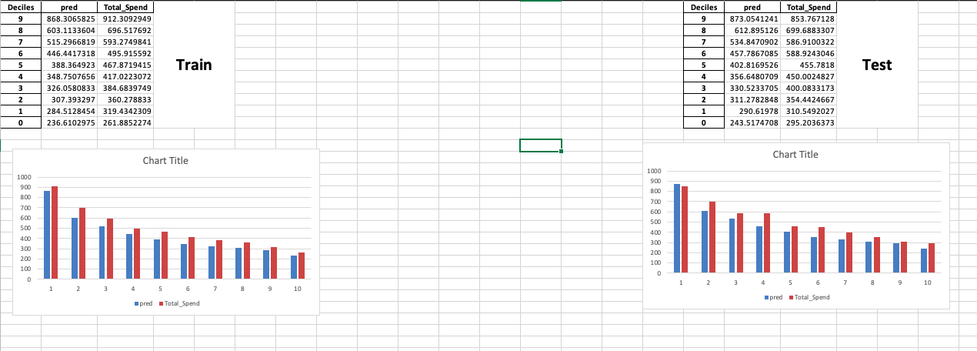
Decile Analysis :
The Decile Analysis for train and test shows the Step-Wise flow.

Slide 37

Residual Plot :
The model residual shows the normal distribution, which is the condition of Linear Regression

Slide 38
Recommendation & Next Step :
Regular model rebuilding after specific time interval will be required for maintenance.
The key drivers for the model are income and existing cards possessed by the customer.
One should make sure that they remain consistent after certain time period. Any changes should be incorporated into the model and retrained accordingly.
Also check should be performed if newer predictors can be found and helpful to have better prediction on the data.

