Slide 1
Project output
Network Intrusion Detection System
A. Binomial Classification
B. Multinominal classification

Slide 2
Business problem :
Building network intrusion detection system to detect anomalies and attack in the network.
Binomial classification : to determine whether the network in under attack or not
Multinomial classification : to determine the class of the attack
Business goal :
To Predict Whether The Attack Have Been Detected In The System Or Not.
To Determine In Which Attack Class The Attack Belong i.e normal, dos, probe, r2l or u2r

Slide 3
Project solution Approach :
To Predict The Happening Of An Event Which Is Whether The System Have An Intrusion Or Not.
Statistical Solution For Such Problem Is Logistic Regression
Performing Exploratory Data Analysis I.E Univariate And Bivariate Analysis
Feature Engineering To Select The Variables Which Are Important For Modeling Purpose, Methodology Includes RFE, Select K-best, Univariate Variable Reduction, Chi-square Test & Vif
After Selecting The Variables We Will Build The Models And Compare The Metrics Like Auroc Score & Gini Score
Finding Sensitivity, Specificity, Accuracy To Find The Optimal Cut-off And Confusion Matrix
Predicting The Event On The Basis Of Optimal Cut-off And Comparing The Above Mentioned Matrices For Train And Test Data

Slide 4
Exploratory data analysis
Data Have 125972 Rows And 43 Columns
Data Have 29 Numerical, 8 Categorical And 6 Boolean Variables
Histogram And Boxplot Have Been Plotted For Analysis Purpose
Data Have Been Further Distributed Into Two Category I.E Numerical And Categorical And Analyzed Respectively

Slide 5
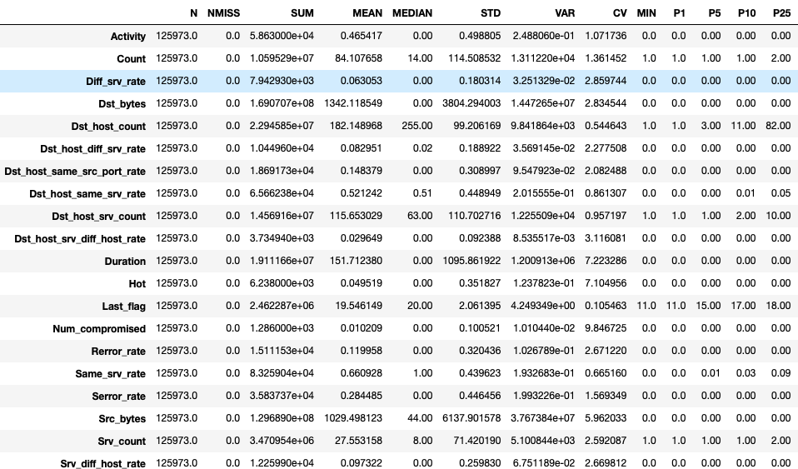
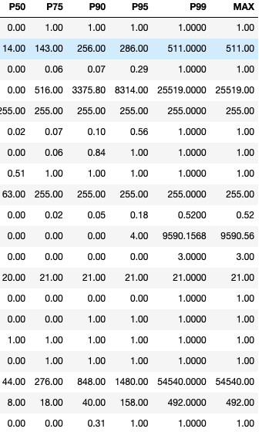
Exploratory data analysis

Slide 6
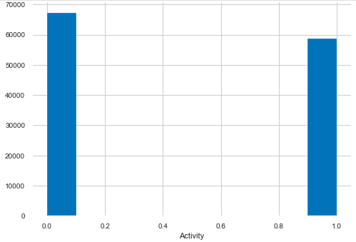
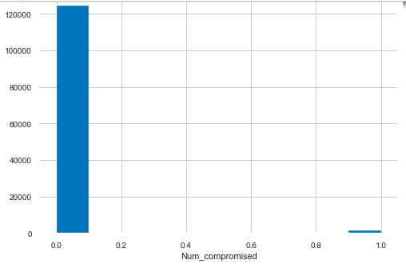
Univariate analysis numerical :
The data have 44% of attacks
0% of Number of `compromised' 'conditions'`, Number of operations on access control files and Failed login

Slide 7
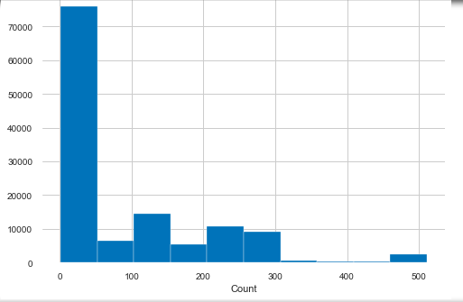
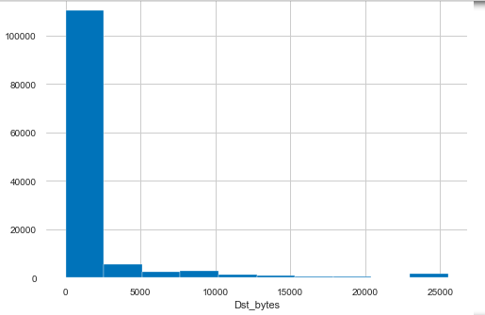
Mostly connection have the same destination host as the current connection in the past two second
In 80% of connection the `data bytes transfer` is 0 from `source to single data connection`

Slide 8
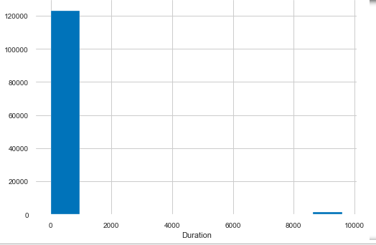
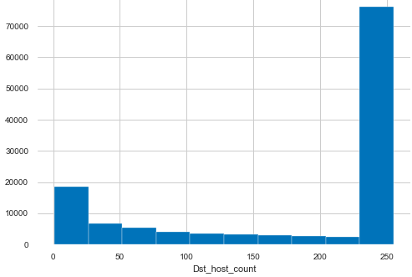
95% of the connection have 0 connection time
70% of connections have the same destination host IP address 250

Slide 9
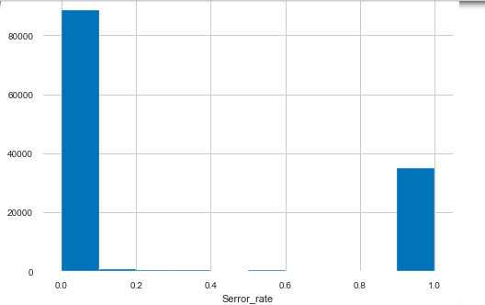
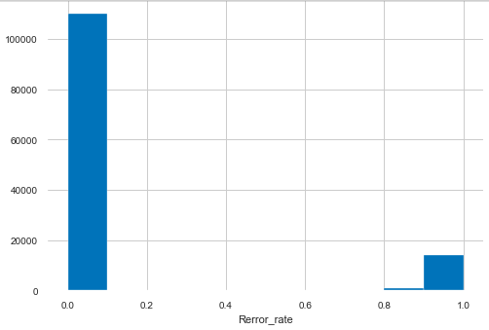
81%, 68% of connections have Rerror rate and Serror rate have been 0 respectively

Slide 10
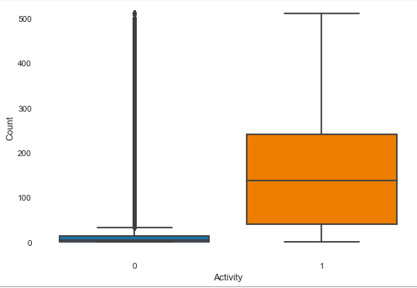
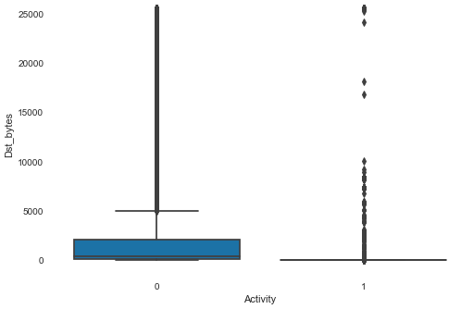
Bivariate Analysis numerical :
The connections who have an attack in their network have more number of connection to the same destination host at the current connection in past 2 seconds
Normal connections have `more number of data bytes transferred from destination to source in single connection

Slide 11
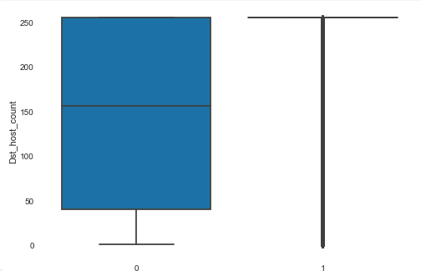
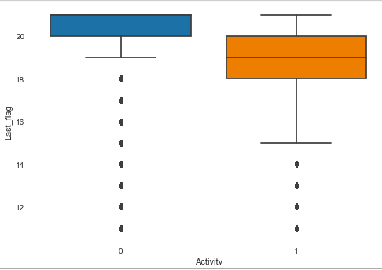
Connections who have been attacked have more number of connections having the same destination host IP address
Normal connections have more activated Last Flag than attacked networks

Slide 12
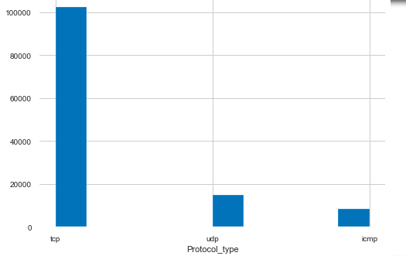
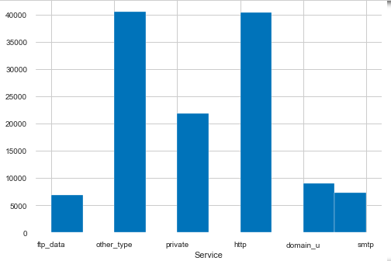
Univariate Analysis categorical :
1. Most of the network protocol are of TCP type
2. HTTP have been used more as service type

Slide 13
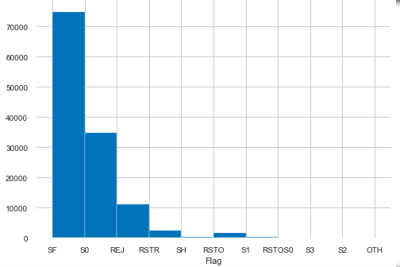
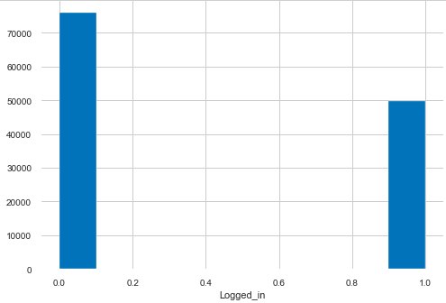
3. SF flag have been activated more
4. 44% of the connection are not successful login

Slide 14
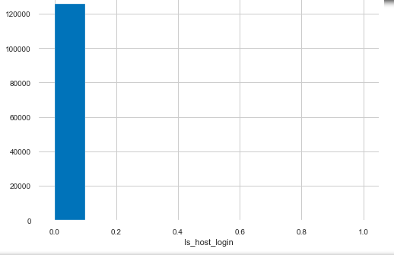
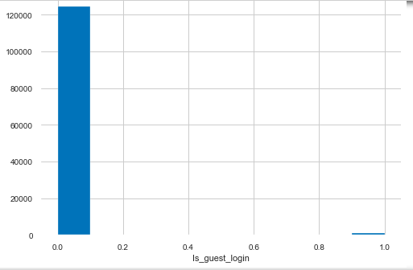
6. None of the connection belongs to the `Hot` list and are not guest login

Slide 15

5. In none of the connections the root shell have been obtained

Slide 16
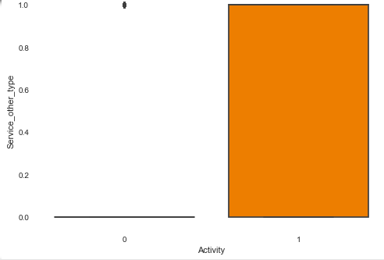
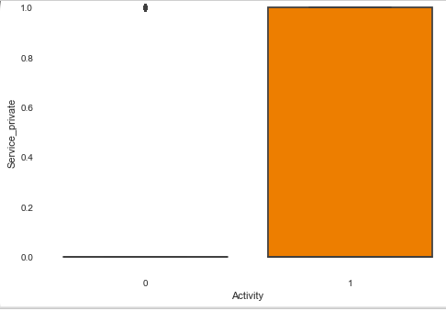
Bivariate analysis categorical :
Attacked connection have other type, private of service more as compare to normal connection

Slide 17
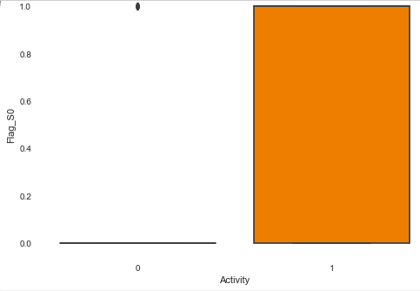
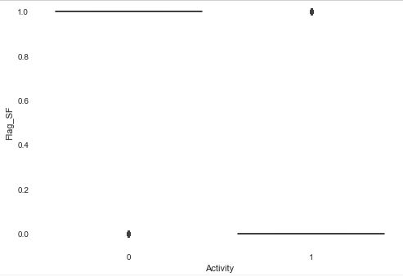
3. Flag_S0 have been activated more in attacked connections
4. Flag_SF have been activated more in normal connections

Slide 18
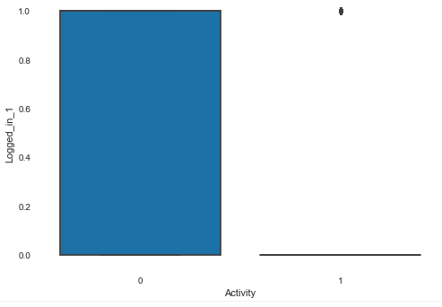
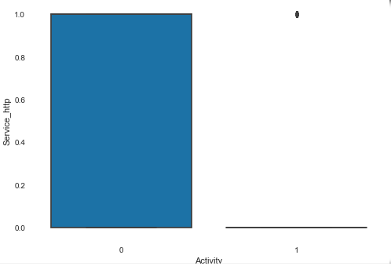
5. Normal connections have more successful logins
Normal connection have http type service more than attacked connection

Slide 19
Data preparation
Target variable :
The target variable is derived from attack variable, where event is described by 1 and non event is defined by 0
Dropped the attack variable from the data
Variable Service have 70 sub categories in it, rest 65 categories are clubbed into “Other type” sub category, while others sub categories are http, private, domain_u, smtp, ftp_data
All The Process Have Been Done On Train.Txt And Similar Steps Have Been Performed On Test.Txt

Slide 20
On the basis of pandas profiling report, the variables having high multicollinearity are dropped from the data, variables are :
Num_root, Srv_serror_rate ,Srv_rerror_rate ,Dst_host_serror_rate ,Dst_host_srv_serror_rate ,Dst_host_rerror_rate ,Dst_host_srv_rerror_rate ,Wrong_fragment
On the basis of pandas profiling report, the variables which are constant are dropped from the data, variables are :
Num_access_files ,Num_failed_logins ,Num_file_creations ,Num_outbound_cmds, Num_shells

Slide 21
Data have no missing values
Outliers treatment :
The data have been clipped by quantile function, where lower clip is given by 0.01 and upper clip is given by 0.99

Slide 22
Feature engineering
Methods used for feature engineering are :
Recursive feature elimination
Select k best
Chi-square test
Univariate regression

Slide 23
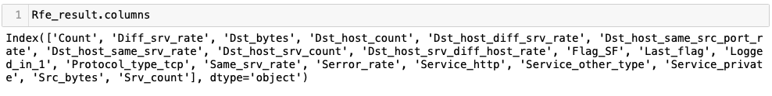
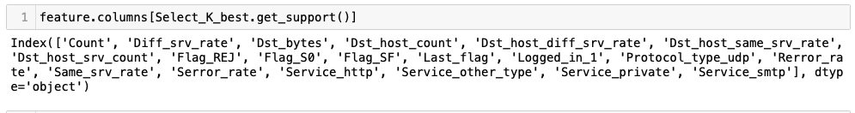
RFE on entire data :
Selecting 20 variables from the data
Select k best on entire data :
Selecting 20 variables from the data

Slide 24
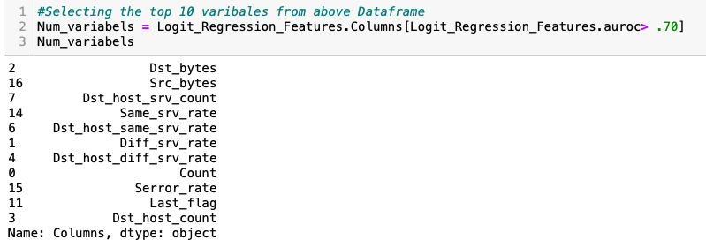
Univariate regression :
Selected the top 10 variables which have auroc score more than .70

Slide 25
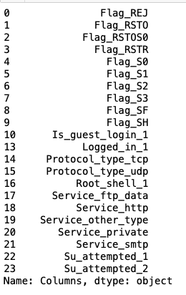
Chi-square test :
Selected categorical variables which have p value more than 0.05

Slide 26
Final variables selected for VIF :
Count
Diff_srv_rate
Dst_bytes
Dst_host_count
Dst_host_diff_srv_rate
Dst_host_same_srv_rate
Dst_host_srv_count
Flag_S0
Flag_SF
Last_flag
Logged_in_1
Protocol_type_tcp
Protocol_type_udp
Same_srv_rate
Serror_rate Service_http Service_other_type
Service_private
Src_bytes
variables finalized after vif :
Count
Diff_srv_rate
Dst_bytes
Dst_host_diff_srv_rate
Protocol_type_udp
Same_srv_rate
Serror_rate
Service_http
Service_other_type
Service_private
Src_bytes
Flag_REJ

Slide 27
Model Building :
Methods used for building different models are :
Logistic regression
KNN classifier
Decision Tree classifier
Bagging classifier
Random Forest classifier
Ada boost classifier
Gradient Boost classifier
Boost classifier

Slide 28
Data splitting
Data is split into train (70%) and test (30%)
K-fold validation have been set as 2
All the techniques mentioned in the previous slide have been used and they have been compared using auroc, gini and confusion metrics

Slide 29
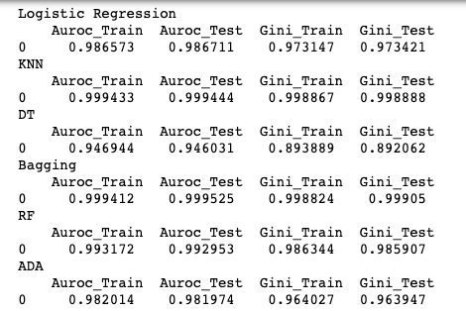
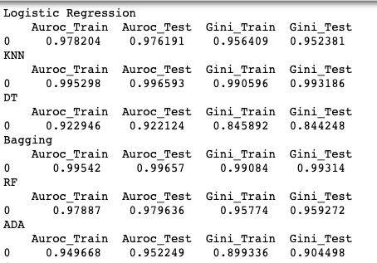
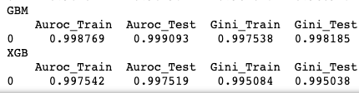
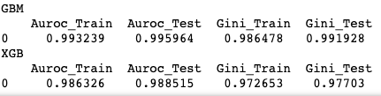
Model Comparison : From the given metrics and confusion metrics bagging is giving out the best result
Train.txt
Test.txt

Slide 30
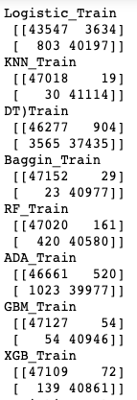
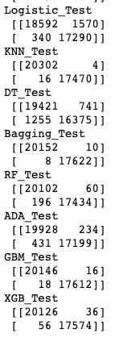
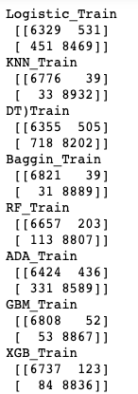
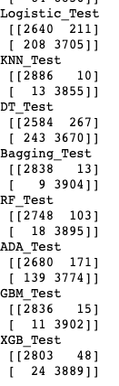
Confusion Metrix :
Train.txt
Test.txt

Slide 31
Multinominal Classification
Data Preparation :
Target Variable Attack_class Have Been Created.
Five Sub-categories Have Been Created Within Attack_class Variable, Sub-categories Are Normal, Dos, Probe, R2l, U2r
Variables Which Were Selected For Modelling In Logistic Regression Are Being Used Here In Multinominal Classification
Machine Learning Methods which are used here are KNN, DT, RF, Bagging, ADA Boost, GBM, XGBoost

Slide 32
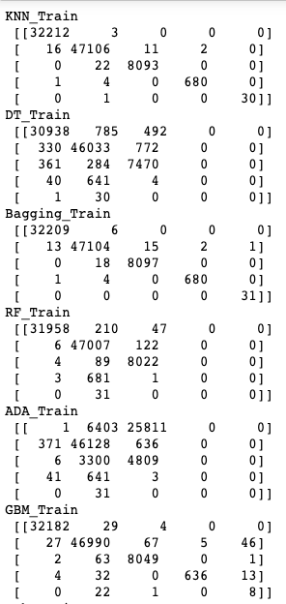
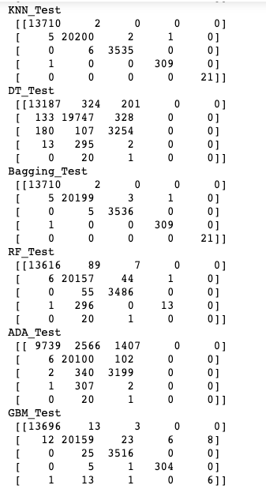
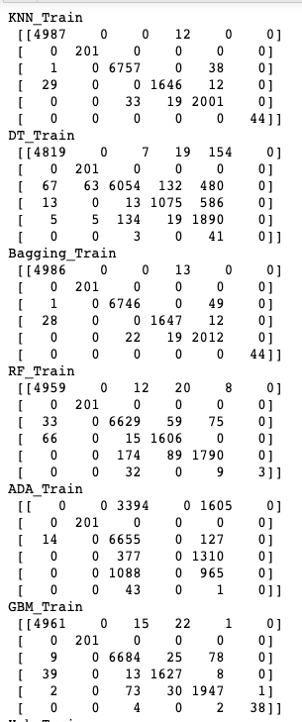
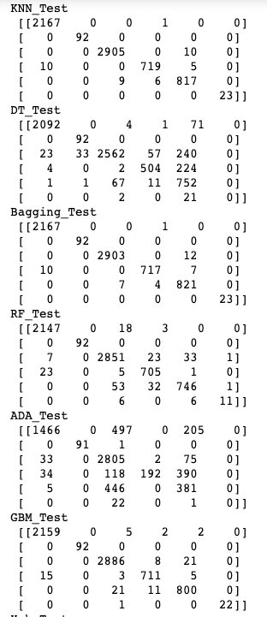
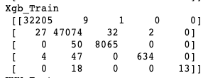
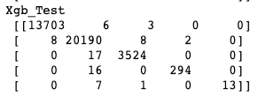
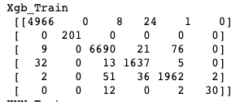
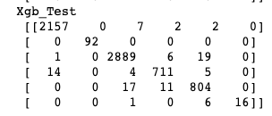
Train.txt
Test.txt

Slide 33
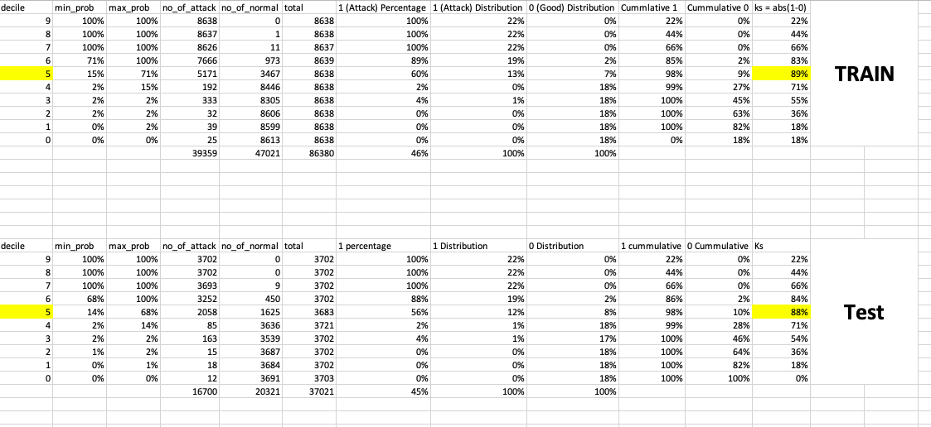
Decile Analysis :

Slide 34
Recommendation & Next Step :
Regular model rebuilding after specific time interval will be required for maintenance.
Any changes should be incorporated into the model and retrained accordingly.
Also check should be performed if newer predictors can be found and helpful to have better prediction on the data.

