Slide 1


Git Assignment – Push & Pull
Presented By: Saurabh Kumar Choudhary
Notes:
Note: First “Right Click” on the Gradient background, go to “Order” option and “Send it to Back”, then insert your picture into “Image Placeholder”, “Right Click” on the picture and again go to “Order” option and “Send it to Back” to get the “Gradient” effect.
1

Slide 2

Our Agenda
01
Git Introduction
02
Working of Git
03
Git command and snapshots
04
Push & Pull Definition and working
05
References

Slide 3
Introduction of Git
Git is an Open Source Distributed Version Control System.
Control System: This basically means that Git is a content tracker. So Git can be used to store content — it is mostly used to store code due to the other features it provides.
Version Control System: The code which is stored in Git keeps changing as more code is added. Also, many developers can add code in parallel. So Version Control System helps in handling this by maintaining a history of what changes have happened. Also, Git provides features like branches and merges, which I will be covering later.
Distributed Version Control System: Git has a remote repository which is stored in a server and a local repository which is stored in the computer of each developer. This means that the code is not just stored in a central server, but the full copy of the code is present in all the developers’ computers. Git is a Distributed Version Control System since the code is present in every developer’s computer.

Slide 4
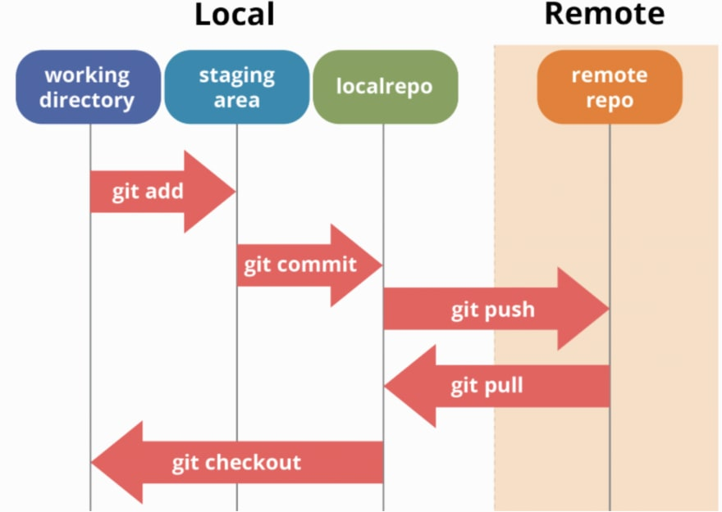
Working of Git
Steps to Follow
Step 1 − You modify a file from the working directory.
Step 2 − You add these files to the staging area.
Step 3 − You perform commit operation that moves the files from the staging area. After push operation, it stores the changes permanently to the Git repository.

Slide 5
Basic Git Commands
git init - The git init command creates a new Git repository. It can be used to convert an existing, or a new project to a Git repository or initialize a new, empty repository.
git add - git add is the first command in a chain of operations that directs Git to "save" a snapshot of the current project state, into the commit history.
git status - The git status command displays the state of the working directory and the staging area.
git commit - The git commit command captures a snapshot of the project’s currently staged changes.
git branch - Branches are used to create another line of development. By default, Git has a master branch, which is same as trunk in Subversion. Usually, a branch is created to work on a new feature. Once the feature is completed, it is merged back with the master branch and we delete the branch.
git push - git push is a command used to add all committed files in the local repository to the remote repository. So in the remote repository, all files and changes will be visible to anyone with access to the remote repository.
git fetch - fetch command used to get files from the remote repository to the local repository but not into the working directory.
git merge - merge command used to get the files from the local repository into the working directory.
git pull - pull command used to get files from the remote repository directly into the working directory. It is equivalent to a git fetch and a git merge .
Notes:
5

Slide 6
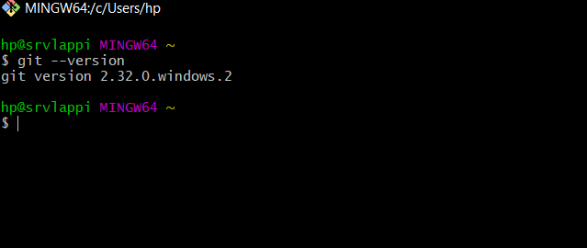
Working with Git Commands
Create a GitHub Account first.
Install Git in your machine
To check the git is installed or not use the command : git --version
Notes:
6

Slide 7
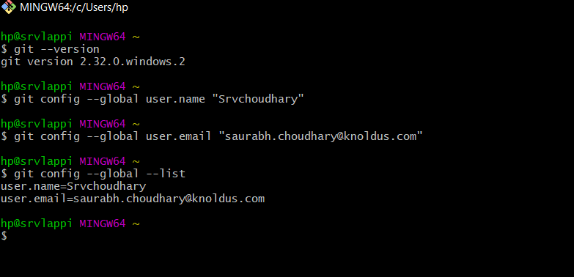
Working with Git Commands
Configure the git by entering your user.name and user.email.
To configure use command : git config –global user.name (for username) & git –global user.email (for email)
To check the filled details use : git config –global –list.
Notes:
7

Slide 8
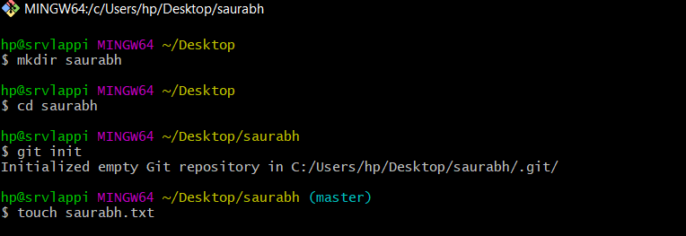
Working with Git Commands
Now start working with git:--
Create a new repository on GitHub
Now, navigate to the folder where you want to use git.
cd desktop
Make a directory if you want : - mkdir foldername
Initialize the git in the directory: - git init
Create a file using : -- touch filename.file-extension
Notes:
8

Slide 9
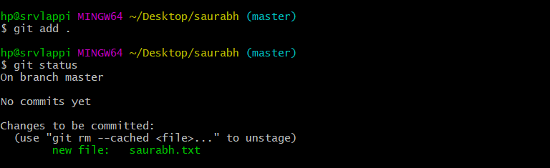
Working with Git Commands
Add files to the Staging Area for commit:
Now to add the files to the git repository for commit : -- git add .
To add a specific file to git :-- git add filename.file-extension
To see the staged file :-- git status
Notes:
9

Slide 10
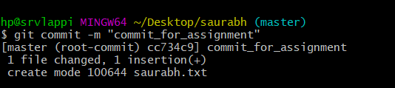
Working with Git Commands
To commit the changes you made to the file :-- git commit –m “comment”
Comment: The comment is the description of the commit you made, what the commit is actually about.
Notes:
10

Slide 11
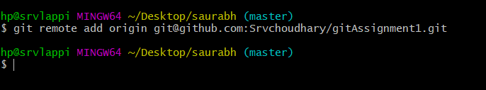
Push Operation
Push - Push operation copies changes from a local repository instance to a remote one. This is used to store the changes permanently into the Git repository.
Add a remote origin:--
git remote add origin remote_repository_URL :-- sets your remote origin
git remote -v :-- List the remote connections of your repositories
Push operation :--
git push –u origin master :-- Pushes the file from the local repo to the remote repo.
Notes:
11

Slide 12
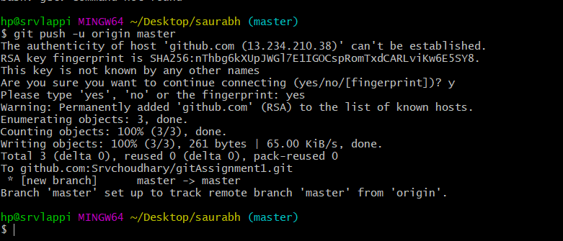
Push Snapshots
Notes:
12

Slide 13
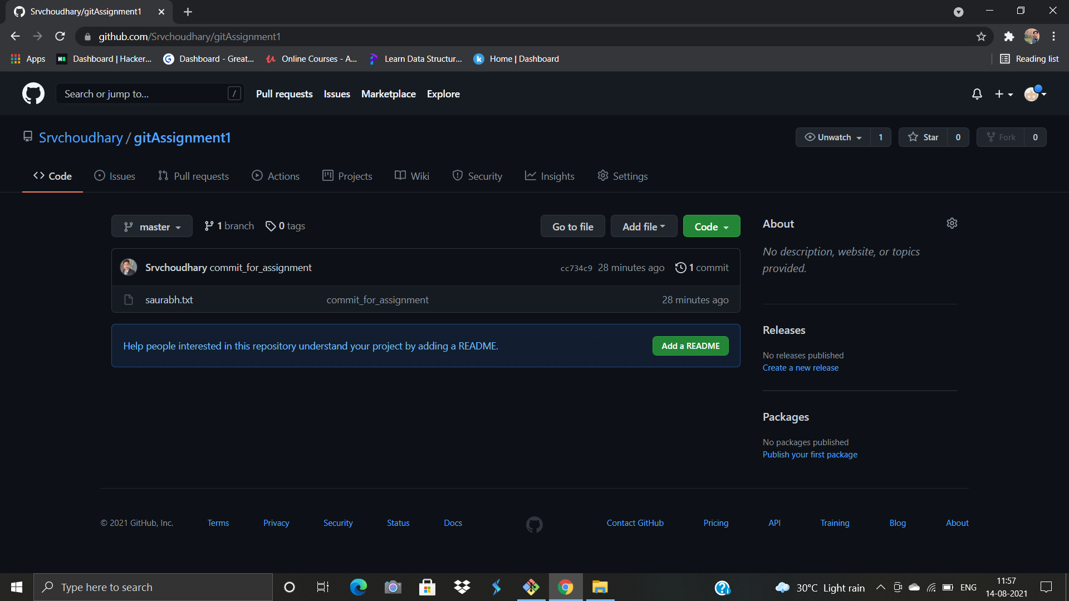
GitHub Repo Snapshot
After pushing the file from the local to the remote repository :-- -
Notes:
13

Slide 14
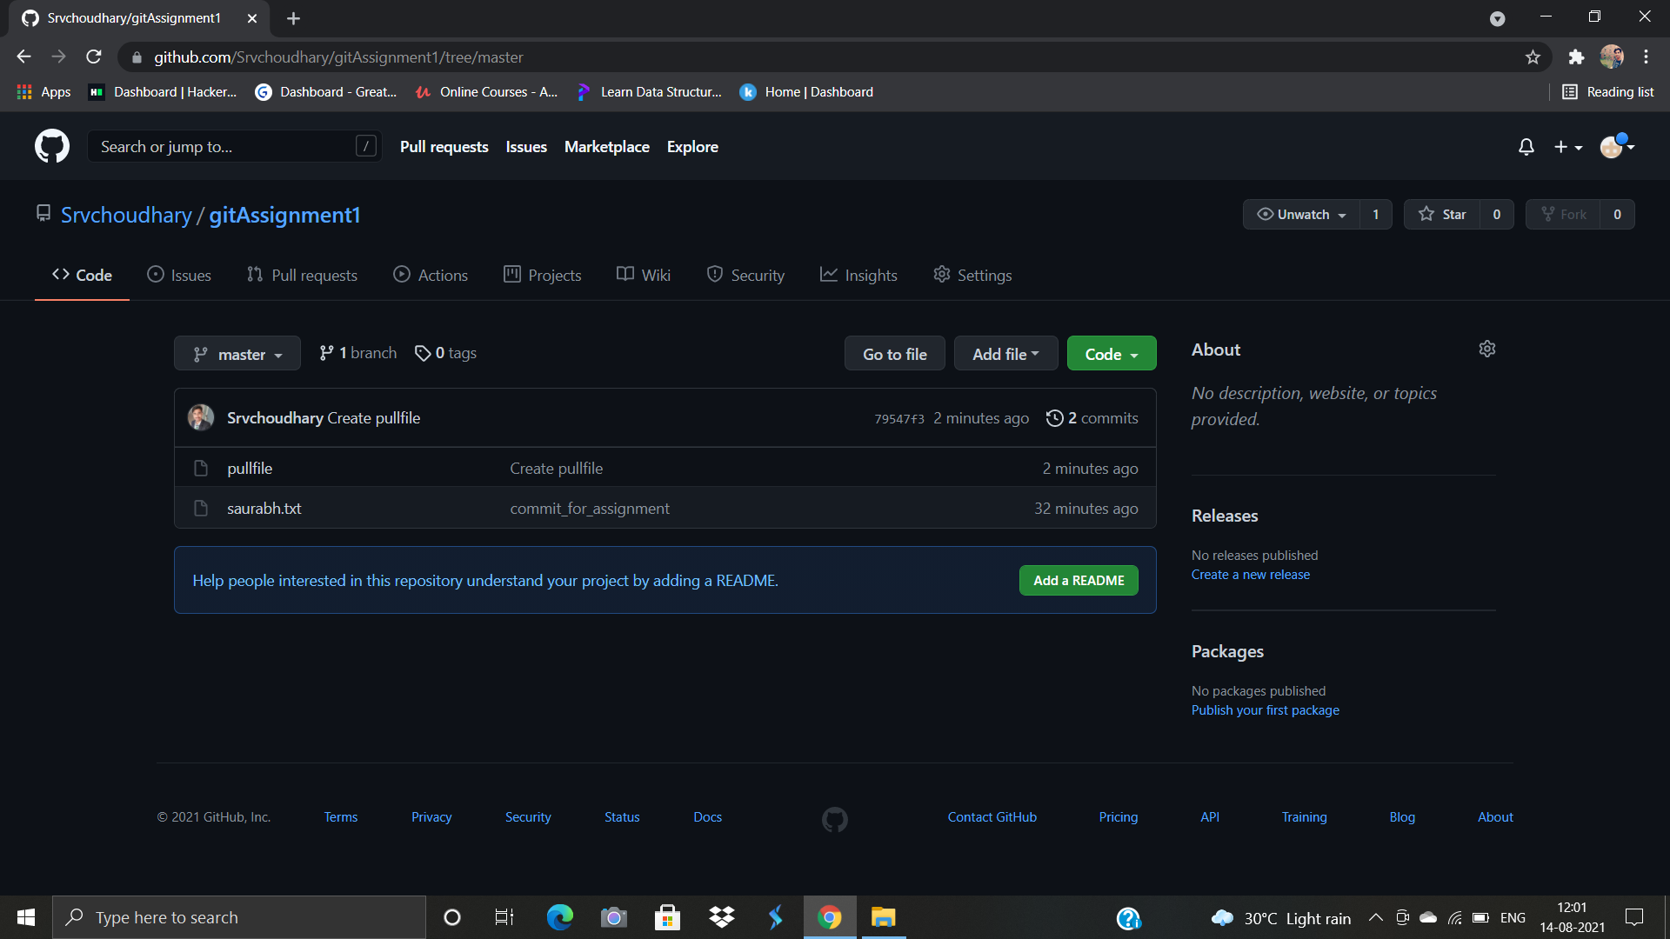
Pull Operation
Pull - The term pull is used to receive data from GitHub. It fetches and merges changes from the remote server to your working directory. The git pull command is used to pull a repository.
To pull the file from the remote repo : -- git pull origin master
To perform the pull we created a file named “pullfile” using the GitHub GUI
Notes:
14

Slide 15
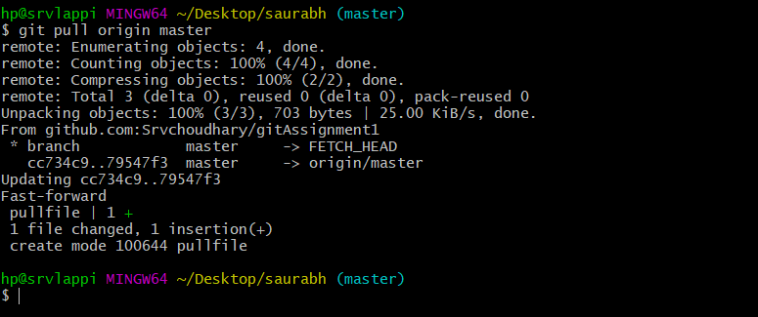
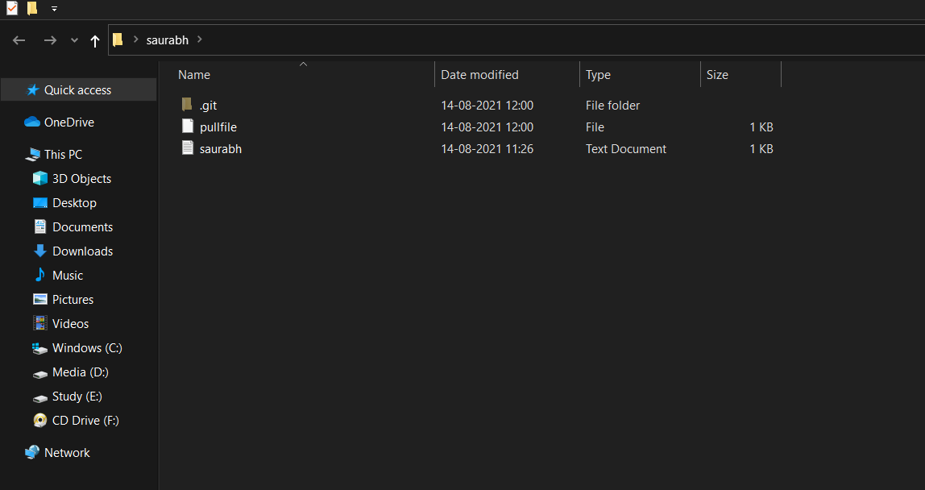
Pull Snapshot
Now we pulled the file from the remote repository:
Notes:
15

Slide 16
References
https://www.freecodecamp.org/news/what-is-git-and-how-to-use-it-c341b049ae61/
https://www.datacamp.com/community/tutorials/git-push-pull
Notes:
16

Slide 17
Thank You !
Notes:
17

