Slide 1
Understanding Tail Latency in Kubernetes Microservices
Tech: Kubernetes + eBPF
TEAM GROUP: 9 | GRS Project | CSE-638
Rajat Kumar Srivastava - M.Tech CSE (MT25078)
Harsha Verma - M.Tech CSE (MT25024)
Anurag Sharma - M.Tech CSE (MT25063)

Slide 2
The Problem
warning
Unexpected Latency Spikes
Some requests take 300–500 ms even when system metrics appear healthy.
Metric Blind Spots
CPU utilization is normal
Memory usage is fine
No application errors visible
The Core Question
Why does p99 spike when nothing looks wrong?

Slide 3

Why eBPF?
visibility
The Kubernetes Gap
Kubernetes abstracts away the kernel, hiding the low-level behavior that drives tail latency.
Tail Latency Culprits
CPU scheduling delays
Network stack bottlenecks
Kernel-level resource contention
The eBPF Solution
A Linux kernel feature that runs lightweight observability programs directly inside the kernel at runtime.
eBPF instruments the kernel beneath the pod, revealing causes of p99 violations that Kubernetes metrics miss.

Slide 4

System Setup
settings
Evaluating configurations to analyze kernel-level resource contention.
1. Single-node Setup
Multiple pods running on a single compute resource.
All services localized to one node.
Designed to study local contention effects.
2. 3-node Minikube Cluster
Distributed environment across three dedicated nodes.
Node 1: Redis (master backend)
Node 2: Flask workers (requests)
Node 3: CPU stress (noisy neighbor)
Request flow: wrk → Flask → Redis

Slide 5

Experiment Phases
1. Baseline
Normal conditions setup.
No stress pod
Captures normal latency and kernel behavior
2. Stress
Introducing contention.
CPU stress enabled on node
Measures impact on events and percentiles
3. Recovery
Post-stress observation.
Stress pod removed
Measures signal return to baseline
Overall Impact Assessment
Single Node Setup - No isolation leads to direct CPU competition between pods, resulting in more severe tail latency
Multi Node Setup - Node-level isolation prevents direct CPU competition; noisy neighbor on a separate node shows no observable impact on tail latency.

Slide 6
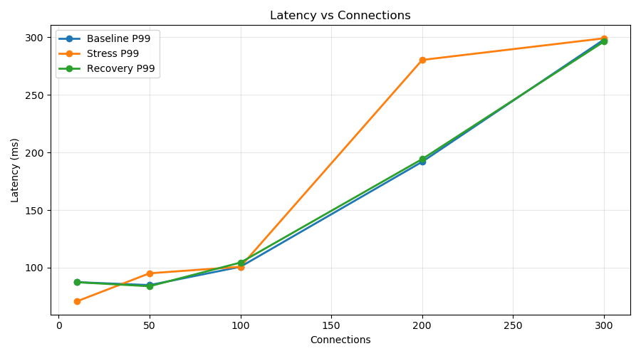
On a single node, CPU stress causes p99 latency to spike 43% at 200 connections (195ms → 280ms) due to direct kernel scheduler contention between the Flask app and cpu-stress. Recovery phase returns to baseline, proving the degradation is fully reversible.
Single Node Results

Slide 7
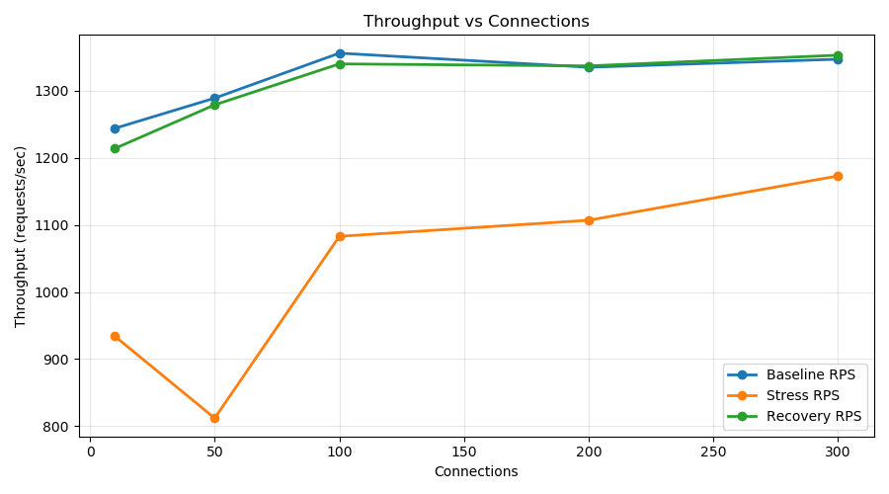
On a single node, despite p99 latency appearing similar at low concurrency, cpu-stress causes a 37% RPS collapse at 50 connections (1290 → 810 RPS) — revealing that the system is silently degrading throughput while masking latency impact. This demonstrates that RPS drop is a more sensitive indicator of CPU starvation than tail latency alone.
Single Node Results

Slide 8
Single Node Observations
Latency & Growth
p99 latency increases steadily with load
No sudden spikes; smoother growth than multi-node
Reaches ~300 ms at high connections
Tail latency exists even without network effects
Throughput & Capacity
Increases initially but plateaus early
System hits capacity limit quickly
No sharp drop → no network overhead
Key Technical Insights
• Resource Saturation: Indicates CPU saturation on the same node
• Performance Bottleneck: Limited mainly by CPU contention
• Root Cause: Kernel scheduling and local contention are sufficient to cause p99 issues

Slide 9

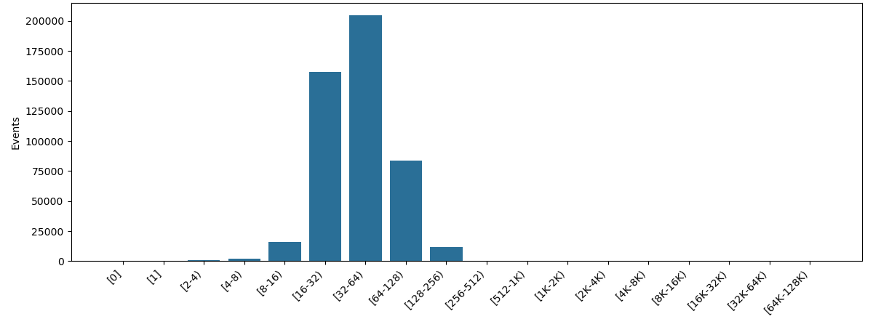
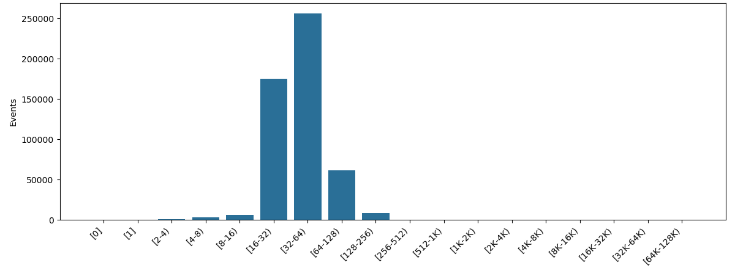
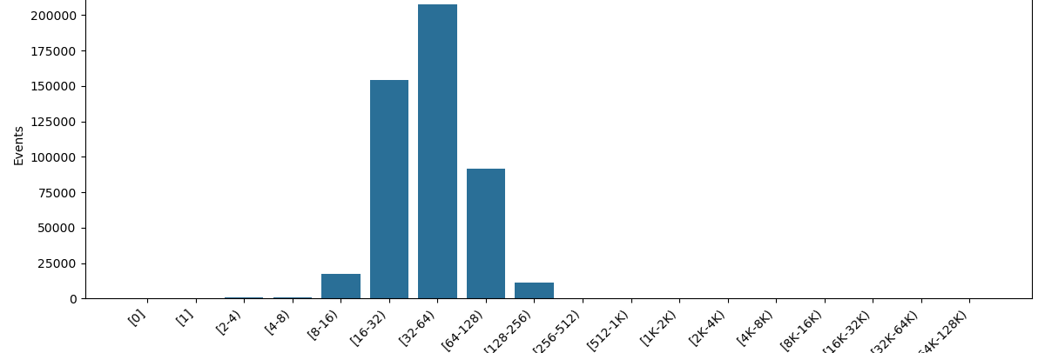
Multi-Node: TCP Probe Send Latency Results
Phase 1: Baseline TCP Send Latency Distribution
Phase 2: Stress TCP Send Latency Distribution
Phase 3: Recovery TCP Send Latency Distribution

Slide 10
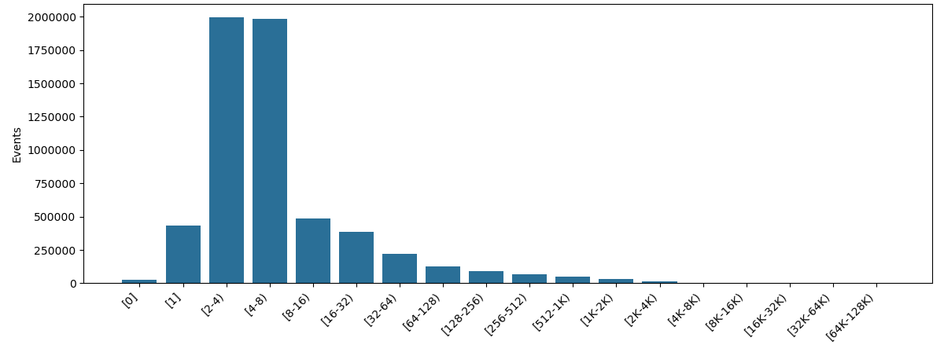
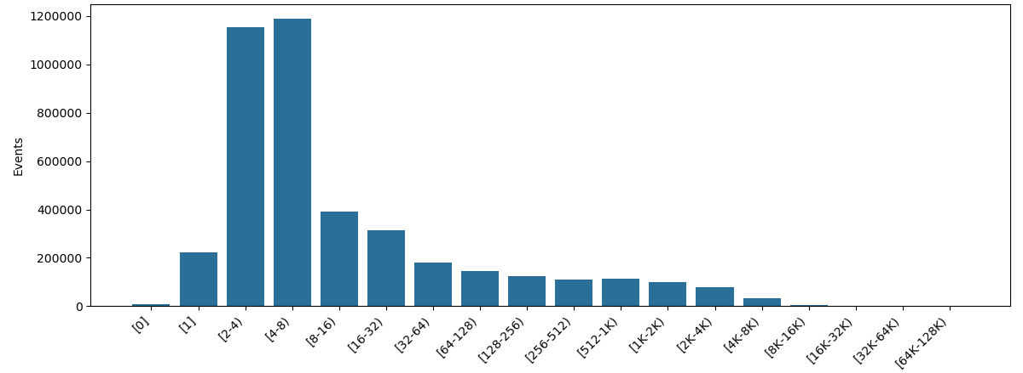
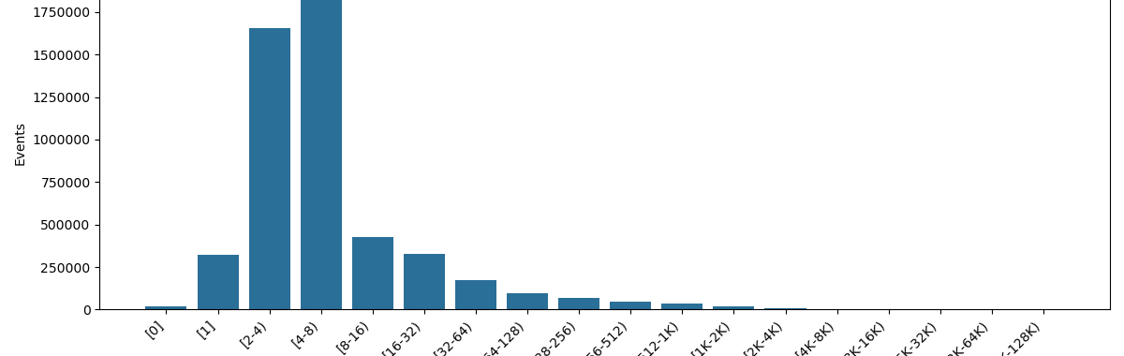
Multi-Node: Run-Queue Latency Analysis
Phase 1: Baseline Run-Queue Latency Distribution
Phase 2: Stress Run-Queue Latency Distribution
Phase 3: Recovery Run-Queue Latency Distribution

Slide 11
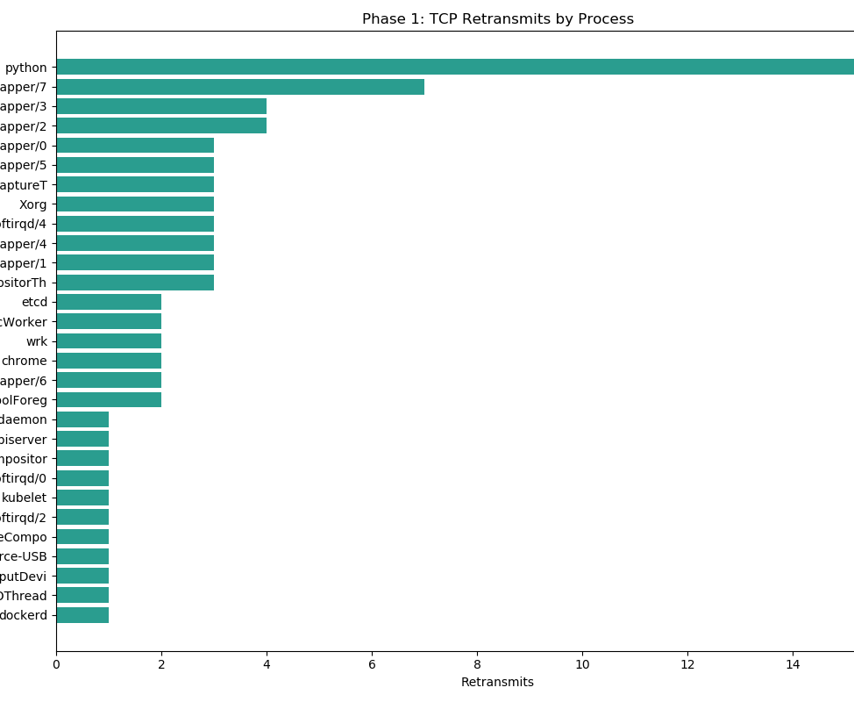
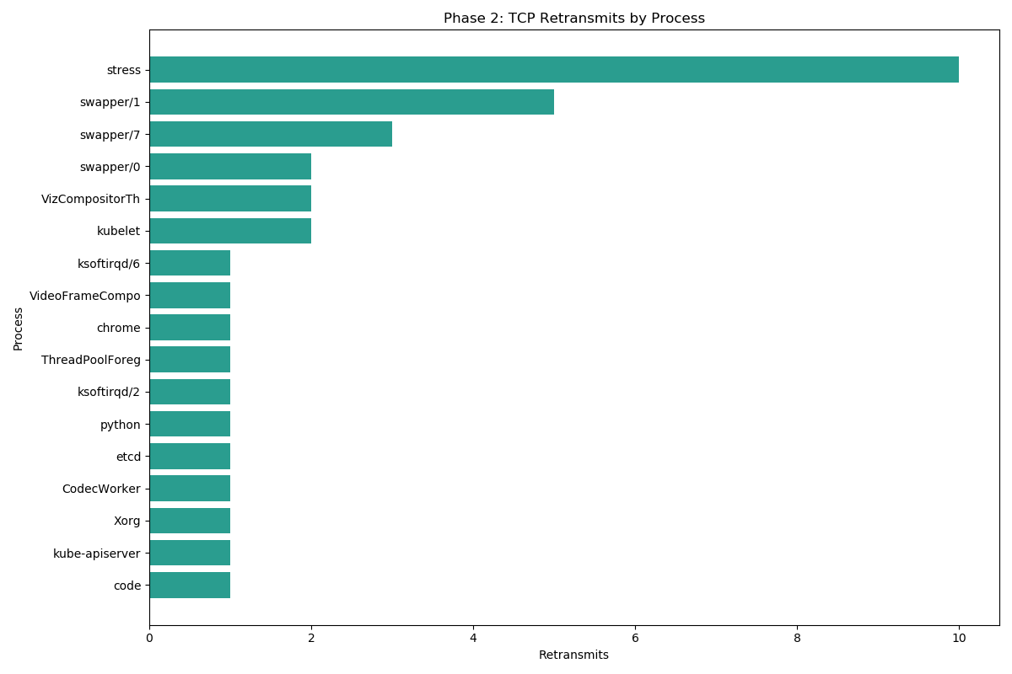
Multi-Node: TCP-Retransmit By Process Analysis
Phase 1: TCP Retransmits by Process
Phase 2: TCP Retransmits by Process

Slide 12

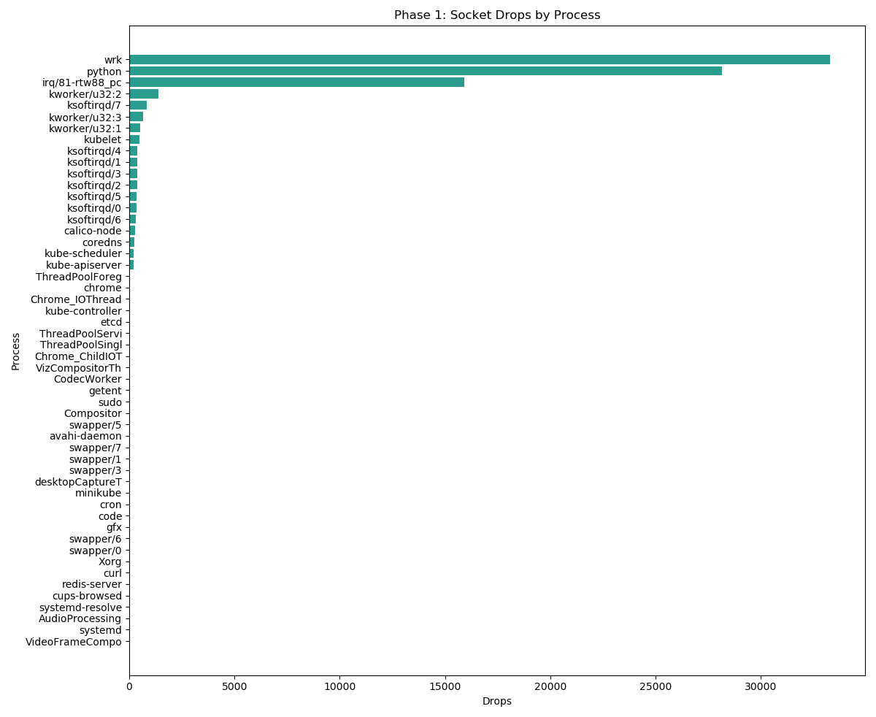
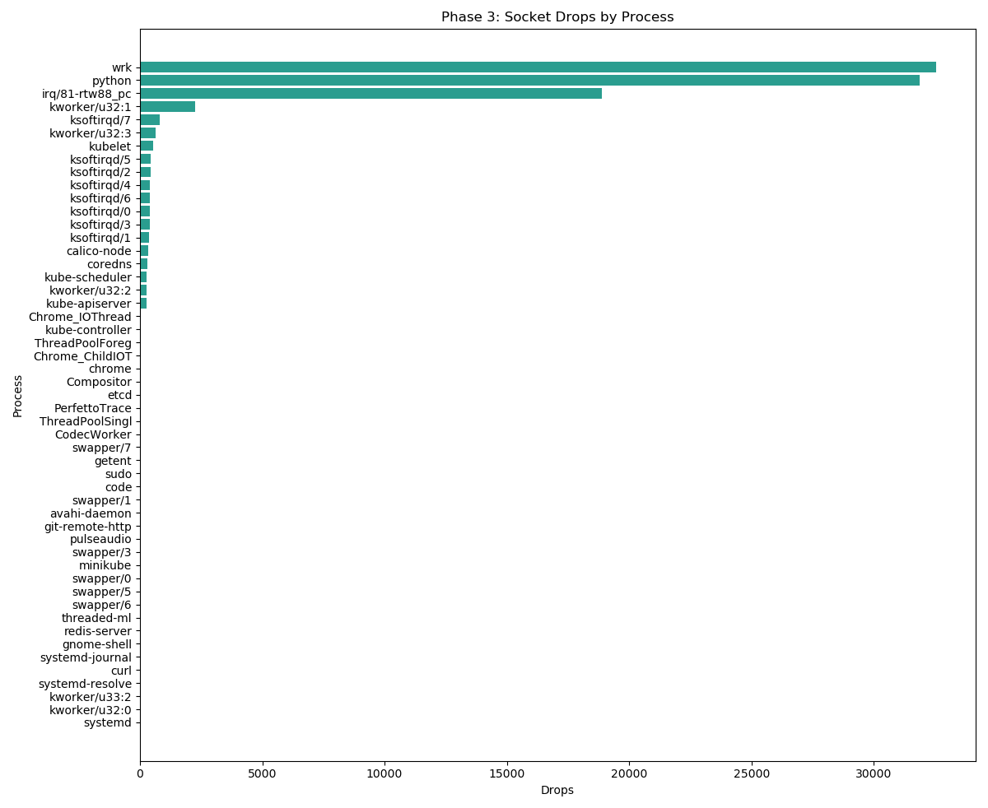
Multi-Node: Socket-Drop Analysis
Phase 1: Socket Usage by Process
Phase 2: Socket Usage by Process

Slide 13
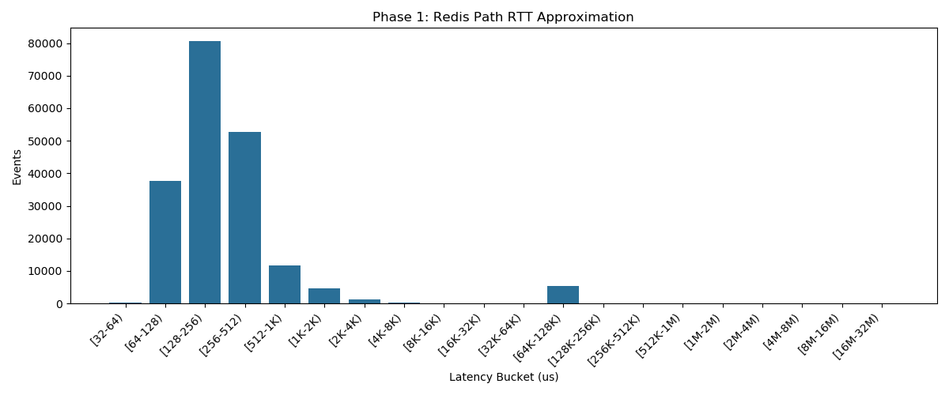
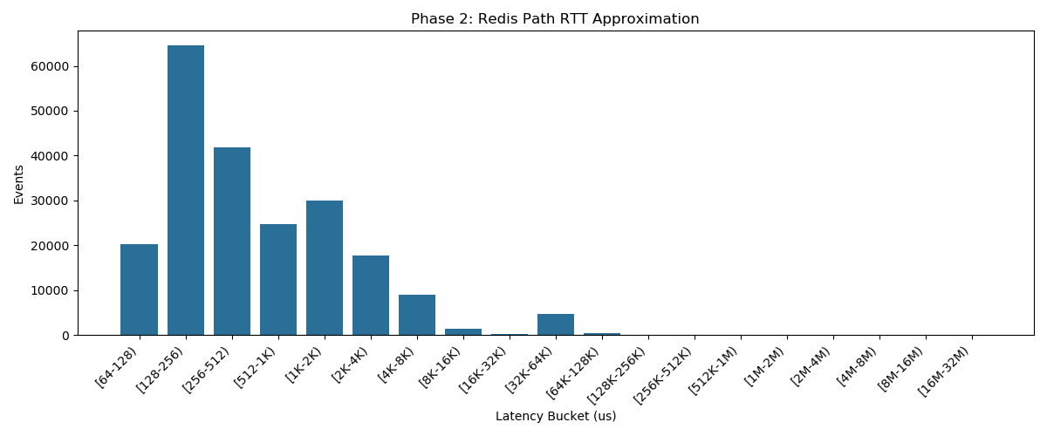
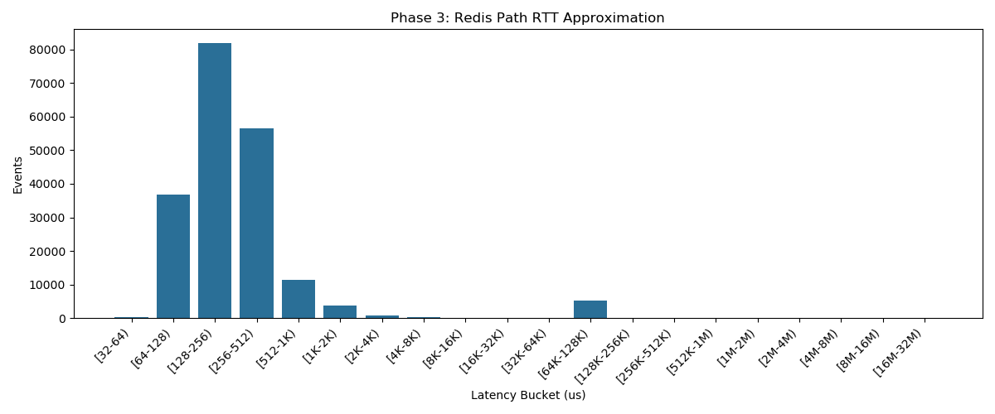
Multi-Node: Probe- Redis Latency Analysis

Slide 14
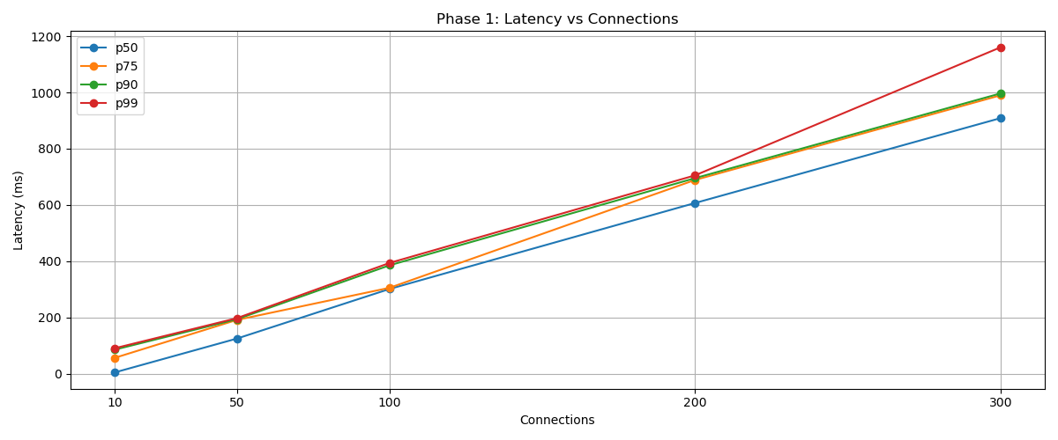
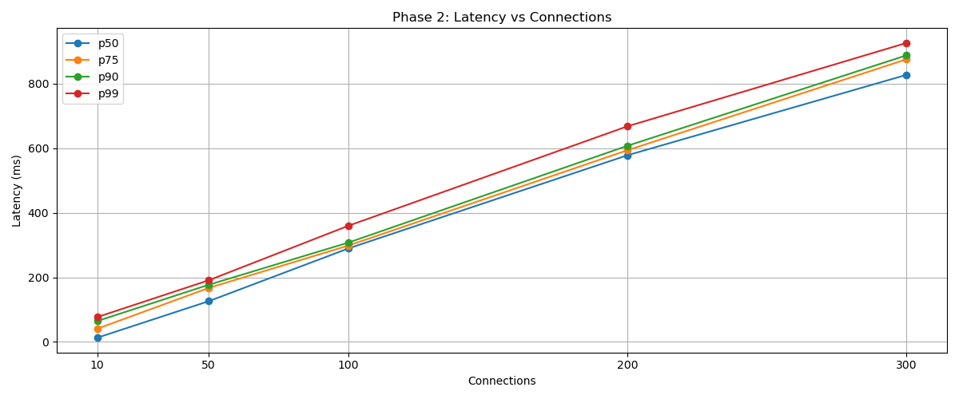
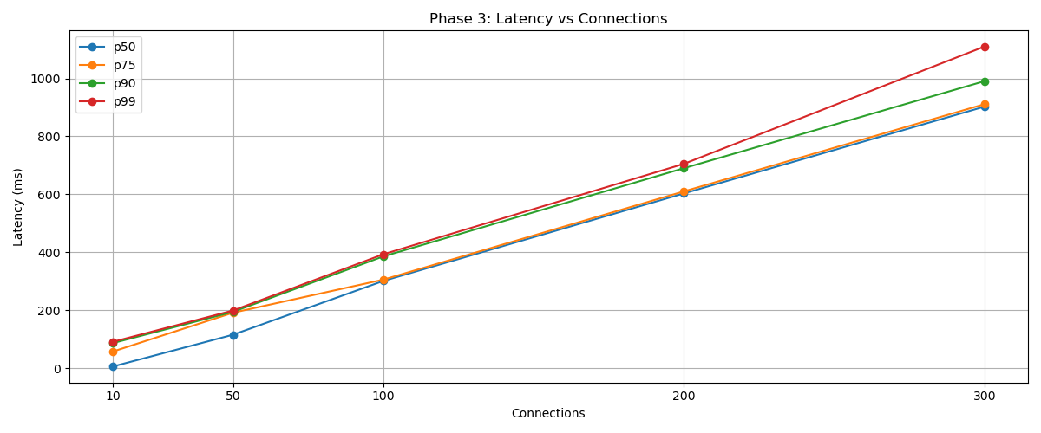
All Phase Latency vs Connections Analysis
CPU stress forces a throughput-latency tradeoff — in Phase 2, the system maintains similar p99 latency only by sacrificing 35% RPS, meaning the kernel is throttling request processing to avoid latency blowup rather than serving at full capacity.
Phase 1: Baseline
Phase 2: CPU Stress
Phase 3: Recovery

Slide 15
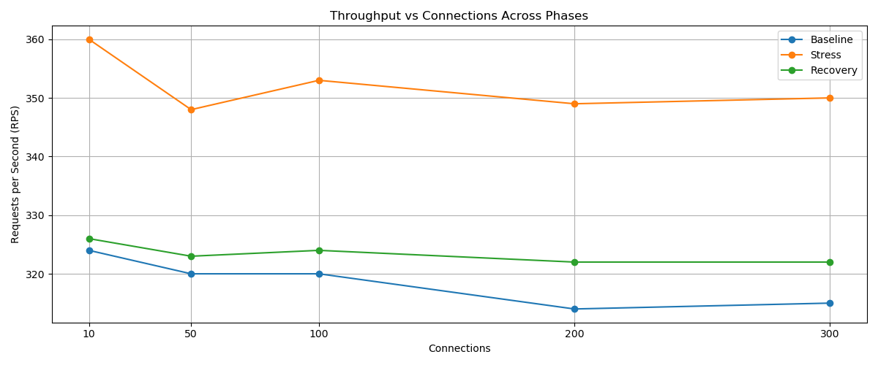
All Phase Throughput vs Connections Analysis

Slide 16
Multi-Node Obsevations
LATENCY TRENDS
Latency increases with load in all phases
STRESS PEAK
Highest p99 during stress (especially 200+ connections)
RECOVERY
Recovery closely follows baseline performance
THROUGHPUT
Significant drop in throughput under stress
CONSISTENCY
Baseline and recovery remains similar
ROOT CAUSE
CPU contention impacts system performance
Conclusion: CPU resource management is critical for maintaining multi-node stability.

Slide 17
Single vs Multi Comparison
Single Node Configuration
Multi-Node Configuration
Contention Model
Strong CPU contention occurs as all processes compete on the same physical node.
Performance Impact
Shows more severe performance degradation under high load conditions.
Contention Model
Partial isolation across nodes significantly reduces the impact of resource contention.
Performance Impact
Results in more stable performance and predictable latency profiles.
Key Takeaway: These results highlight the critical importance of node-level isolation for system stability.

Slide 18

SLO Impact
SLO Targets
Observations
Service Level Observation
P50 ≤ 50 ms
P99 ≤ 100 ms
●Violations at most load levels
●Especially severe under stress

Slide 19
Correlation Between p99 Latency and Kernel Events
Observation
Insight
Conclusion
Spikes at 100 connections:
p99 latency (~607 ms)
CPU scheduling delay
TCP send latency
Socket drops & Redis RTT
Events co-occur at the same load and phase.
Indicates multiple kernel-level bottlenecks across the stack.
Tail latency (p99) is driven by a combination of CPU contention, network delays, and backend latency — not a single factor.
Key Finding: Latency is a multi-factor issue requiring holistic analysis.

Slide 20
Mitigation Strategies
CPU Isolation (Reduces run-queue latency / CPU contention)
Pod Anti-Affinity (Prevents co-location of stress and application pods)
Priority Scheduling (Ensures critical pods survive under system pressure)

Slide 21
Conclusion
Observability Gap
Latency Origins
Kubernetes metrics are not enough. Standard monitoring fails to capture fine-grained system behavior.
Tail latency comes from kernel behavior in our experiment.
Tooling Insight
Primary Bottleneck
eBPF reveals hidden root causes. It provides the necessary visibility into kernel interactions.
CPU scheduling is a key bottleneck in our experiments. Contention at the scheduler level is the most significant performance drag.
Thank You

