Slide 1
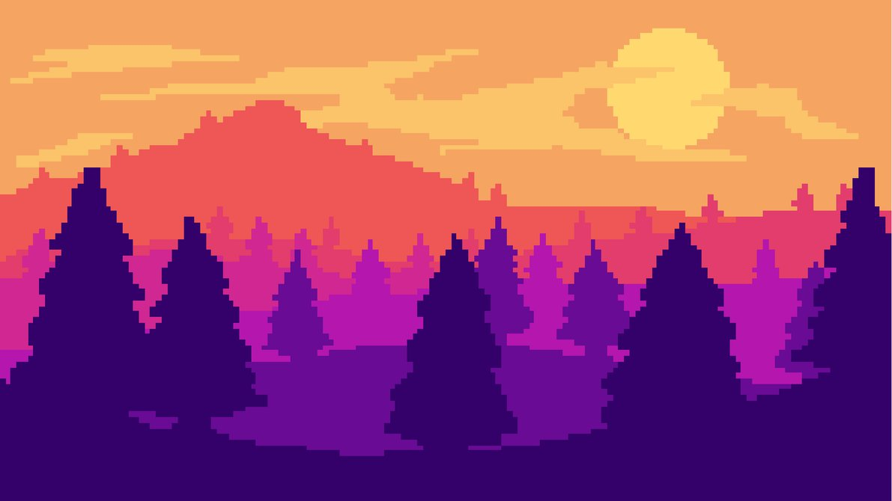
Game Art Intensive

Slide 2
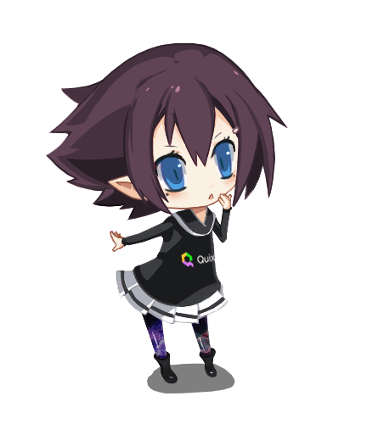
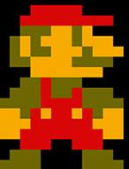
Today we’re going get accustomed to some concepts for 2D game art!
Words of the day:
#OUTLINE
#PALETTE
#SPRITES
#GIF

Slide 3
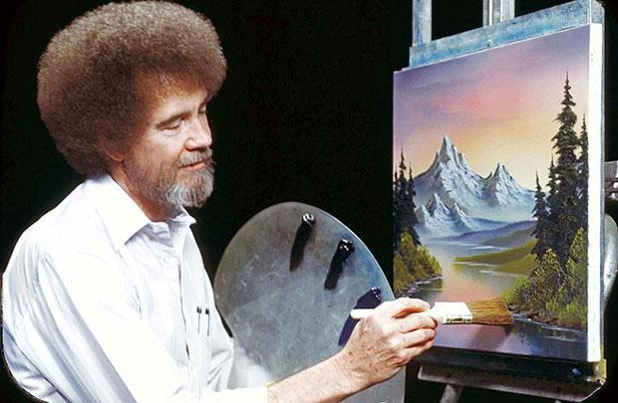
#PALETTES
A palette is an artist’s crayon box.
A palette is by definition a place to keep your colors.
Originally a palette was nothing more than a bit of wood where an artist would place their paints, and mix them as well.
By default, Photoshop allows us to work with a full 24bit color palette (Bajillions of colors!).
Just think of what a renaissance painter would have thought of Photoshop.

Slide 4
#PALETTES
A palette is an artist’s crayon box.
For older games, and pixel art games of today, color palettes are much more restrictive.
In general, during the 8-Bit NES days, the average color depth allowed for 12 colors per sprite.
During the 16-Bit SNES/Genesis days, the color depth allowed for 256 colors per sprite.
Photoshop lets us set our color depth from “RGB” to “Indexed Color” with a max of 256 colors.
Indexed Color mode also allows us to create our own Palettes as well!

Slide 5
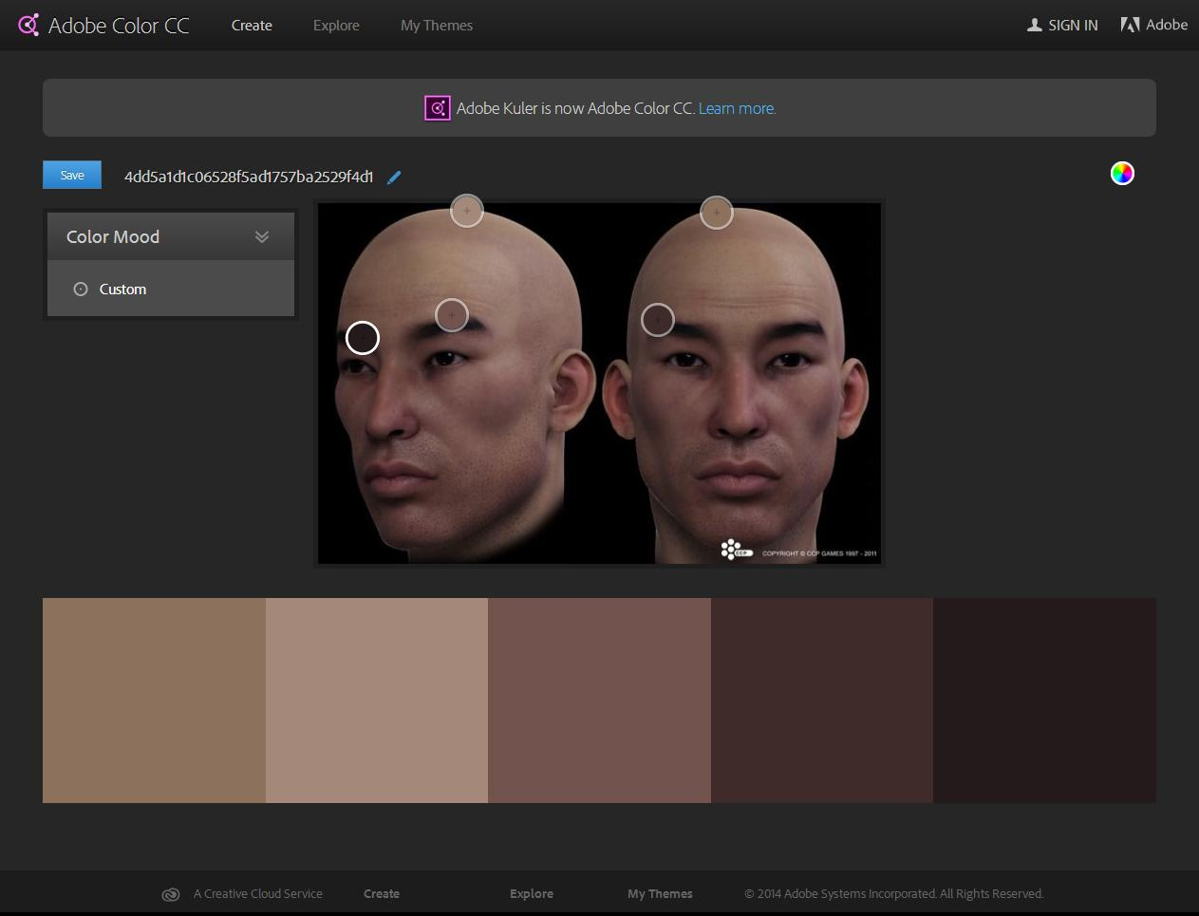
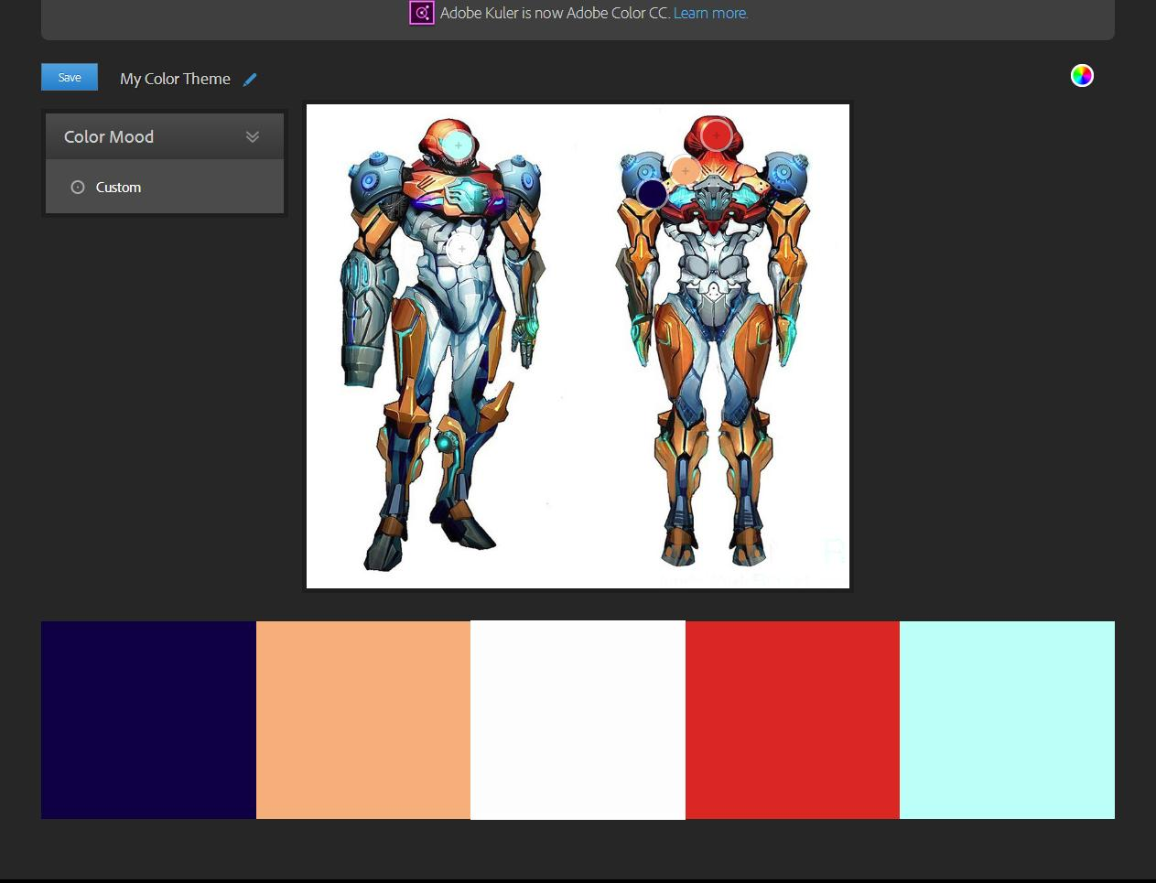
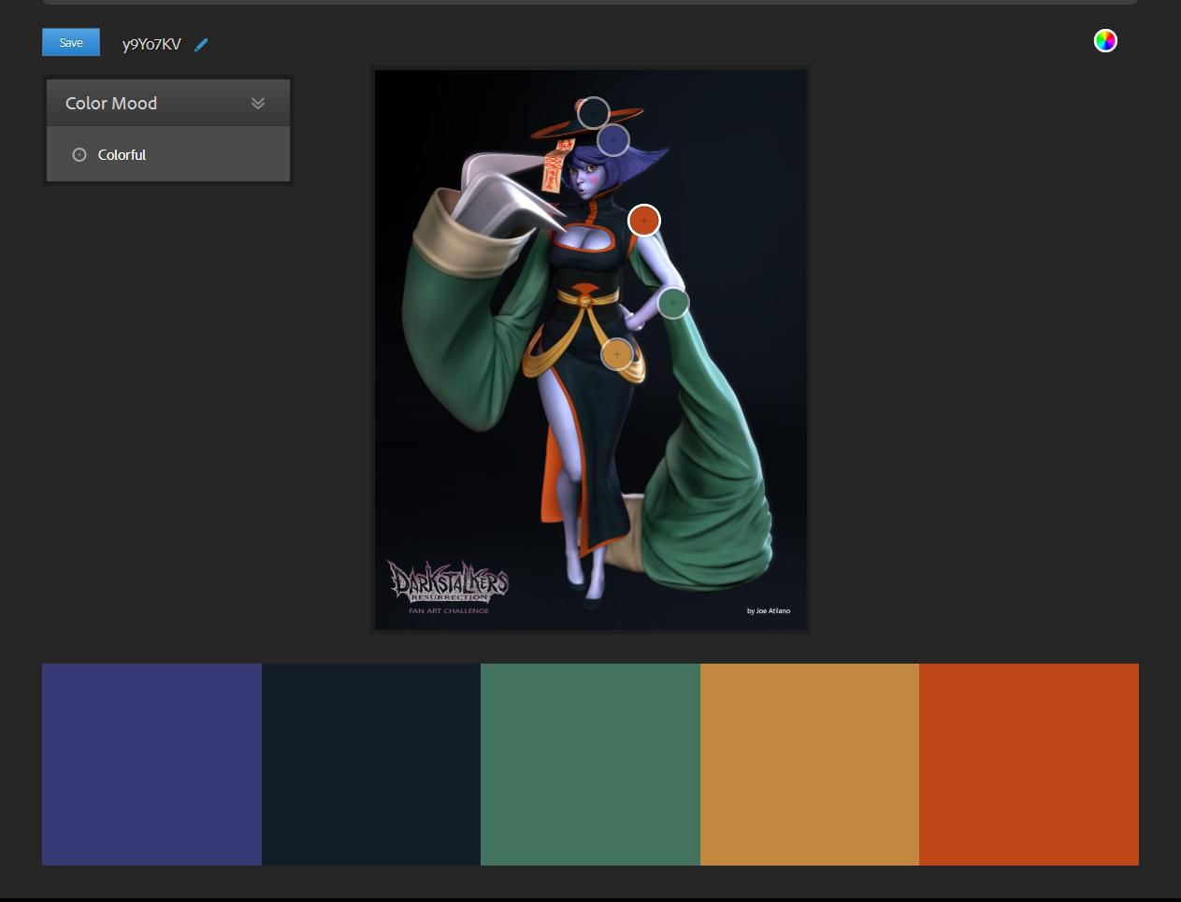
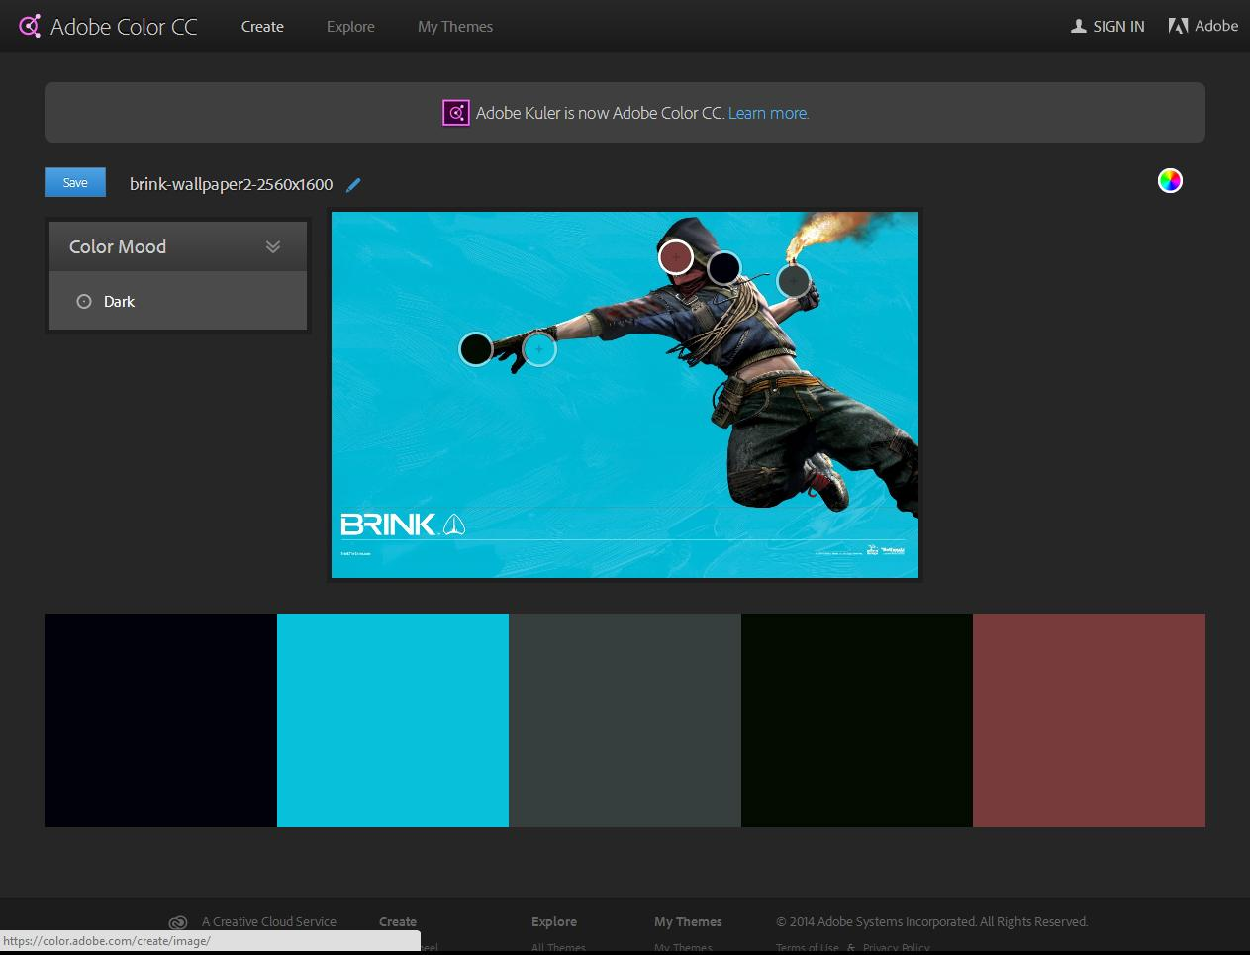
#PALETTES
https://color.adobe.com allows you to create a palette from any image file.

Slide 6
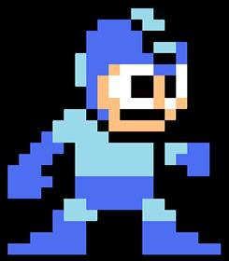
#SPRITES
Originally the art form was created out of limitations and necessity.
Today 2D game art is a stylistic choice or sometimes even a budgeting choice.
Sprites are collections of 2D images which can then be combined in engine to create the game assets.
You can have sheets of animated Sprites, as well as static Sprites for props and backgrounds.

Slide 7
#SPRITES
Originally the art form was created out of limitations and necessity.
Sprites can be based on 2D Pixel art, pre-rendered 3D images, or even captured film performance.
Think of Mario Brothers, Donkey Kong Country, or the old Mortal Kombat games.
Sprite sizes (*And also texture sizes for 3D art) use “Power of 2” or square sizing.
Computers REALLY like powers of 2.
Sprites and texture size range from 16x16, 32x32, 64x64, 128x128, 256x256, etc. pixels.

Slide 8
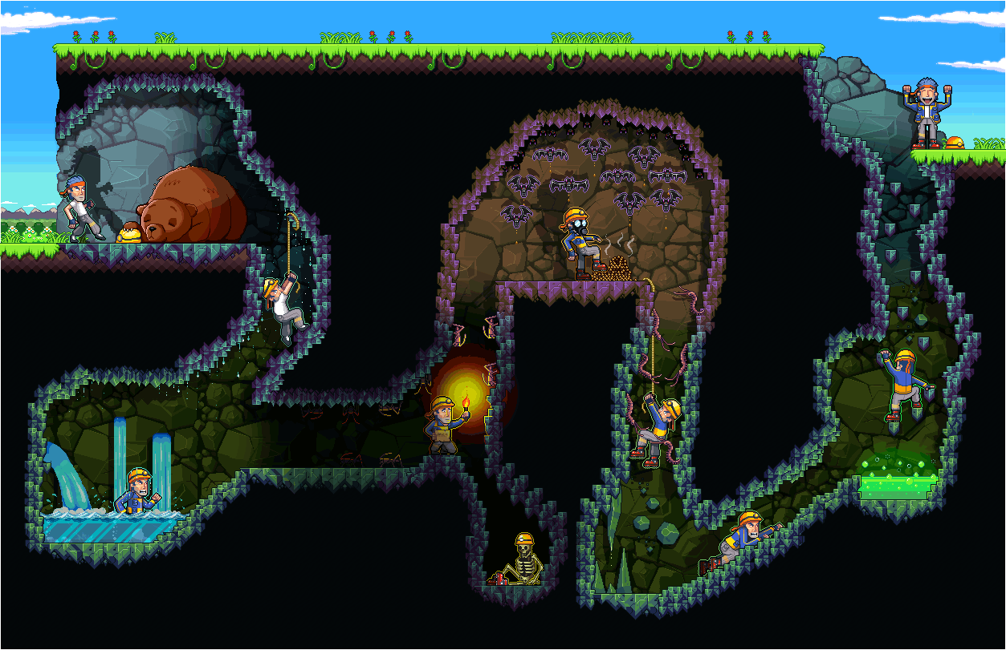
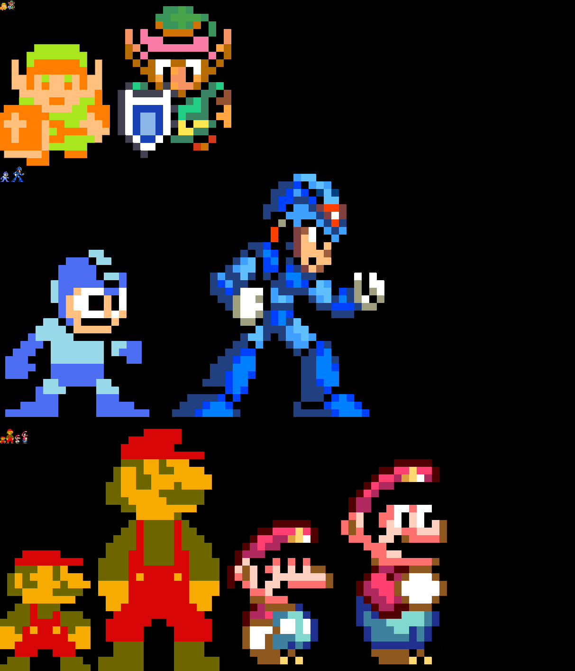
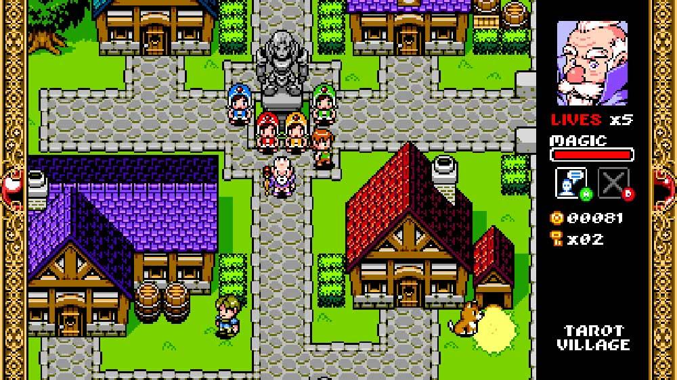
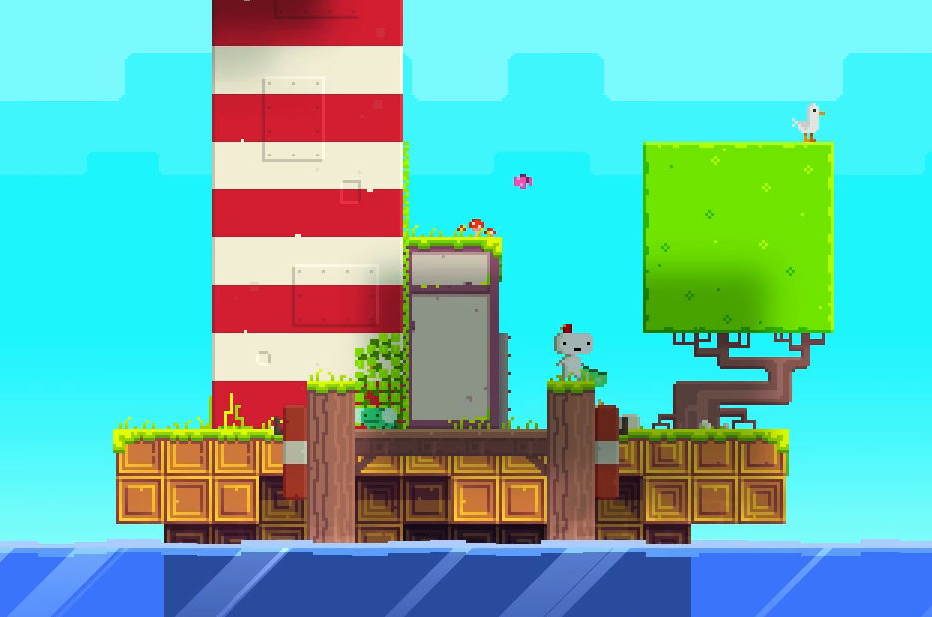
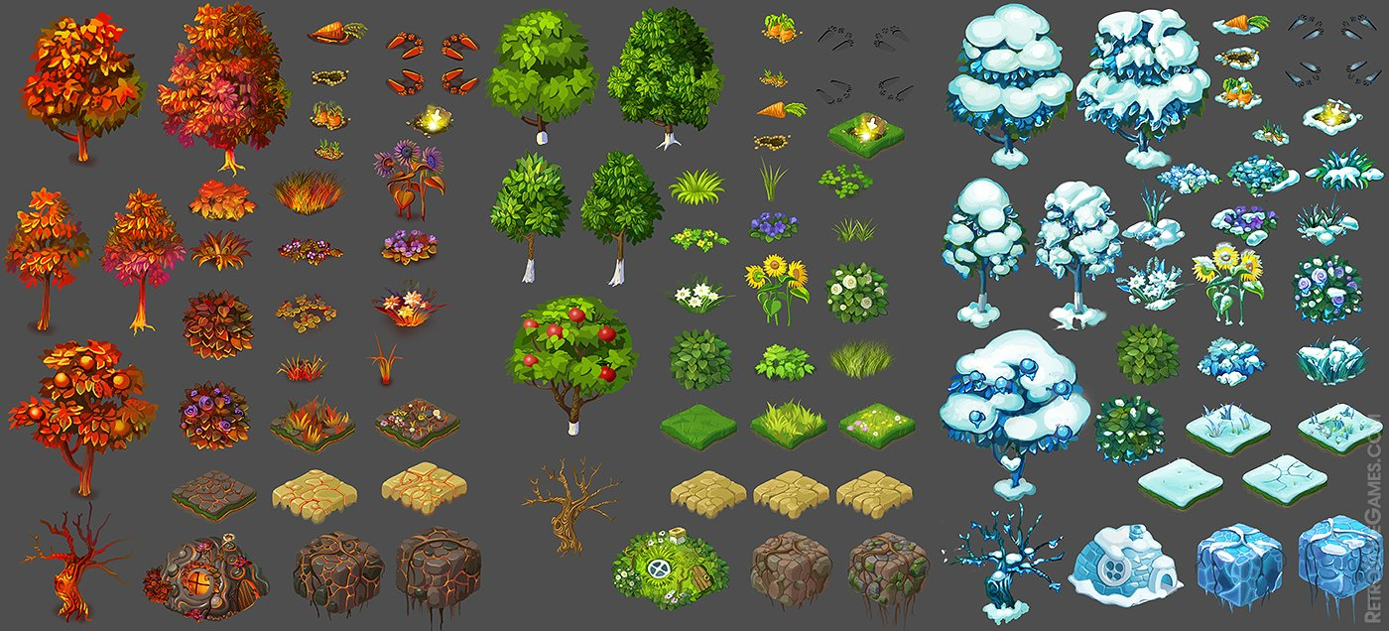
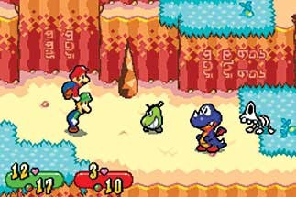
Painted Sprites

Slide 9
#SPRITES
Originally the art form was created out of limitations and necessity.
Things to consider:
Perspective is important (camera position).
Is the game a “Side Scroller” (Mario Brothers), “Top down” (Old Zelda) view, Isometric (Most tactics games) or First Person Shooter (Insert generic green/brown palette)
Light Source: Day or night, location and direction
Where ever the light is determines your shading, shadows and highlights.
Ensure consistency across all of your assets.
If there’s a level where you want to change lighting, realize the hit you are going to take on redoing art treatments.

Slide 10
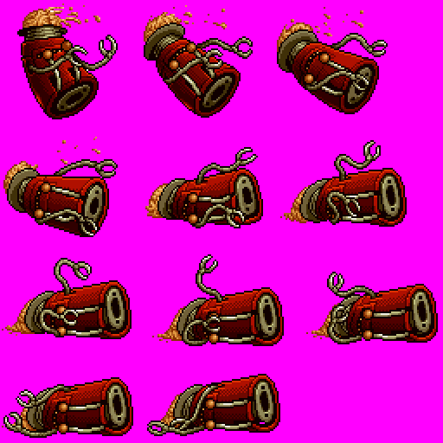
#SPRITES
Sheets. Sheets and and sheets of SPRITES!
-Sprite sheets are a single “texture map” that can contain multiple images or animation frames.
-This sprite sheet is a single character sheet.
By the looks of it, it’s from Metal Slug.
-This sheet is an example of a single character, in an animated sequence.
-This is the simplest type of animated sprite sheet. It also is one of the lowest cost to performance!

Slide 11
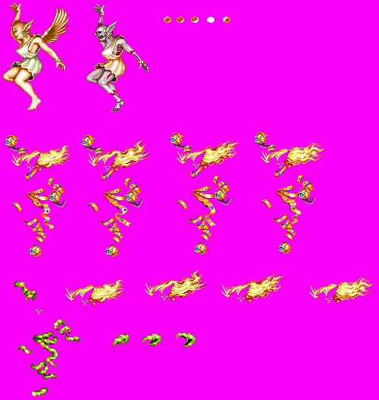
#SPRITES
Sheets. Sheets and and sheets of SPRITES!
Another type of sprite sheet is a Composite sheet. This is two sprites fixed one on top of another.
Usually used to add more detail to a character, or for things such as damage or armor.
For each part that breaks apart, that specific part would have to be saved out in it’s own specific image file. This can get pretty processing intensive.

Slide 12
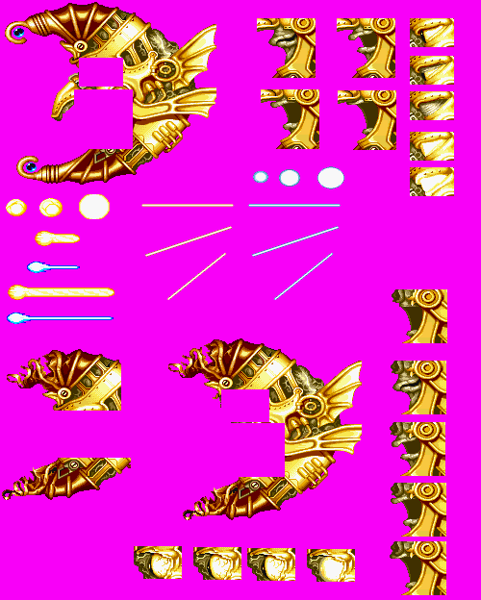
#SPRITES
Sheets. Sheets and and sheets of SPRITES!
A character that is entirely made drawn as a background.
You must draw every part every frame. There is nothing behind the mouth or eyes. So if you wanted the mouth to be destroyed, a artist would have to draw the mouth in a destroyed state.
-The best choice if you had a boss character that was the entire screen/level.

Slide 13
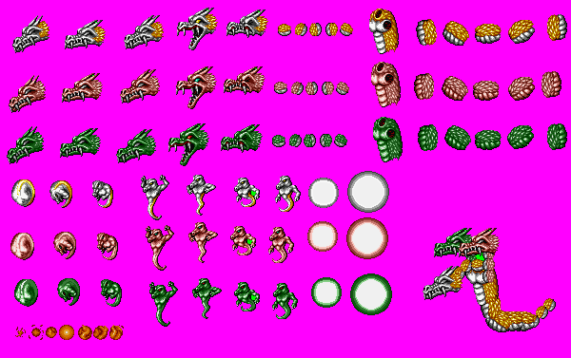
#SPRITES
Sheets. Sheets and and sheets of SPRITES!
Hierarchal sprite sheets.
A group of sprites clustered together to appear to be a single bigger sprite.
These are usually animated programmatically, this is the fastest known way to be hated by programmers.

Slide 14
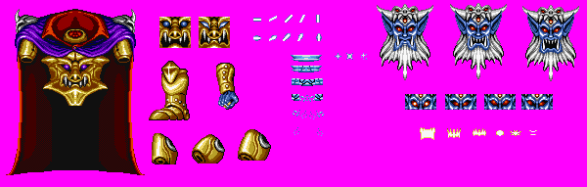
#SPRITES
Sheets. Sheets and and sheets of SPRITES!
Background Hybrid:
-Background and sprites are used together to achieve extremely large characters (Or bosses).
-Works great for large characters or characters that have destructible parts.
-Works like a puppet on strings, each part can move independently on it’s own pivot.
-Unlike the Hierarchal sprite, this character is made up of both sprites and background.

Slide 15
#SPRITES
Why is this important to a you ?
Know what you have to work with, and know what you’re asking for from your programmers/designers.
Each situation is different, knowing what type of sprites to use, and how much memory you are using can make or break a design.

Slide 16
#SPRITES
Why is this important to a you ?
It is extremely costly for artist to fix or redo art due to a design error. Sometimes it can’t be avoided, but if a designer understands the fundamentals then the frustration level is kept to a minimum leaving more time for improvements and leading to less design cuts at the end.
It is important to understand how memory and frame-rate will affect a game experience when making 2D games. The designer must always have a clear vision of the scope of their game and be flexible enough to make design changes when necessary.

Slide 17
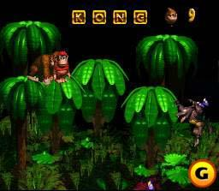
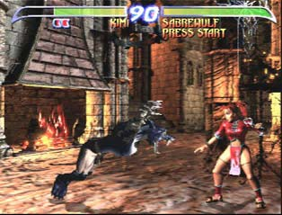
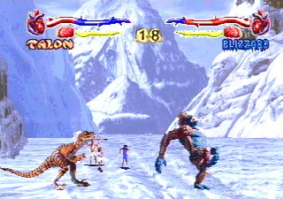
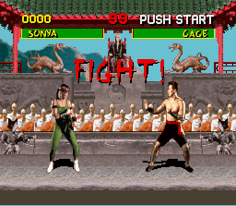
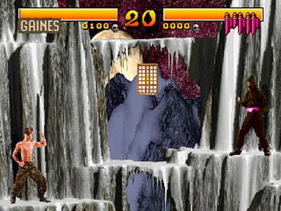
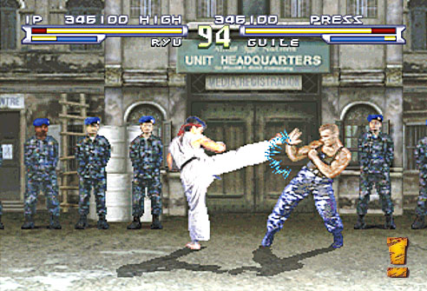
Rendered Sprites

Slide 18
#GIF
The old school animated GIF!
We can thank the internet for the animated GIF file.
The “Graphics Interchange Format” was introduced in 1987.
It has a limited color palette of 256 colors, and yet it supports animation!
Photoshop allows us to output our animations as GIF images.

Slide 20
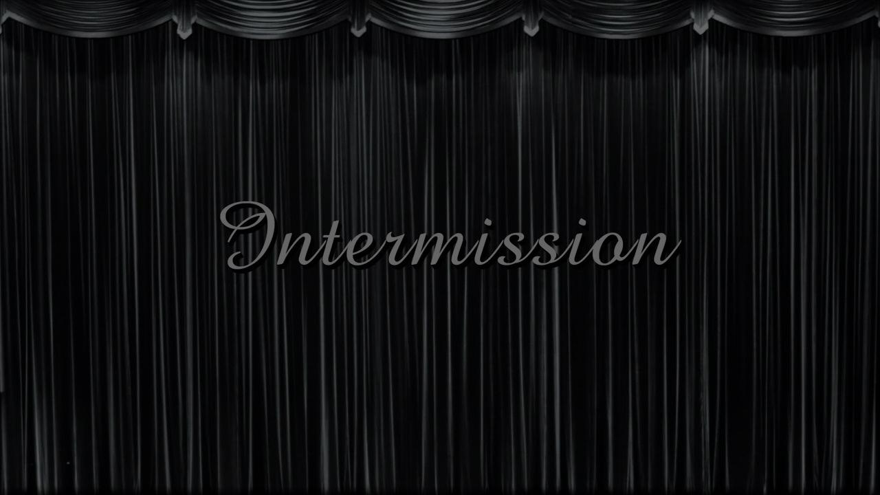
#INTERMISSION
Time for a little Q & A

Slide 21
#PALETTES
A Palette is an artist’s box of crayons.
Creating a Palette in Photoshop is actually pretty easy.
The easiest way to create a palette is to take one from an image that has colors you like.
We can do that by loading the image in Photoshop, and forcing Photoshop to compress the colors.
I’ll give it a quick demo, and we’ll extract a palette in class.
We can also use the Adobe online palette picker tool to pick key colors from any image.
We can also save out our palette/swatches for use later!

Slide 22
#SPRITES
Originally the art form was created out of limitations and necessity.
Let’s create some pixel art sprites!
We’re going to go over making a simple isometric building in class.
Our first assignment will be to make an isometric avatar of ourselves, so pay attention. ☺
Create a small blank image in Photoshop (64x64 is fine for this exercise. Power of 2!!!)
Let’s turn on our grid to give us a hand with placing our pixels, and then get to work!
Let’s set our color palette in the “Mode” menu, and start painting.
For this, and our assignment, we will limit our palette to just 16 colors.

Slide 23











#SPRITES
But what if I can’t draw???
As with any problem, this is easiest when broken down into bite sized chunks!

Slide 24
#SPRITES
But what if I can’t draw???
Zoom in close in Photoshop an check out the actual pixels of the images.

Slide 25
#GIF
The old school animated GIF!
We’ll briefly go over creating animation frames in Photoshop, and how to save out the GIF file.
It’s pretty easy to do, but as with anything, you need to do it a couple of times to get it.
Let’s do a simple ball bounce in class!!!

Slide 26
RESOURCES
After:
Build a Pixel Building: http://www.idigitalemotion.com/tutorials/guest/pixel/pixel.html
Dithering/Shading: http://fc08.deviantart.net/fs24/f/2007/317/b/9/DITHERING_TUTORIAL___Basics_by_kitted.png
Pixel art anime eyes: http://fc05.deviantart.net/fs71/f/2012/127/e/0/pixel_eye_tutorial_by_topachi-d4yui7a.png
Isometric building: http://design.tutsplus.com/tutorials/create-an-isometric-pixel-art-apartment-building-in-adobe-photoshop--cms-23006
Isometric car: http://design.tutsplus.com/tutorials/how-to-create-an-isometric-pixel-art-vehicle-in-adobe-photoshop--cms-22550
Isometric character: http://design.tutsplus.com/tutorials/create-an-isometric-pixel-art-character-in-adobe-photoshop--cms-21825
Funny tutorial: http://fc06.deviantart.net/fs15/f/2007/104/d/2/Titan_Statue__Tutorial_by_The_Titan.png
Great read: http://gas13.ru/v3/tutorials/sywtbapa_almighty_grass_tile.php
Great read: http://www.pixeljoint.com/forum/forum_posts.asp?TID=11299

Slide 27
Build an Avatar!

