Slide 1
ICT111 · FINAL PITCH
SmartTimetable
A live, self-correcting class schedule for RIC — students always know whether their next class is actually happening.
MVP
Real testers, real fixes
Team Digitry.
July 2026
Notes:
Open with the one-line pitch: RIC's timetable is out of date the moment it's printed. We built the fix.

Slide 2
01
The problem, and who feels it
A schedule nobody trusts, and three groups stuck compensating for it.
Notes:
Frame the two-part opener: what's broken, and who it breaks for.

Slide 3

01 · PROBLEM
CONFIRMED IN LAB 03 DISCOVERY
76%
of 21 RIC students, lecturers, and staff surveyed rated a real-time timetable alternative 7/10 or higher in potential value — the static PDF doesn't update when a class is cancelled, moved, or double-booked, and changes spread informally through group chats, if at all.
Notes:
The static PDF timetable is the root problem. Cancellations and room changes spread informally, if at all. Cite the Lab 03 discovery numbers.

Slide 4



01 · TARGET USER
Three groups feel this daily
Primary — Students
Secondary — Lecturers
Tertiary — Admin & Staff
Feel the problem most often and most directly — turning up to a class that isn't happening.
Need one channel to publish a change instead of repeating it across several group chats.
Review reports and keep the master schedule accurate over time.
Notes:
Three groups, one shared problem, ordered by who feels it most.

Slide 5
02
Evidence, and the promise
Three rounds of testing, and the single sentence the product has to deliver on.
Notes:
Second part: proof the problem is real, and the promise we're making back.

Slide 6
02 · EVIDENCE
Validated across three testing rounds
ROUND
METHOD
RESULT
Lab 03
21-response survey
Confirmed the problem is real, not assumed
Lab 08
7 testers, task-based
95% task success, 4.5/5 usefulness rating
Lab 13
Real-device mobile retest
Two Critical usability issues found and fixed
Notes:
Three separate testing rounds, each building on the last. Emphasize this isn't a one-off survey — it's a validation trail.

Slide 7
02 · VALIDATION RESULTS
Measured, not projected
95%
4.5/5
95%
2/2
Task completion
Usefulness rating
Would use again
Critical issues fixed & re-verified
Report form validation visibility and admin edit field order were fixed and re-verified before this submission — not left as future work.
Notes:
These aren't projected numbers — they're measured results from Lab 08, re-verified after the Lab 13 fixes.

Slide 8
02 · VALUE PROPOSITION
Always know if your next class is actually happening
For RIC students who experience unreliable, outdated class schedule information, SmartTimetable gives every class a live status label and a one-tap way to report a mismatch — no personal information required.
Notes:
Read this close to verbatim — it's the core pitch statement.

Slide 9
03
The product, and the model
What we actually built, and why it's worth building on.
Notes:
Third part: the working product, and how it creates value.

Slide 10
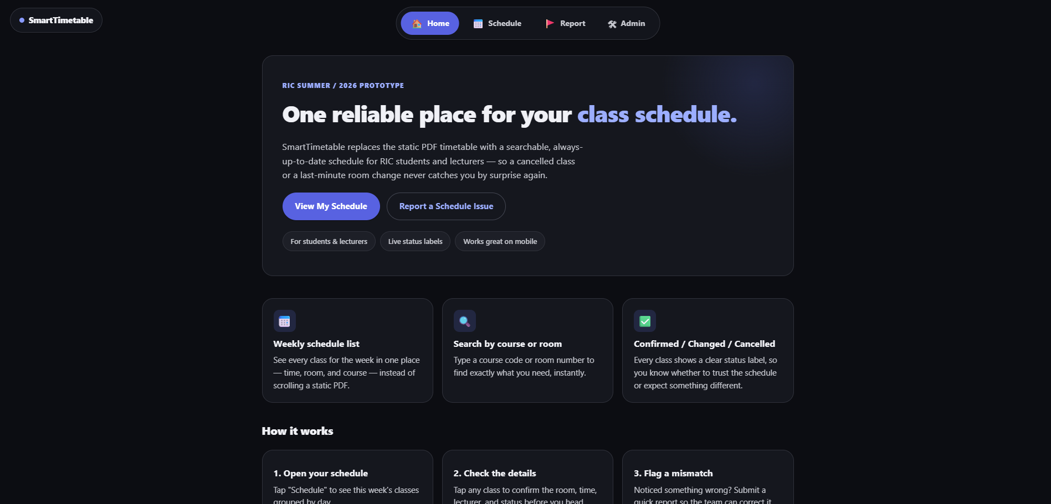
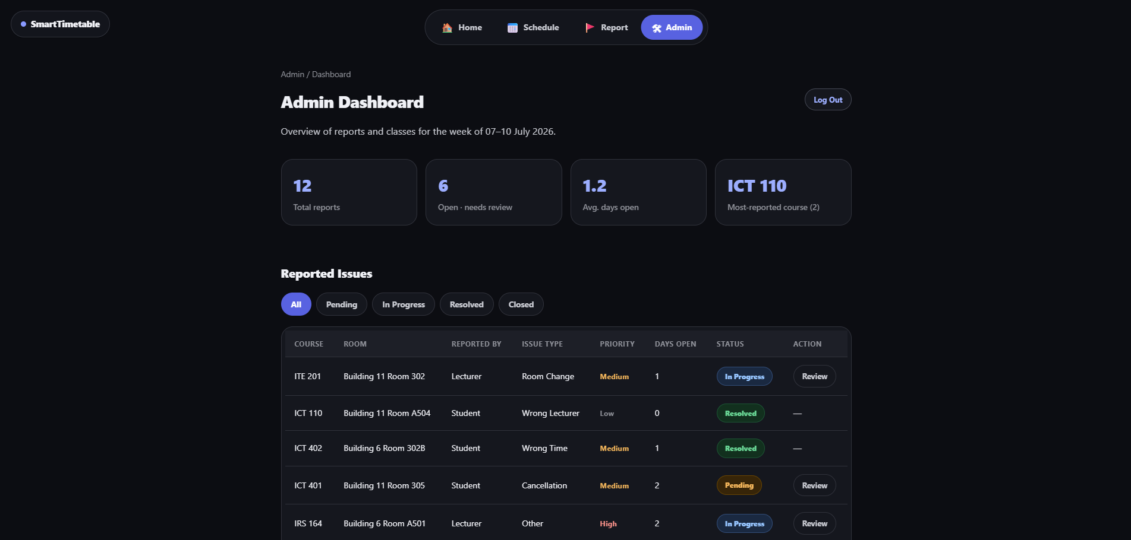



03 · PROTOTYPE
A working app, not a mockup
Student view
Admin view
Check status in seconds
One-tap mismatch report
Live admin dashboard
Notes:
This is a working prototype, not a mockup — validated with real testers at every stage. Drop in screenshots of the student and admin views here.

Slide 11
03 · BUSINESS MODEL
A self-correcting information loop
Customer Segments
Value Proposition
RIC students, lecturers, and admin/staff.
A live schedule plus a report loop that replaces a low-trust source with a self-correcting one.
Value Captured
How it compounds
Operational efficiency — fewer wasted trips, fewer repeat announcements — not direct revenue, appropriate for an internal university tool at this MVP stage.
The report loop means the system gets more accurate the more it's used.
docs/business-model-canvas.md
Notes:
This is not a revenue play at MVP stage — it's an efficiency play for an internal university tool.

Slide 12
04
Reaching students, and what's next
The rollout plan, and the gaps we're upfront about.
Notes:
Final part: how we reach students, and what's left to build.

Slide 13



04 · GO-TO-MARKET
Reach students where they already are
Class group chats
Campus QR posters
Instagram
RIC student Line group
Where changes already spread informally.
Placed at high-traffic buildings.
Wider awareness beyond direct classes.
Targeted rollout, not a public launch.
docs/go-to-market-plan.md · docs/acquisition-metrics.md
Notes:
Targeted rollout through channels RIC students already use, not a broad public launch.

Slide 14
04 · NEXT IMPROVEMENT
What's next after this MVP
A real backend/database, replacing today's deliberate localStorage simulation
Real admin authentication, beyond the current basic credential check
The remaining 8 of 12 defined startup metrics, not yet visualized on the dashboard
A real channel launch, to replace the current seeded acquisition data
Notes:
Be upfront: these are known, documented gaps at MVP stage, not oversights.

Slide 15
ICT111 · FINAL PITCH
Thank you
SmartTimetable — a live, self-correcting timetable for RIC.
github.com/Ssai-21/ICT111-DigiTry-MVP
Notes:
Thank the panel and point to the repo for the full documentation trail.

