Slide 1
3- System Architecture

Slide 2


Hardware
HW Module:
Architecture
Cloud Server
Firebase
Organize Hex File
Notify Telematic Unit
Check Authentication
UI Unit
Touch Screen
Show Update Message
HTTP
Telematic Unit
Gateway Unit
HTTP
HDMI
Tx
CANH
Raspberry Pi 3 Model B
Stm32f103
Receive and Send User Reply
Esp32
Check Safe Mode
Deliver Hex File to Correct Target
Check Security Principles
Send and Receive User Reply
Parse and Send Hex File
Rx
CANL
OEM Website
Upload Hex File
Target ECU
Target ECU
Client Side
Server Side
Apply Security Bot
Store Cipher File and Digest in Firebase
Stm32f103
Stm32f103
Receive Hex File
Flash Update Using Bootloader
Receive Hex File
Flash Update Using Bootloader

Slide 3

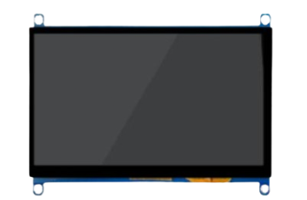
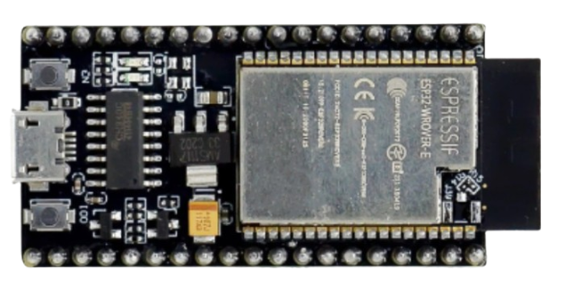
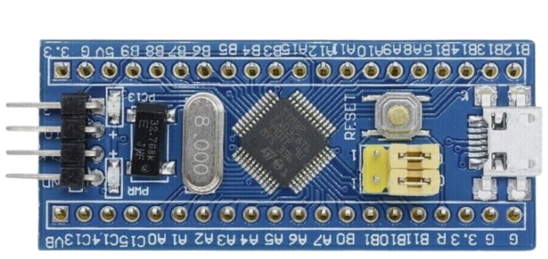
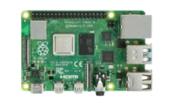
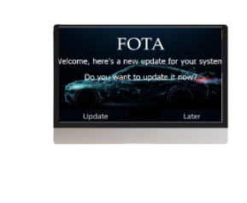
Hardware
Architecture
HTTP
HDMI
HTTP
Tx
CANH
Rx
CANL

Slide 4
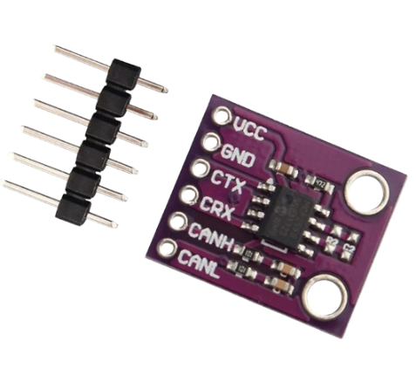
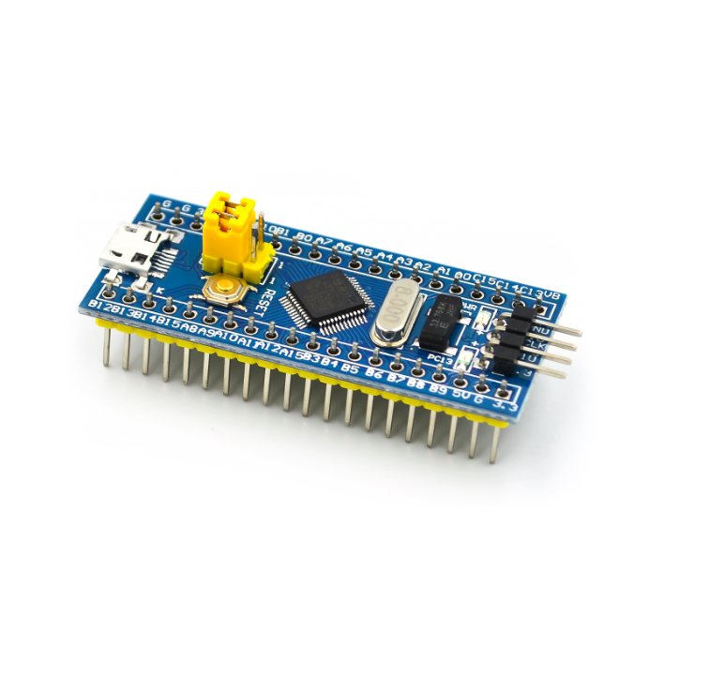
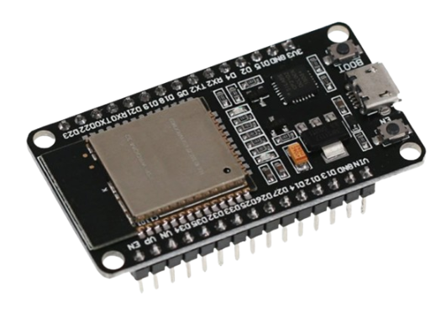
Hardware Specs
Stm32f103
Esp32
Mcp 2551
• Operating at 72 MHz frequency
• Flash memory up to 128 Kbytes
• It offers two 12-bit ADCs
• 3 general-purpose 16-bit timers
• 2x I²Cs.
• 2x SPIs
• 3x USART
• 1x USB
• 1x CAN
Microcontroller Dual Core ,operating at 240 MHz
The SRAM 520 KB
Flash memory: 4 MB
Built-in secure wi-fi module 802.11 BGN HT40
30 GPIO leads, including:
3x UART
3x SPI
2x I2C (2x I2S)
Supports 1 Mb/s operation
High noise immunity due to differential bus Implementation
Up to 112 nodes can be connected
Low current standby operation

Slide 5
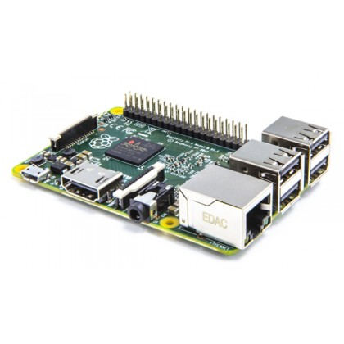
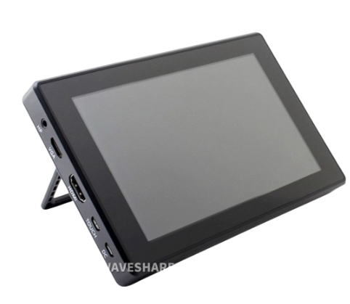
Hardware Specs
Raspberry Pi 3 Model B
7inch Capacitive Touch Screen
• Operating at 1.2 GHz frequency.
• Broadcom VideoCore IV operates at 250MHz.
• 4 USB 2.0 ports.
• Audio output Analog via 3.5 mm phone jack.
• Digital audio signals via HDMI.
• 1GB Kbytes of SDRAM.
• 17x GPIO that can be used as:
• I2C.
• SPI.
• USART.
• I2S audio.
size 7inch
Resolution1024×600
Display Interface HDMI / VGA
Touch Type Capacitive
Audio Output 3.5mm Jack

Slide 6
Software
Architecture
APP
APP
LAYER
BIT MATH
STD TYPE
OS
SERVICE
LAYER
Wi-Fi
SCREEN
SPEED
HAL
LAYER
LIBRARY
Motors
NVIC
DMA
SPI
USART
CAN
RCC
MCAL
LAYER
AFIO
FBEC
SYS-TICK
EXTI
GPIO
TIMER

Slide 7
Cloud Server

Slide 8

Cloud Server
Cloud Server
Firebase
Storage
Real Time Database
Authentication
HTTP
OEM Website
Server Side
Express.js
Node.js
MongoDB
HTML
CSS
JavaScript
Client Side

Slide 9
FIREBASE SERVICES
Firebase is a Google-backend Web app development based on the backend as a service system.
It has the ability to manage data in real-time and provides an enhanced app-usage experience to the users.
We interested in firebase database and firebase authentication

Slide 10






FIREBASE SERVICES
Authentication
Storage
Realtime Database

Slide 11
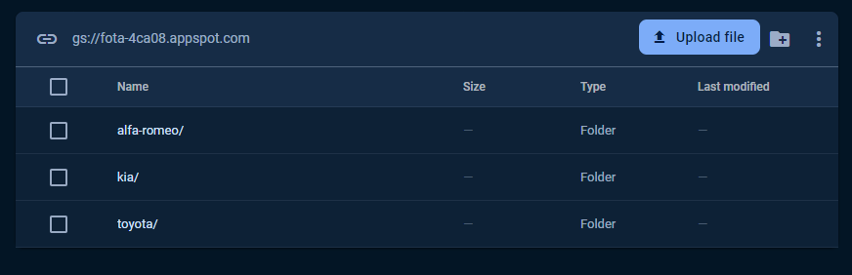
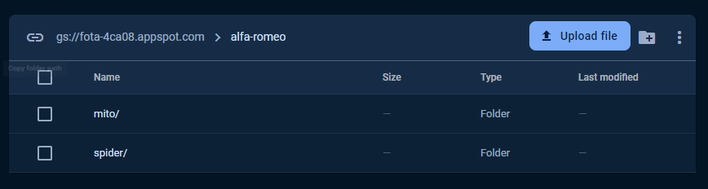
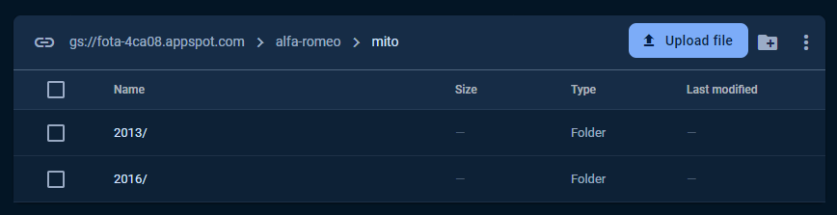
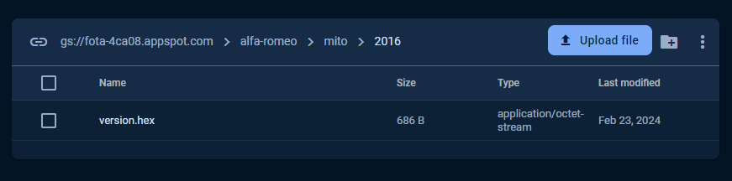
FIREBASE SERVICES
All Brands
All Modules for each Brand
ALL Years for each Module
Update files for each Year

Slide 12
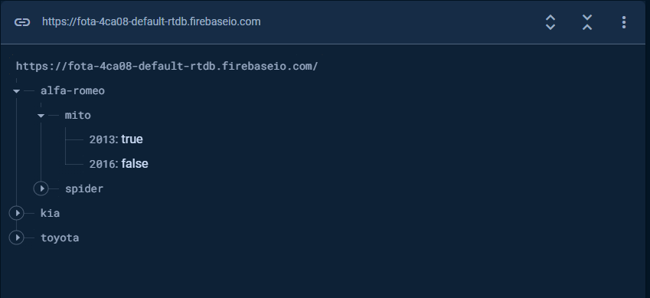
FIREBASE SERVICES
Realtime Database Flags

Slide 13
Telematic unit

Slide 14
Telematic Unit
Cloud Server
Firebase
Storage
Real Time Database
Authentication
HTTP
Telematic Unit
HTTP
Esp32
Tx
32-bit LX6 Microprocessor
up to 240 MHz
802.11,up to 150Mbps
520 KB of SRAM
448 KB of ROM
Rx
OEM Website
Server Side
Express.js
Node.js
MongoDB
HTML
CSS
JavaScript
Client Side

Slide 15

Telematic Unit
Using ESP32 as a Telematic Unit to do four process :
Using WIFI Module to Connect with Firebase to :
Check if we have new update
take a New update and store it in system file memory section
Check Security Principles
Confidentiality
Authentication
Integrity
Notify HMI about new Update
Parsing Hex File and using UART to send Record by Record

Slide 16
Telematic Unit
Connect WiFi
sign in to Firebase
send notification to HMI
Check Realtime Database
True
False
check User Reply
Store notification in HMI
Wait Accept Reply
Wait
Accept
Download Hex file to ESP32 Memory
Parsing HEX File
Wait Ack from STM
NOK
File Free?
NO
OK
Send Record
YES
Write False In Realtime Database
Repeat ESP32 Authentication

Slide 17
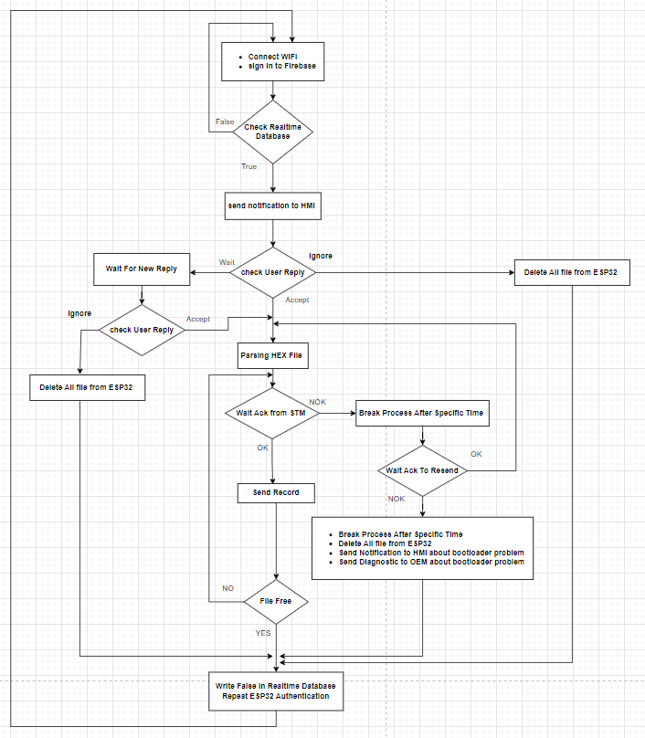
Telematic Unit

Slide 18
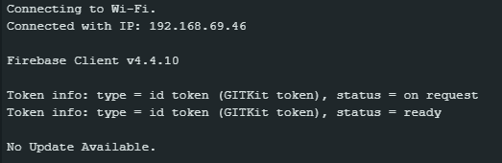

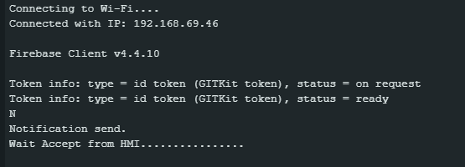

Telematic Unit
No Update Available
Update Available ,and Wait Reply

Slide 19
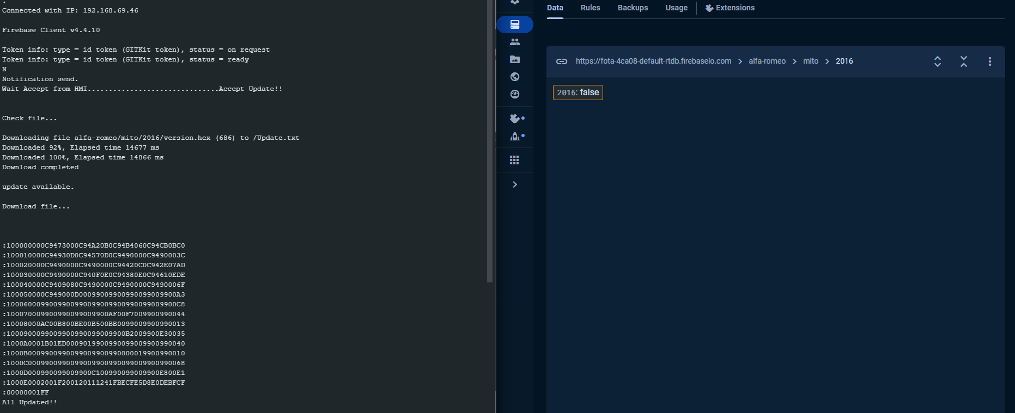
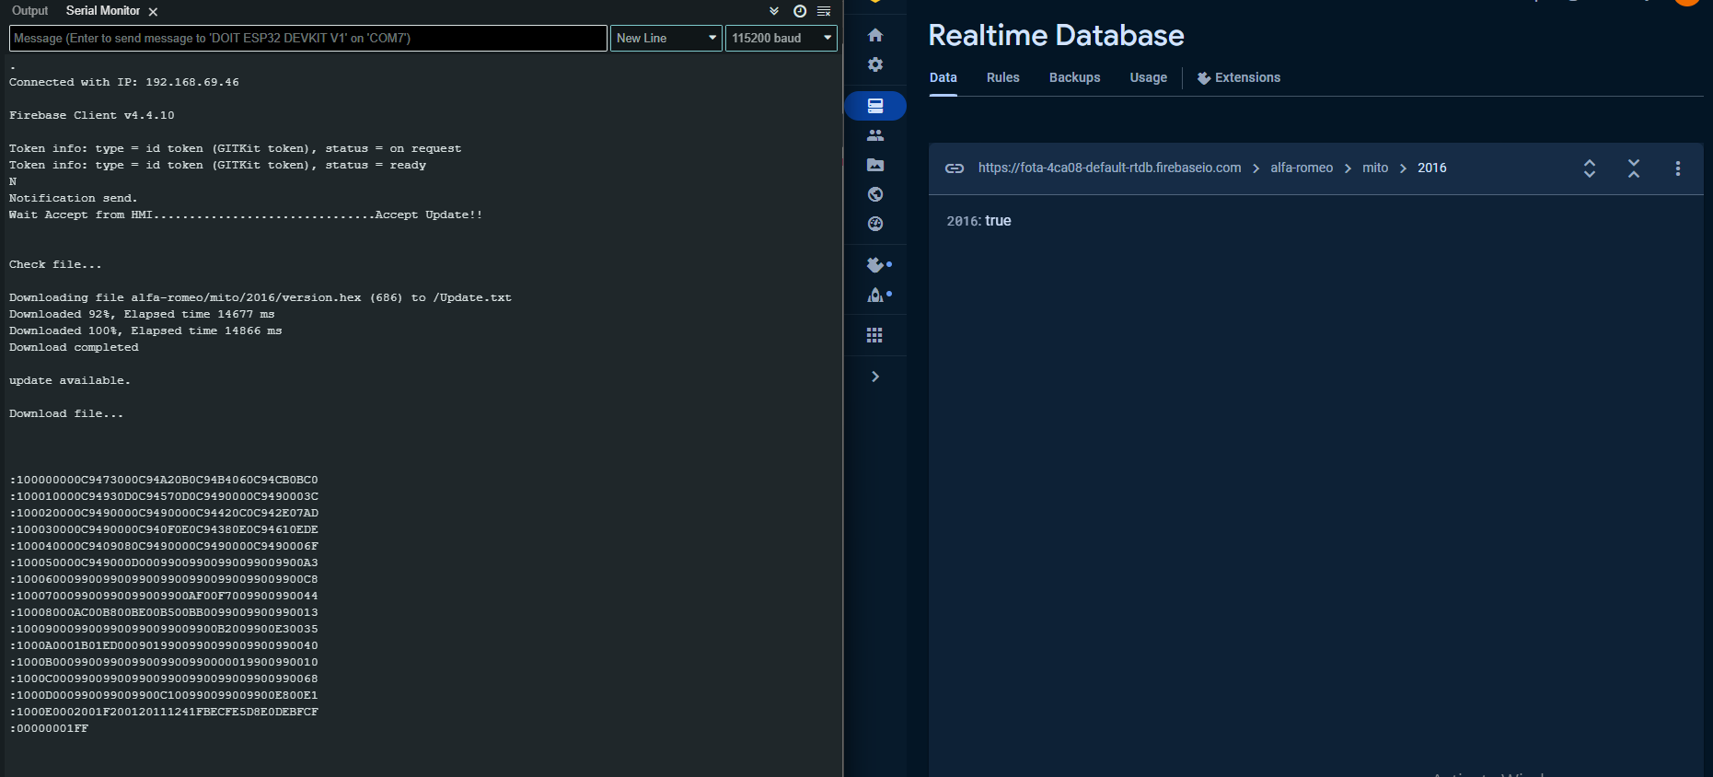
Telematic Unit
Used Accepted Update , Send All Record and Change Realtime Database To false

