Slide 1
3- System Architecture

Slide 2


Hardware
HW Module:
Architecture
Cloud Server
Firebase
Organize Hex File
Notify Telematic Unit
Check Authentication
UI Unit
Touch Screen
Show Update Message
HTTP
Telematic Unit
Gateway Unit
HTTP
HDMI
Tx
CANH
Raspberry Pi 3 Model B
Stm32f103
Receive and Send User Reply
Esp32
Check Safe Mode
Deliver Hex File to Correct Target
Check Security Principles
Send and Receive User Reply
Parse and Send Hex File
Rx
CANL
OEM Website
Upload Hex File
Target ECU
Target ECU
Client Side
Server Side
Apply Security Bot
Store Cipher File and Digest in Firebase
Stm32f103
Stm32f103
Receive Hex File
Flash Update Using Bootloader
Receive Hex File
Flash Update Using Bootloader

Slide 3

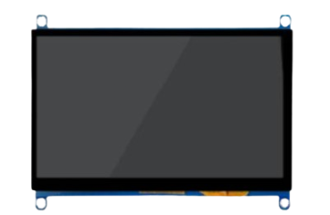
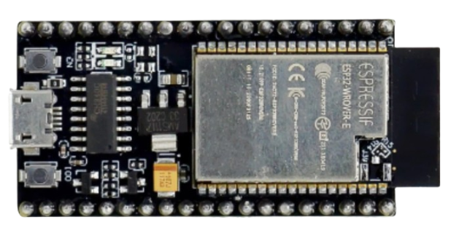
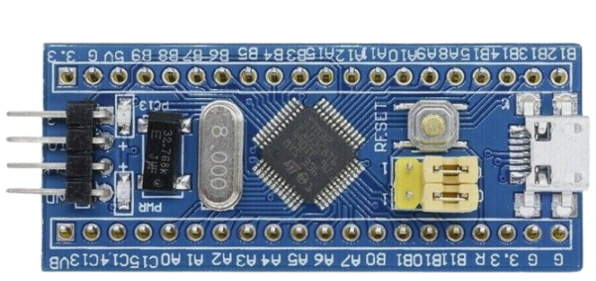
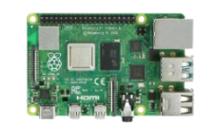
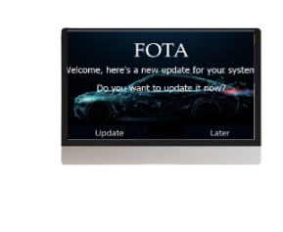
Hardware
Architecture
HTTP
HDMI
HTTP
Tx
CANH
Rx
CANL

Slide 4
Software
Architecture
APP
APP
LAYER
BIT MATH
STD TYPE
OS
SERVICE
LAYER
Wi-Fi
SCREEN
SPEED
HAL
LAYER
LIBRARY
Motors
NVIC
DMA
SPI
USART
CAN
RCC
MCAL
LAYER
AFIO
FBEC
SYS-TICK
EXTI
GPIO
TIMER

Slide 5

Cloud Server
Cloud Server
Firebase
Storage
Real Time Database
Authentication
HTTP
OEM Website
Server Side
Express.js
Node.js
MongoDB
HTML
CSS
JavaScript
Client Side

Slide 6
FIREBASE SERVICES
Firebase is a Google-backend Web app development based on the backend as a service system.
It has the ability to manage data in real-time and provides an enhanced app-usage experience to the users.
We interested in firebase database and firebase authentication

Slide 7



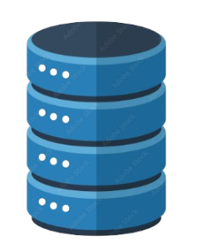


FIREBASE SERVICES
Authentication
Storage
Realtime Database

Slide 8
Telematic Unit
Cloud Server
Firebase
Storage
Real Time Database
Authentication
HTTP
Telematic Unit
HTTP
Esp32
Tx
32-bit LX6 Microprocessor
up to 240 MHz
802.11,up to 150Mbps
520 KB of SRAM
448 KB of ROM
Rx
OEM Website
Server Side
Express.js
Node.js
MongoDB
HTML
CSS
JavaScript
Client Side

Slide 9

Telematic Unit
Using ESP32 as a Telematic Unit to do four process :
Using WIFI Module to Connect with Firebase to :
Check if we have new update
take a New update and store it in system file memory section
Check Security Principles
Confidentiality
Authentication
Integrity
Notify HMI about new Update
Parsing Hex File and using UART to send Record by Record

