Slide 1

NEURO-FUZZY AGENT FOR RESUME RANKING IN HR SYSTEMS
Group members :
Advait Dhananjay Sathe - 15102028
Raj Surve - 16202015
Shreya Salgia - 15102054
Surya Swaminath - 14102031
Project Guide : Prof.P.P.Adivarekar

Slide 2
Contents
Abstract
Introduction
Objectives
Literature Review
Problem Definition
Existing System Architecture
Proposed System Architecture
Use Case Diagram of our proposed system
Class Diagram of our proposed system
References

Slide 3
Abstract
Traditionally, many new methods were discovered to reduce the time and efforts of the recruitment process.
Nowadays, ATS and many other resume parsing softwares are being implemented in the industry.
Our system tackles with a similar issue.
We use a Neuro-Fuzzy Agent to scan the resumes uploaded by the HR.
And rank those resumes based on the skillsets specified by the experts for that particular job vacancy.

Slide 4
Introduction
Our system will help to remove human uncertainty by ranking the candidates based on their resumes and job requirement skillsets given by the experts.
Our system uses neuro-fuzzy ranking algorithm to rank candidates.
System will use artificial neural network concepts to scan resumes of different candidates uploaded by the HR.
Fuzzy sets for ranking those resumes.

Slide 5
Objectives
Our system will reduce the workload of HR department during ranking the resumes
Main objective of our system is to rank the candidates according to the criteria given to HR deprtment by the experts
Our system will scan resumes using neuro-fuzzy system

Slide 6
Litrature Review
A Neuro-Fuzzy Based Agent for Group Decision Support in Applicant Ranking within Human Resources Systems : This paper is basically used to replace the manual work of HR recruitment process.
Visualizing Consensus in Group Decision Making Situations (S. Alonso, E. Herrera-Viedma, F.J. Cabrerizo, F. Chiclana, F. Herrera) : Consensus is a critical decision and requires a mixture of expertise.so this paper presents the idea of creating a tool which creates diagrams that help the experts to easily summarize and get an overview of the problem
Decision Making Approach in Recruitment using NeuroFuzzy System.( International Journal of Computer Applications (0975 – 8887) Volume 180 – No.34, April 2018) : This paper presents the idea of neuro fuzzy agent .But it is the combination of the weighting system and Neuro-Fuzzy system.It helps the company in making the right decisions and merit based selections in the recruitment process

Slide 7
Litrature Review
Feature weighting using neural networks(2004 IEEE International Joint Conference on Neural Networks (IEEE Cat. No.04CH37541) : This paper proposes an idea for classification using neural network by extracting relevant information. It creates attributes based on the strengths of the related links in which the most important one is connected to strong links as it has more impact on the outputs.It is applied to the nearest neighbor classifier.

Slide 8
Problem Definition
To create a neuro-fuzzy hybrid system for scanning submitted resumes.
Candidates and ranking them based on the skillset requirement for that particular job role.

Slide 9
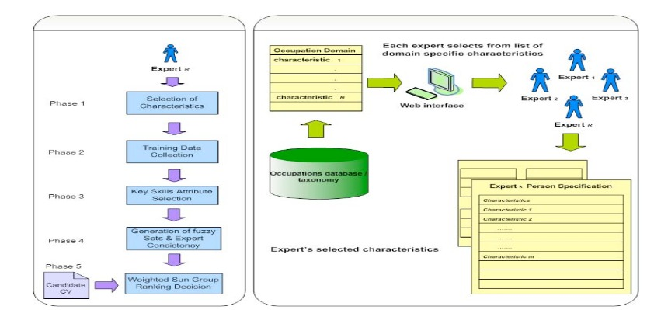
Existing System Architecture

Slide 10
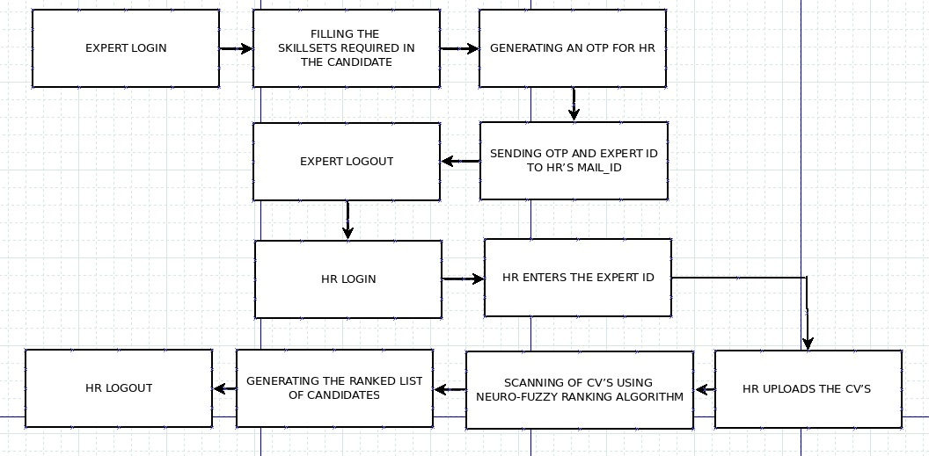
Proposed System Architecture

Slide 11
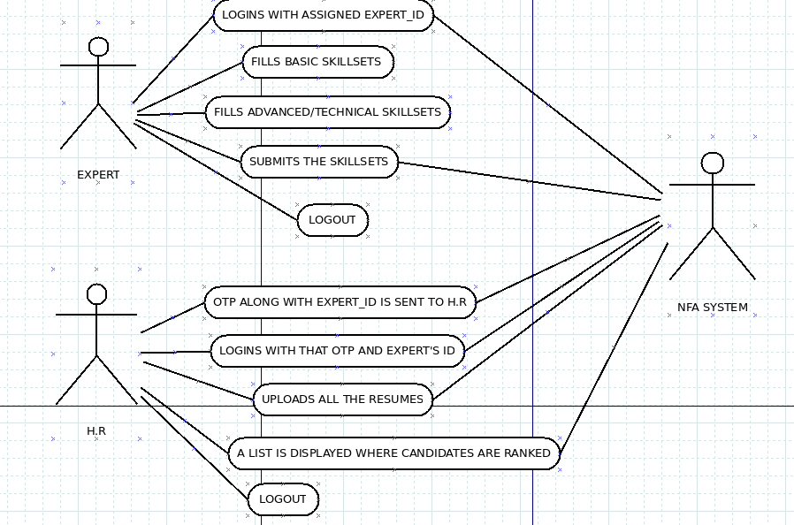
Use-Case Diagram of our proposed system

Slide 12
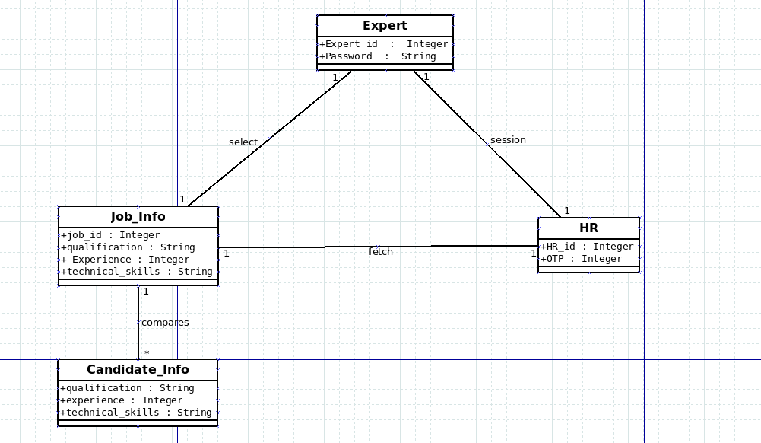
Class Diagram of our proposed system

Slide 13
References
[1]A Neuro-Fuzzy Based Agent for Group Decision Support in Applicant Ranking within Human Resources Systems Conference Paper in IEEE International Conference on Fuzzy Systems September 2009.
[2]Visualizing Consensus in Group Decision Making Situations (S. Alonso, E. Herrera-Viedma, F.J. Cabrerizo, F. Chiclana, F. Herrera).
[3]Feature weighting using neural networks(2004 IEEE International Joint Conference on Neural Networks (IEEE Cat. No.04CH37541).
[4]I. Aleksander and H. Morton, An Introduction to Neural Computing, International Thomson Computer Press, 2nd edition, 1995.

Slide 14
References
[5]K. Hornik, M. Stinchcombe, and H. White, “Multilayer Feedforward Networks are Universal Approximators.” Neural Networks, vol. 2, no. 5, pp. 359-366, 1989.
[6] Z. Xinchuan and T. Martinez“ Feature Weighting using Neural Networks,” Proceedings of the IEEE International Joint Conference on Neural Networks, Budapest, Hungary, vol. 2, pp. 1327-1330, July 2004.
[7]K. Hornik, M. Stinchcombe, and H. White, “Multilayer Feedforward Networks are Universal Approximators.” Neural Networks, vol. 2, no. 5, pp. 359-366, 1989.

Slide 15
Thank You...!!

