Slide 1



Optimizing Campaign Performance: Data-Driven Insights and Strategic Recommendations

Slide 2
Problem Statement
Optimizing Marketing Campaign Performance
A Bank has been conducting various marketing campaigns aimed at enhancing customer engagement and driving sales. Data from multiple campaigns, including Trigger Campaigns and Cross Sell Campaigns, needs to be thoroughly analyzed to ensure the effectiveness of these campaigns and maximize return on investment (ROI).
Evaluate Campaign Effectiveness: Assess the performance of each marketing campaign in terms of key performance indicators (KPIs) such as response rates, accounts booked, and customer lifetime value (LTV).
Identify Trends and Patterns: Detect trends and patterns over time to understand what drives customer responses and sales conversions.
Optimize Future Campaigns: Use the insights derived from the analysis to optimize future marketing strategies and campaign designs.
Data Sources
List of Campaigns: Contains details of all the campaigns conducted, including campaign IDs, names, types, and dates.
Trigger Campaign Performance: Provides performance metrics for trigger campaigns, including the number of customers targeted, responded, accounts booked, and total LTV.
Cross Sell Campaign Performance: Provides performance metrics for cross-sell campaigns, including similar metrics as trigger campaigns.
Data Dictionary: Contains definitions and descriptions of the KPIs and other important fields.

Slide 3
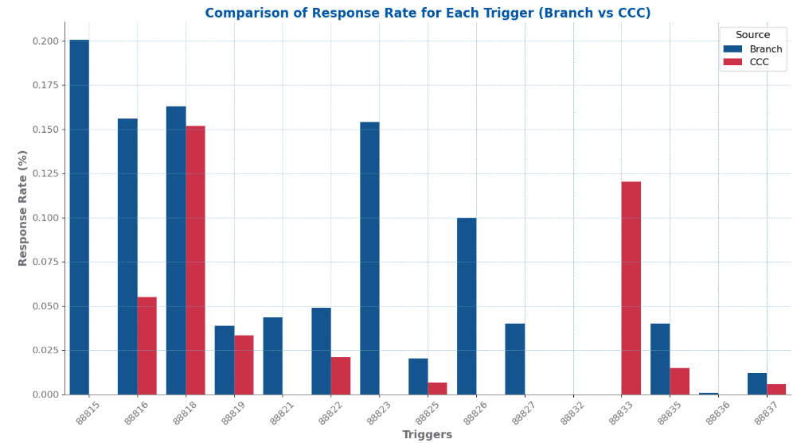
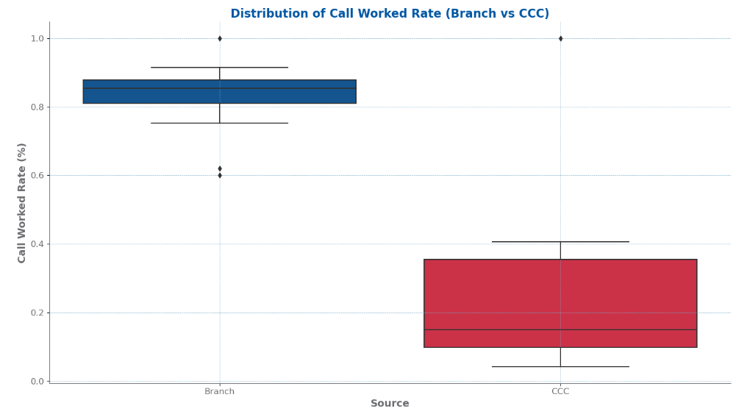

Funnel Chart
BMO
Comparison of Response Rate and Call Worked Rate (Branch vs CCC)
CCC campaigns, with a 7.2% response rate versus 3.5% for Branch triggers, are more effective in engaging customers, suggesting that CCC methods better resonate with the target audience.
Branch triggers have a significantly higher Call Worked Rate compared to CCC triggers, demonstrating greater effectiveness in completing and managing calls.

Slide 5
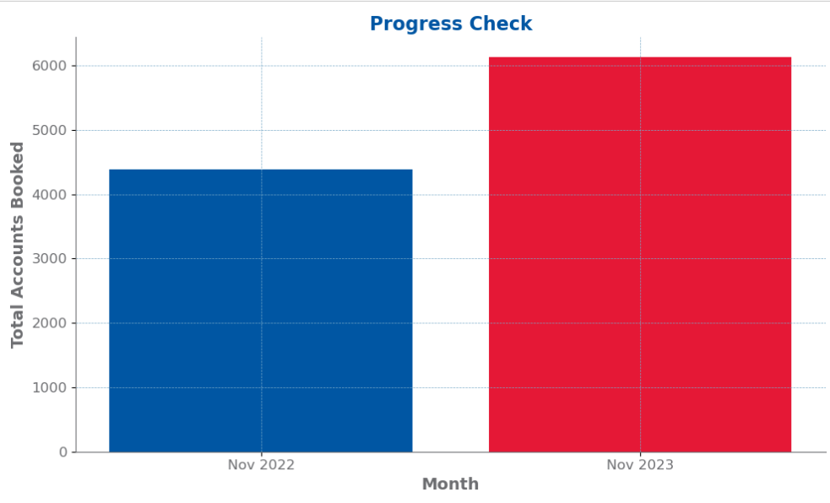
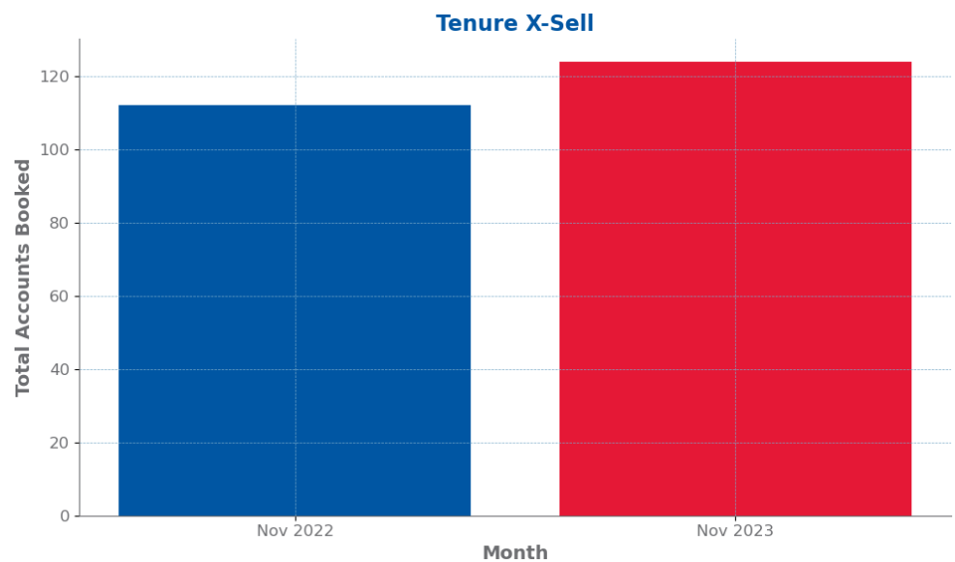
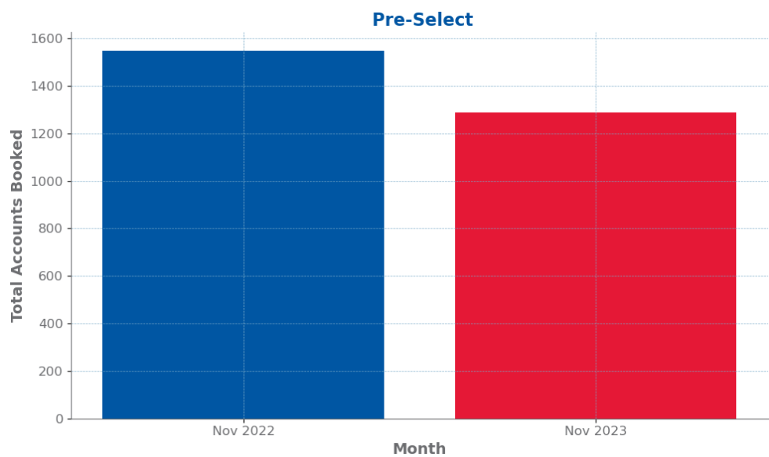
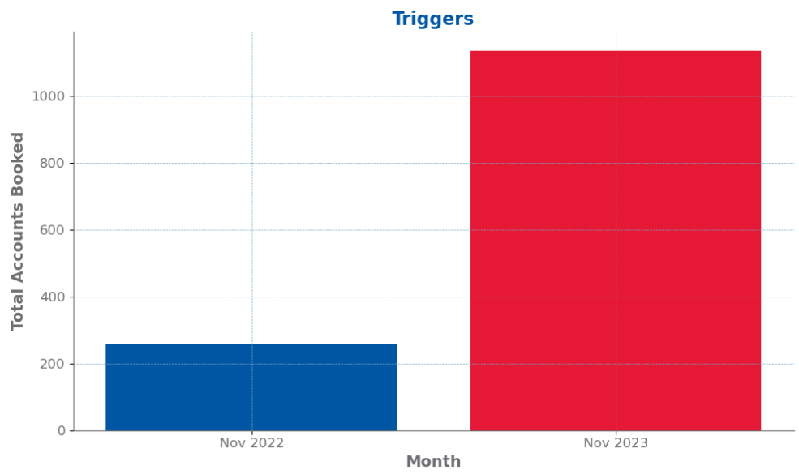
Total Accounts Booked For Cross Sell Campaign Performance

Slide 6
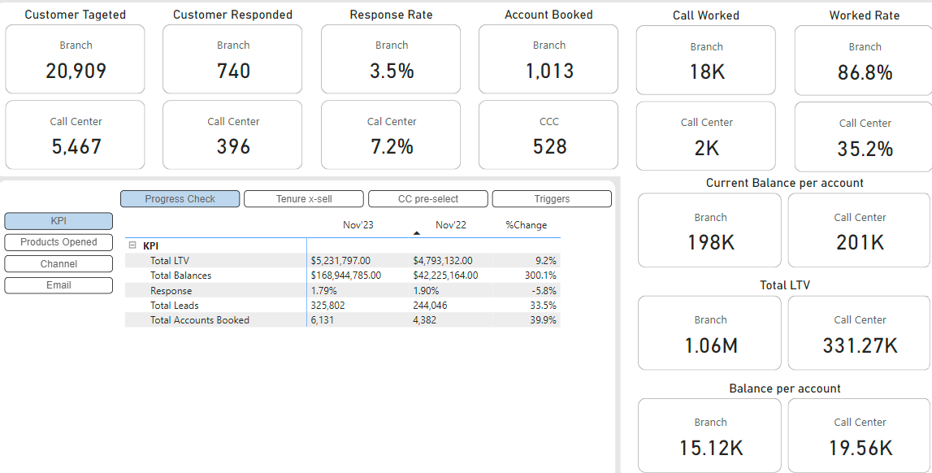
Optimizing Growth and Efficiency: Strategies for Capitalizing on Success and Addressing Declines
1.Enhance Call Center Campaigns: Given the higher response rate and balance per account, focusing on enhancing and expanding Call Center campaigns could drive further engagement and conversions.
2. Investigate Decrease in Response Rate: The slight decline in the response rate should be investigated to identify potential issues and implement strategies to improve customer engagement.
3. Leverage Successful Strategies: Analyze what specific strategies in the Call Center are leading to higher response rates and balances per account and consider applying these strategies to the Branch campaigns.
4. Optimize Follow-Up Processes: The high worked rate in the Branch indicates effective follow-up processes that could be optimized further to improve conversion rates in the Call Center.

Slide 7

THE END

