Slide 1

DATABASE MANAGEMENT SYSTEMS
Electronic Medical
Records System
Hospital Management System · Database Design & Implementation
Ssegirinya Simon (2025/BCS/215/PS)

Slide 2





Presentation Overview
01
04
System Selection & Justification
MySQL Implementation
02
05
Business Case & Application Domain
Sample Queries & Results
03
06
Database Design & ERD
Real-World Reference: OpenMRS

Slide 3





01 System Selection
Other Possible Systems in Hospital Setting:
Pharmacy Management System
Hospital Billing System
CHOSEN SYSTEM
Electronic Medical
Records (EMR)
Laboratory Information System
Ward Admission System
Hospital Setting
Why EMR?
Central backbone of all hospital operations
Rich relational structure with many entities
Direct real-world applicability in health IT
Diverse data types — ideal for SQL practice
HR & Payroll System
Appointment Scheduling System

Slide 4


02 Business Case
Application Domain
Digitizing patient health information in a hospital — replacing paper records with a centralized MySQL database serving doctors, nurses, pharmacists, lab technicians, and administrators.
BENEFITS
COSTS & RISKS
Eliminates paper storage and retrieval costs
Faster patient processing & reduced wait times
Reduces medication errors via digital Rx tracking
Improves care quality — instant patient history access
Enhanced data security vs physical files
Server hardware: $3,000 – $8,000
Software & licenses: $500 – $2,000/yr
Development: $5,000 – $15,000
Staff training: $1,000 – $3,000

Slide 5

02 User Groups & Roles
Doctors
Nurses
Lab Technicians
Record diagnoses, write prescriptions, order lab tests
Update patient vitals, manage ward admissions & discharges
Enter and retrieve lab test results
Pharmacists
Receptionists
Administrators
View and dispense patient prescriptions
Register patients, schedule appointments
Generate reports and monitor hospital performance

Slide 6
03 Database Design — Entities & Relationships
Entity / Table | Key Attributes
patients | patient_id (PK), first_name, last_name, dob, gender, blood_type, phone
doctors | doctor_id (PK), first_name, last_name, specialization, department
appointments | appointment_id (PK), patient_id (FK), doctor_id (FK), appointment_date, status
medical_records | record_id (PK), patient_id (FK), doctor_id (FK), diagnosis, treatment
prescriptions | prescription_id (PK), record_id (FK), medication, dosage, duration
lab_tests | test_id (PK), patient_id (FK), doctor_id (FK), test_name, result
wards | ward_id (PK), ward_name, capacity, floor_number
admissions | admission_id (PK), patient_id (FK), ward_id (FK), admit_date, discharge_date
nurses | nurse_id (PK), first_name, last_name, department, ward_id (FK)

Slide 7
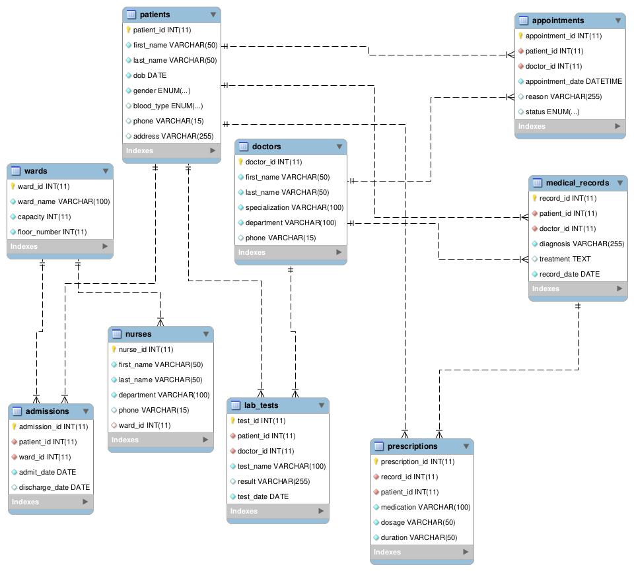
03 Entity Relationship Diagram (ERD)
DOCTORS
LAB_TESTS
PRESCRIPTIONS

Slide 8
04 MySQL Implementation
-- Sample: CREATE TABLE patients
9
Tables Created
CREATE TABLE patients (
patient_id INT AUTO_INCREMENT
PRIMARY KEY,
first_name VARCHAR(50) NOT NULL,
last_name VARCHAR(50) NOT NULL,
dob DATE NOT NULL,
gender ENUM('Male','Female','Other'),
blood_type ENUM('A+','A-','B+', 'B-','AB+','AB-','O+','O-'),
phone VARCHAR(15),
address VARCHAR(255)
);
10
Patients (sample)
5
Doctors
10
Sample Queries

Slide 9

05 Sample Queries & Results
Q1 List all patients
Q2 Doctor appointment load
SELECT patient_id, CONTACT(first_name,' ',last_name)
FROM patients ORDER BY last_name;
SELECT d.last_name, COUNT(DISTINCT a.patient_id)
FROM doctors d JOIN appointments a USING(doctor_id)
GROUP BY d.doctor_id;
Use case: Basic retrieval for administration
Use case: Monitor staff workload
Q3 Patients with no lab tests
Q4 Currently admitted patients
SELECT patient_id FROM patients
WHERE patient_id NOT IN
(SELECT patient_id FROM lab_tests);
SELECT p.first_name, w.ward_name
FROM admissions a
JOIN patients p USING(patient_id)
JOIN wards w USING(ward_id)
WHERE discharge_date IS NULL;
Use case: Nurse ward management

Slide 10




06 Real-World Reference System
OpenMRS — Open Medical Record System
Used in 40+ countries · Founded 2004 · Deployed in Uganda, Kenya, Rwanda, South Africa, Haiti, India
Patient-Centric Design
Role-Based Access Control
All data organized around a central patient record — directly informed our design to make patient_id the central FK across all tables.
OpenMRS assigns different permissions per role — informed our role-based UI menu structure for doctors, nurses, receptionists, and admins.
Encounter vs Visit Model
Audit Trails
OpenMRS separates a Visit (period of care) from an Encounter (single interaction) — informed our separate Appointments and Medical Records tables.
OpenMRS logs every record change with timestamp and user — noted as a future enhancement in our system limitations section.

Slide 11
System Limitations & Conclusion
Current Limitations
Project Summary
No real-time medical device integration (manual entry required)
Single-hospital scope — no inter-hospital record sharing
No AI-based clinical decision support or drug alerts
English-only — no multilingual support
Desktop-only — no mobile application
✔ 9 tables designed, normalized, and implemented
✔ Full ERD with multiplicities documented
✔ 10 functional SQL queries demonstrated
✔ Business case with ROI analysis completed
✔ OpenMRS studied as real-world reference
✔ Role-based UI dialogue structure designed
✔ System covers patients, appointments,
medical records, prescriptions, lab tests,
wards, admissions, doctors & nurses
The EMR system demonstrates the real-world power of relational database design — transforming complex hospital workflows into a structured, queryable, and secure digital system.

Slide 12
Thank You
Electronic Medical Records System
Hospital Management System · Database Management Systems
Ssegirinya Simon (2025/BCS/215/PS)

