Slide 1
A STUDY OF THE MOST COMMON BUSINESSES IN KAMPALA
SSENTUMBWE ENOCH

Slide 2
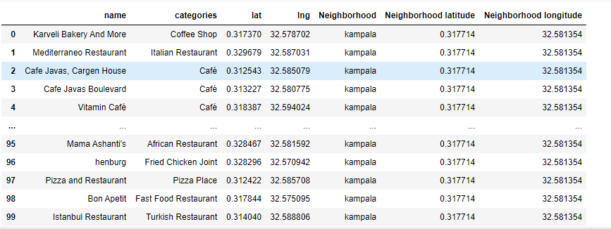
Dataset

Slide 3
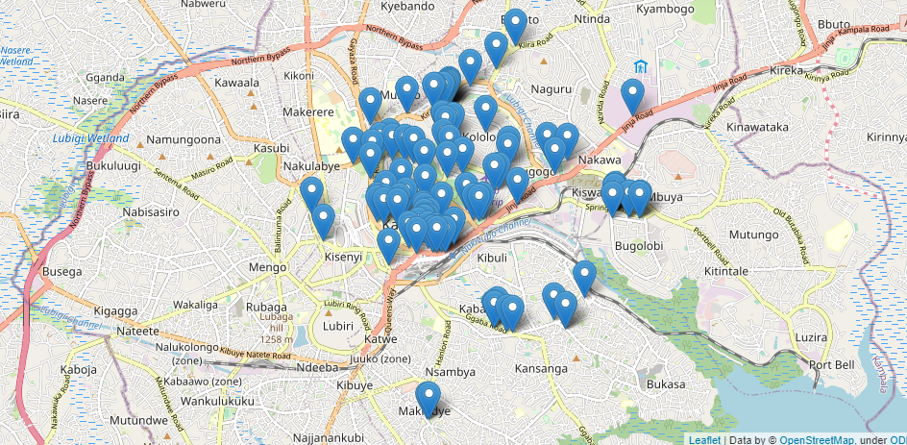
Map representation

Slide 4
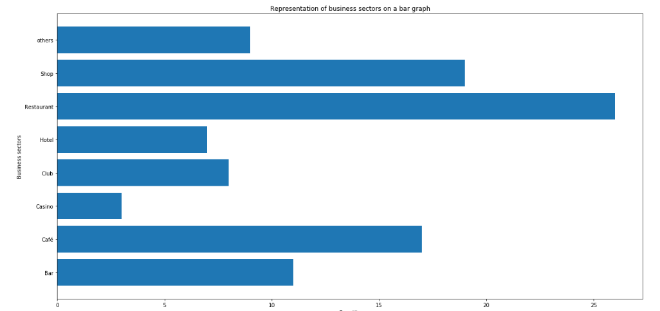
Bar graph of count of types of businesses

Slide 5
Sector results
So far, we have about 7 columns that show the name of the place, category, coordinates, and the district with its coordinates
We want to use this information to further simply the data categories into shops, hotels, bakeries and so on as shown in the function "sectors“
From the graph, we see that:
Restaurant are most common
Shops are second
Coffee shops come in third and the rest follow

Slide 6
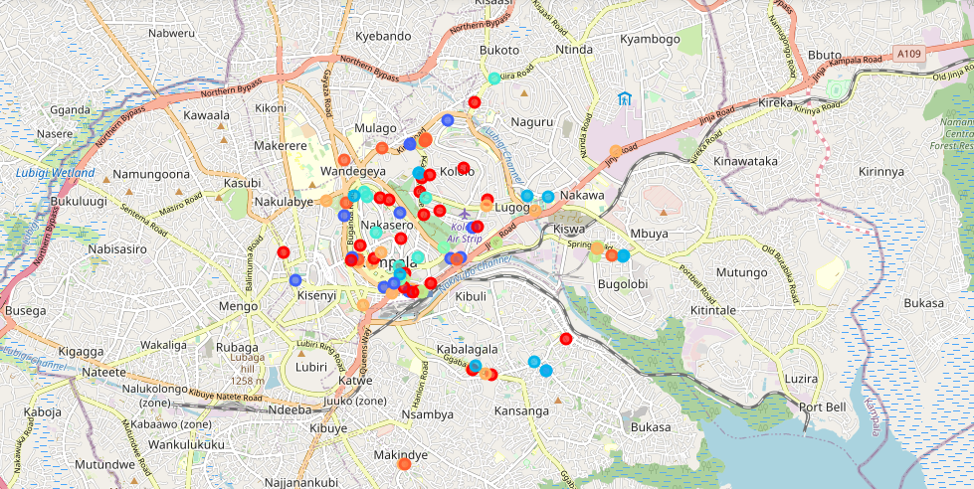
Map representation of different sectors

Slide 7
Restaurant
Since the most common business there is in Kampala is restaurant, let us examine the diversity in the business.
First, I separated the data from the main data set.
Secondly, I represented the data on a bar graph categorizing it according to the restaurant categories

Slide 8
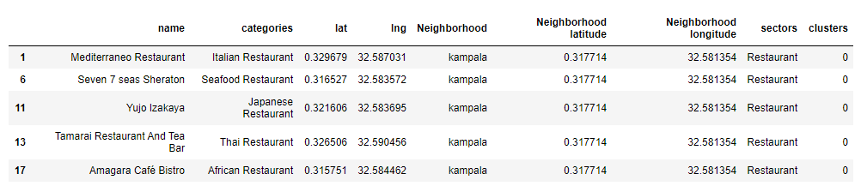
Restaurants

Slide 9
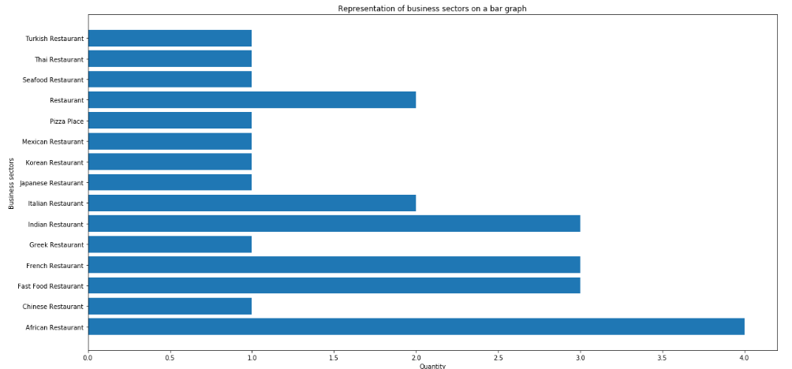
Bar graph of the many categories of the restaurants

Slide 10
Conclusion
From the data we see that those that specialize in a specific cuisine are the most popular. We also see that fast food restaurants are doing well too.
Some notes to take are:
In order for one to start a restaurant, you must have a specific cuisine to take on with the African cuisine the most preferred route.
Keep away from residential places like Nakasero Hill. Although these places are very high end, people avoid them probably because the rent is too high and there is little foot traffic.
Being along a main road is also the preferred route.
You can set up a restaurant anywhere even near you competitor but it is better to spread away from other restaurants too but not that far.

