Slide 1
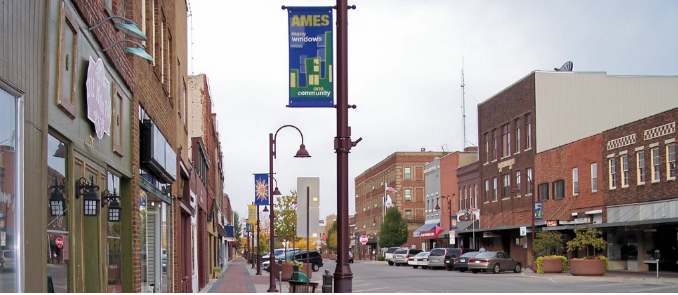
House Price Prediction
(EDA & Model Prediction)
By Uday Pratap Yati

Slide 2
Introduction
Data set :
Ames Housing data set compiled by Dean De Cock for use in data science education
Goal :
Predict the sale price for each house.
Minimize the difference between predicted and actual prices (RMSE/MSE)
Records :
Number of records:1460
Number of features : 80
Target variable : SalePrice

Slide 3
Assumption and Hypothesis:
Hypothesis:
Dependent (or target) variable is the sale price,
Naturally the larger the house the higher the price
Real estate professionals : Price / sq ft.
Q : How and why the price per square foot might differ from house to house??
Assumptions :
No two houses are exactly identical.
Neighborhood-specific and unit-specific characteristics help determine house prices.
Neighborhood
Good schools, leisure facilities
Transportation facilities
Aesthetics (roads, house quality)
No. of Room (bedroom/bathrooms)
Condition of kitchen
Age and physical condition of the house
Construction materials and any structural improvements
Notes:
So property size measures, will be key variables, and there are several such variables in the Ames dataset.
Real estate professionals too tend to focus on price per square foot (or meter) instead of the overall price.
The factors that effect housing prices may be summarized as property size, location desirability, nearby amenities, number of rooms, construction materials, and age and condition of the structure
It is therefore useful to investigate the suspects effecting house prices.

Slide 4
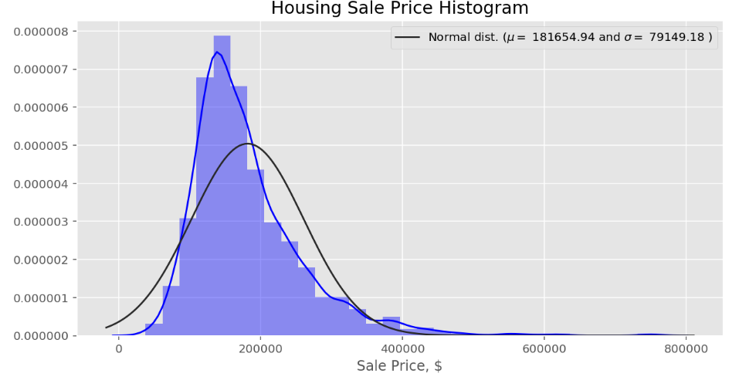
Sale Price Distribution
Right Skewed (extreme values on right)
Many outliers in the data
Can have Adverse effect on model
Notes:
Dealing with outliers can be tricky
As some may provide important information
Don’t define outliers too liberally and throw them out.

Slide 5
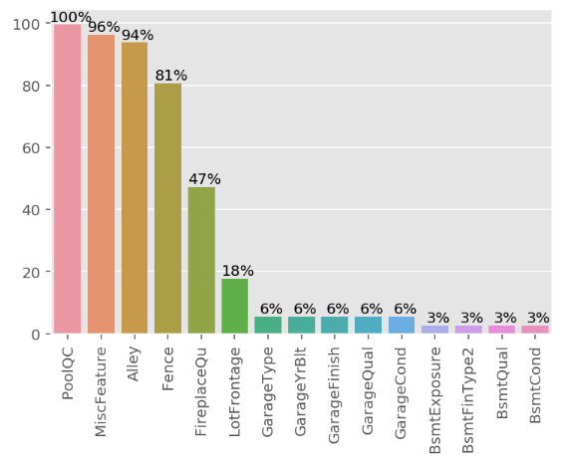
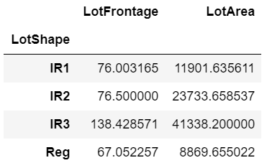
Data cleaning
So many null values
Dropped columns with more than 80% null values
LotFrontage -> 259 missing values
Filled with “average LotFrontage” grouped by their “LotShape” categories.
Notes:
So many Null Values!!!
these are not actually the null values, rather these are the features which are not present in the house.
let check the field Alley, Value "NA: here means house has "No Alley Access"

Slide 6
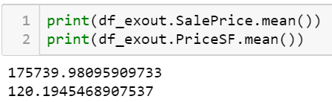
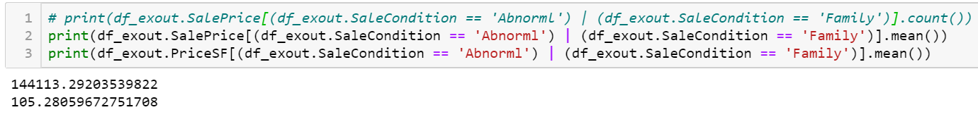
Data cleaning
Size of property(Important Metric), zoomed on to “GrLivArea”, “LotSize” and “GarageArea”
separated the basement size from other measures
Created Finished basement area variable “BaseLivArea”
Created SalePrice per square ft variable.
Search for outliers
observations in “SalePrice”, “GrLivArea” and “BaseLivArea” above 3 std. dev.
32 Observation (2% of the sample size)
SaleCondition (shows type of sales for each transaction)
Most observations were in the “Normal” sale category
113 observations recorded as “Abnormal” or “Family” (intra-family sale)
Notes:
If these transactions were not primarily commercial in nature, then their inclusion in the dataset would introduce bias into a model

Slide 7
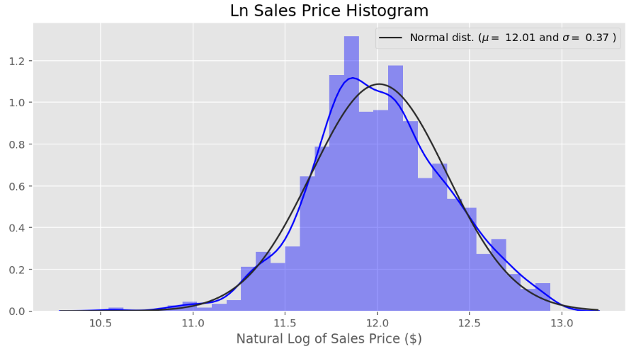
Feature engineering:
No. of observation reduced from 1460 to 1305.
Constructed a variable to express the age of the property, “Age”
natural log-transformation of “SalePrice”
More symmetrical
Less extreme values

Slide 8
Dearth location desirability variable
Neighborhood:
25 neighborhoods : unclear how to rank them
Its obvious to rank these neighborhoods by their price per square foot (high co-relation with SP)
Dummify these 25 neighborhoods
There are very few records for some neighborhoods (<50)
Significant multicollinearity between certain neighborhoods that share similar characteristics
Constructed an ordinal variable “Location”, from quality and condition variables.
“OverallQual”, “OverallCond”, “ExterQual”, “ExterCond”
Low, Med-Low, Med-High, High
Neighborhood is more desirable, for better quality and condition houses.
Dummies
4 dummies for the 4 zones (FV, RH, RL, RM).
one dummy (“RoadRail”) for being near an artery road or railway line
one dummy (“Amenities”) for being near positive amenities such as a park
one for garages (“Garage”)
one for flat roofs (“FlatRoof”)
one for houses higher than one floor (“TwoStorey”)

Slide 9
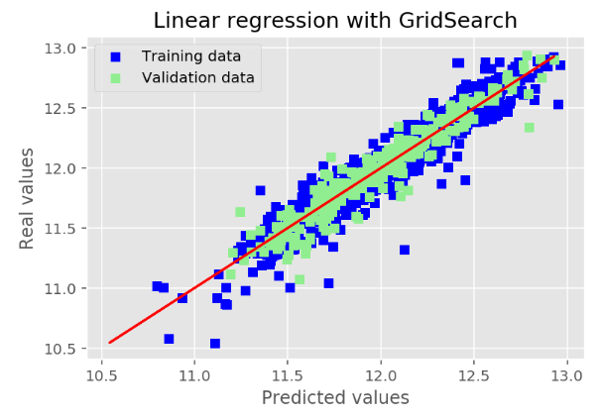
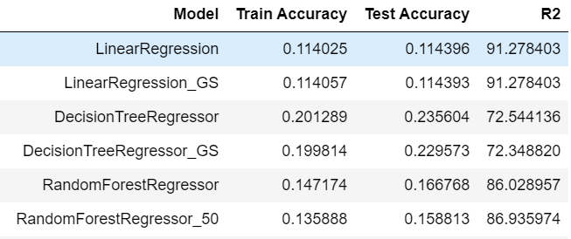
Modelling:
Models Used :
LinearRegression Model
DecisionTreeRegressor Model
RandomForestRegressor Model
Data scaling : Used MinMaxScaler to scale values between 0 to 1
Dimensionality reduction : Backward Elimination using OLS method
Features selected : 38

Slide 10
Conclusion:
Zoomed in on various property size measures as likely important features for the regression model
Undertook a log transformation of the highly skewed house price target variable.
Extensive feature engineering on various structural and internal factors expected to be significant in determining the house prices
location desirability variable
zoning dummies
build quality and condition
proximity to amenities
The model achieved rather stable results and scores, with the OLS coefficients
The model achieved an R-squared of approximately 91-92% on the training-validation sets.
Property size variables, namely internal living area, basement finished area, lot area and garage area, were all found to be positively correlated to the sale price and statistically significant
Build quality, location and condition were also found to be among the most important determinants of house prices

Slide 11
Thank You

